Slide 2
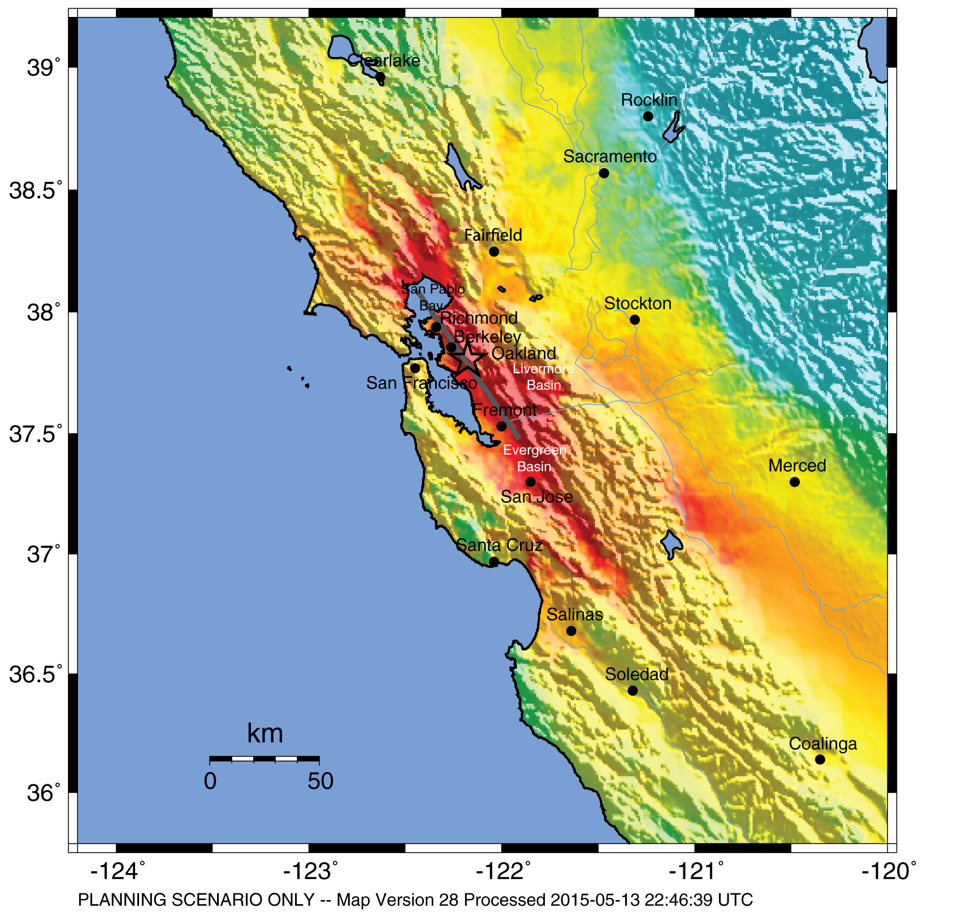
HayWired Scenario
U.S. Geological Survey ShakeMap of the HayWired Earthquake Scenario’s hypothetical magnitude 7.0 mainshock.
HayWired Scenario Volume 1: Chapter A, Figure 4
1

Slide 3
HayWired Scenario
Estimated building-restoration delays due to utility disruption following the hypothetical magnitude 7.0 mainshock of the HayWired Earthquake Scenario.
Utility | San Francisco |  | Oakland
 | 50% Restoration | Tail restoration | 50% Restoration | Tail Restoration
Water | 3 days | 100 percent at 7 days | 30 days | 100 percent at 90 days
Natural gas | ~9 days | 90 percent at ~33 days | ~10 days | 90 percent at ~36 days
Electricity | 1 day | 99.5 percent at 30 days | 2 days | 96 percent at 30 days
Voice/data | 5 days | 100 percent at 7 days | 7 days | 100 percent at 30 days
HayWired Scenario Volume 2: Chapter O, Tables 6 and 7
2

Slide 4
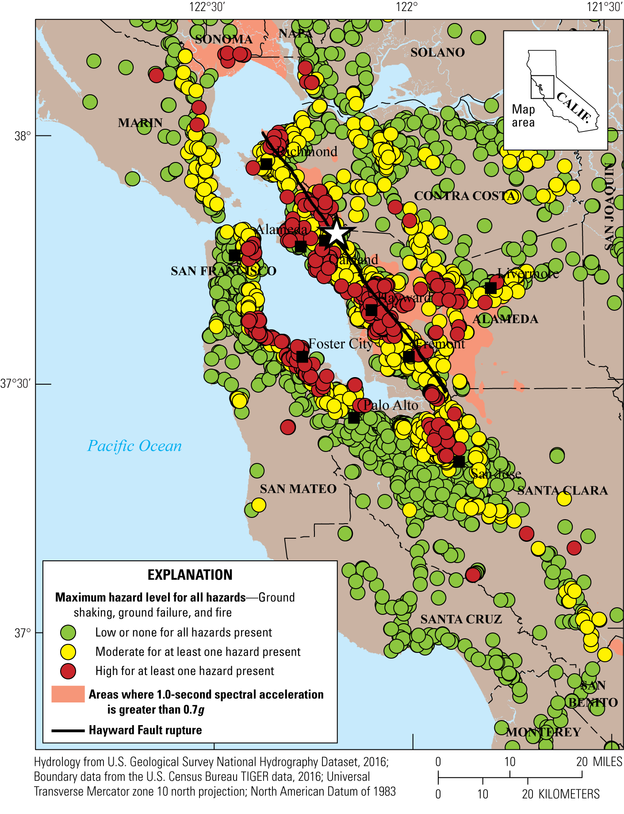
HayWired Scenario
Map showing combined hazards for all types of cellular sites for the HayWired Earthquake Scenario mainshock in the Bay Area. Each cellular site is identified based on the highest level of hazard mapped for shaking, liquefaction and landslide probability, and fire density (burned-building square footage relative to the developed area containing the fires).
White star shows the mainshock epicenter. g, acceleration due to gravity.
HayWired Scenario Volume 3: Chapter S, Figure 14
3

Slide 5
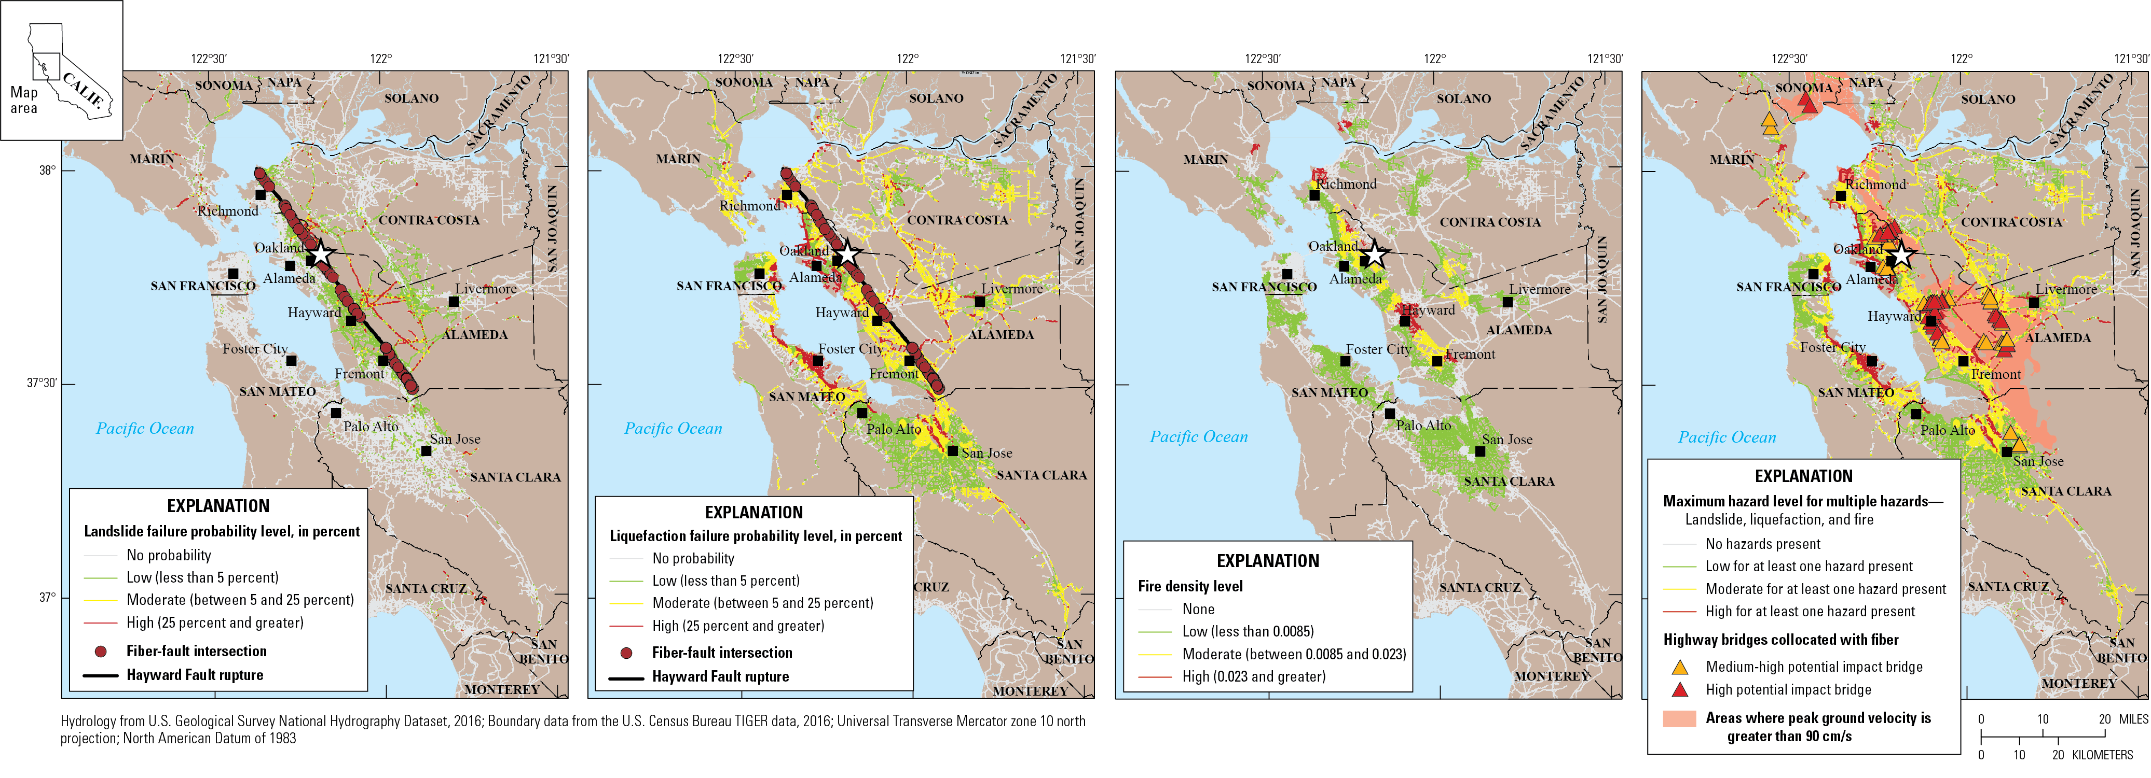
HayWired Scenario
A
B
C
D
Maps showing the exposure of fiber optic lines to various hazards from the HayWired Earthquake Scenario mainshock. White star shows the mainshock epicenter. Descriptions of the 4 maps: A, Map of fiber optic line exposure to landslide hazards. B, Map of fiber optic line exposure to liquefaction hazards. C, Map of fiber optic line exposure to fire density hazards (defined as the burned-building square footage relative to the developed area containing the fires). D,
Map of bridges classified as medium-high or high potential impact that carry fiber optic lines relative to multiple HayWired Earthquake Scenario mainshock hazards (landslide, liquefaction, and fire density). cm/s, centimeters per second.
HayWired Scenario Volume 3: Chapter S, Figure 15
4

Slide 6
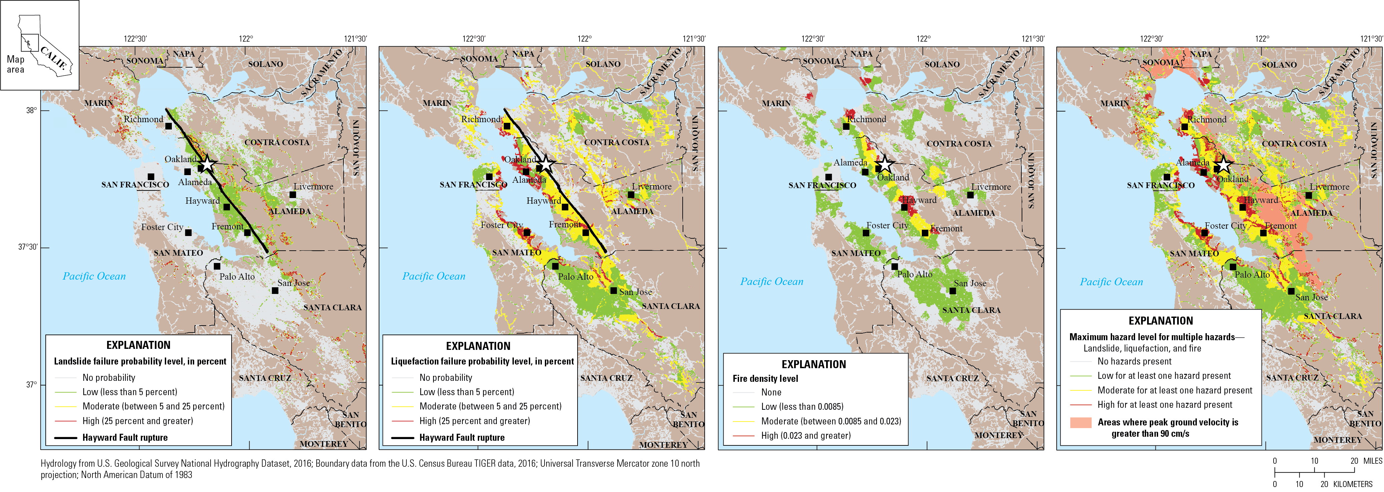
HayWired Scenario
A
B
C
D
Maps showing the exposure of surface streets (a proxy for copper and coaxial lines) to various hazards for the HayWired Earthquake Scenario mainshock. White star shows the mainshock epicenter. Descriptions of the 4 maps: A, Map of surface street exposure to landslide hazards. B, Map of surface street exposure to liquefaction hazards. C, Map of surface street exposure to fire density hazards (defined as the burned-building square footage relative to the developed area containing the fires). D, Map of surface street exposure relative to multiple HayWired Earthquake Scenario mainshock hazards
(landslide, liquefaction, and fire density). cm/s, centimeters per second.
HayWired Scenario Volume 3: Chapter S, Figure 17
5

Slide 7
HayWired Scenario
Exposure of transportation infrastructure to ground shaking from the HayWired Earthquake Scenario mainshock.
Total in study area | Roadways, highway (km) | Roadways, secondary (km) | Roadways, surface (km) | Railways (km) | BART facilities | Highway bridges | Ports
Mainshock ground shaking
Low exposure | 1,989 | 7,595 | 30,699 | 916 | 8 | 1,361 | 90
Percentage exposed | 43% | 46% | 44% | 34% | 17% | 39% | 13%
Moderate exposure | 2,267 | 7,621 | 34,233 | 1,607 | 33 | 1,867 | 586
Percentage exposed | 49% | 47% | 49% | 59% | 70% | 53% | 84%
High exposure | 368 | 1,138 | 4,967 | 203 | 6 | 292 | 20
Percentage exposed | 8% | 7% | 7% | 7% | 13% | 8% | 3%
Total exposure | 4,624 | 16,353 | 69,899 | 2,726 | 47 | 3,520 | 696
Percentage exposed | 100% | 100% | 100% | 100% | 100% | 100% | 100%
[Exposure is detailed by amount (kilometers or number of facilities) and percentage (relative to the entire study region) of affected infrastructure. Owing to rounding, amounts and percentages within exposure classes for an individual hazard may not add up to the total exposed. BART, Bay Area Rapid Transit; km, kilometers; %, percent]
HayWired Scenario Volume 3: Chapter T, Appendix 2, Table 2.2, Part 1
6

Slide 8
HayWired Scenario
Exposure of transportation infrastructure to liquefaction hazards from the HayWired Earthquake Scenario.
Total in study area | Roadways, highway (km) | Roadways, secondary (km) | Roadways, surface (km) | Railways (km) | BART facilities | Highway bridges | Ports
Liquefaction
Low exposure | 522 | 2,095 | 8,189 | 291 | 12 | 549 | 10
Percentage exposed | 11% | 13% | 12% | 11% | 26% | 16% | 1%
Moderate exposure | 633 | 2,102 | 7,836 | 400 | 21 | 550 | 14
Percentage exposed | 14% | 13% | 11% | 15% | 45% | 16% | 2%
High exposure | 179 | 314 | 1,523 | 90 | 1 | 171 | 45
Percentage exposed | 4% | 2% | 2% | 3% | 2% | 5% | 6%
Total exposure | 1,334 | 4,511 | 17,548 | 781 | 34 | 1,270 | 69
Percentage exposed | 29% | 28% | 25% | 29% | 72% | 36% | 10%
[Exposure is detailed by amount (kilometers or number of facilities) and percentage (relative to the entire study region) of affected infrastructure. Owing to rounding, amounts and percentages within exposure classes for an individual hazard may not add up to the total exposed. BART, Bay Area Rapid Transit; km, kilometers; %, percent]
7

Slide 9
HayWired Scenario
Exposure of transportation infrastructure to landslide hazards from the HayWired Earthquake Scenario.
Total in study area | Roadways, highway (km) | Roadways, secondary (km) | Roadways, surface (km) | Railways (km) | BART facilities | Highway bridges | Ports
Landslide
Low exposure | 306 | 1,022 | 4,418 | 180 | 12 | 558 | 2
Percentage exposed | 7% | 6% | 6% | 7% | 26% | 16% | <1%
Moderate exposure | 14 | 54 | 233 | 8 | 0 | 82 | 0
Percentage exposed | <1% | <1% | <1% | <1% | 0% | 2% | 0%
High exposure | 7 | 42 | 276 | 5 | 0 | 20 | 1
Percentage exposed | <1% | <1% | <1% | <1% | 0% | 1% | <1%
Total exposure | 327 | 1,118 | 4,927 | 193 | 12 | 660 | 3
Percentage exposed | 7% | 7% | 7% | 7% | 26% | 19% | <1%
[Exposure is detailed by amount (kilometers or number of facilities) and percentage (relative to the entire study region) of affected infrastructure. Owing to rounding, amounts and percentages within exposure classes for an individual hazard may not add up to the total exposed. BART, Bay Area Rapid Transit; km, kilometers; %, percent]
7

Slide 10
HayWired Scenario
Exposure of transportation infrastructure to fire following earthquake hazards from the HayWired Earthquake Scenario.
Total in study area | Roadways, highway (km) | Roadways, secondary (km) | Roadways, surface (km) | Railways (km) | BART facilities | Highway bridges | Ports
Fire following earthquake
Percentage developed¹ | 78% | 67% | 65% | 56% | 100% | 87% | 17%
Low exposure | 737 | 2,747 | 10,847 | 328 | 14 | 712 | 5
Percentage exposed | 16% | 17% | 16% | 12% | 30% | 20% | 1%
Moderate exposure | 144 | 541 | 1,883 | 82 | 12 | 194 | 3
Percentage exposed | 3% | 3% | 3% | 3% | 26% | 6% | <1%
High exposure | 47 | 151 | 777 | 40 | 3 | 31 | 2
Percentage exposed | 1% | 1% | 1% | 1% | 6% | 1% | <1%
Total exposure | 928 | 3,439 | 13,507 | 450 | 29 | 937 | 10
Percentage exposed | 20% | 21% | 19% | 17% | 62% | 27% | 1%
[Exposure is detailed by amount (kilometers or number of facilities) and percentage (relative to the entire study region) of affected infrastructure. Owing to rounding, amounts and percentages within exposure classes for an individual hazard may not add up to the total exposed. BART, Bay Area Rapid Transit; km, kilometers; %, percent]
7

Slide 11
Exposure of transportation infrastructure to aftershocks from the HayWired Earthquake Scenario.
HayWired Scenario
Total in study area | Roadways, highway (km) | Roadways, secondary (km) | Roadways, surface (km) | Railways (km) | BART facilities | Highway bridges | Ports
Aftershocks
3 months² | 150 | 405 | 2,097 | 54 | 0 | 104 | 3
1 year³ | 392 | 1,271 | 4,966 | 150 | 0 | 362 | 2
Total exposed⁴ | 303 | 1,025 | 4,363 | 105 | 0 | 294 | 3
Percentage exposed | 7% | 6% | 6% | 4% | 0% | 8% | <1%
[Exposure is detailed by amount (kilometers or number of facilities) and percentage (relative to the entire study region) of affected infrastructure. Owing to rounding, amounts and percentages within exposure classes for an individual hazard may not add up to the total exposed. BART, Bay Area Rapid Transit; km, kilometers; %, percent]
¹Percentage developed refers to the percentage of an individual lifeline infrastructure system found in areas classified as low-, moderate-, or high-intensity developed land by the 2011 National Land Cover
Database.
²This count includes the lifeline infrastructure length or facility count exposed to all aftershocks of magnitude (M) 5 or greater during the first three months after the HayWired Earthquake Scenario mainshock. If a lifeline is exposed to multiple aftershocks, it is counted each time it is exposed. Aftershocks included in this category are a M6.2 event with a hypocenter in Palo Alto on May 28, 2018, at 4:47 a.m., a M5.7 event with a hypocenter in Palo Alto on May 28, 2018, at 11:53 p.m., a M5.2 event with a hypocenter in Palo Alto on June 23, 2018, at 8:27 p.m., and a M5.3 event with a hypocenter in Palo Alto on July 1, 2018, at 11:19 a.m.
³This count includes the lifeline infrastructure length or facility count exposed to all aftershocks M5 or greater between 3 and 12 months after the HayWired Earthquake Scenario mainshock. If a lifeline is exposed to multiple aftershocks, it is counted each time it is exposed. Aftershocks included in this category are a M6.0 event with a hypocenter in Mountain View on September 30, 2018, at 8:16 p.m., a M6.4 event with a hypocenter in Cupertino on October 1, 2018, at 12:33 a.m., and a M5.4 event with a hypocenter in Sunnyvale on October 1, 2018, at 2:24 a.m.
⁴Total exposed to aftershocks is the count of exposed lifeline infrastructure length or facilities affected by at least moderate shaking from one or more aftershocks (regardless of the number of aftershocks to which the lifeline infrastructure are exposed).
7

Slide 12
HayWired Scenario
Exposure of oil and gas infrastructure to ground shaking from the HayWired Earthquake Scenario mainshock.
Total in study area | Pipelines, natural gas (km) | Pipelines, petroleum (km) | Natural gas compressor stations | Natural gas processing plants | Natural gas receipt and delivery points | Natural gas storage facilities | POL terminals, storage facilities, tank farms | Oil Refineries
Mainshock ground shaking
Low exposure | 3,237 | 598 | 7 | 0 | 0 | 2 | 3 | 0
Percentage exposed | 42% | 26% | 21% | 0% | 0% | 33% | 8% | 0%
Moderate exposure | 4,021 | 1,532 | 22 | 0 | 2 | 4 | 32 | 4
Percentage exposed | 52% | 66% | 65% | 0% | 100% | 67% | 89% | 80%
High exposure | 416 | 205 | 5 | 0 | 0 | 0 | 1 | 1
Percentage exposed | 5% | 9% | 15% | 0% | 0% | 0% | 3% | 20%
Total exposure | 7,674 | 2,336 | 34 | 0 | 2 | 6 | 36 | 5
Percentage exposed | 100% | 100% | 100% | 100% | 100% | 100% | 100% | 100%
[Exposure is detailed by amount (kilometers or number of facilities) and percentage (relative to the entire study region) of affected infrastructure. Owing to rounding, amounts and percentages within exposure classes for an individual hazard may not add up to the total exposed. km, kilometers; POL, petroleum, oil, and lubricants; %, percent]
HayWired Scenario Volume 3: Chapter T, Appendix 2, Table 2.4, Part 1
11

Slide 13
HayWired Scenario
Exposure of oil and gas infrastructure to liquefaction hazards from the HayWired Earthquake Scenario.
Total in study area | Pipelines, natural gas (km) | Pipelines, petroleum (km) | Natural gas compressor stations | Natural gas processing plants | Natural gas receipt and delivery points | Natural gas storage facilities | POL terminals, storage facilities, tank farms | Oil Refineries
Liquefaction
Low exposure | 685 | 137 | 3 | 0 | 0 | 0 | 1 | 0
Percentage exposed | 9% | 6% | 9% | 0% | 0% | 0% | 3% | 0%
Moderate exposure | 781 | 398 | 2 | 0 | 0 | 0 | 5 | 0
Percentage exposed | 10% | 17% | 6% | 0% | 0% | 0% | 14% | 0%
High exposure | 92 | 81 | 3 | 0 | 0 | 0 | 12 | 1
Percentage exposed | 1% | 3% | 9% | 0% | 0% | 0% | 33% | 20%
Total exposure | 1,558 | 616 | 8 | 0 | 0 | 0 | 18 | 1
Percentage exposed | 20% | 26% | 24% | 0% | 0% | 0% | 50% | 20%
[Exposure is detailed by amount (kilometers or number of facilities) and percentage (relative to the entire study region) of affected infrastructure. Owing to rounding, amounts and percentages within exposure classes for an individual hazard may not add up to the total exposed. km, kilometers; POL, petroleum, oil, and lubricants; %, percent]
12

Slide 14
HayWired Scenario
Exposure of oil and gas infrastructure to landslide hazards from the HayWired Earthquake Scenario.
Total in study area | Pipelines, natural gas (km) | Pipelines, petroleum (km) | Natural gas compressor stations | Natural gas processing plants | Natural gas receipt and delivery points | Natural gas storage facilities | POL terminals, storage facilities, tank farms | Oil Refineries
Landslide
Low exposure | 263 | 118 | 1 | 0 | 0 | 0 | 0 | 0
Percentage exposed | 3% | 5% | 3% | 0% | 0% | 0% | 0% | 0%
Moderate exposure | 14 | 8 | 0 | 0 | 0 | 0 | 0 | 0
Percentage exposed | <1% | <1% | 0% | 0% | 0% | 0% | 0% | 0%
High exposure | 16 | 8 | 0 | 0 | 0 | 0 | 0 | 0
Percentage exposed | <1% | <1% | 0% | 0% | 0% | 0% | 0% | 0%
Total exposure | 293 | 134 | 1 | 0 | 0 | 0 | 0 | 0
Percentage exposed | 4% | 6% | 3% | 0% | 0% | 0% | 0% | 0%
[Exposure is detailed by amount (kilometers or number of facilities) and percentage (relative to the entire study region) of affected infrastructure. Owing to rounding, amounts and percentages within exposure classes for an individual hazard may not add up to the total exposed. km, kilometers; POL, petroleum, oil, and lubricants; %, percent]
12

Slide 15
HayWired Scenario
Exposure of oil and gas infrastructure to fire following earthquake hazards from the HayWired Earthquake Scenario.
Total in study area | Pipelines, natural gas (km) | Pipelines, petroleum (km) | Natural gas compressor stations | Natural gas processing plants | Natural gas receipt and delivery points | Natural gas storage facilities | POL terminals, storage facilities, tank farms | Oil Refineries
Fire following earthquake
Percentege developed¹ | 42% | 46% | 74% | 0% | 100% | 33% | 94% | 100%
Low exposure | 753 | 313 | 6 | 0 | 0 | 0 | 9 | 2
Percentage exposed | 10% | 13% | 18% | 0% | 0% | 0% | 25% | 40%
Moderate exposure | 75 | 27 | 0 | 0 | 0 | 0 | 0 | 0
Percentage exposed | 1% | 1% | 0% | 0% | 0% | 0% | 0% | 0%
High exposure | 30 | 22 | 1 | 0 | 0 | 0 | 0 | 0
Percentage exposed | <1% | 1% | 3% | 0% | 0% | 0% | 0% | 0%
Total exposure | 858 | 362 | 7 | 0 | 0 | 0 | 9 | 2
Percentage exposed | 11% | 15% | 21% | 0% | 0% | 0% | 25% | 40%
[Exposure is detailed by amount (kilometers or number of facilities) and percentage (relative to the entire study region) of affected infrastructure. Owing to rounding, amounts and percentages within exposure classes for an individual hazard may not add up to the total exposed. km, kilometers; POL, petroleum, oil, and lubricants; %, percent]
12

Slide 16
Exposure of oil and gas infrastructure to aftershocks from the HayWired Earthquake Scenario.
HayWired Scenario
Total in study area | Pipelines, natural gas (km) | Pipelines, petroleum (km) | Natural gas compressor stations | Natural gas processing plants | Natural gas receipt and delivery points | Natural gas storage facilities | POL terminals, storage facilities, tank farms | Oil Refineries
Aftershocks
3 months² | 145 | 0 | 0 | 0 | 0 | 0 | 0 | 0
1 year³ | 331 | 0 | 0 | 0 | 0 | 0 | 1 | 0
Total exposed⁴ | 244 | 0 | 0 | 0 | 0 | 0 | 1 | 0
Percentage exposed | 3% | 0% | 0% | 0% | 0% | 0% | 3% | 0%
[Exposure is detailed by amount (kilometers or number of facilities) and percentage (relative to the entire study region) of affected infrastructure. Owing to rounding, amounts and percentages within exposure classes for an individual hazard may not add up to the total exposed. km, kilometers; POL, petroleum, oil, and lubricants; %, percent]
¹Percentage developed refers to the percentage of an individual lifeline infrastructure system found in areas classified as low-, moderate-, or high-intensity developed land by the 2011 National Land Cover
Database.
²This count includes the lifeline infrastructure length or facility count exposed to all aftershocks of magnitude (M) 5 or greater during the first three months after the HayWired Earthquake Scenario mainshock. If a lifeline is exposed to multiple aftershocks, it is counted each time it is exposed. Aftershocks included in this category are a M6.2 event with a hypocenter in Palo Alto on May 28, 2018, at 4:47 a.m., a M5.7 event with a hypocenter in Palo Alto on May 28, 2018, at 11:53 p.m., a M5.2 event with a hypocenter in Palo Alto on June 23, 2018, at 8:27 p.m., and a M5.3 event with a hypocenter in Palo Alto on July 1, 2018, at 11:19 a.m.
³This count includes the lifeline infrastructure length or facility count exposed to all aftershocks M5 or greater between 3 and 12 months after the HayWired Earthquake Scenario mainshock. If a lifeline is exposed to multiple aftershocks, it is counted each time it is exposed. Aftershocks included in this category are a M6.0 event with a hypocenter in Mountain View on September 30, 2018, at 8:16 p.m., a M6.4 event with a hypocenter in Cupertino on October 1, 2018, at 12:33 a.m., and a M5.4 event with a hypocenter in Sunnyvale on October 1, 2018, at 2:24 a.m.
⁴Total exposed to aftershocks is the count of exposed lifeline infrastructure length or facilities affected by at least moderate shaking from one or more aftershocks (regardless of the number of aftershocks to which the lifeline infrastructure are exposed).
12

Slide 17
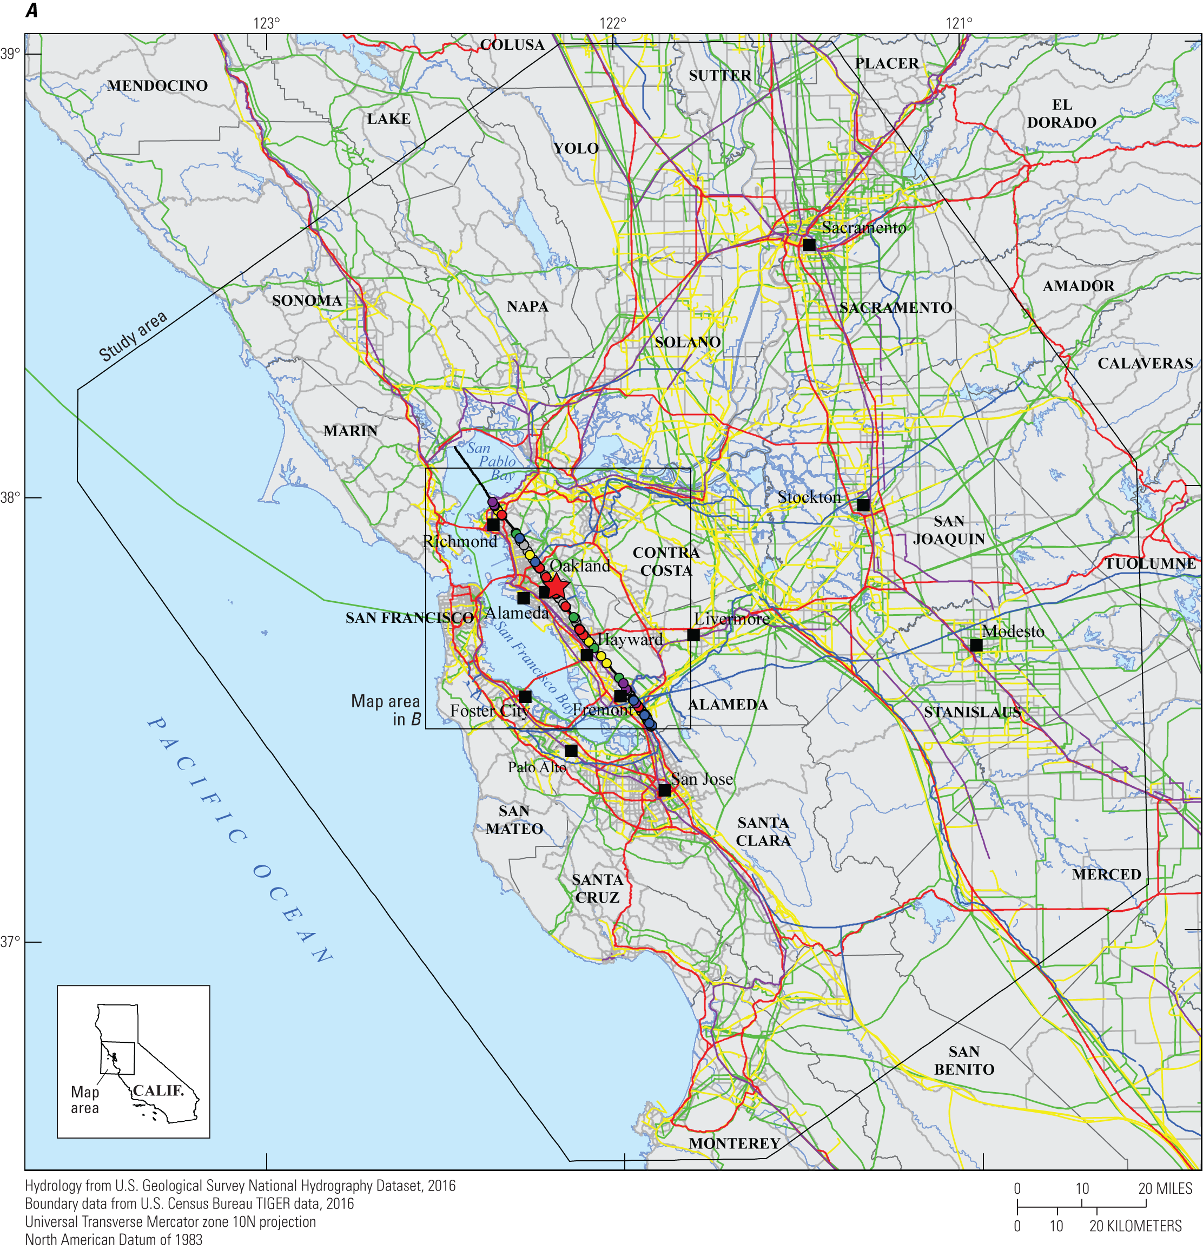
HayWired Scenario
Map showing transmission infrastructure relative to rupture of the Hayward Fault during the HayWired Earthquake Scenario mainshock. Many transmission
infrastructure lifelines cross the fault, including natural gas and petroleum pipelines, water supply transmission systems, highways and secondary roads, electric power transmission lines, and long-haul fiber optic cables. Where linear features cross the fault, the intersection points are colored to be consistent with the linear infrastructure they correspond to (for example, a yellow point denotes where a natural gas or petroleum pipeline crosses the fault).
HayWired Scenario Volume 3: Chapter T, Figure 2A
16

Slide 18
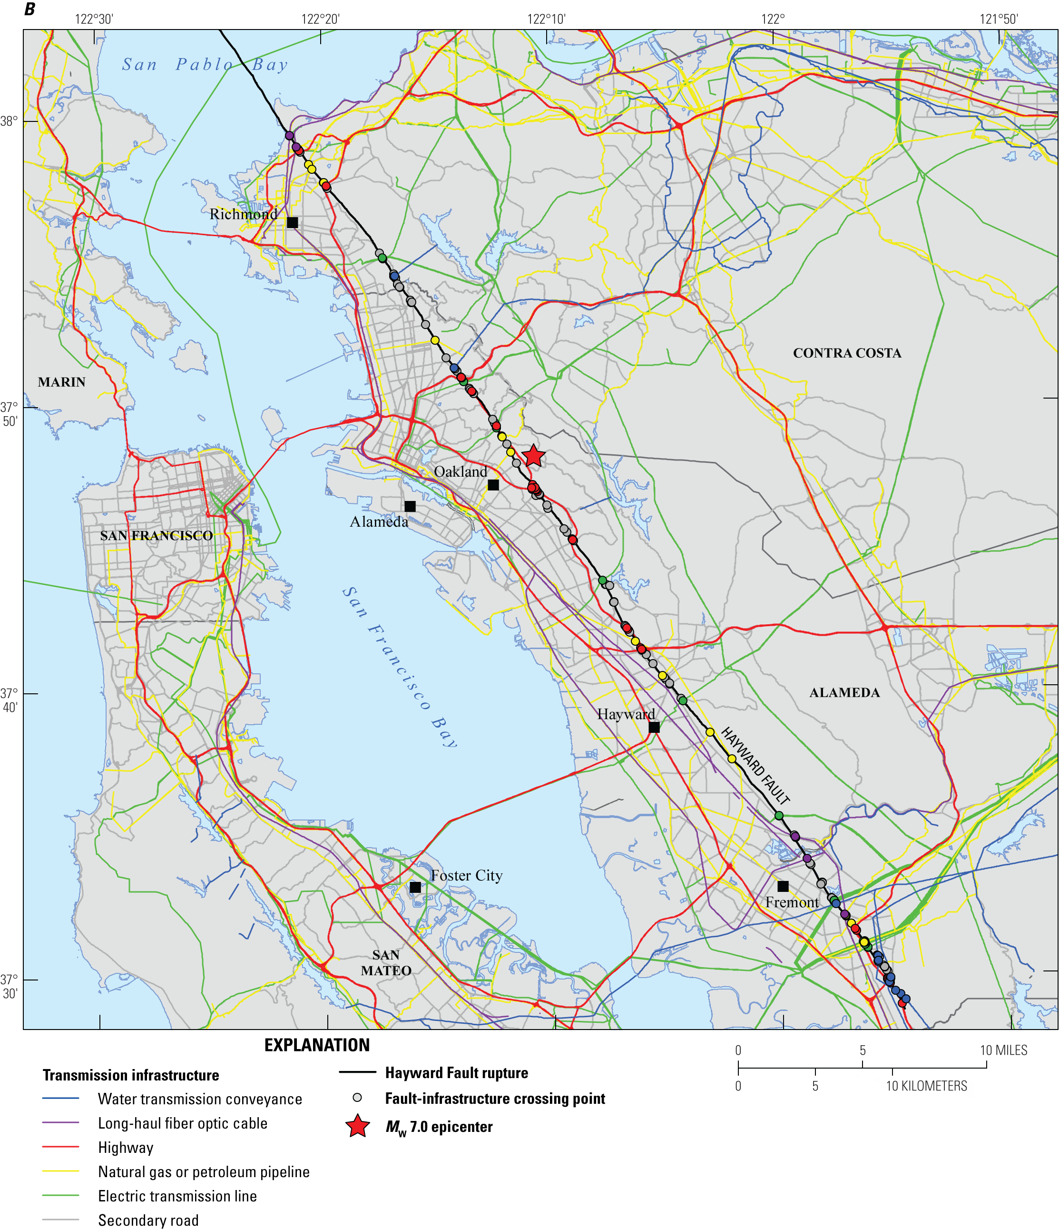
HayWired Scenario
Map showing transmission infrastructure relative to rupture of the Hayward Fault during the HayWired Earthquake Scenario mainshock. Many transmission infrastructure lifelines cross the fault, including natural gas and petroleum pipelines, water supply transmission systems, highways and secondary roads, electric power transmission lines, and long-haul fiber optic cables. Where linear features cross the fault, the intersection points are colored to be consistent with the linear infrastructure they correspond to (for example, a yellow point denotes where a natural gas or petroleum pipeline crosses the fault).
HayWired Scenario Volume 3: Chapter T, Figure 2B
17

Slide 19
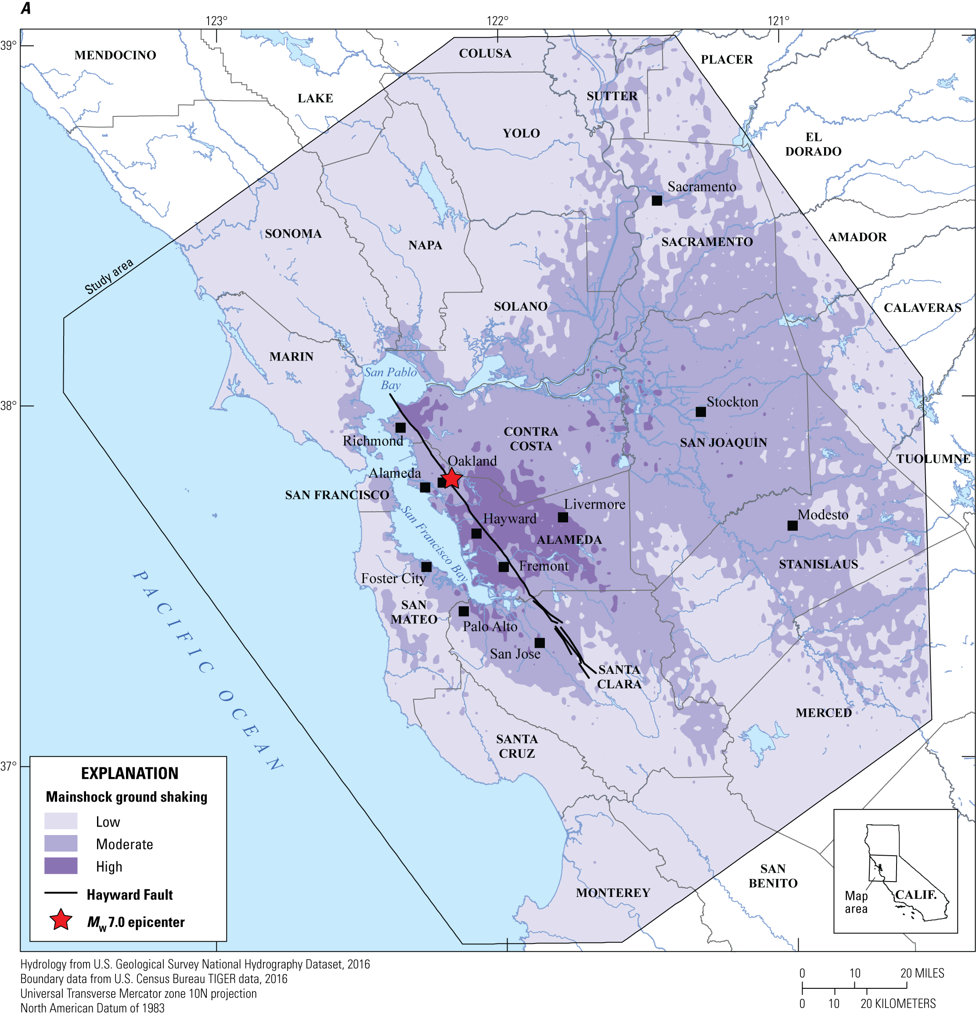
HayWired Scenario
Maps of the Bay Area, showing ground shaking as a result of the HayWired Earthquake Scenario mainshock on the Hayward Fault. Ground-shaking classifications used in this chapter. M_{w}, moment magnitude.
HayWired Scenario Volume 3: Chapter T, Figure 3A
18

Slide 20
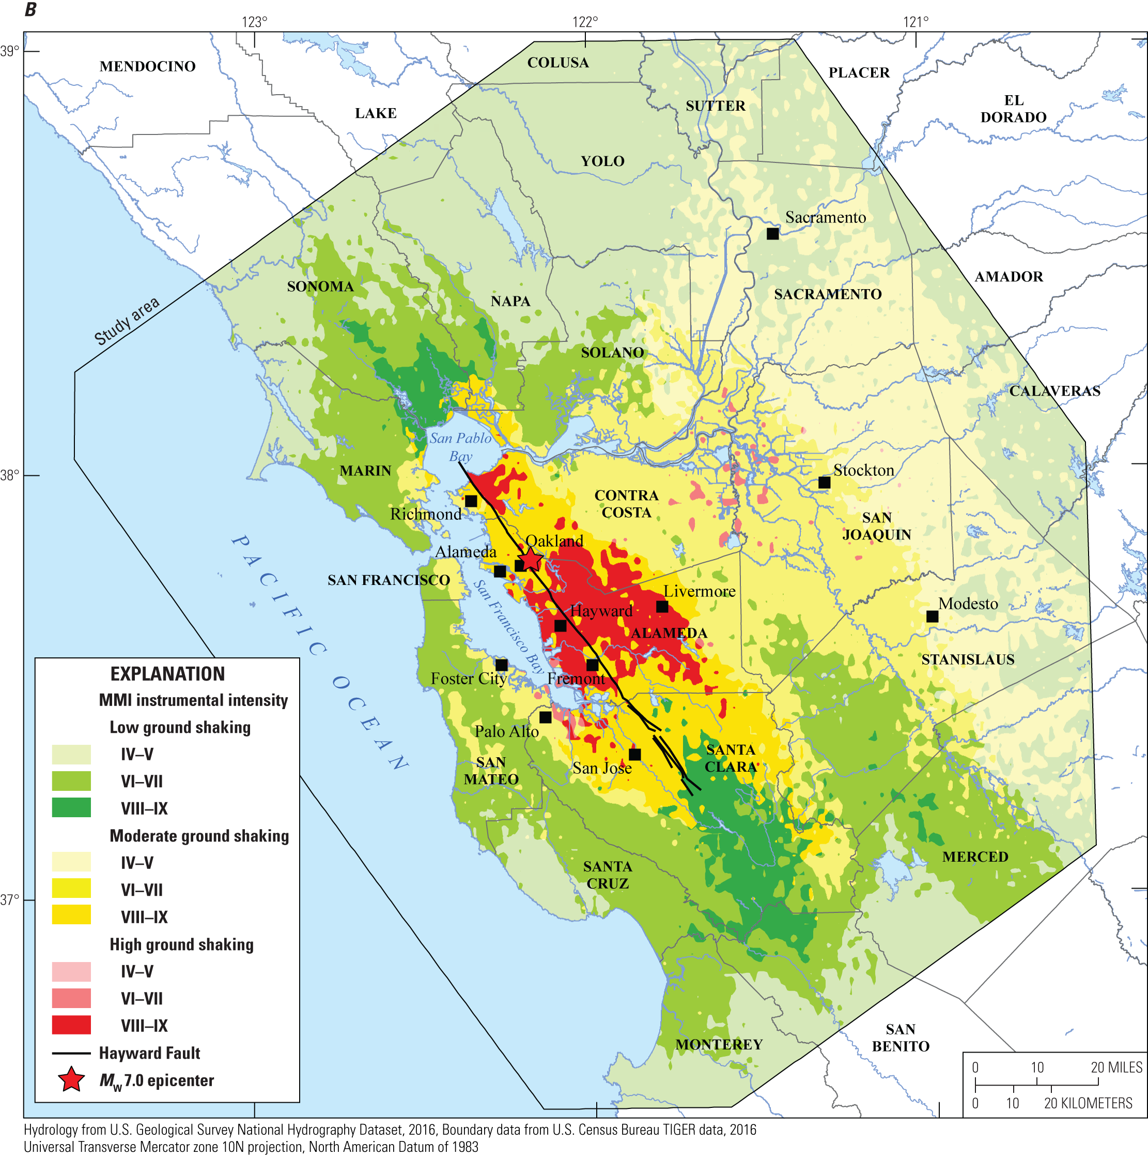
HayWired Scenario
Maps of the Bay Area, showing ground shaking as a result of the HayWired Earthquake Scenario mainshock on the Hayward Fault. Ground-shaking classifications used in this chapter. M_{w}, moment magnitude.
HayWired Scenario Volume 3: Chapter T, Figure 3B
19

Slide 21
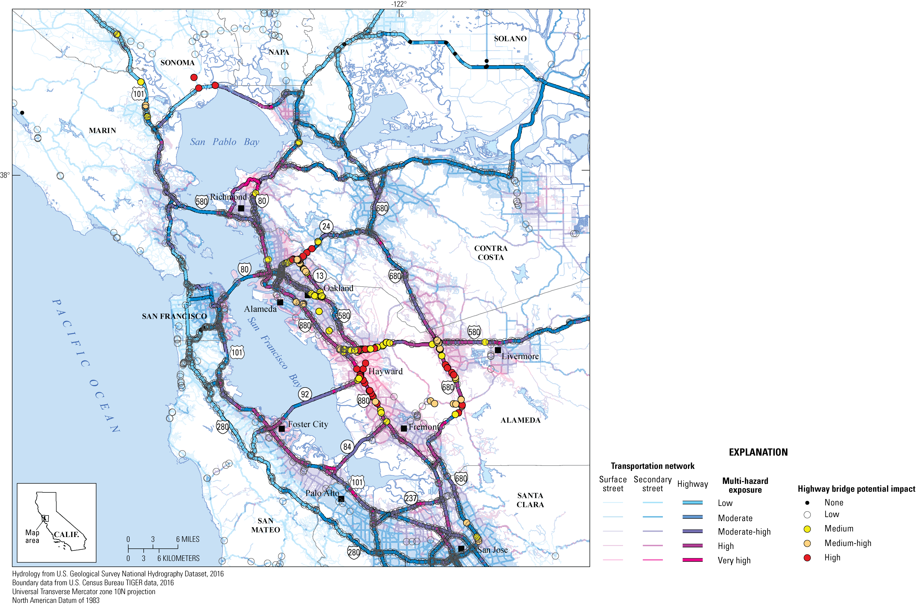
HayWired Scenario
Map showing the multi-hazard exposure of roadways and potential impacts to California Department
of Transportation highway bridges in the HayWired Earthquake Scenario.
HayWired Scenario Volume 3: Chapter T, Appendix 5, Figure 3
20

Slide 22
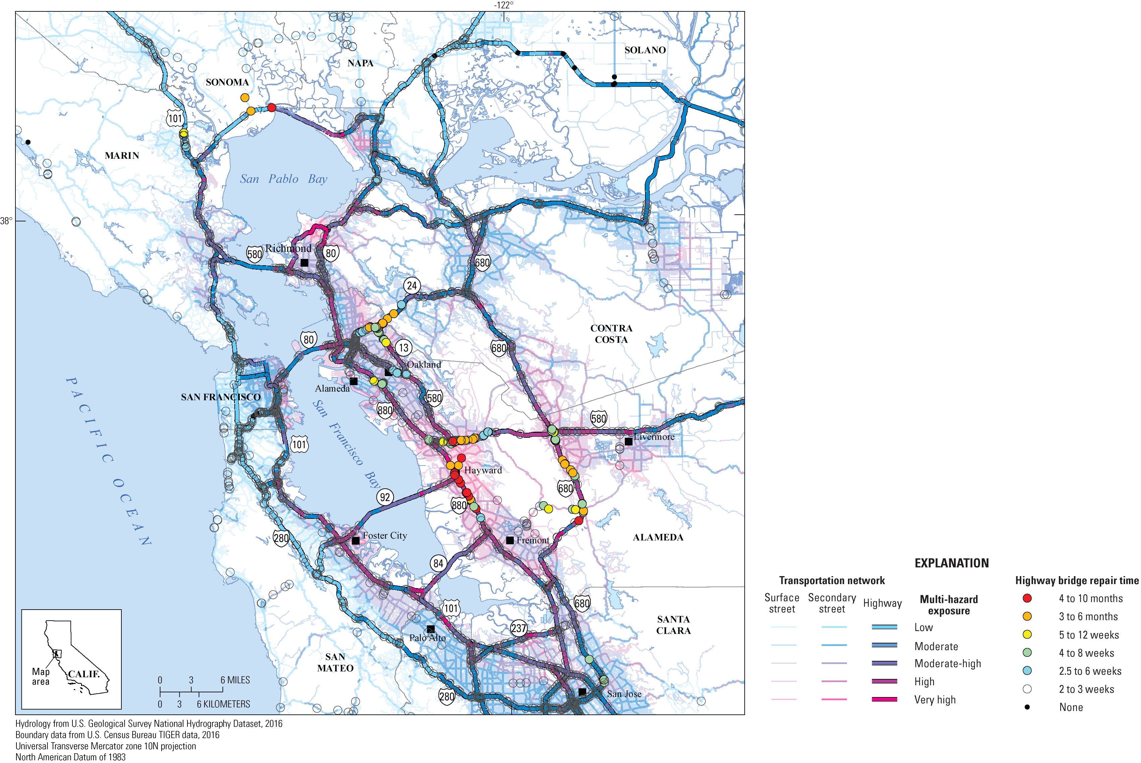
HayWired Scenario
Map showing repair times for highway bridges as determined by the California Department of Transportation relative to multi-hazard exposure in the HayWired Earthquake Scenario.
HayWired Scenario Volume 3: Chapter T, Appendix 5, Figure 4
21

Slide 23
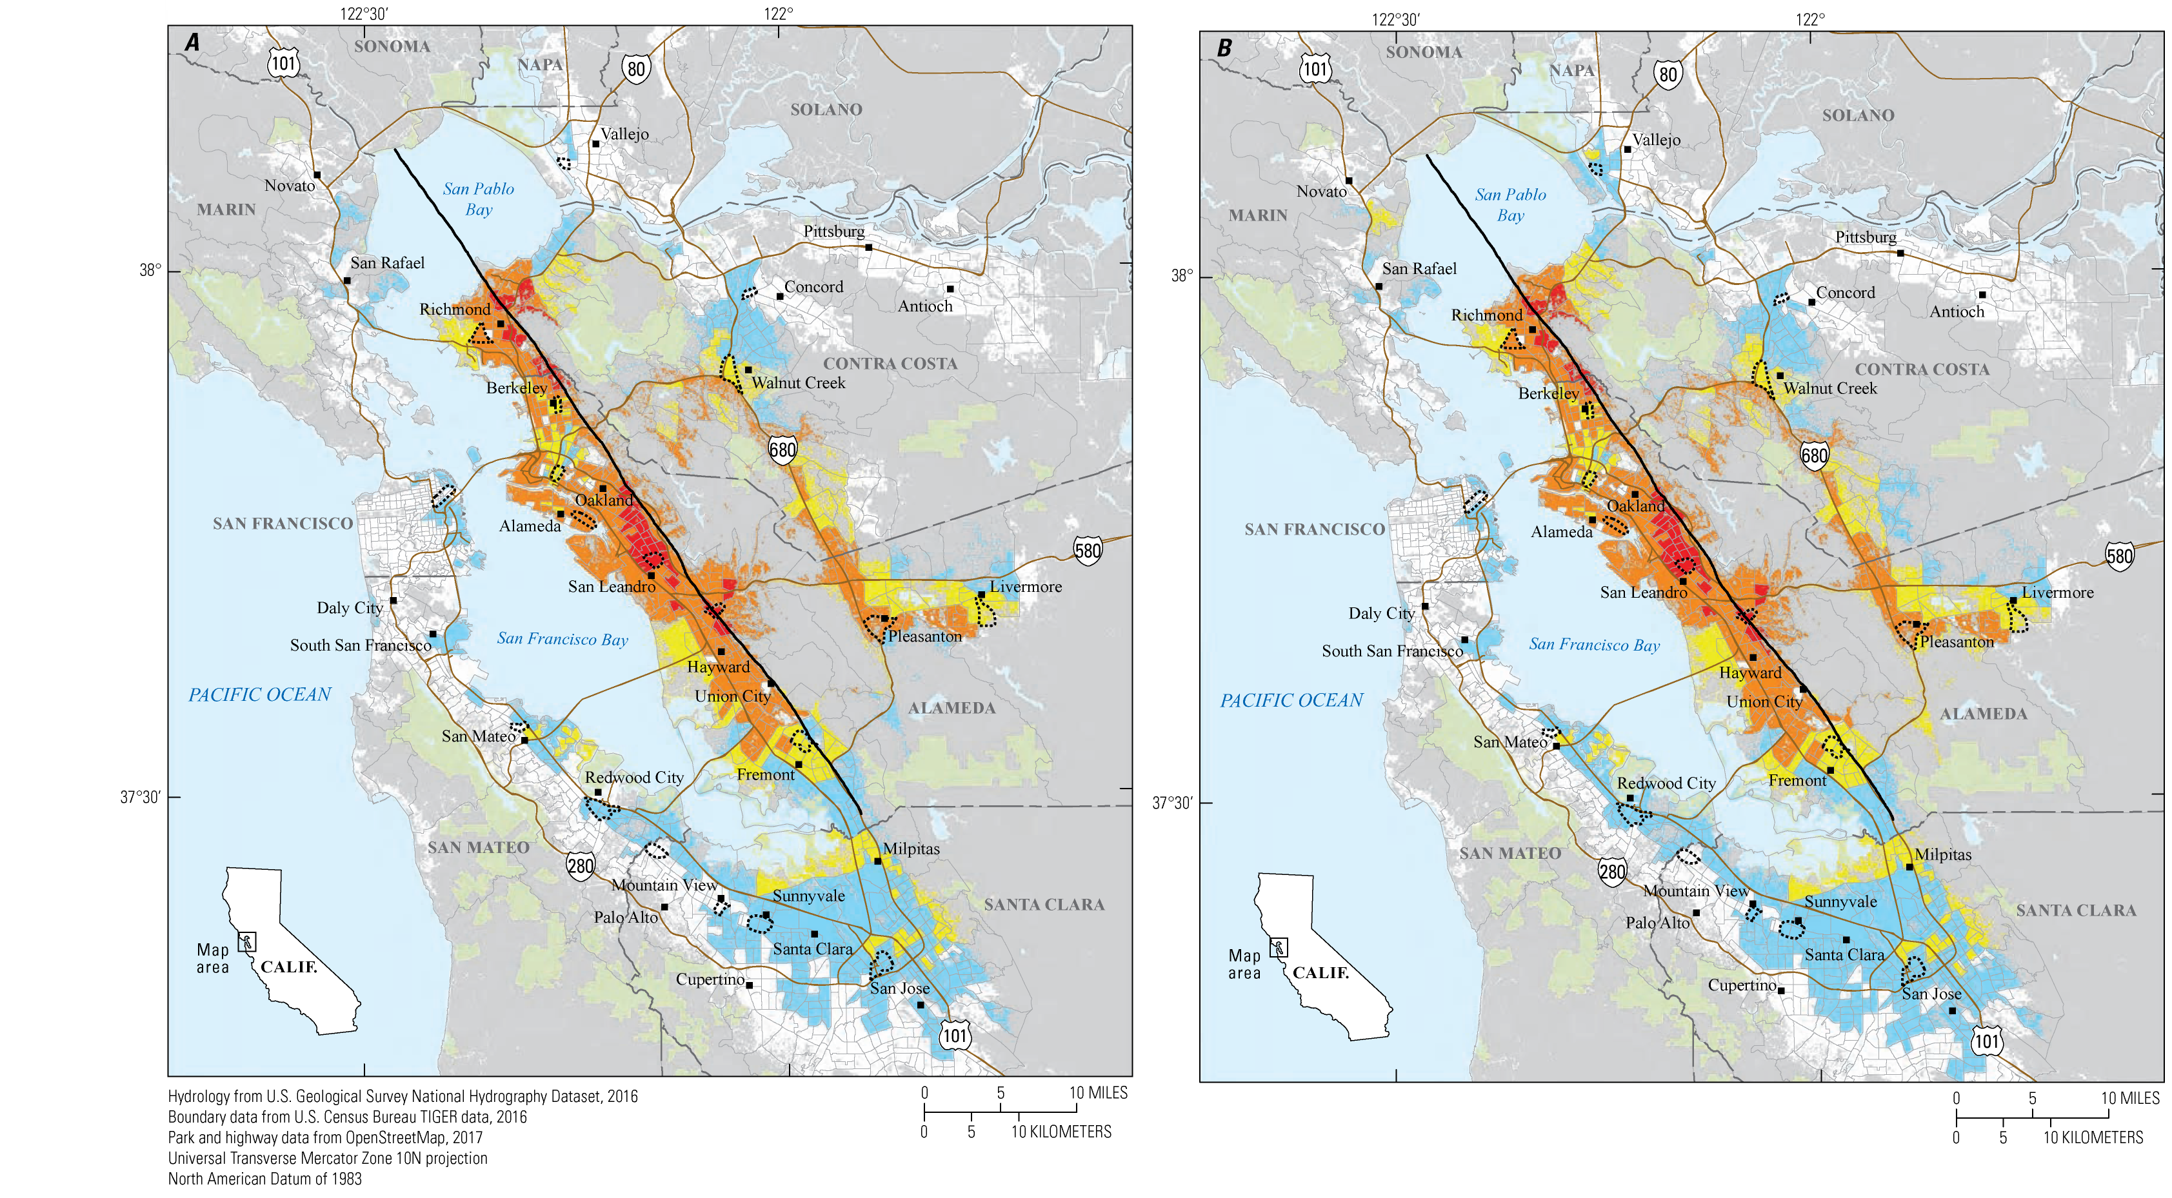
HayWired Scenario
Maps showing census tracts with concentrations of building damage to industrial and warehouse uses in the HayWired Earthquake Scenario mainshock. Buildings with industrial and warehouse uses include heavy and light industrial uses; food, drug, chemical,
or metal processing; high technology; and construction. Descriptions of the 2 maps: A, Shaking, landslide, and liquefaction hazards only (without fire). B, Shaking,
landslide, liquefaction, and fire
hazards.
HayWired Scenario Volume 3: Chapter U, Figure A9
22

Slide 24
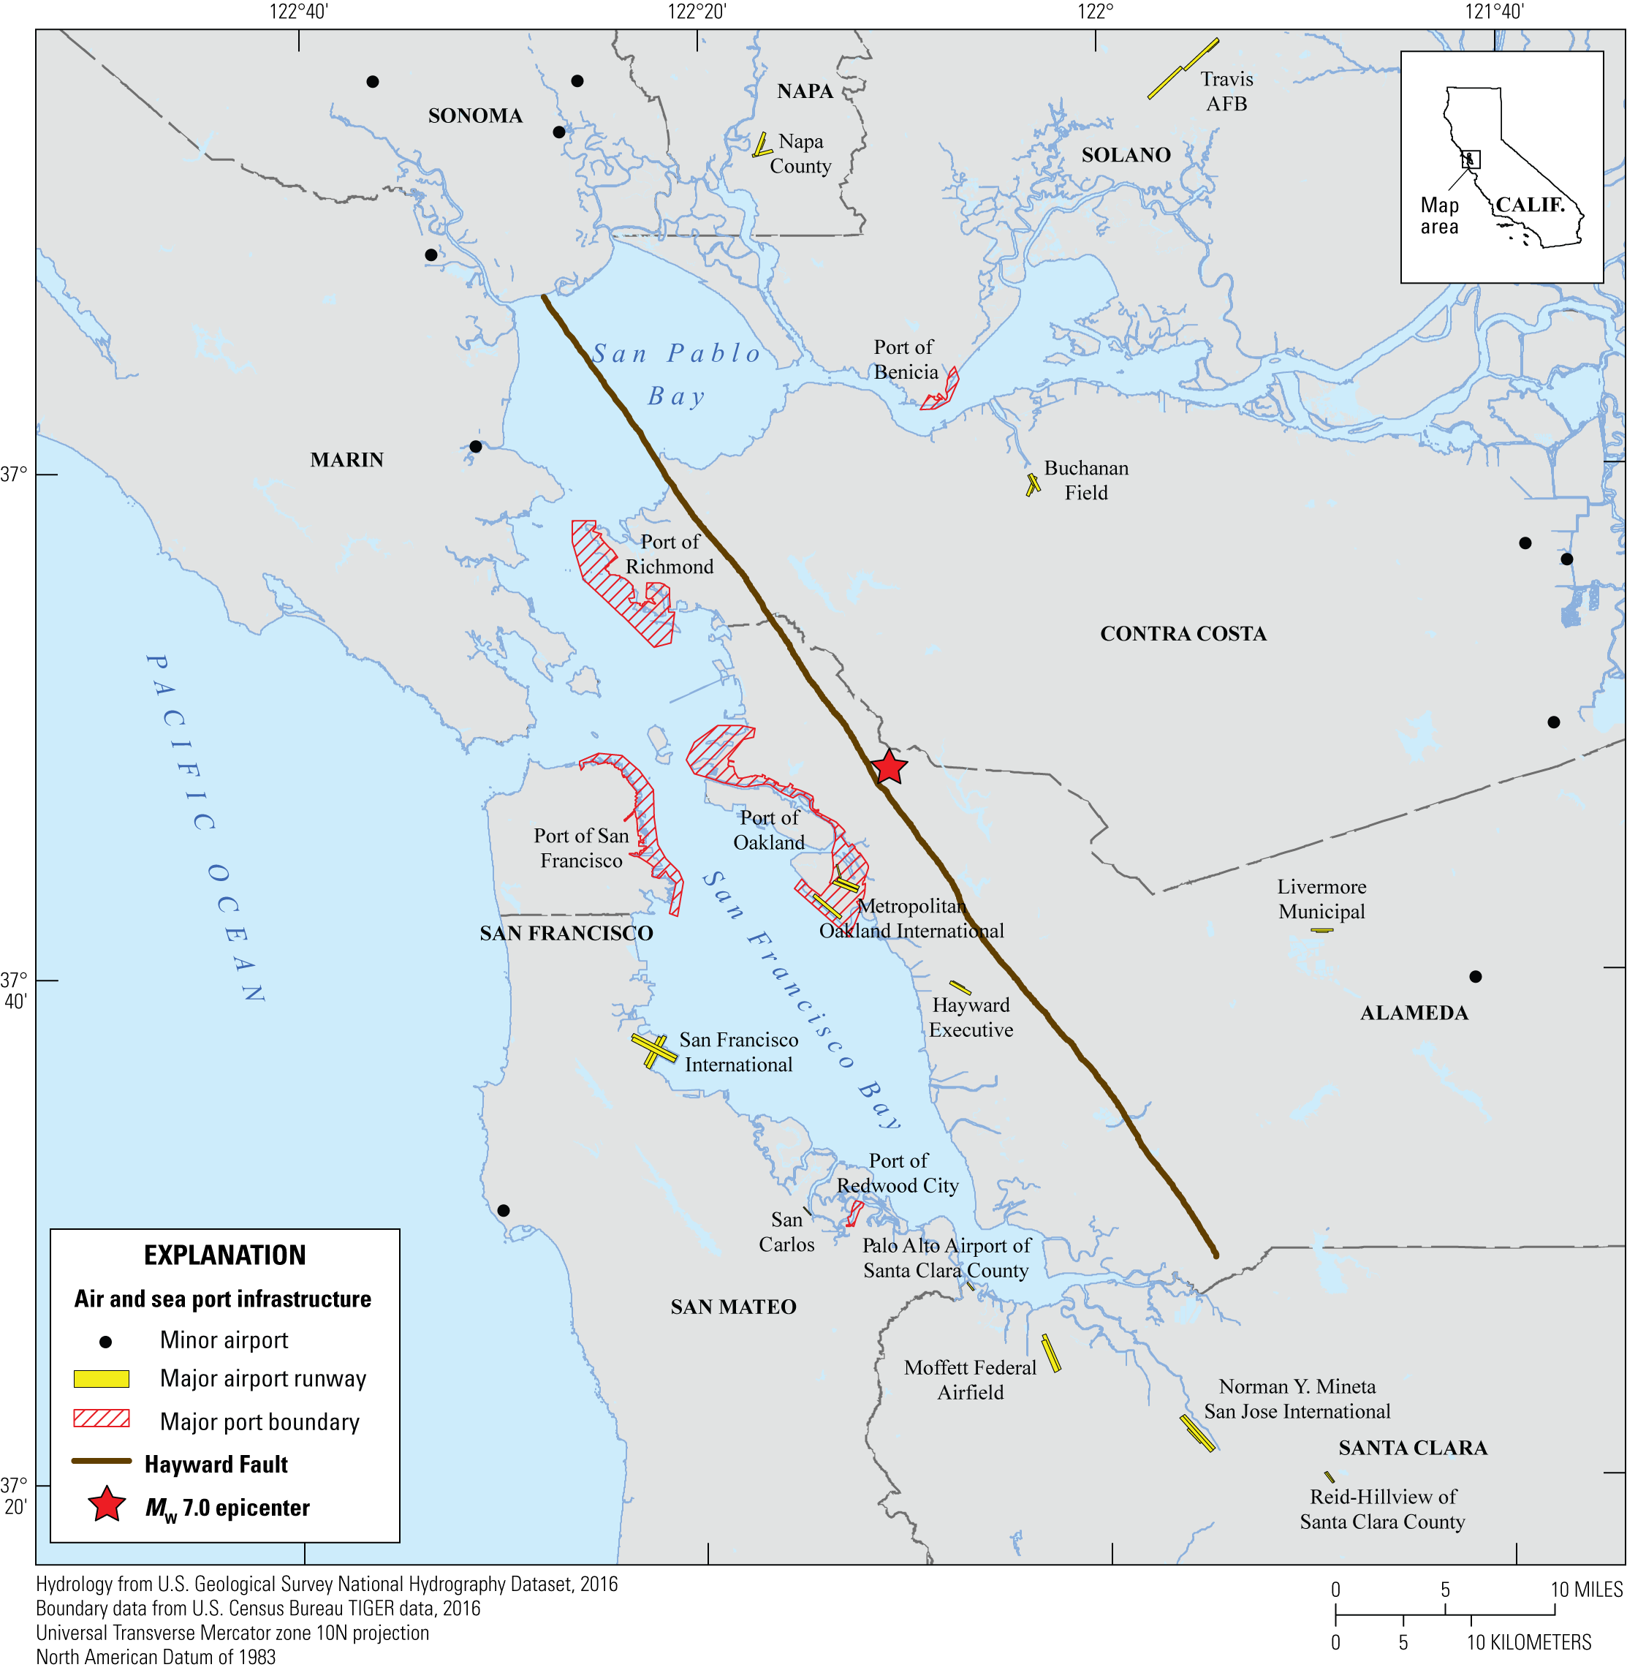
HayWired Scenario
Map showing the locations of air and sea port infrastructure in the Bay Area. Major airports are represented by runways, while minor airports are represented as points. Seaports are shown using full port boundaries. M_{w}, moment magnitude.
HayWired Scenario: Air and Sea Port Infrastructure Map created for HayWired Exercise Toolkit
23

Slide 25
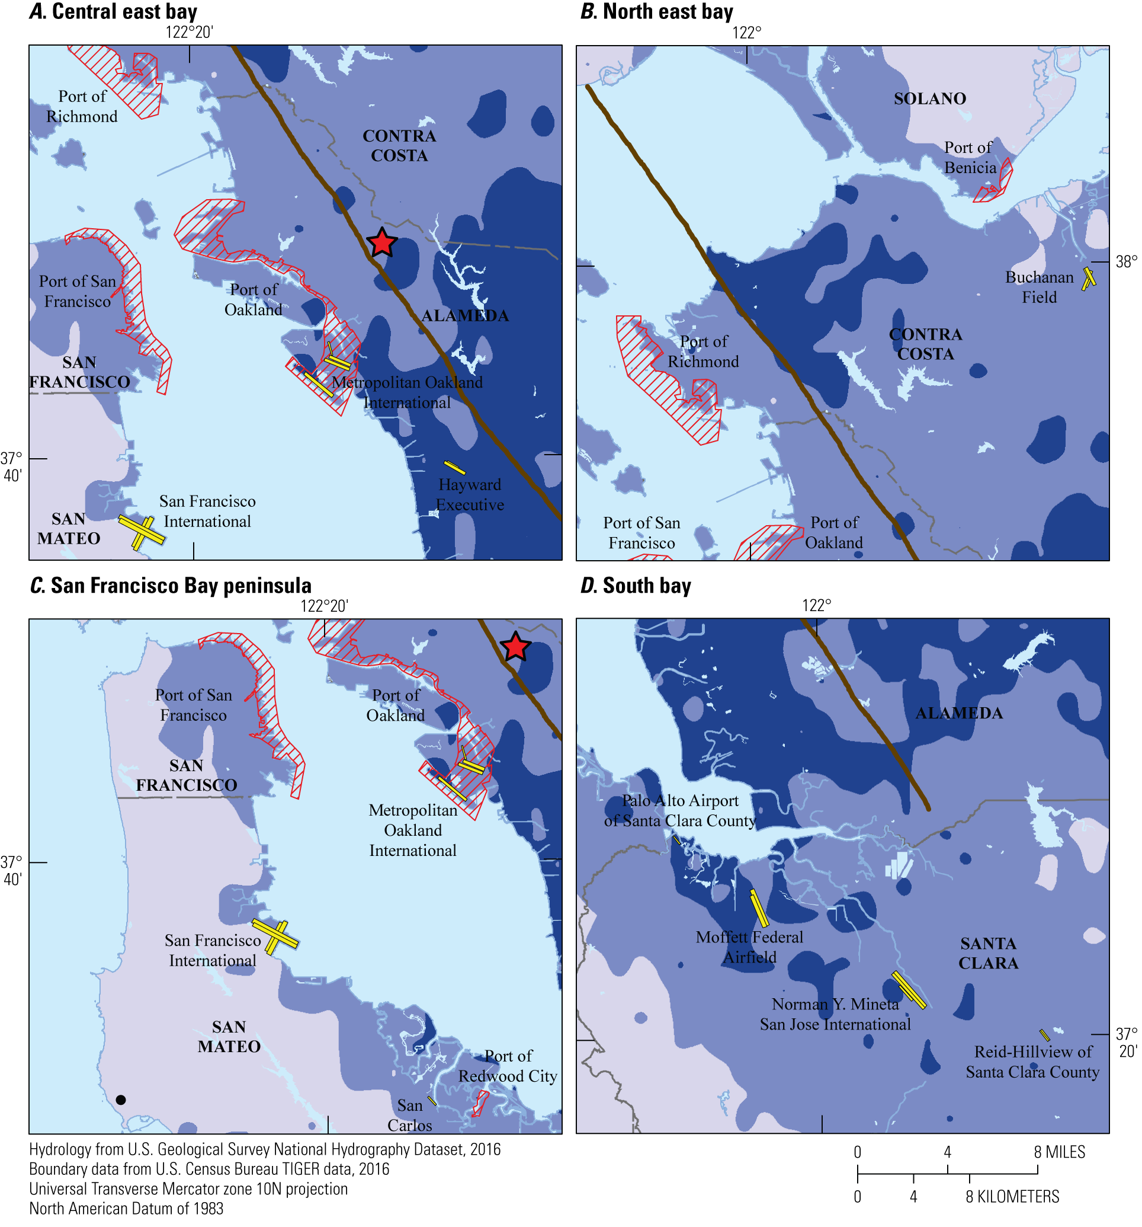
HayWired Scenario
Maps showing the potential impact of HayWired Earthquake Scenario mainshock ground shaking intensity on air and sea port infrastructure.
Description of the 4 maps: A, Central East Bay. B, South Bay. C, San Francisco Bay peninsula. D, North East Bay. M_{w}, moment magnitude.
HayWired Scenario: Ground Shaking on Air and Sea Port Infrastructure Map created for HayWired Exercise Toolkit
24

Slide 26
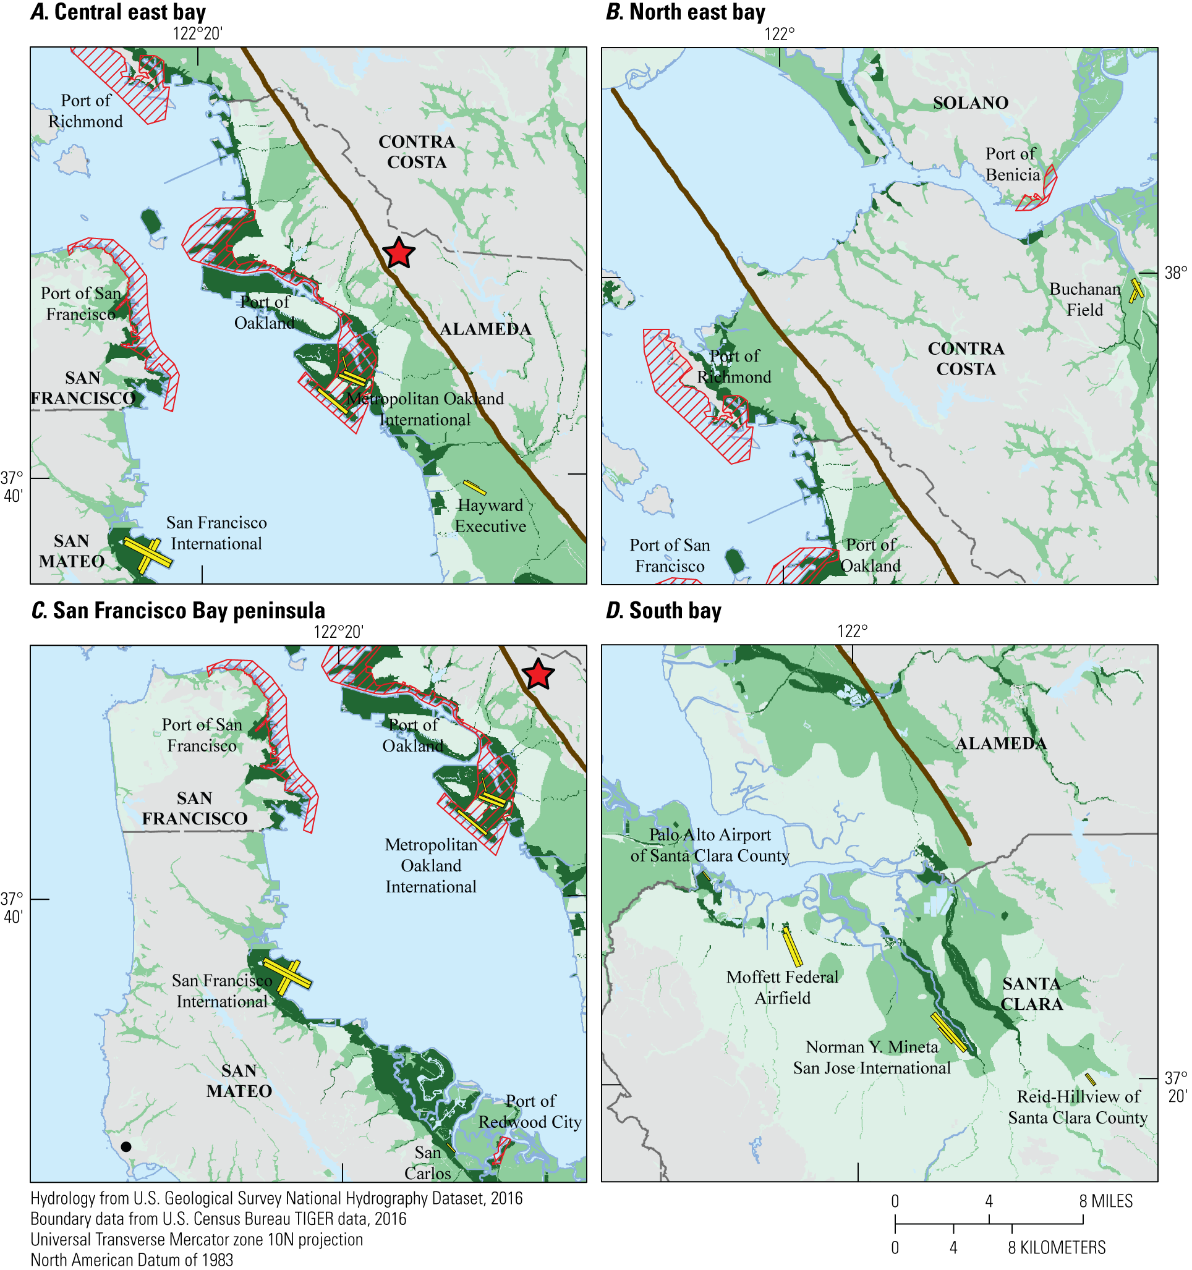
HayWired Scenario
Maps showing the potential impact of HayWired Earthquake Scenario mainshock ground failure intensity on air and sea port infrastructure. Ground failure is represented by liquefaction and landslides.
Description of the 4 maps: A, Central East Bay. B, South Bay. C, San Francisco Bay peninsula. D, North East Bay. M_{w}, moment magnitude.
HayWired Scenario: Ground Failure Air and Sea Port Infrastructure Map created for HayWired Exercise Toolkit
25

Slide 27
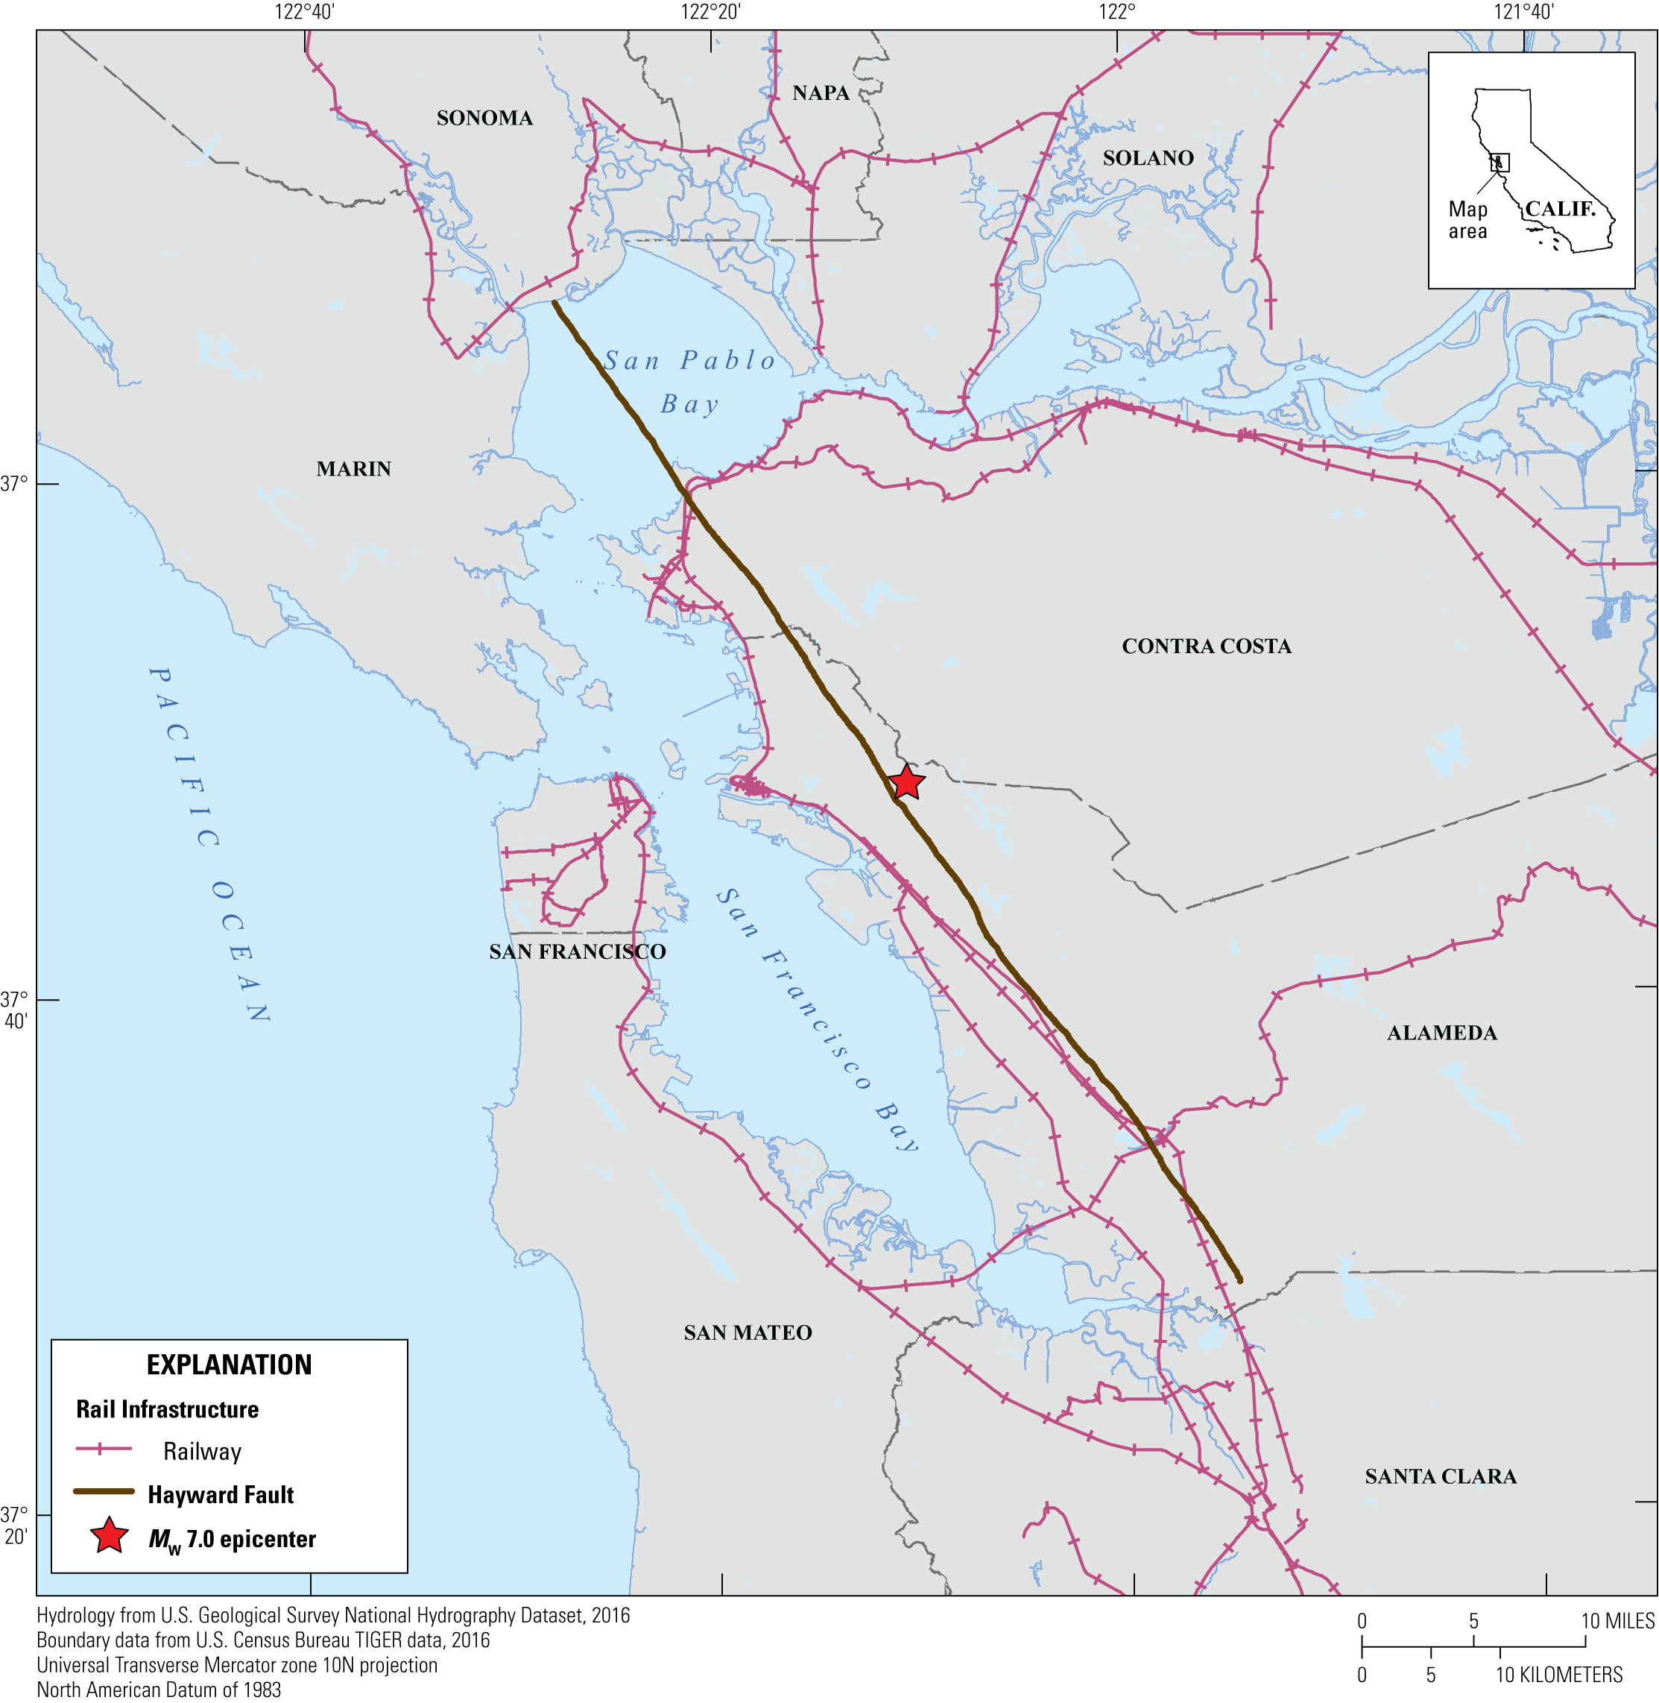
HayWired Scenario
Map showing rail infrastructure in the Bay Area. Concentrations of rail lines can be found in areas with seaports, with major freight lines crossing the region throughout. M_{w}, moment magnitude.
HayWired Scenario: Rail Infrastructure Map created for HayWired Exercise Toolkit
26

Slide 28
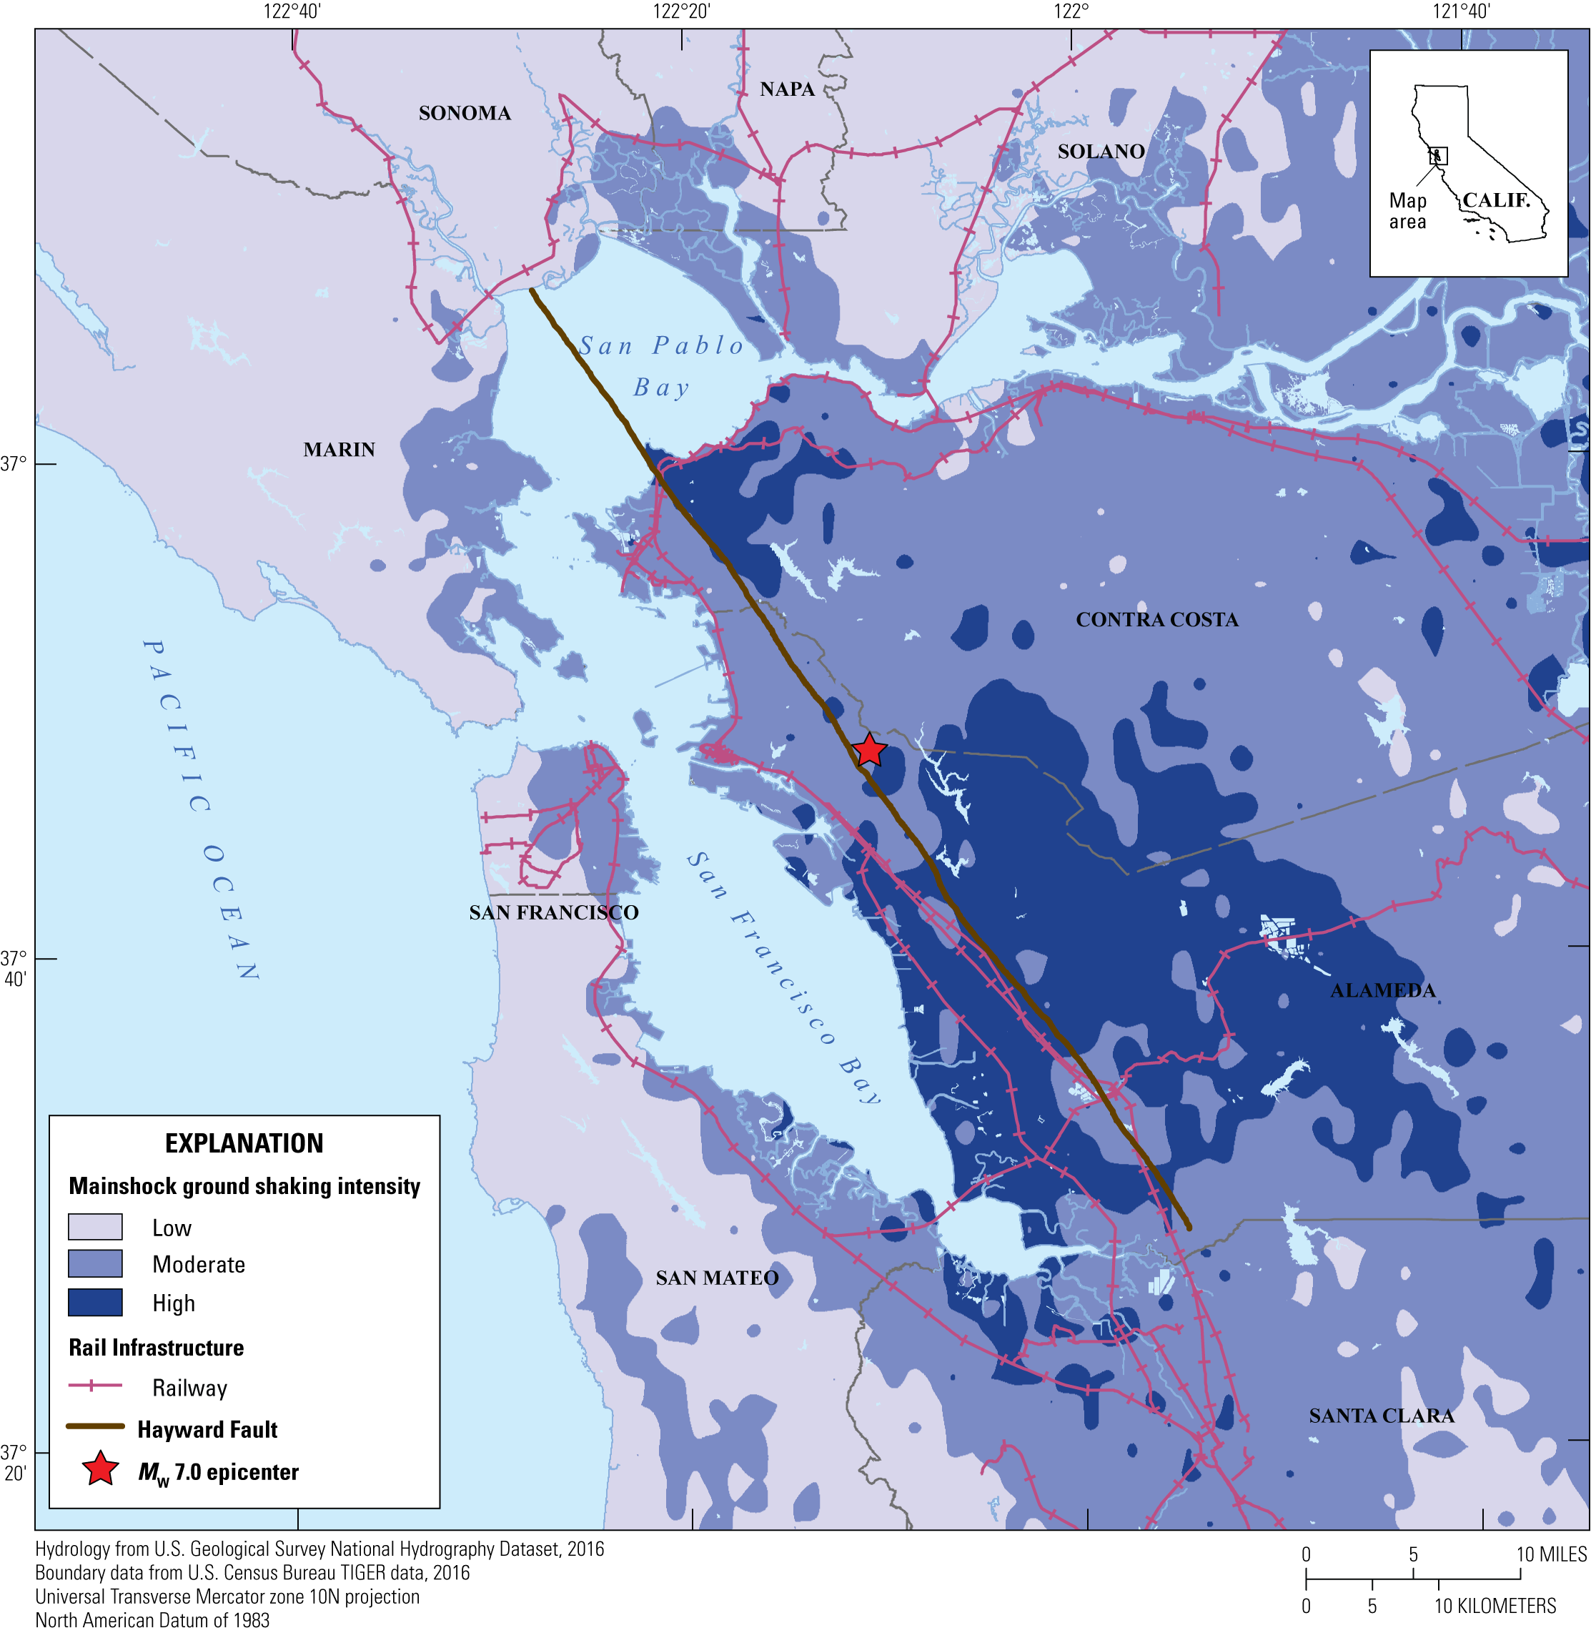
HayWired Scenario
Map showing the potential impact of HayWired Earthquake Scenario mainshock ground shaking intensity on rail infrastructure. M_{w}, moment magnitude.
HayWired Scenario: Ground Shaking on Rail Infrastructure Map created for HayWired Exercise Toolkit
27

Slide 29
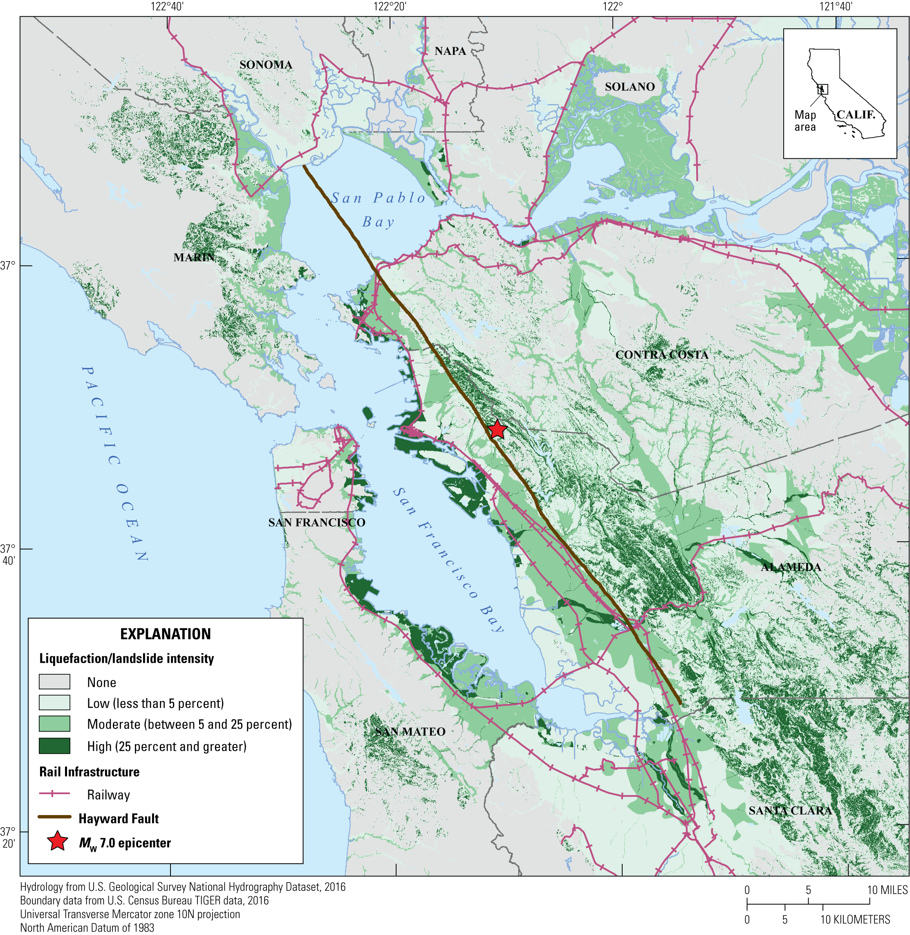
HayWired Scenario
Map showing the potential impact of HayWired Earthquake Scenario mainshock ground failure intensity on rail infrastructure. Ground failure
is represented by liquefaction and landslides. M_{w}, moment magnitude.
HayWired Scenario: Ground Failure on Rail Infrastructure Map created for HayWired Exercise Toolkit
28

Slide 30
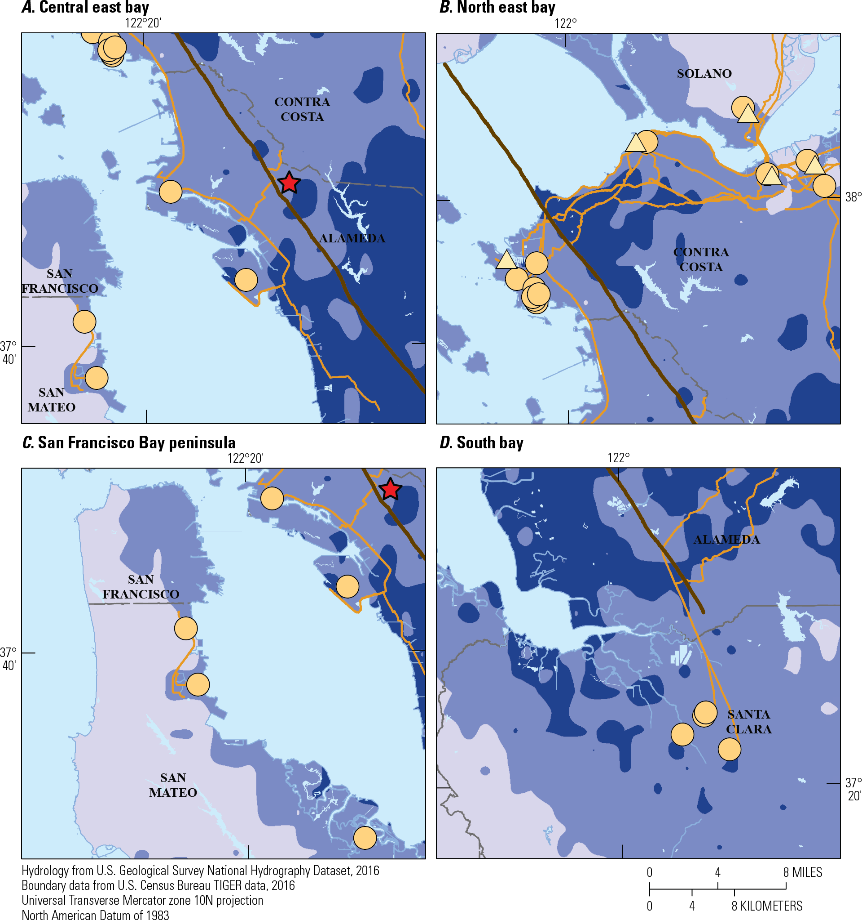
HayWired Scenario
Maps showing the potential impact of HayWired Earthquake Scenario mainshock ground shaking intensity on oil infrastructure. Ground failure is represented by liquefaction and landslides. Description of the 4 maps: A, Central East Bay. B, South Bay. C, San Francisco Bay peninsula. D, North East Bay. M_{w}, moment magnitude.
HayWired Scenario: Ground Shaking on Oil Infrastructure Map created for HayWired Exercise Toolkit
29

Slide 31
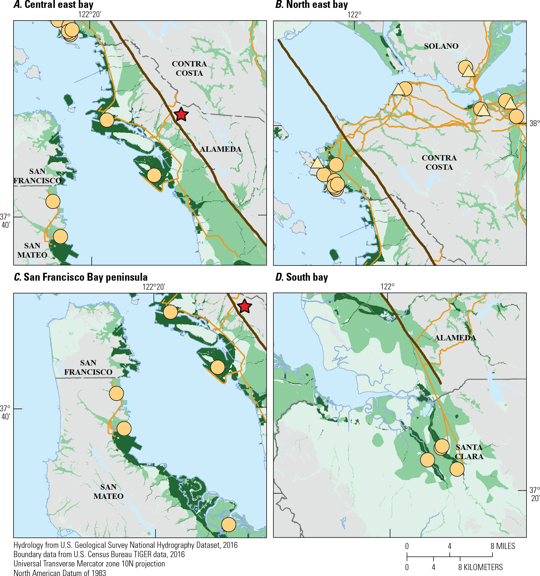
HayWired Scenario
Maps showing the potential impact of HayWired Earthquake Scenario mainshock ground failure intensity on oil infrastructure. Ground failure is represented by liquefaction and landslides. Description of the 4 maps: A, Central East Bay. B, South Bay. C, San Francisco Bay peninsula. D, North East Bay. M_{w}, moment magnitude.
HayWired Scenario: Ground Failure on Oil Infrastructure Map created for HayWired Exercise Toolkit
30

