Slide 1


Slide 2
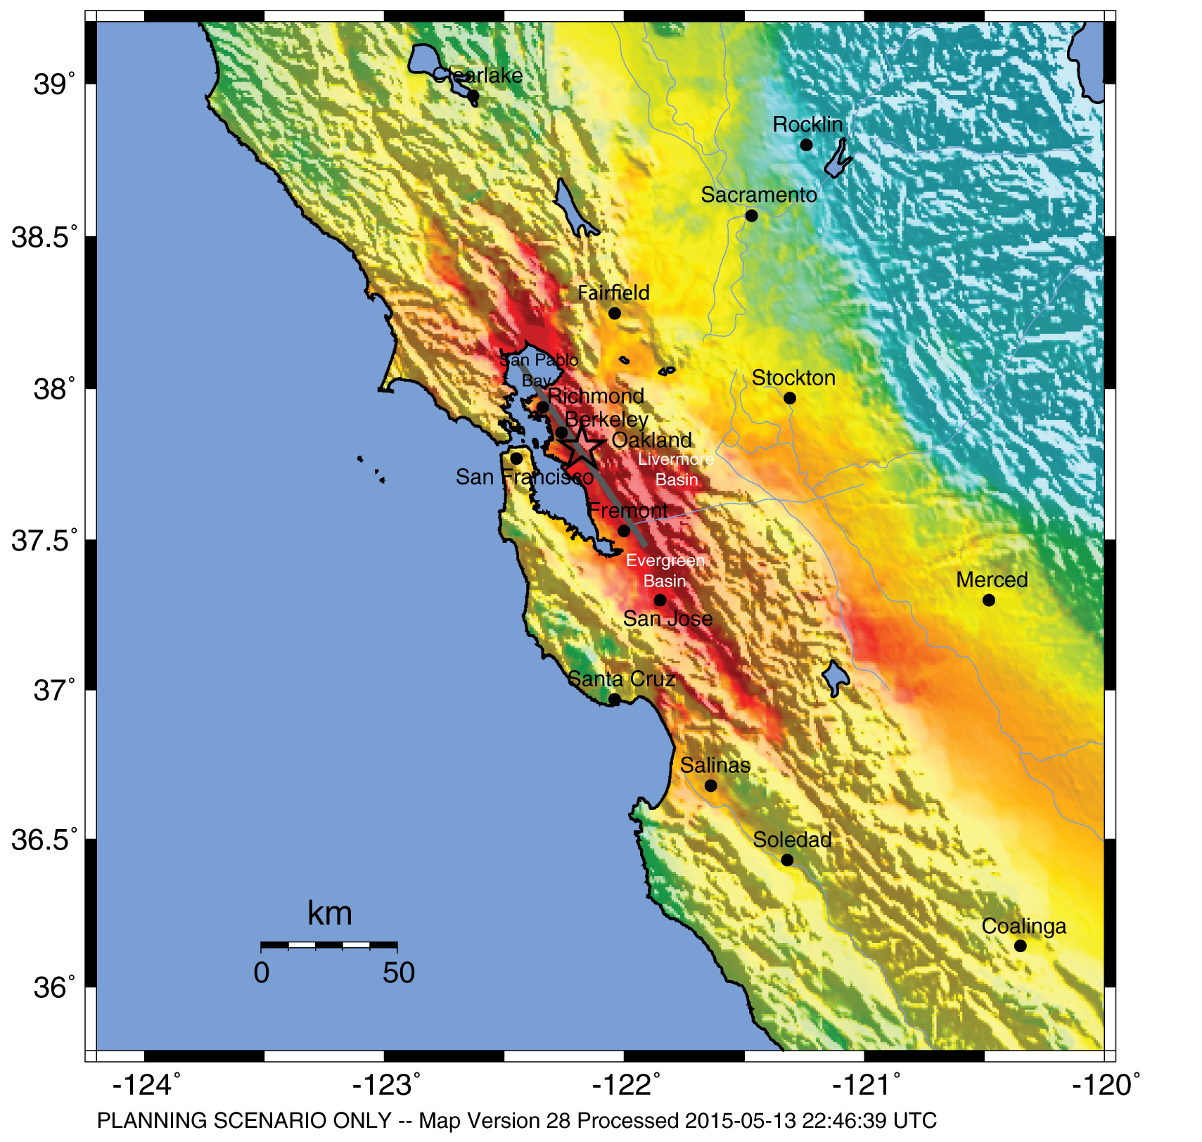
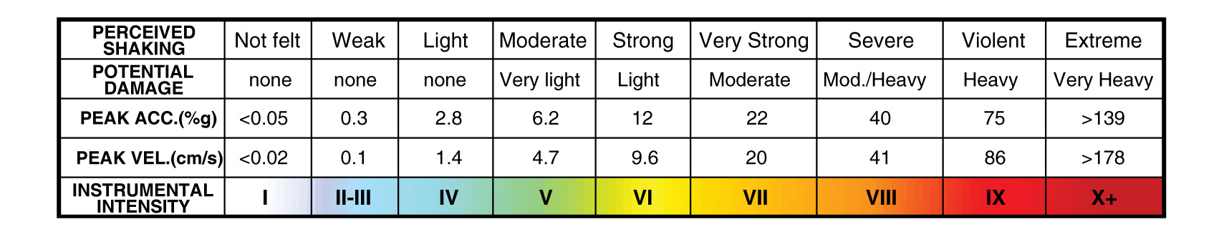
HayWired Scenario
U.S. Geological Survey ShakeMap of the HayWired Earthquake Scenario’s hypothetical magnitude 7.0 mainshock.
HayWired Scenario Volume 1: Chapter A, Figure 4
1

Slide 3
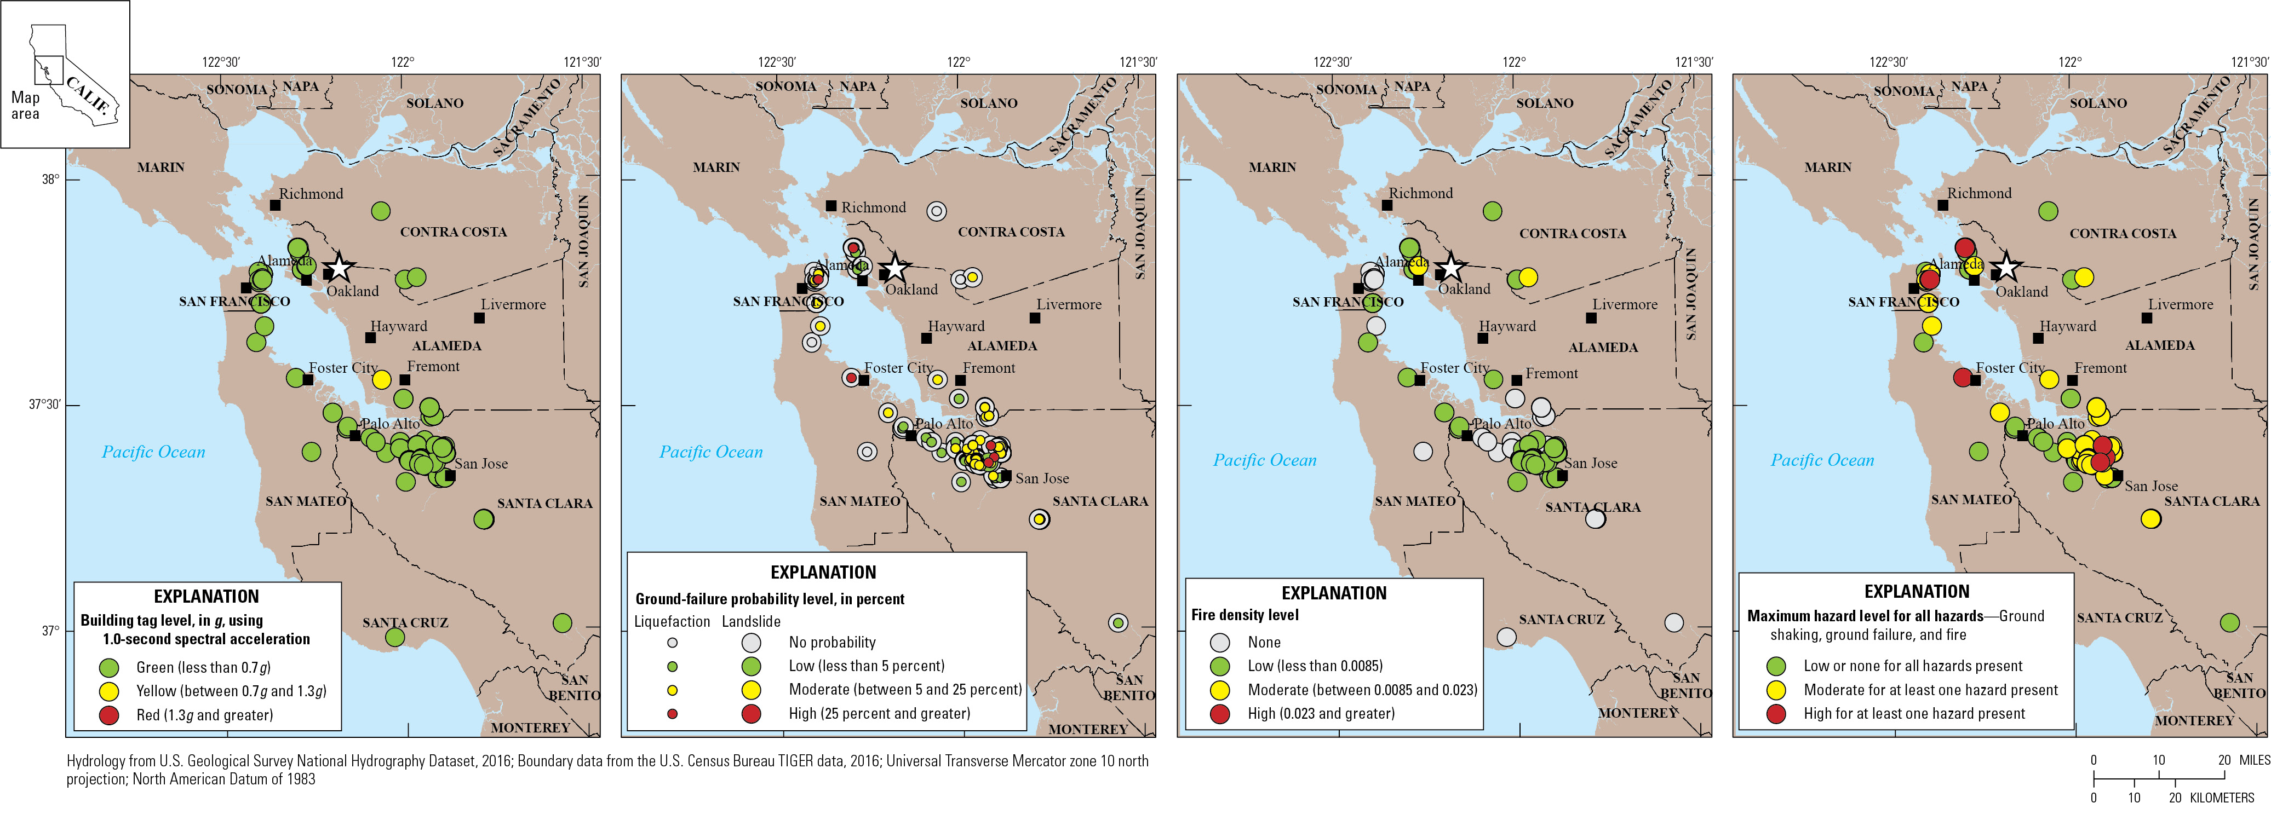
HayWired Scenario
A
B
C
D
Maps showing damage and exposure to HayWired Earthquake Scenario mainshock hazards for data centers. White star shows the mainshock epicenter. Descriptions of the 4 maps: A, Map of potential building tagging from shaking for data centers assuming moderate code (overturning of unanchored equipment also possible in yellow-tagged and red-
tagged buildings). g is acceleration due to gravity. B, Map of data center exposure to ground-failure hazards (liquefaction and landslide). C, Map of data center exposure to fire following earthquake hazards (represented by fire density level—burned- building square footage relative to the developed area containing the fires). D, Map of data centers affected by maximum level of hazard from shaking, ground failure, and fire.
HayWired Scenario Volume 3: Chapter S, Figure 10

Slide 4
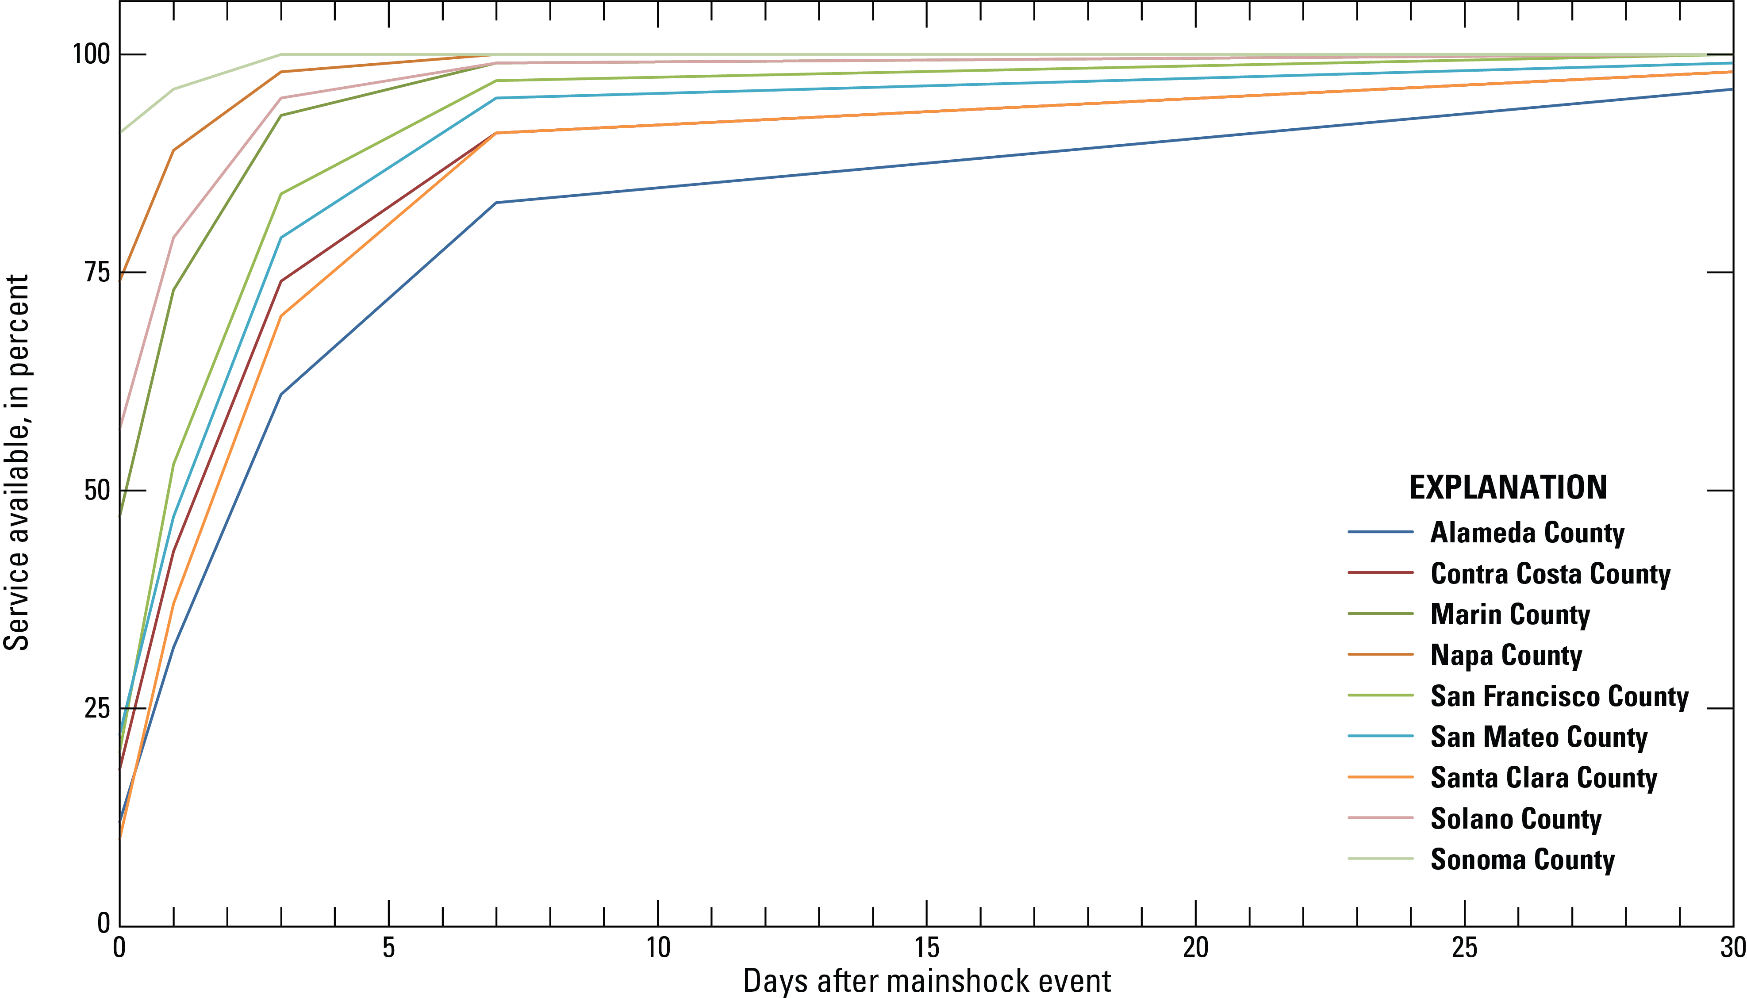
HayWired Scenario
Line graph showing the electric power restoration curves by county for the HayWired Earthquake Scenario mainshock.
HayWired Scenario Volume 3: Chapter S, Figure 10

Slide 5
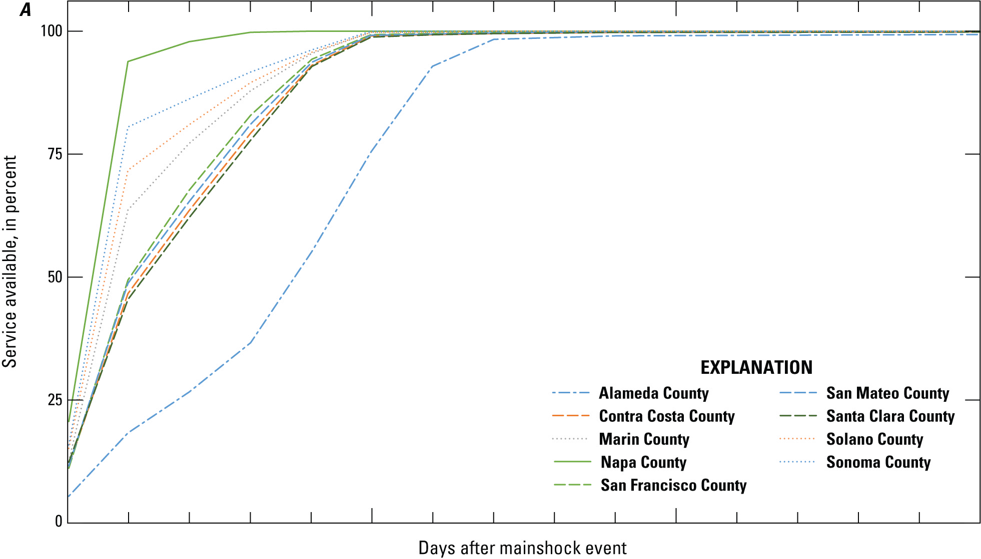
HayWired Scenario
Line graphs showing voice and data restoration curves by county for the HayWired Earthquake Scenario mainshock.
These curves include the following assumptions: use of batteries and/or generators, deployment of portable equipment (including cells on wheels [COWs] and cells on
light truck [COLTs]), and management of user behavior. Demand surge impacts are included in the estimation.
HayWired Scenario Exercise Toolkit: Telecommunications Restoration Curves, A

Slide 6
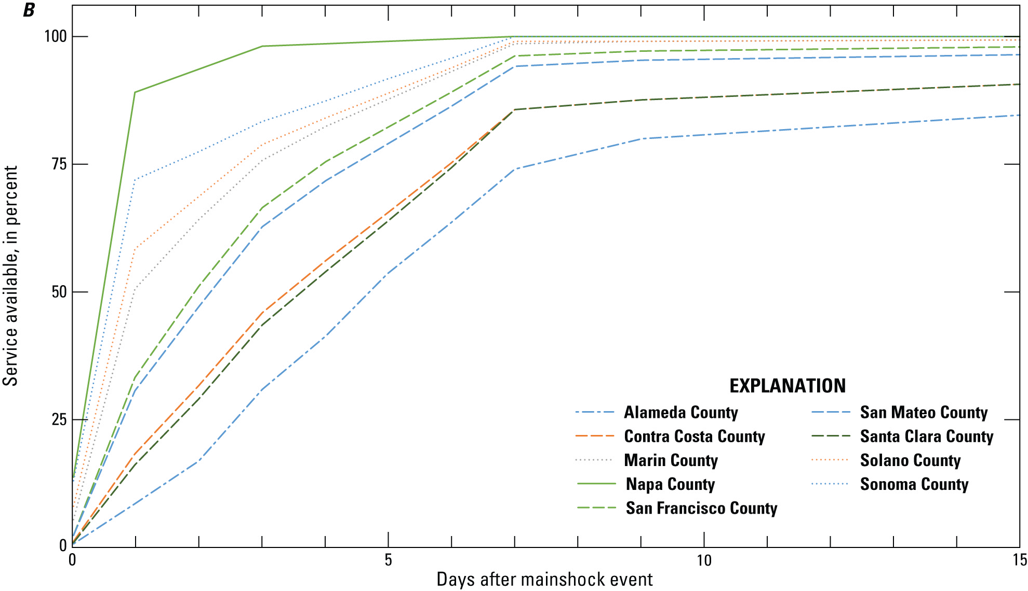
HayWired Scenario
Line graphs showing voice and data restoration curves by county for the HayWired Earthquake Scenario mainshock. The curves are based on system restoration dependent
on electric power restoration without the use of batteries and/or generators, deployment of portable equipment (including cells on wheels [COWs] and cells on
light truck [COLTs]), and management of user behavior.
HayWired Scenario Exercise Toolkit: Telecommunications Restoration Curves, B

