Slide 2
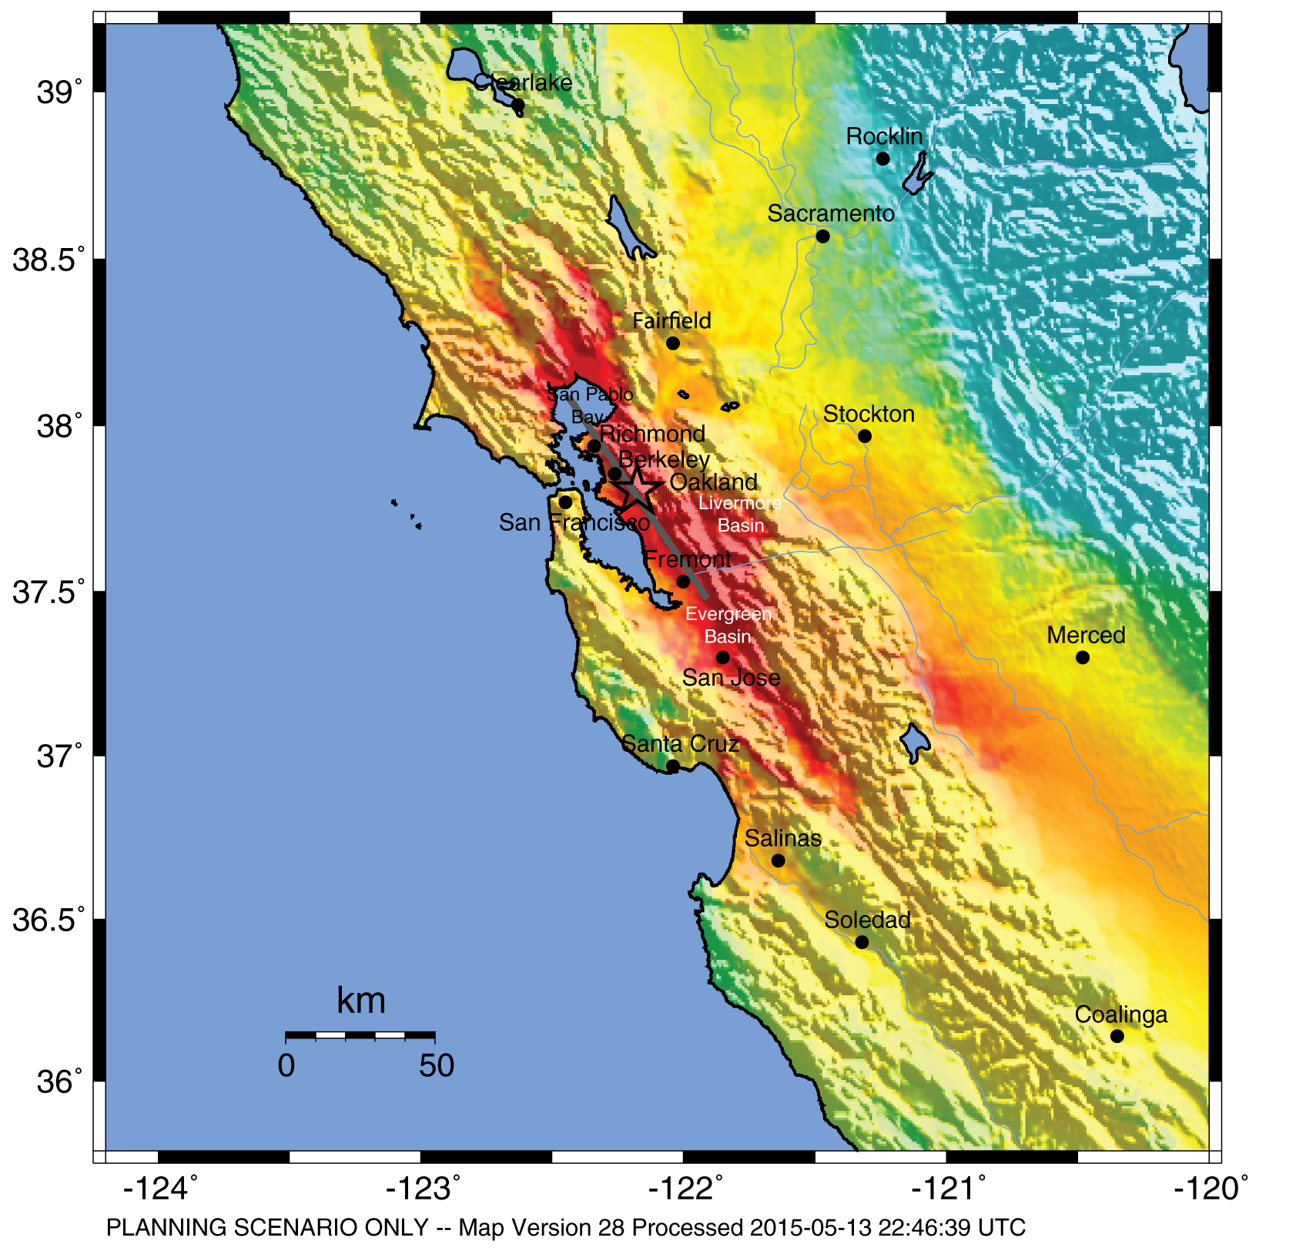
HayWired Scenario
U.S. Geological Survey ShakeMap of the HayWired Earthquake Scenario’s hypothetical magnitude 7.0 mainshock.
HayWired Scenario Volume 1: Chapter A, Figure 4
1

Slide 3
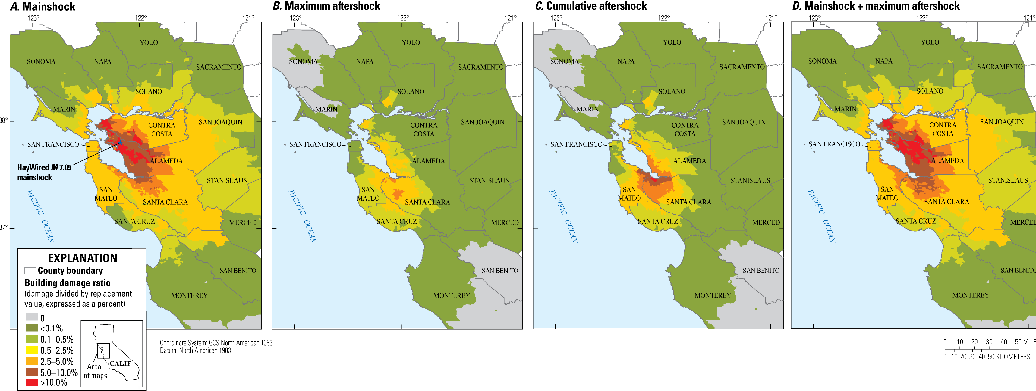
HayWired Scenario
Maps showing building damage ratio from ground shaking caused by the HayWired Earthquake Scenario mainshock and aftershocks. Descriptions of the 4 maps: A, Mainshock building damage ratio; B, Maximum aftershock building damage ratio; C, Cumulative aftershock building damage ratio; and D, Mainshock plus maximum aftershock building damage ratio.
HayWired Scenario Volume 2: Chapter J, Figure 16
2

Slide 4
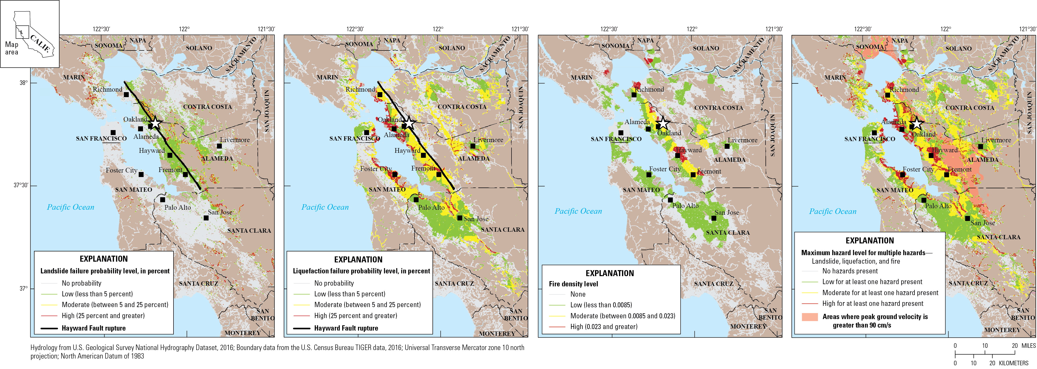
HayWired Scenario
A
B
C
D
Maps showing the exposure of surface streets (a proxy for copper and coaxial lines) to various hazards for the HayWired Earthquake Scenario mainshock. White star shows the mainshock epicenter. Descriptions of the 4 maps: A, Map of surface street exposure to landslide hazards. B, Map of surface street exposure to liquefaction hazards. C, Map of surface street exposure to fire density hazards (defined as the burned-building square footage relative to the developed area containing the fires). D, Map of surface street exposure relative to multiple HayWired Earthquake Scenario mainshock hazards (landslide, liquefaction, and fire density). cm/s, centimeters per second.
HayWired Scenario Volume 3: Chapter S, Figure 17 3

Slide 5
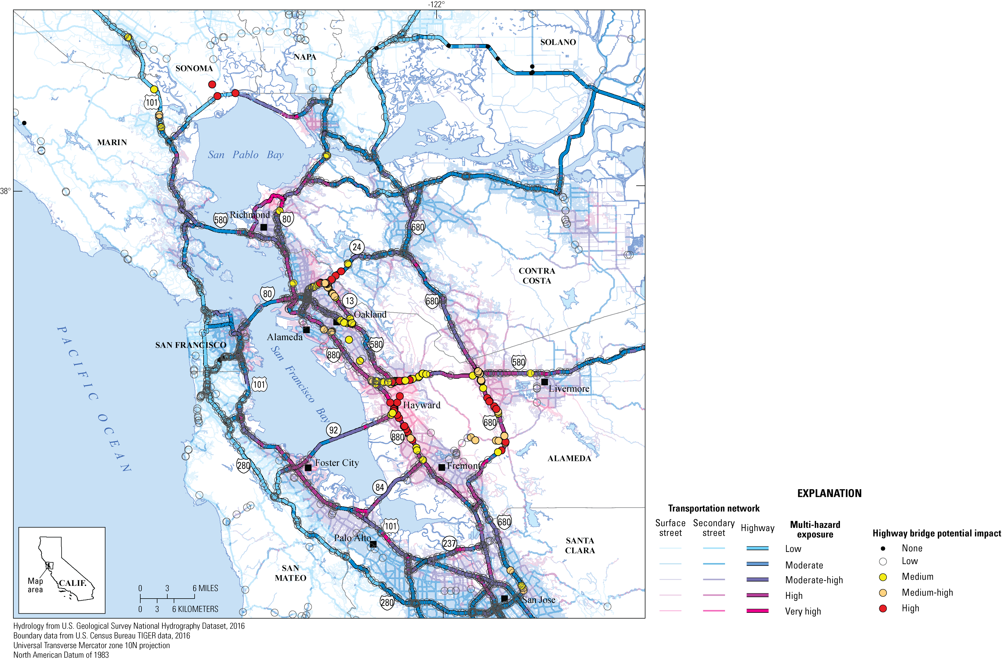
HayWired Scenario
Map showing the multi-hazard exposure of roadways and potential impacts to California Department
of Transportation highway bridges in the HayWired Earthquake Scenario.
HayWired Scenario Volume 3: Chapter T, Appendix 5, Figure 3
4

Slide 6
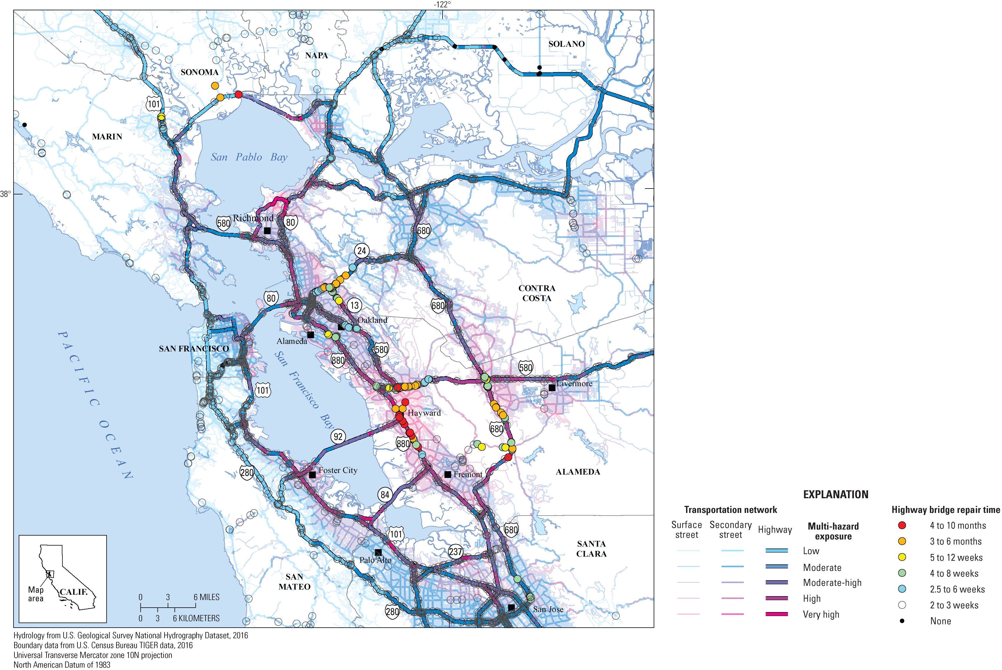
HayWired Scenario
Map showing repair times for highway bridges as determined by the California Department of Transportation relative to multi-hazard exposure in the HayWired Earthquake Scenario.
HayWired Scenario Volume 3: Chapter T, Appendix 5, Figure 4
5

Slide 7
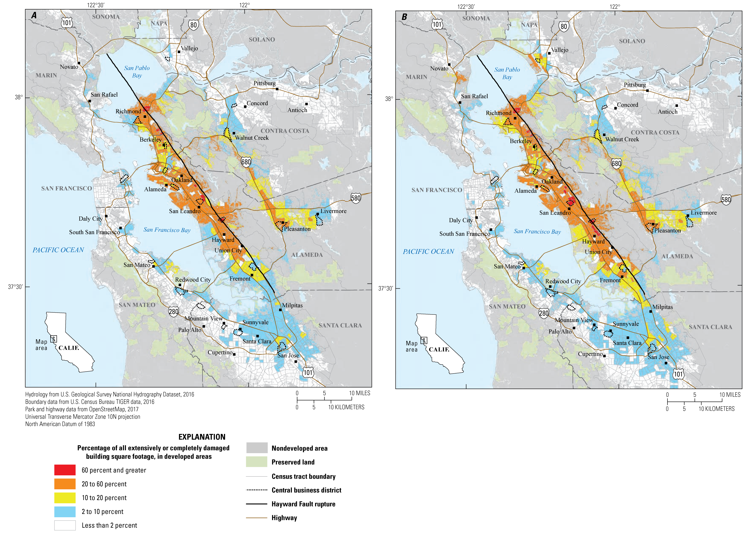
HayWired Scenario
Maps showing census tracts with concentrations of damage to household- serving uses (for example, hospitals, schools, and places of worship) in the HayWired Earthquake Scenario mainshock. Descriptions of the 2 maps: A, Shaking, landslide, and liquefaction hazards only (without fire). B, Shaking, landslide, liquefaction, and fire hazards.
6

Slide 8
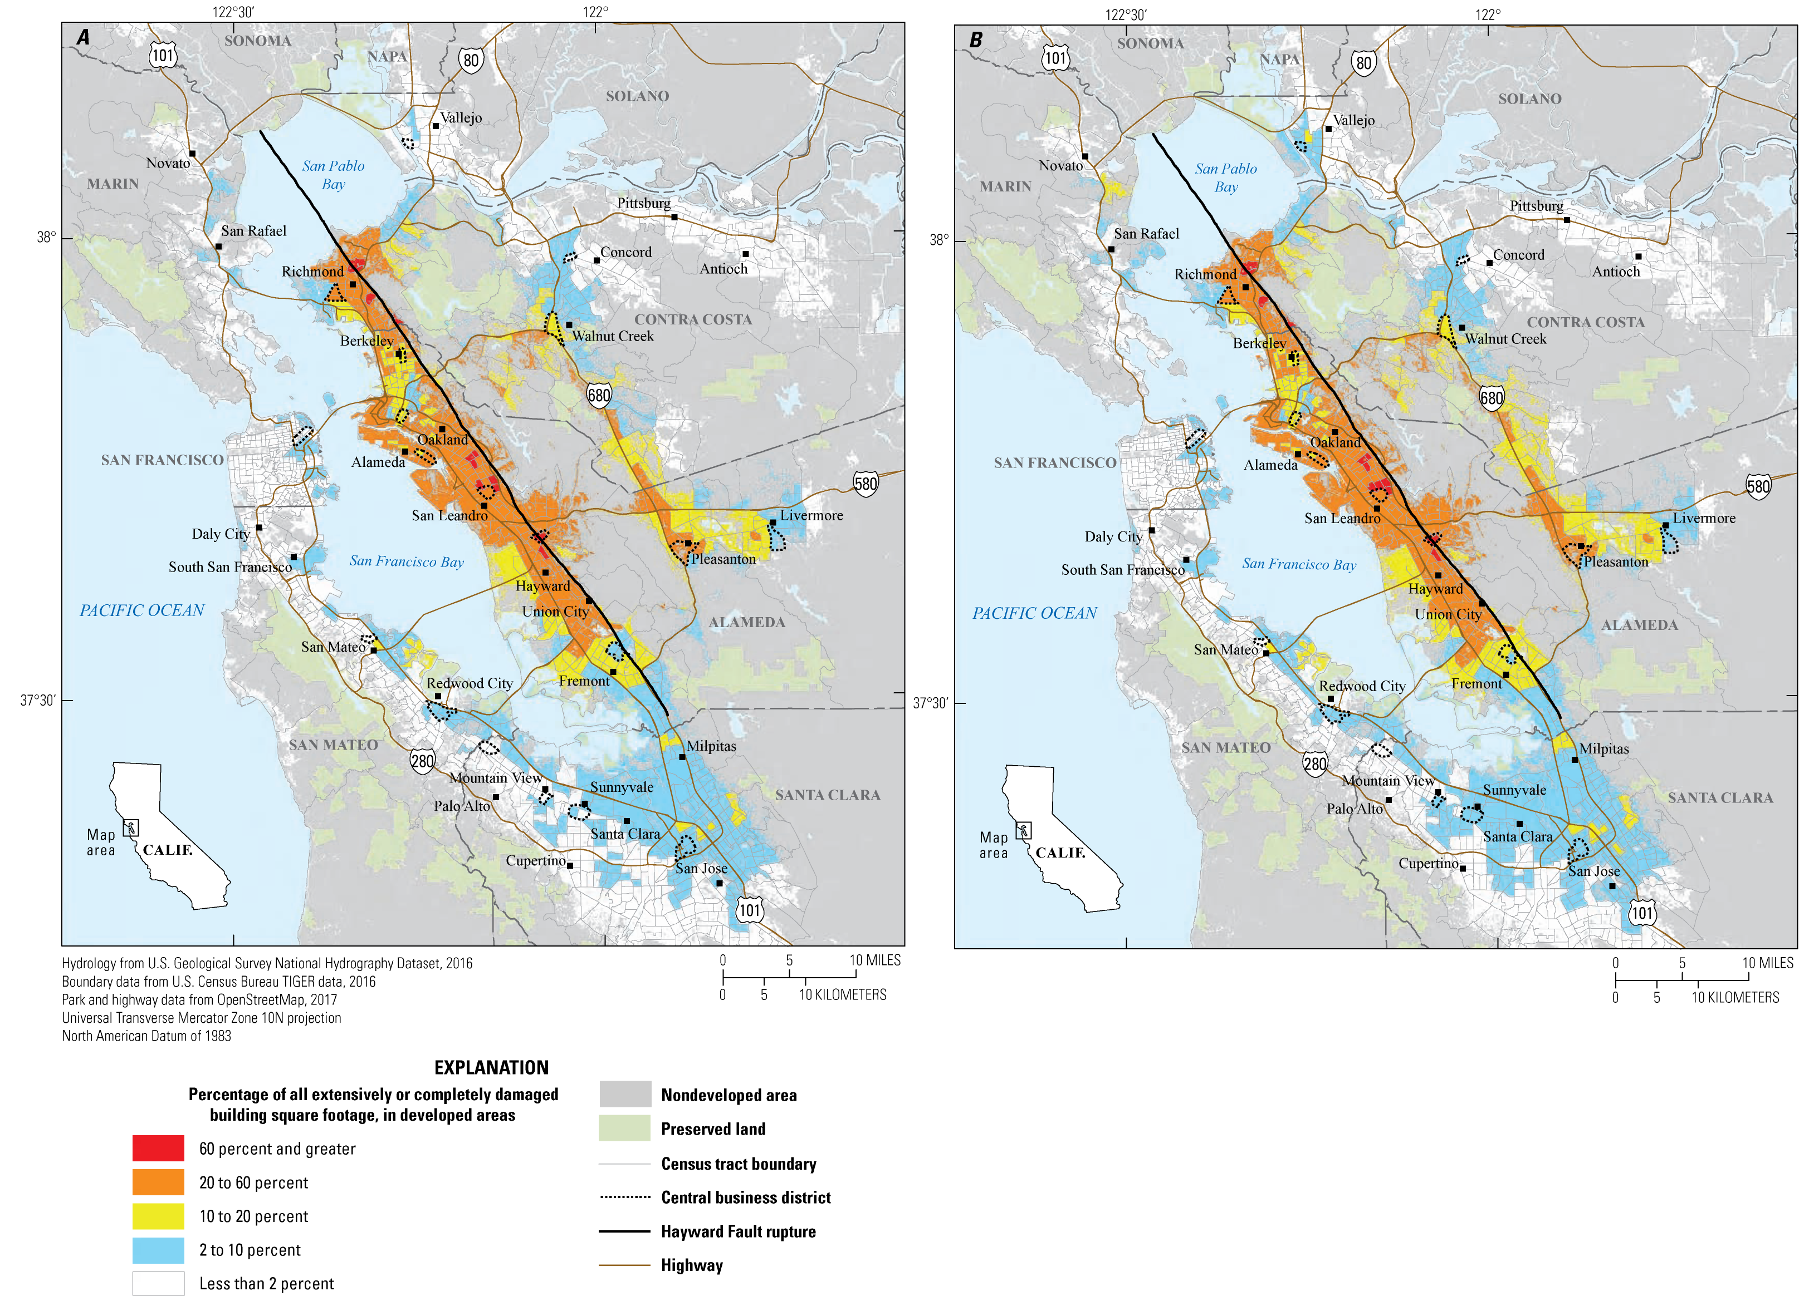
HayWired Scenario
Maps showing census tracts with concentrations of building damage to retail and commercial uses (for example, hotels, retail trade, banks, entertainment and recreation, and parking)
in the HayWired Earthquake Scenario mainshock.
Descriptions of the 2 maps: A, Shaking, landslide, and liquefaction hazards only (without fire). B, Shaking,
landslide, liquefaction, and fire
hazards.
7

Slide 9
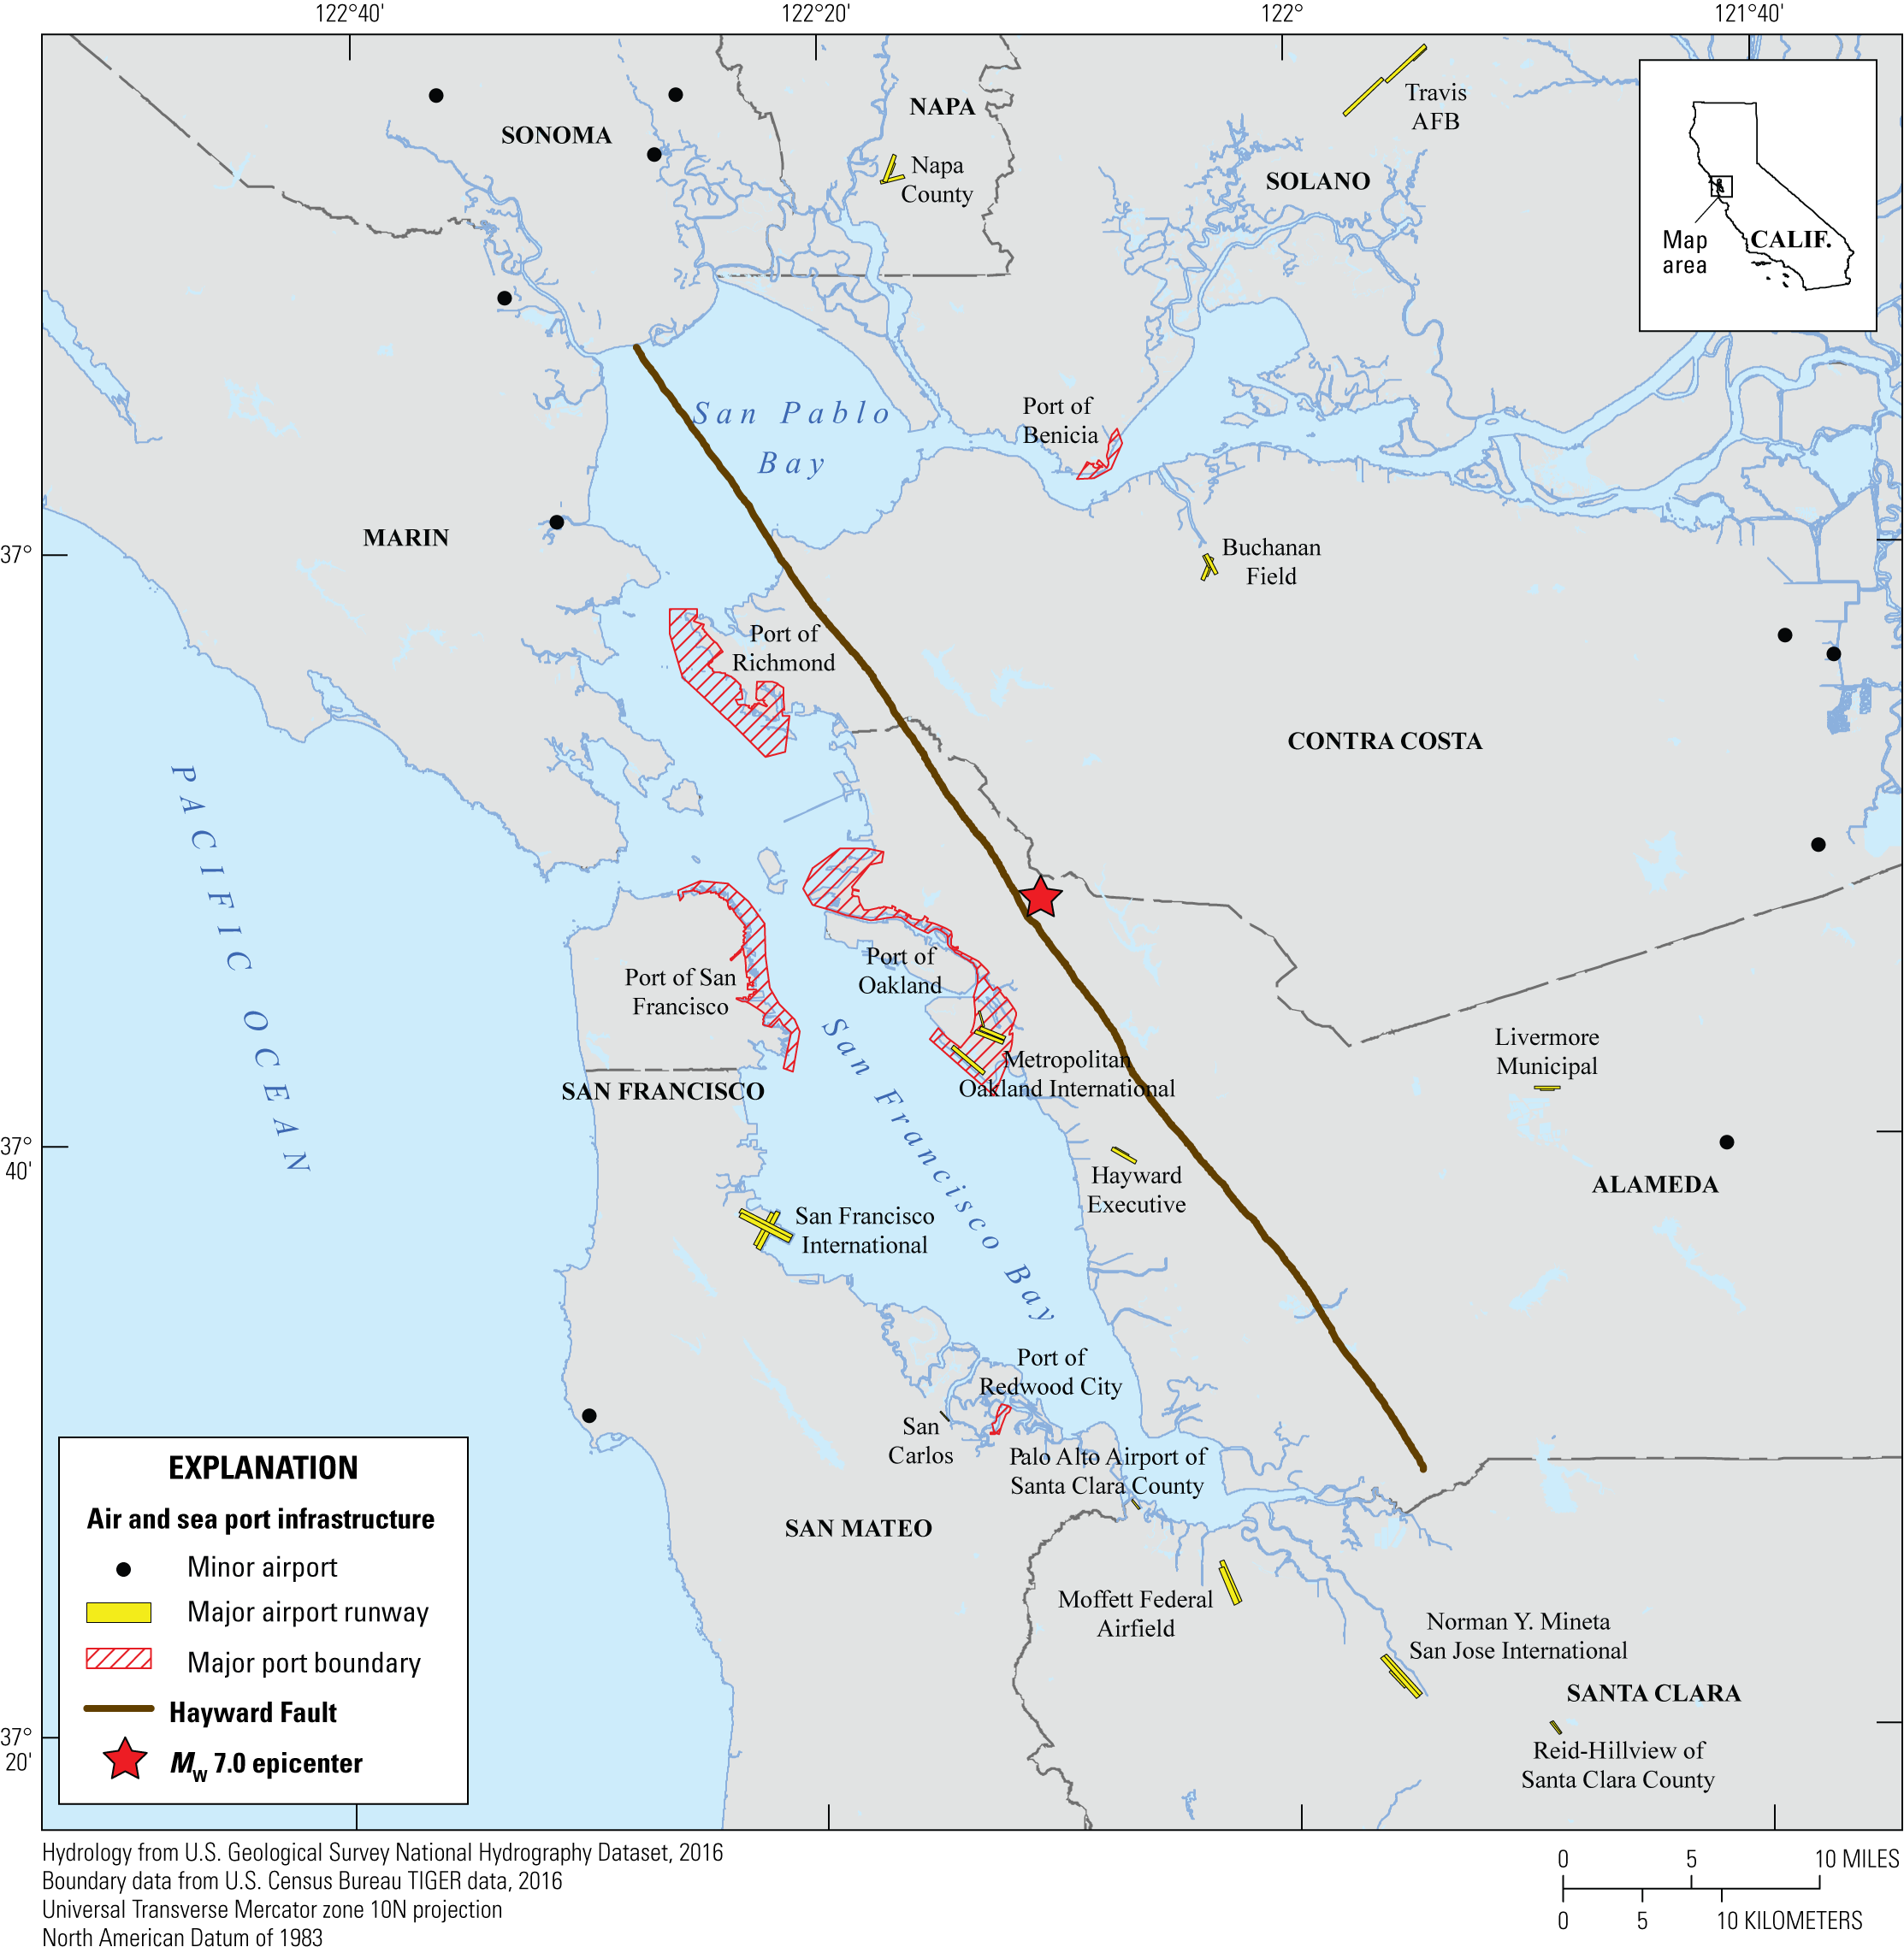
HayWired Scenario
Map showing the locations of air and sea port infrastructure in the Bay Area. Major airports are represented by runways, while minor airports are represented as points. Seaports are shown using full port boundaries. M_{w}, moment magnitude.
HayWired Scenario: Air and Sea Port Infrastructure Map created for HayWired Exercise Toolkit
8

Slide 10
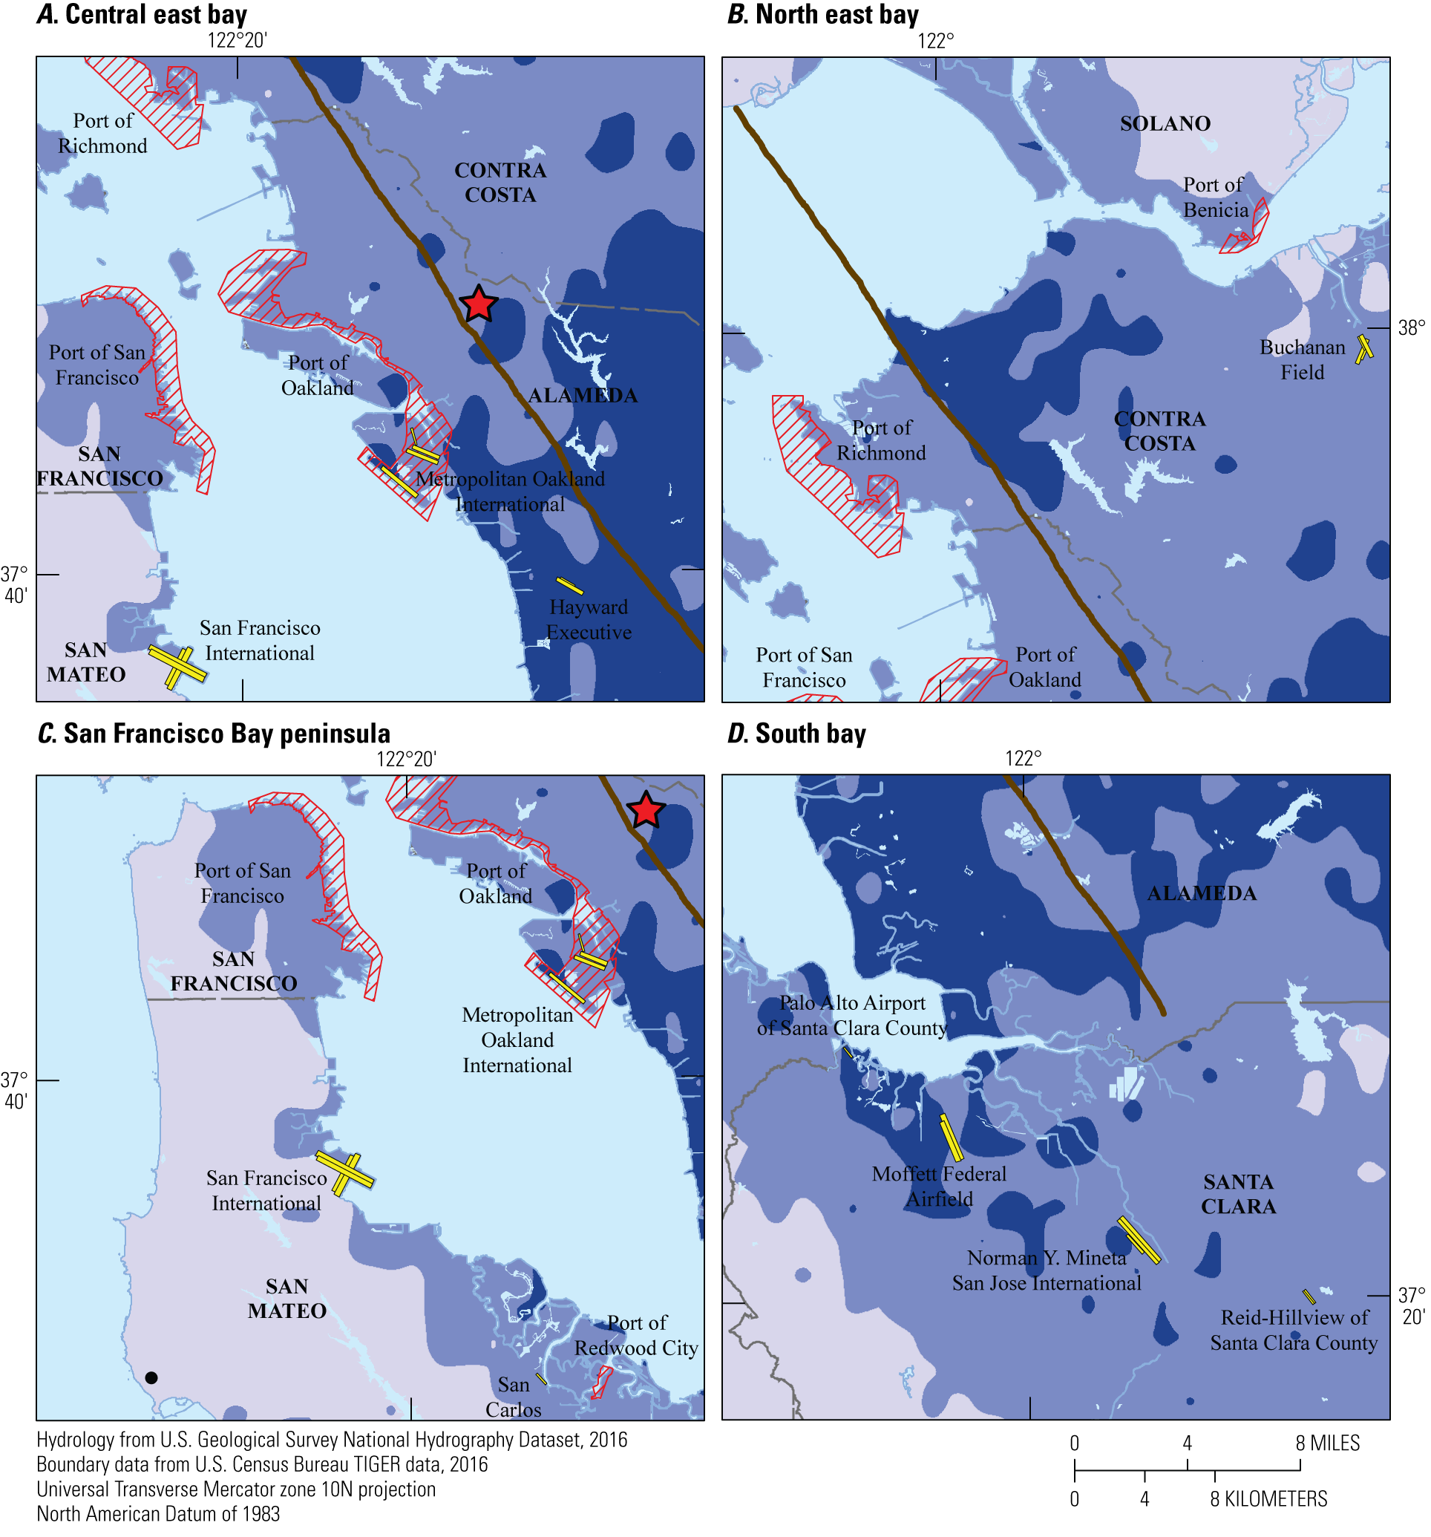
HayWired Scenario
Maps showing the potential impact of HayWired Earthquake Scenario mainshock ground shaking intensity on air and sea port infrastructure.
Description of the 4 maps: A, Central East Bay. B, South Bay. C, San Francisco Bay peninsula. D, North East Bay. M_{w}, moment magnitude.
HayWired Scenario: Ground Shaking on Air and Sea Port Infrastructure Map created for HayWired Exercise Toolkit
9

Slide 11
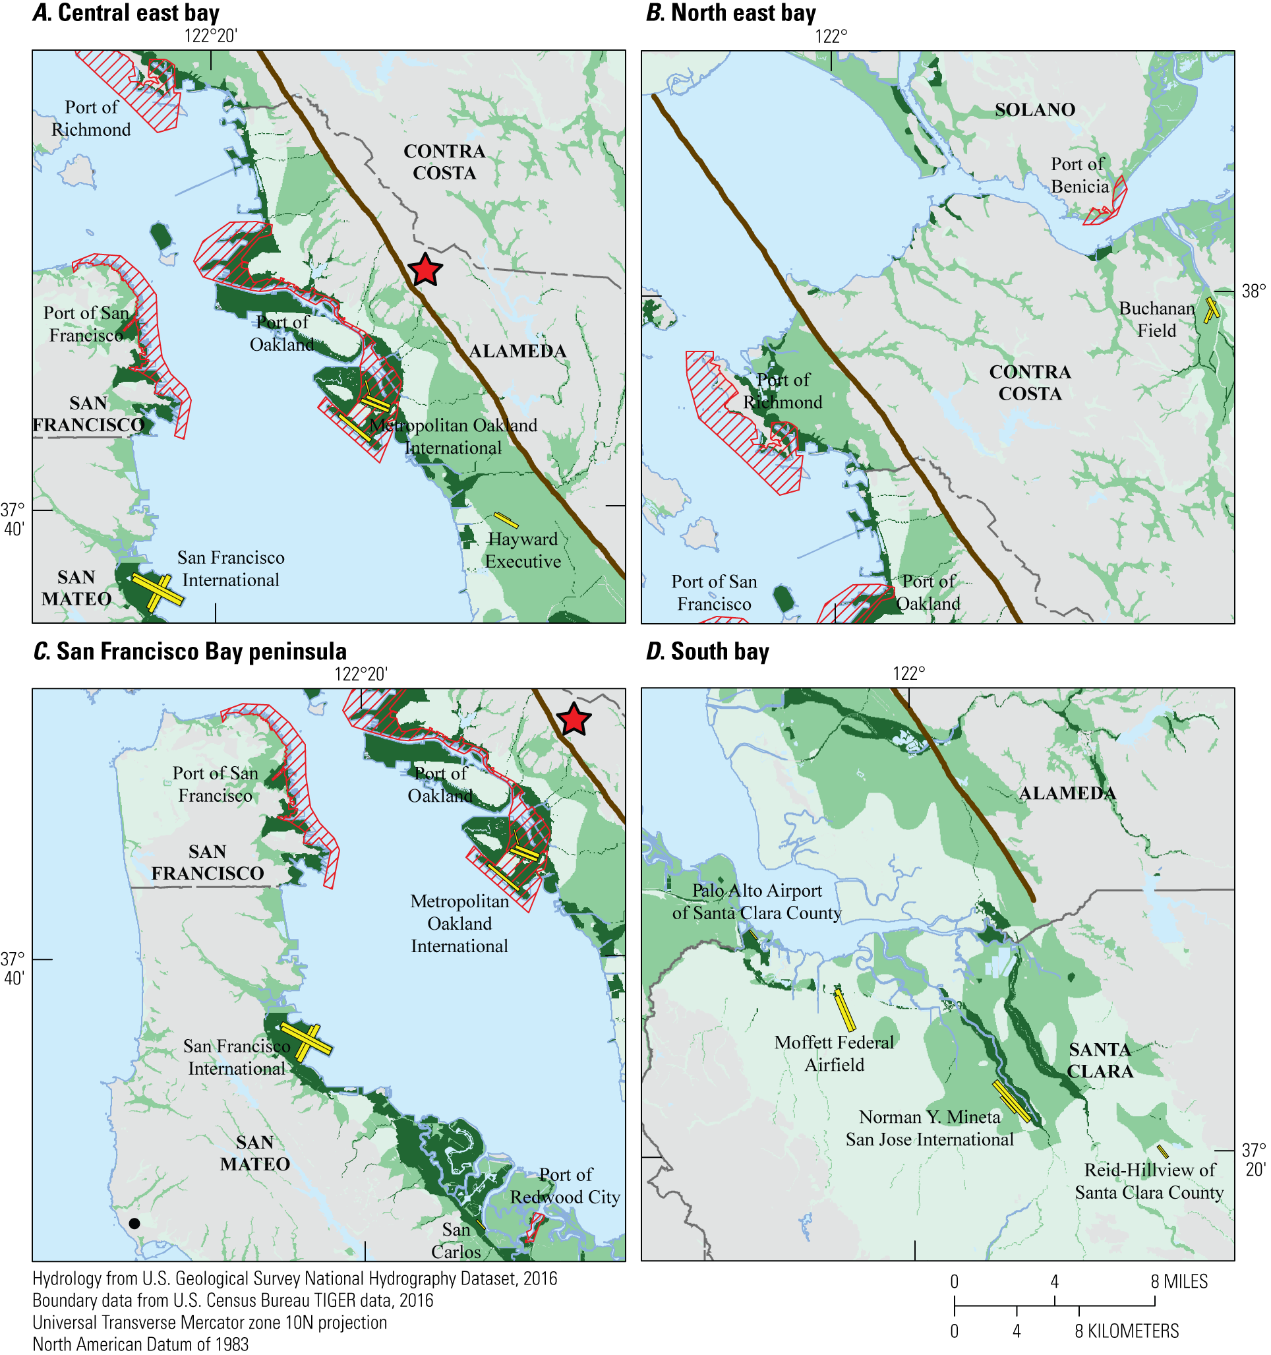
HayWired Scenario
Maps showing the potential impact of HayWired Earthquake Scenario mainshock ground failure intensity on air and sea port infrastructure. Ground failure is represented by liquefaction and landslides.
Description of the 4 maps: A, Central East Bay. B, South Bay. C, San Francisco Bay peninsula. D, North East Bay. M_{w}, moment magnitude.
HayWired Scenario: Ground Failure Air and Sea Port Infrastructure Map created for HayWired Exercise Toolkit
10

