Slide 2
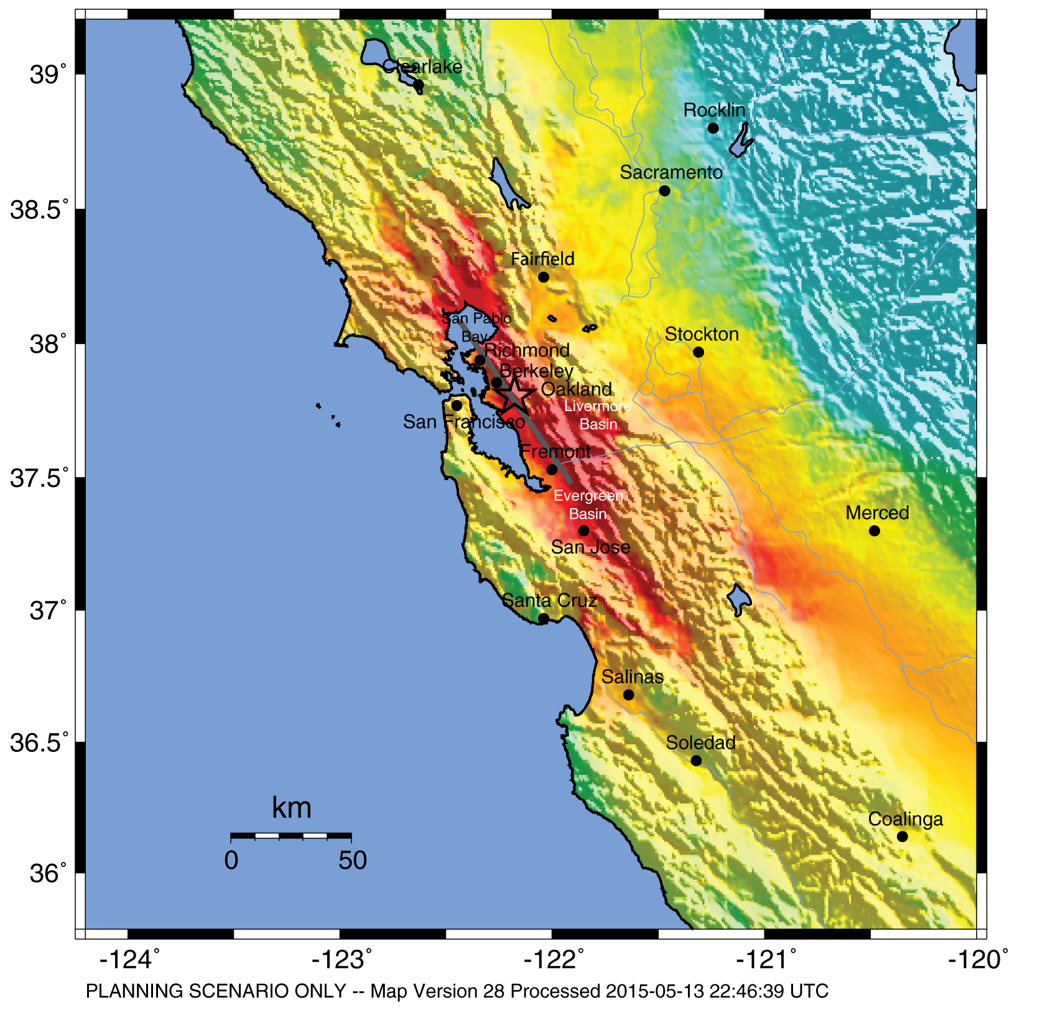
HayWired Scenario
U.S. Geological Survey ShakeMap of the HayWired Earthquake Scenario’s hypothetical magnitude 7.0 mainshock.
HayWired Scenario Volume 1: Chapter A, Figure 4
1

Slide 3
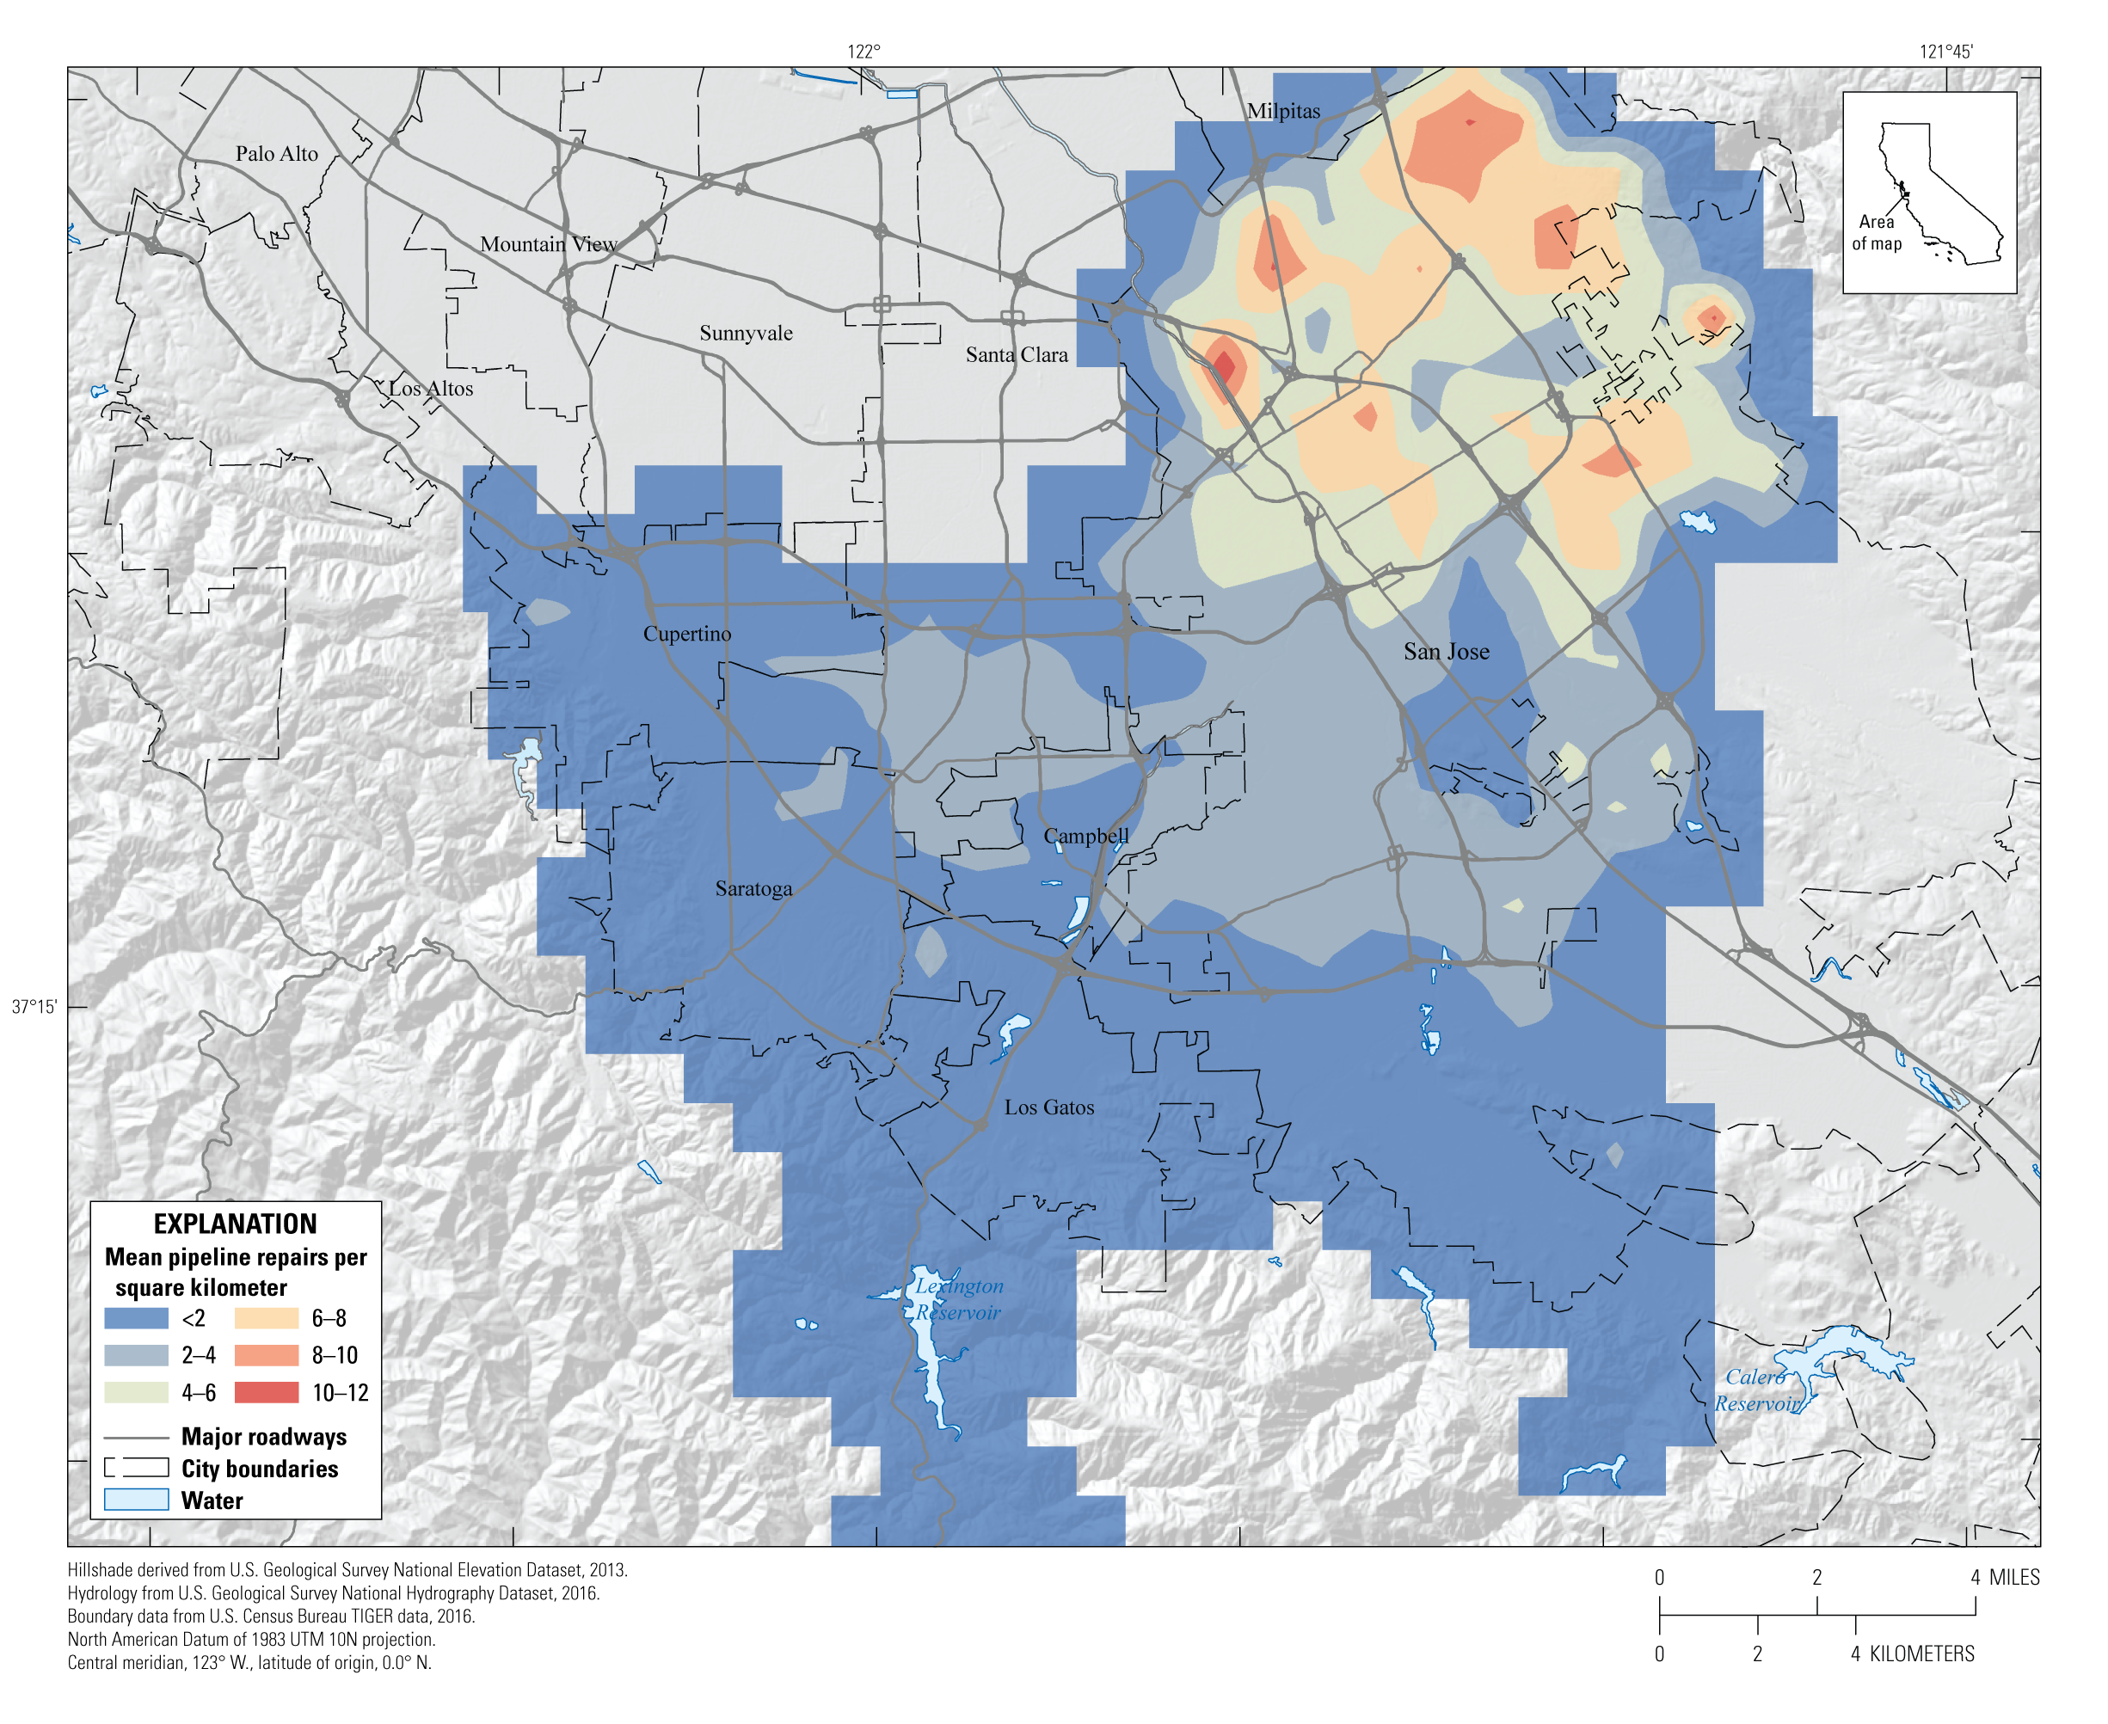
HayWired Scenario
Map of buried water-pipeline damage in San Jose Water Company’s service area for the hypothetical magnitude 7.0 mainshock of the HayWired Earthquake Scenario. Colors indicate mean (average) repairs (breaks and leaks) per square kilometer. A warmer color indicates greater concentration of damage.
HayWired Scenario Volume 2: Chapter N, Figure 19
2

Slide 4
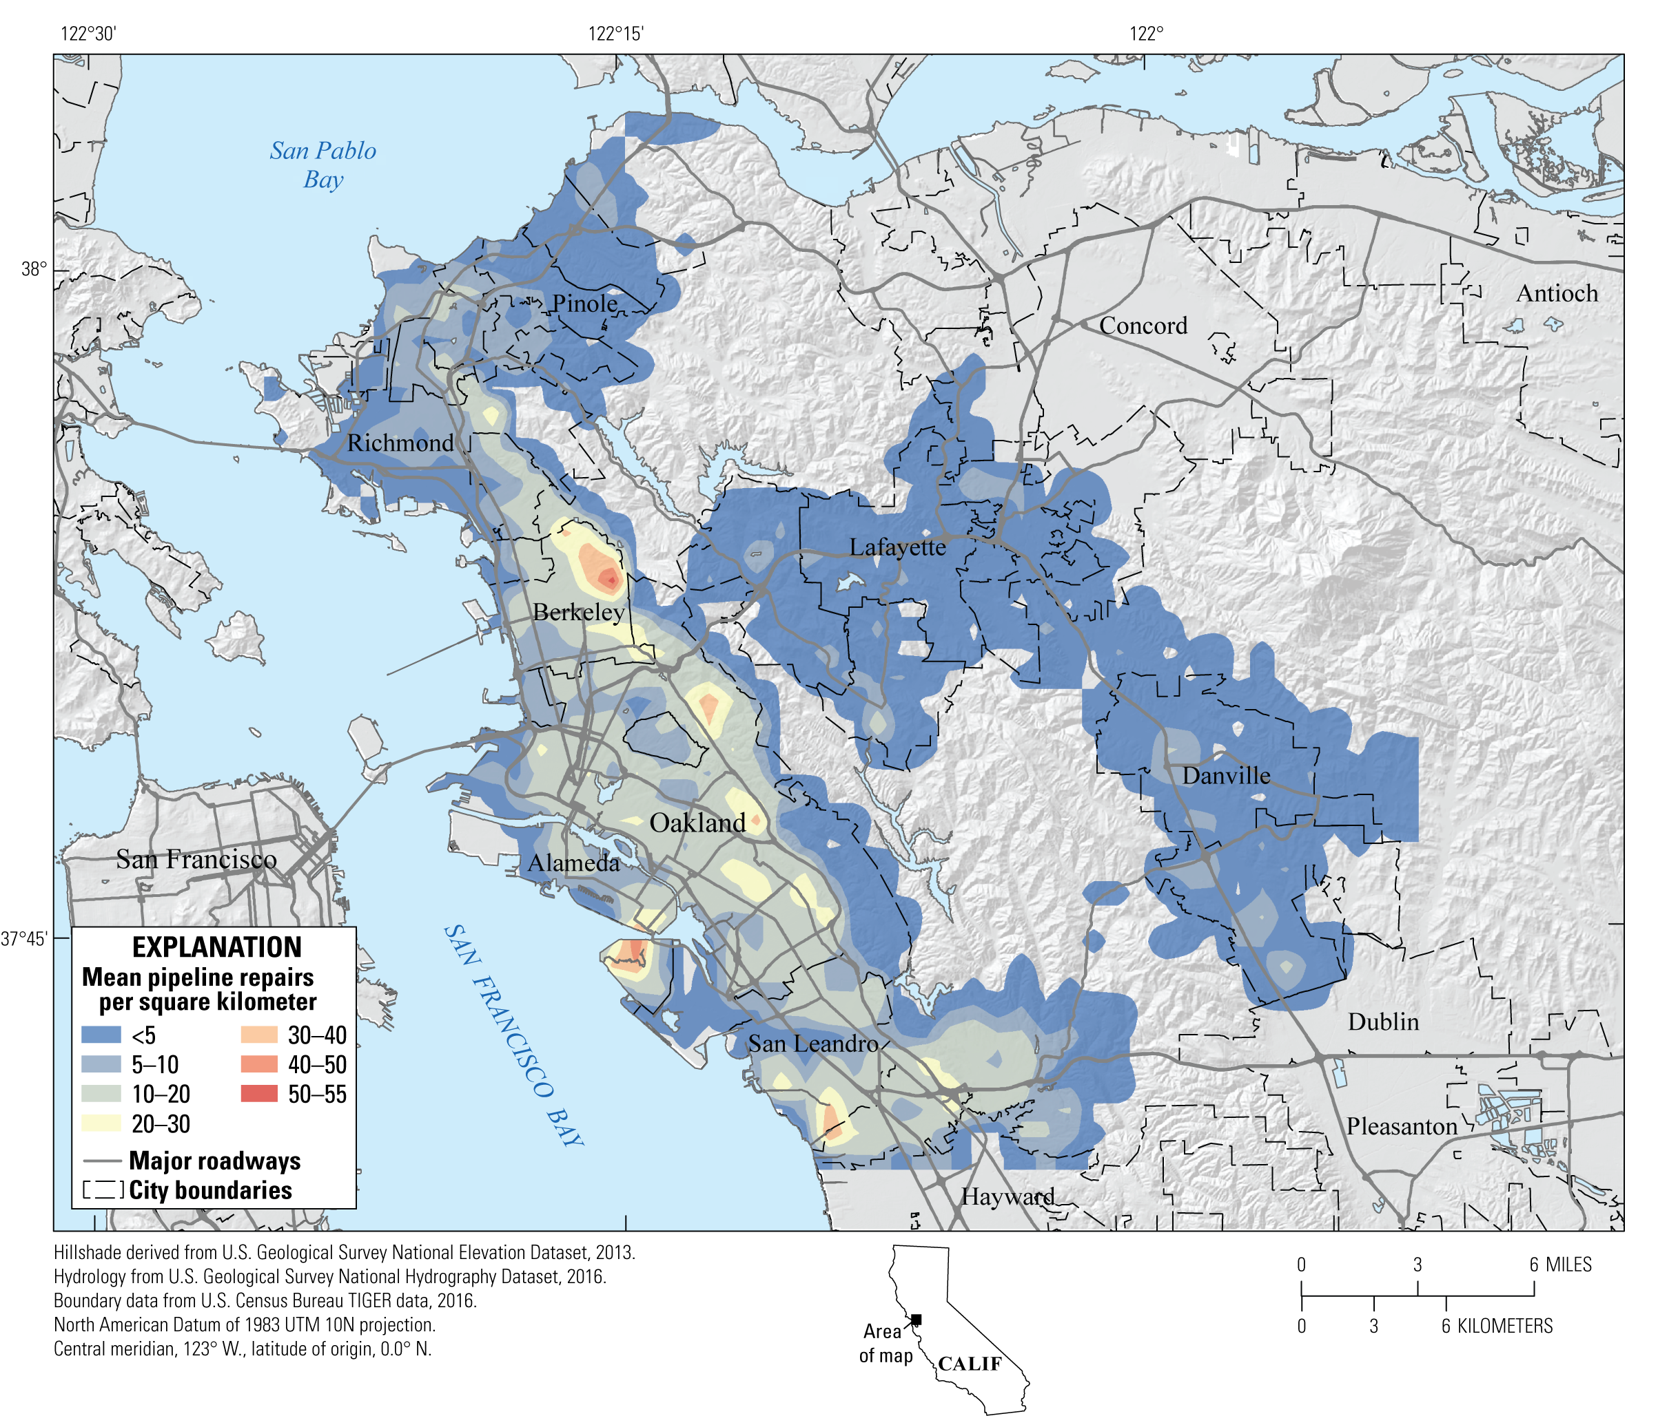
HayWired Scenario
Map of buried water-pipeline damage in East Bay Municipal Utility District’s service area for the entire HayWired Earthquake Scenario sequence including the magnitude 5.0 and above aftershocks. Colors indicate mean (average) repairs per square kilometer. A warmer color indicates greater concentration of damage.
HayWired Scenario Volume 2: Chapter N, Figure 36
3

Slide 5
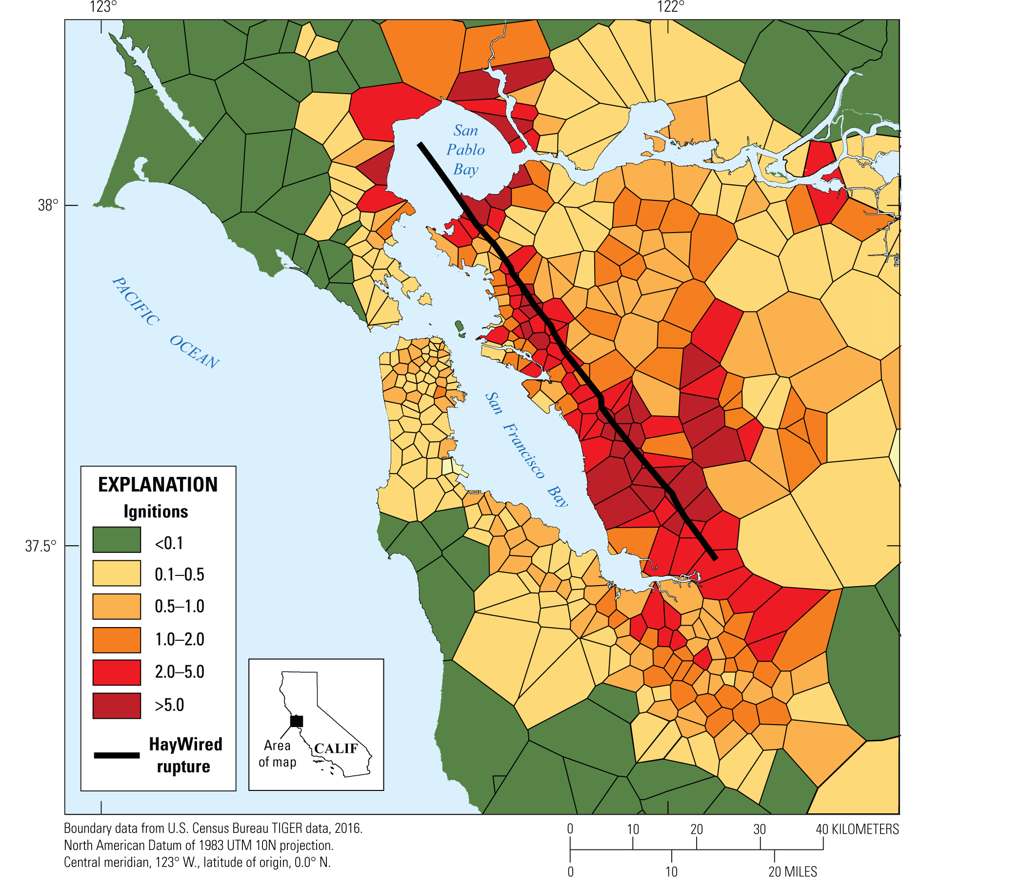
HayWired Scenario
Map showing estimated number of ignitions within fire
station primary response areas following the magnitude
7.0 mainshock of the HayWired Earthquake Scenario. Green indicates a small likelihood of ignition and dark red indicates five or more ignitions per area. The length of the Hayward Fault ruptured in the Scenario is shown on the map.
HayWired Scenario Volume 2: Chapter P, Figure 19
4

Slide 6
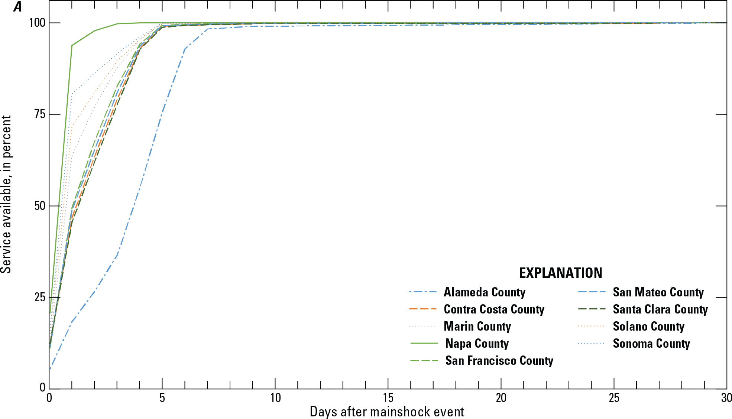
HayWired Scenario
Line graphs showing voice and data restoration curves by county for the HayWired Earthquake Scenario mainshock.
These curves include the following assumptions: use of batteries and/or generators, deployment of portable equipment (including cells on wheels [COWs] and cells on
light truck [COLTs]), and management of user behavior. Demand surge impacts are included in the estimation.
HayWired Scenario Volume 3: Chapter S, Figure 24A
5

Slide 7
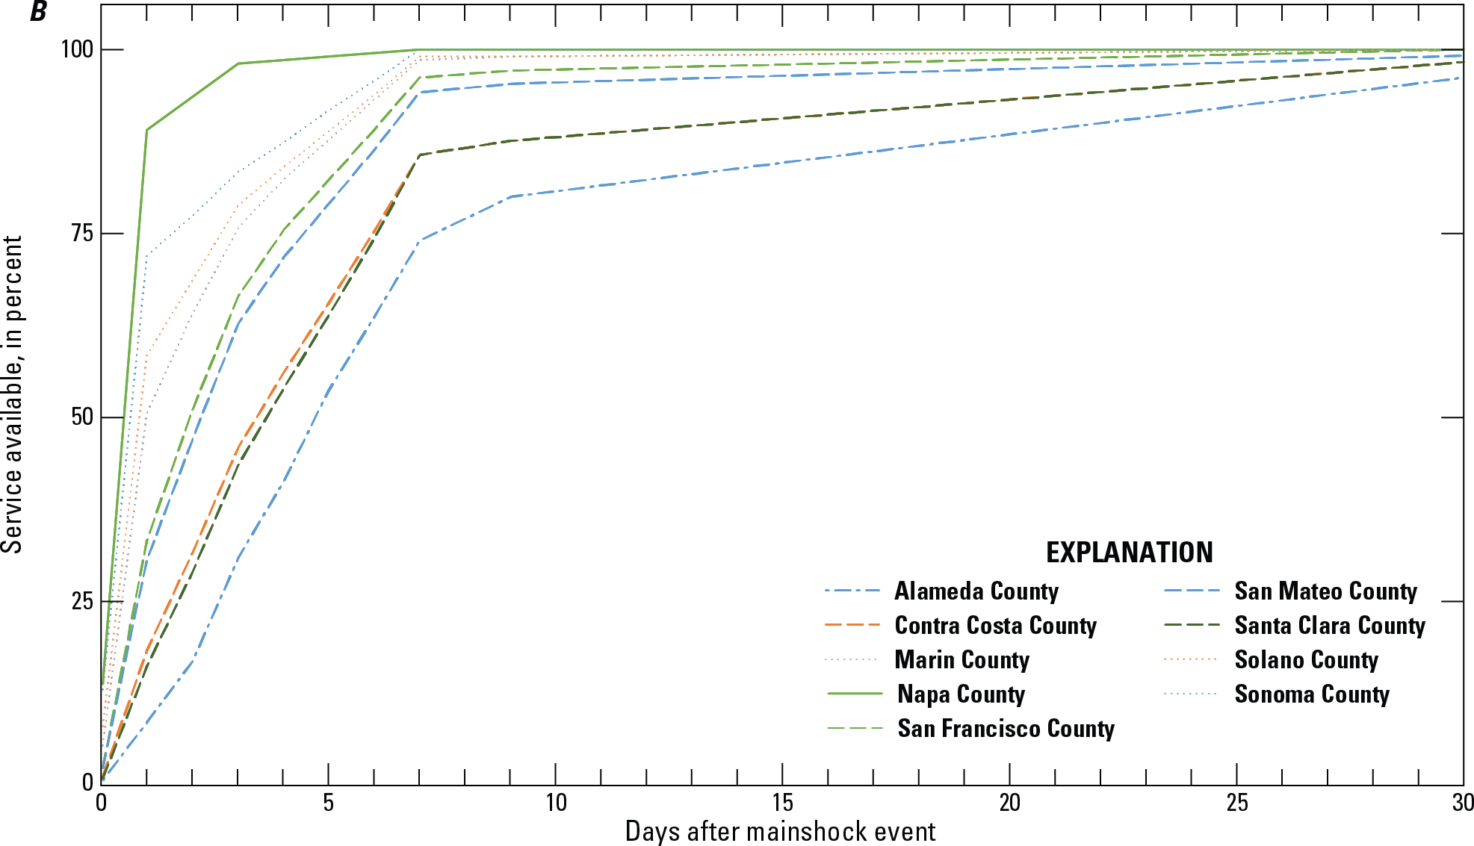
HayWired Scenario
Line graphs showing voice and data restoration curves by county for the HayWired Earthquake Scenario mainshock. The curves are based on system restoration dependent
on electric power restoration without the use of batteries and/or generators, deployment of portable equipment (including cells on wheels [COWs] and cells on
light truck [COLTs]), and management of user behavior.
HayWired Scenario Volume 3: Chapter S, Figure 24B
6

Slide 8
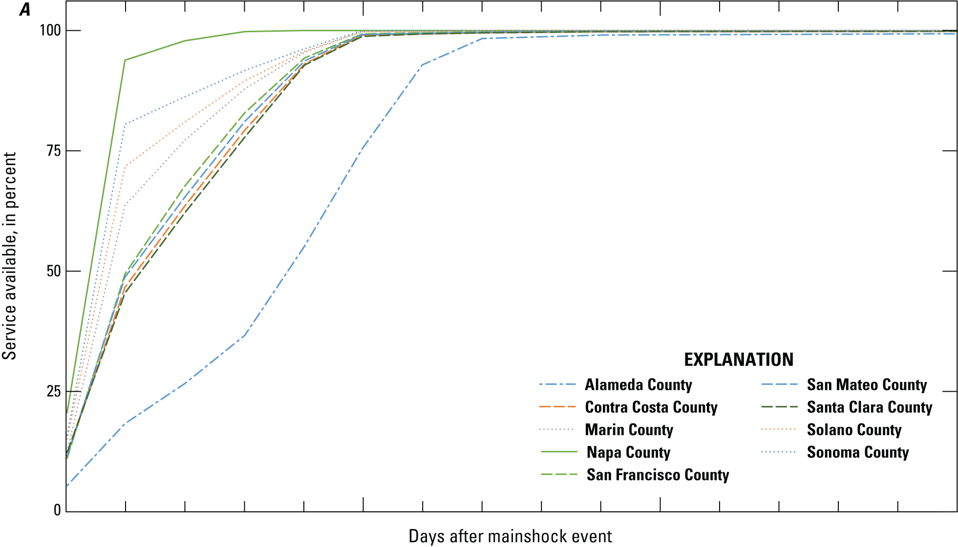
HayWired Scenario
Line graphs showing voice and data restoration curves by county for the HayWired Earthquake Scenario mainshock.
These curves include the following assumptions: use of batteries and/or generators, deployment of portable equipment (including cells on wheels [COWs] and cells on
light truck [COLTs]), and management of user behavior. Demand surge impacts are included in the estimation.
HayWired Scenario Exercise Toolkit: Telecommunications Restoration Curves, A
7

Slide 9
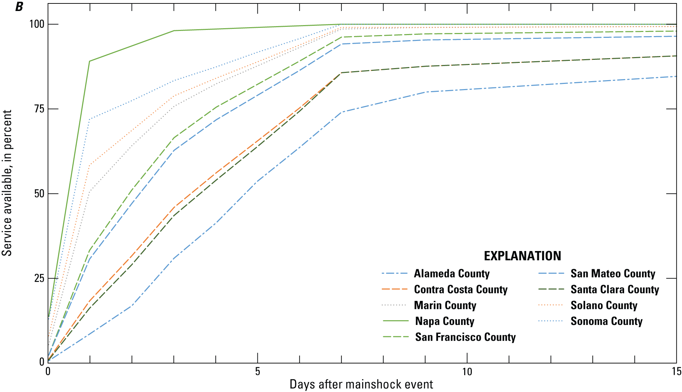
HayWired Scenario
Line graphs showing voice and data restoration curves by county for the HayWired Earthquake Scenario mainshock. The curves are based on system restoration dependent
on electric power restoration without the use of batteries and/or generators, deployment of portable equipment (including cells on wheels [COWs] and cells on
light truck [COLTs]), and management of user behavior.
HayWired Scenario Exercise Toolkit: Telecommunications Restoration Curves, B
8

Slide 10
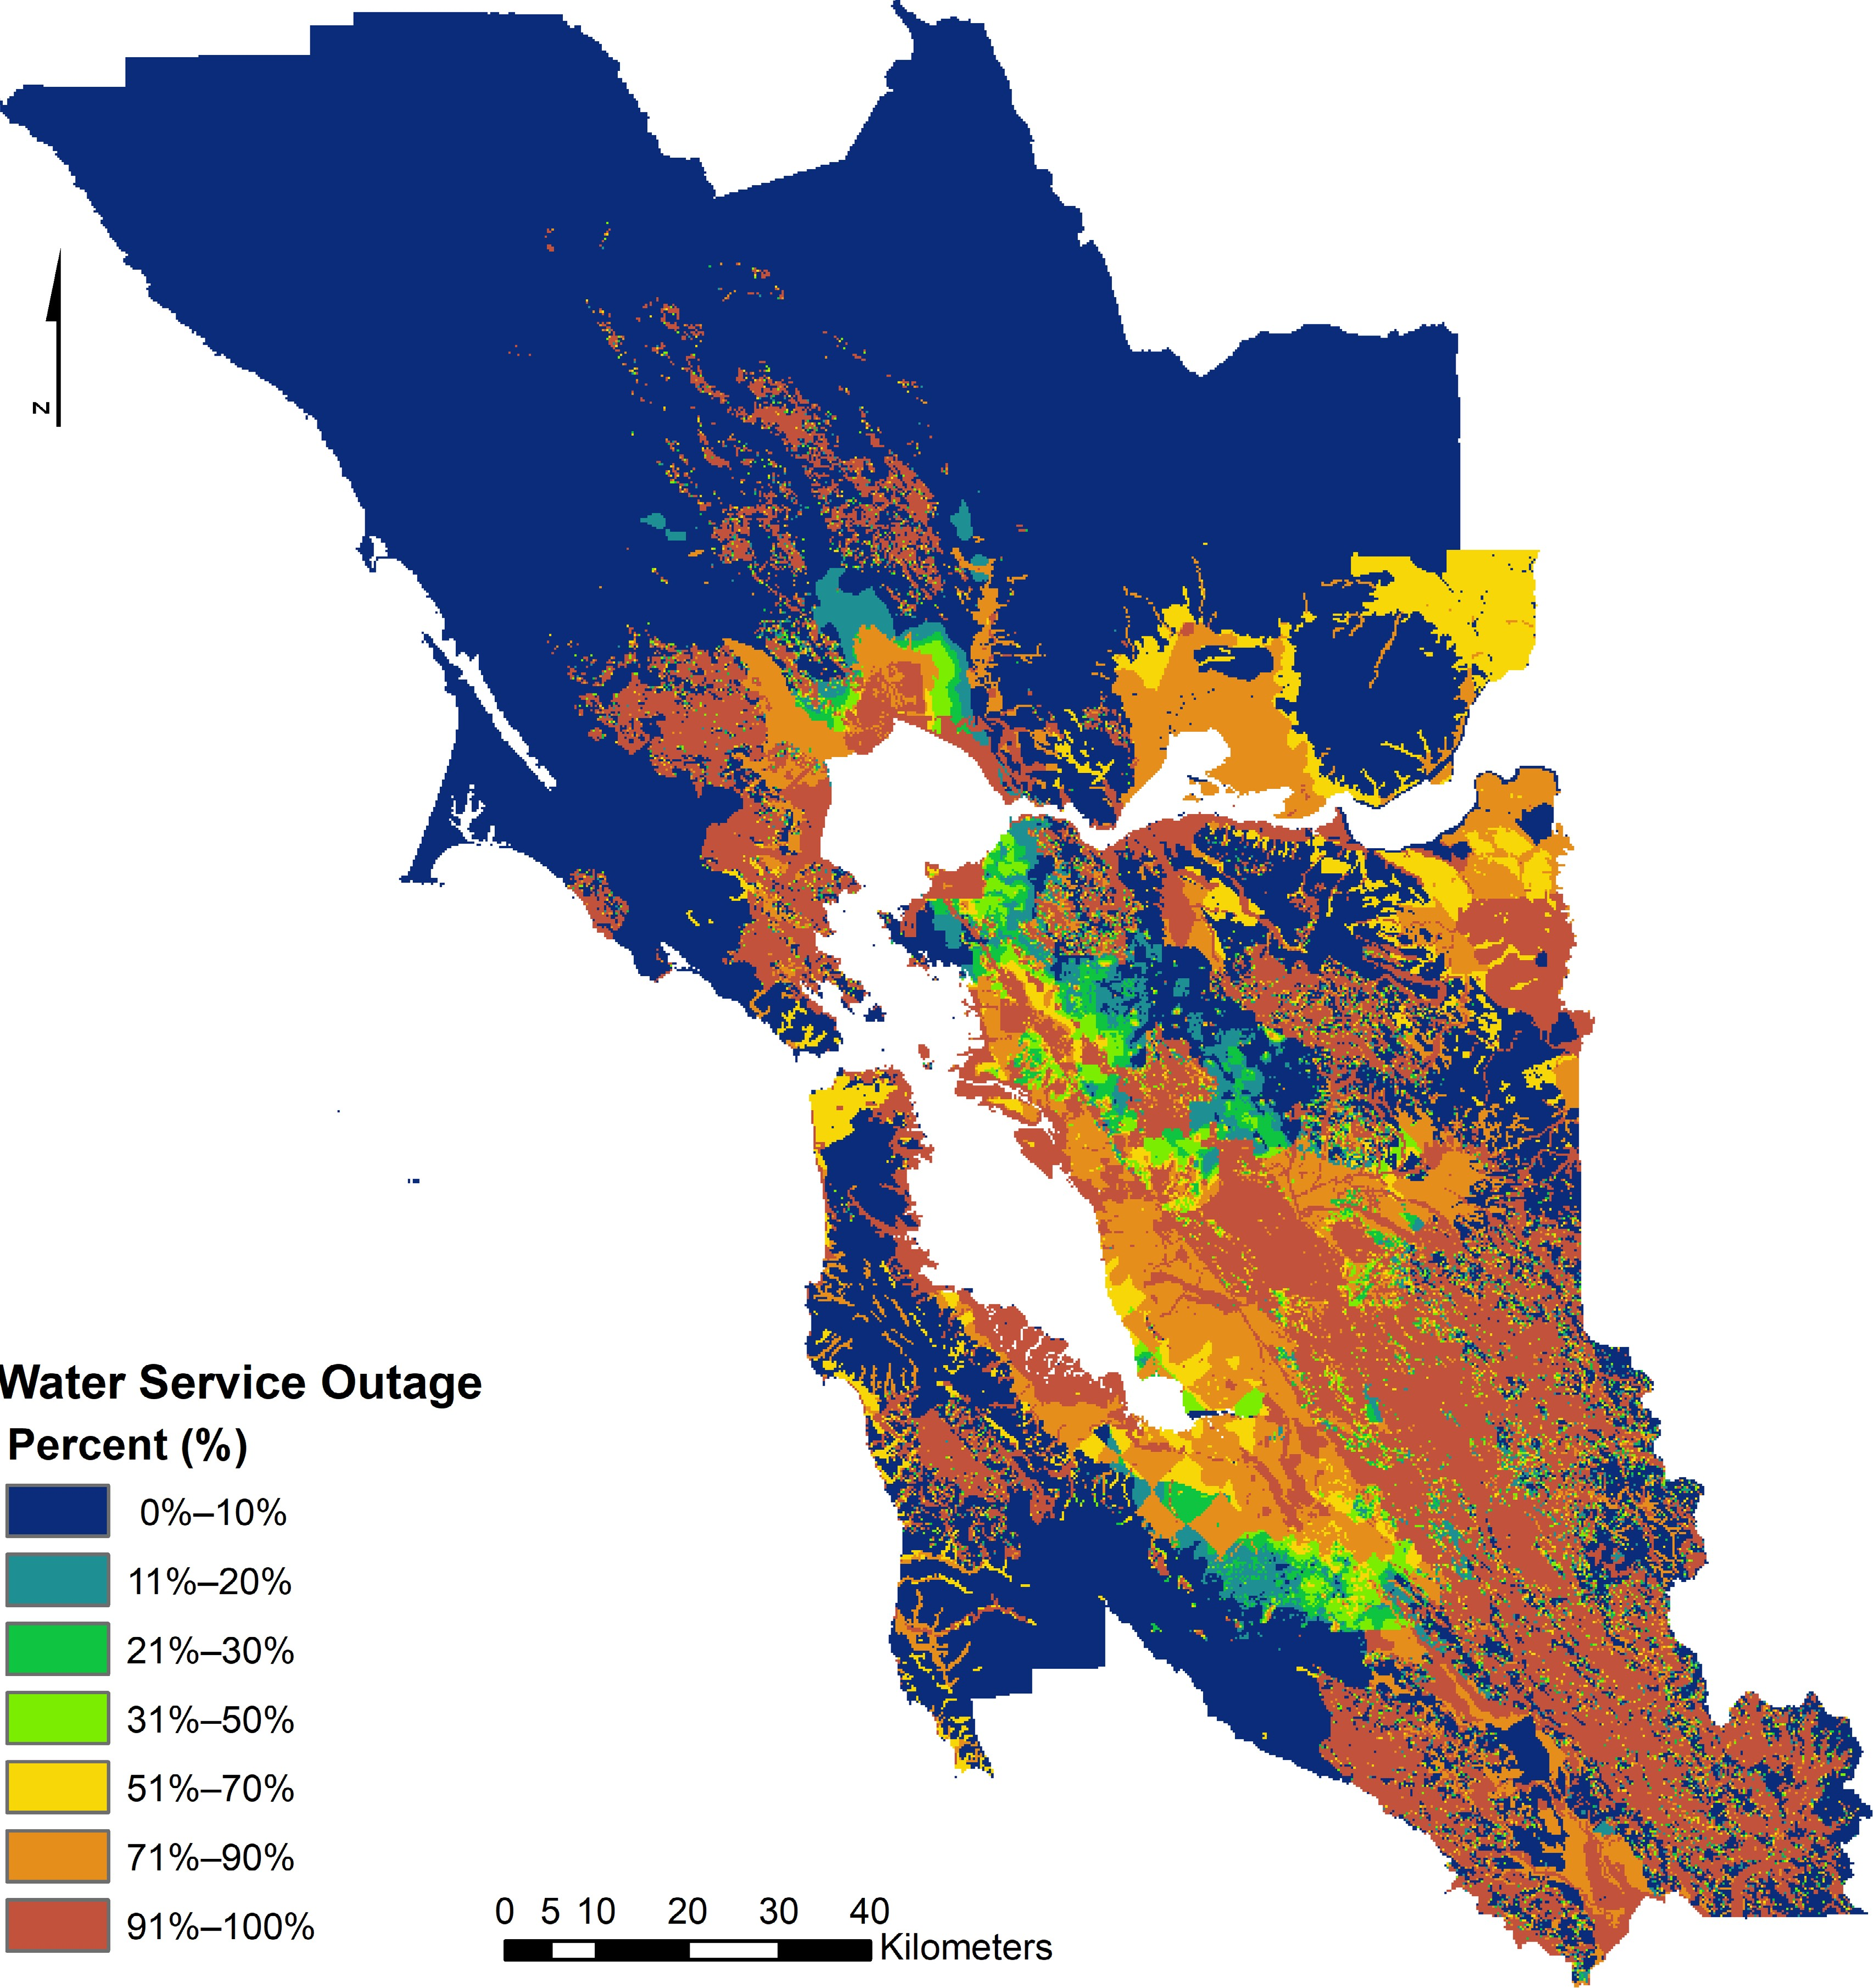
HayWired Scenario
Estimation of the percentage of portable water supply outages for the hypothetical magnitude 7.0 mainshock of the HayWired Earthquake Scenario. Calculated in 250-meter grid cells.
Toland and Wein, 2022: Water Service Outage Map
9

