Slide 2
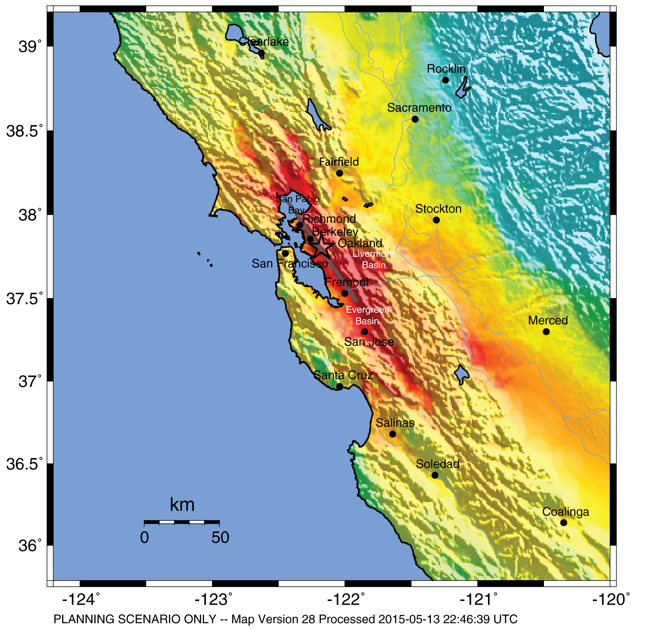
HayWired Scenario
U.S. Geological Survey ShakeMap of the HayWired Earthquake Scenario’s hypothetical magnitude 7.0 mainshock.
HayWired Scenario Volume 1: Chapter A, Figure 4
1

Slide 3
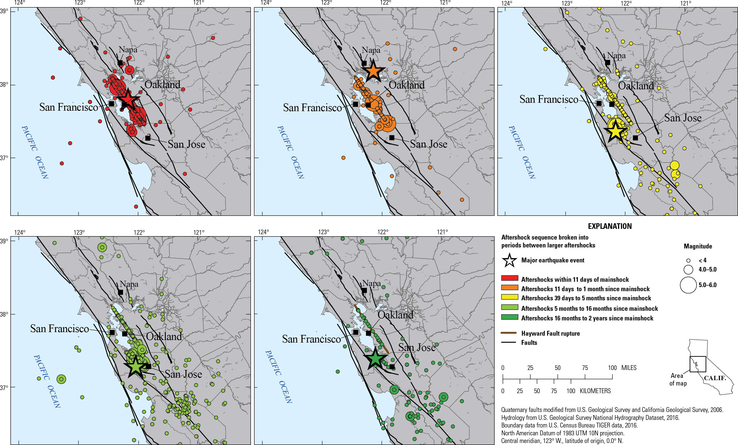
HayWired Scenario
Maps showing the HayWired Earthquake Scenario aftershock sequences within different time periods.
<, less than.
HayWired Scenario Volume 1: Chapter G, Figure 6
2

Slide 4
HayWired Scenario
Estimated building-restoration delays due to utility disruption following the hypothetical magnitude 7.0 mainshock of the HayWired Earthquake Scenario.
Utility | San Francisco |  | Oakland
 | 50% Restoration | Tail restoration | 50% Restoration | Tail Restoration
Water | 3 days | 100 percent at 7 days | 30 days | 100 percent at 90 days
Natural gas | ~9 days | 90 percent at ~33 days | ~10 days | 90 percent at ~36 days
Electricity | 1 day | 99.5 percent at 30 days | 2 days | 96 percent at 30 days
Voice/data | 5 days | 100 percent at 7 days | 7 days | 100 percent at 30 days
HayWired Scenario Volume 2: Chapter O, Tables 6 and 7
3

Slide 5
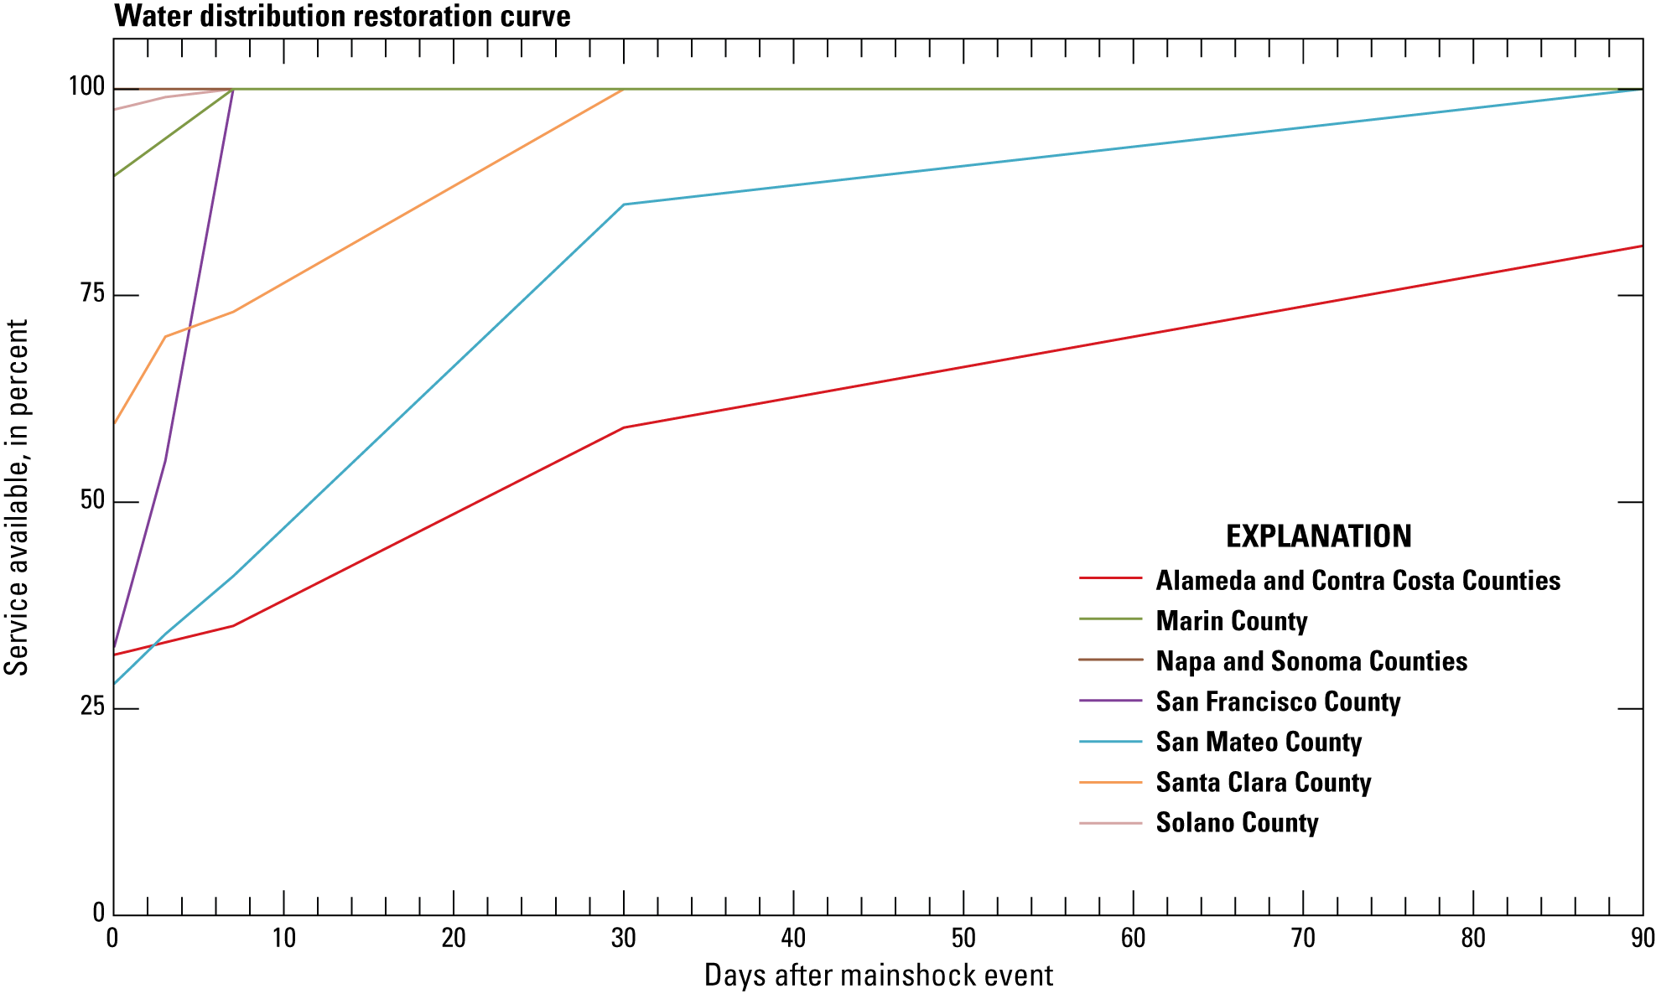
HayWired Scenario
Line graph showing the water distribution restoration curve by county for the HayWired Earthquake Scenario mainshock.
HayWired Scenario Volume 3: Chapter T, Figure 17
4

Slide 6
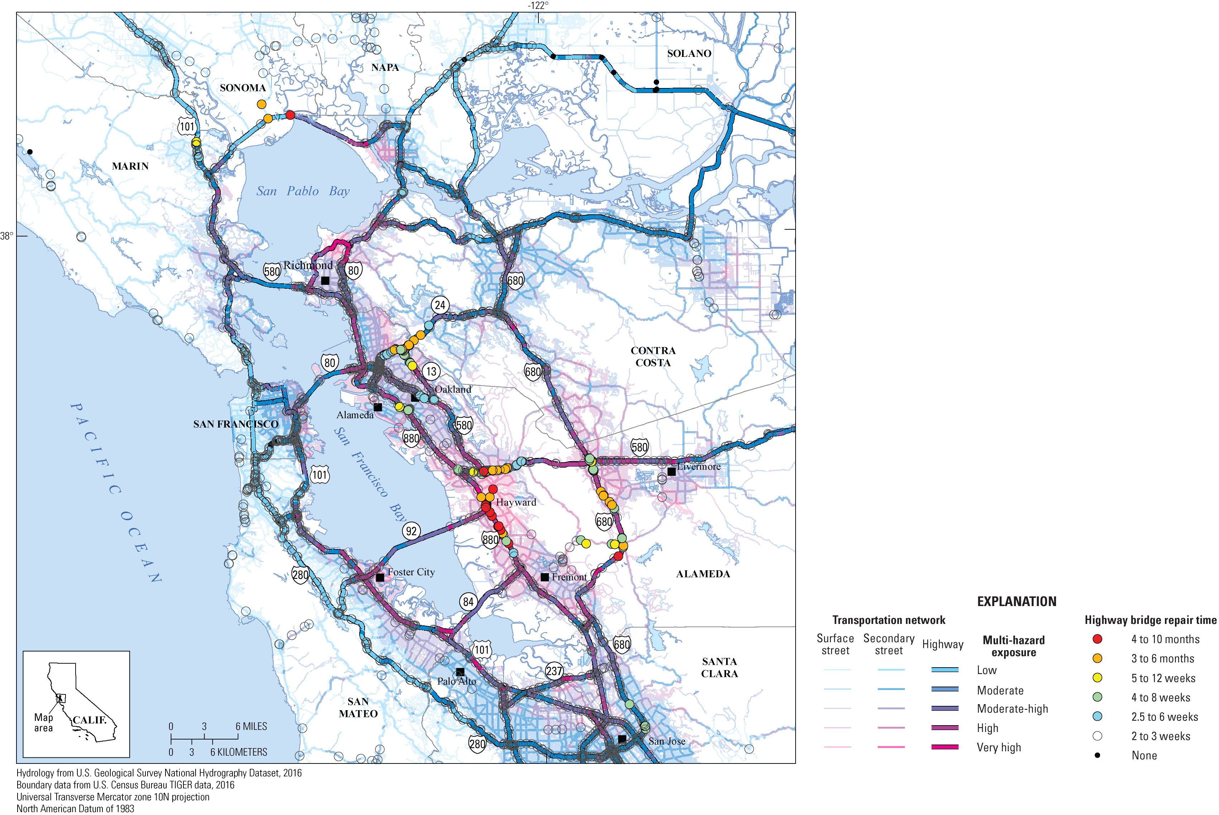
HayWired Scenario
Map showing repair times for highway bridges as determined by the California Department of Transportation relative to multi-hazard exposure in the HayWired Earthquake Scenario.
HayWired Scenario Volume 3: Chapter T, Appendix 5, Figure 4
5

Slide 7
Estimated building-restoration delays following the magnitude 7.0 mainshock of the HayWired Earthquake Scenario.
HayWired Scenario
Residential dwelling type | Hazus damage state
 | Slight | Moderate | Extensive | Complete
Structural and nonstructural repair cost ratios (percentage of building replacement cost)
Single family (RES1) | 2 | 10 | 44.7 | 100
Duplex (RES3A) | 2 | 10 | 41.3 | 100
Multifamily (RES3B–F) | 2 | 10 | 41.3 | 100
Median time for building repair and return to function (number of days)
Single family (RES1) | 2–5 | 30–120 | 90–360 | 180–720
Duplex (RES3A) | 5–10 | 30–120 | 120–480 | 240–960
Multifamily (RES3B–F) | 5–10 | 30–120 | 120–480 | 240–960
[Codes in parentheses are Hazus occupancy classes. Single-family and duplex dwellings are listed separately since Hazus assigns the same repair cost ratios and recovery times to duplexes as it does to other multifamily dwellings. Data from Federal Emergency Management Agency (2012)]
HayWired Scenario Volume 3: Chapter U, Table A1
6

Slide 8
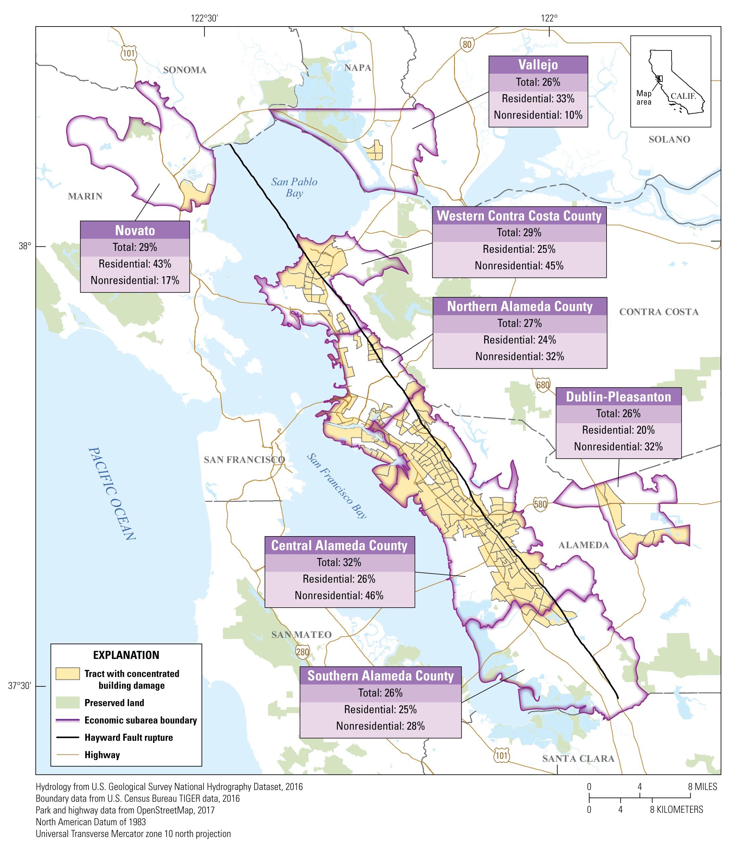
HayWired Scenario
Map showing areas of concentrated damage in economic subareas as a result of hazards caused by the HayWired Earthquake Scenario mainshock. Areas of concentrated damage are defined as census tracts with 20% or more of the total building square footage in extensive or complete damage from ground shaking, liquefaction, landslide, and fire damages. For each economic subarea, the percentage of residential, nonresidential, and total building square footage in an extensive or complete damage state from the integrated damages are also provided.
HayWired Scenario Volume 3: Chapter U, Figure 4
7

Slide 9
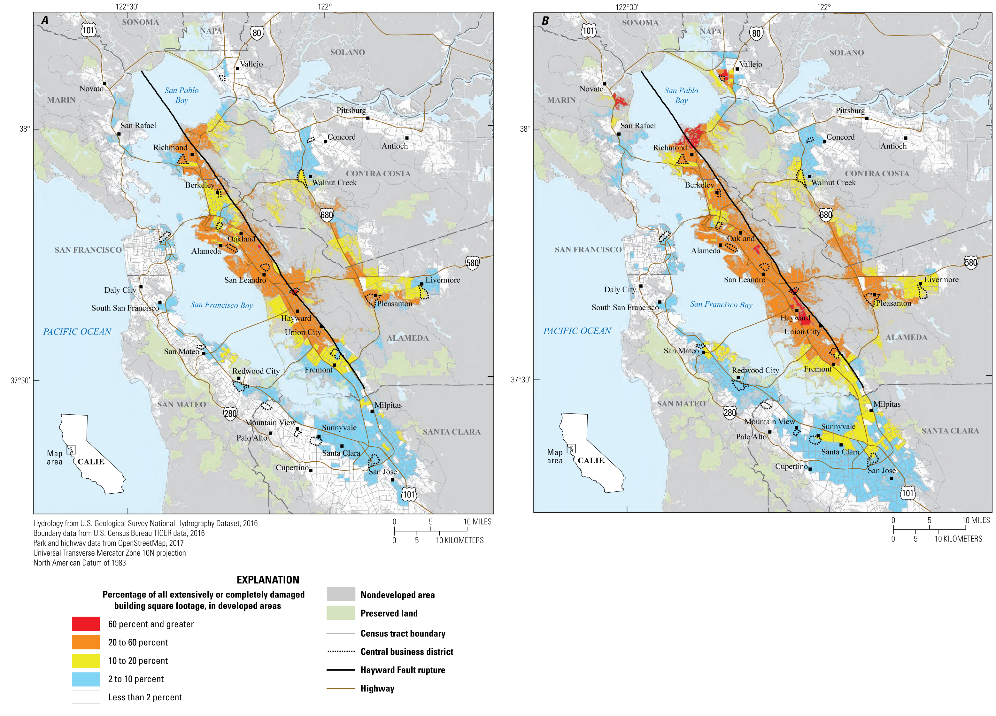
HayWired Scenario
Maps showing census tracts with concentrations of building damage for multifamily dwellings in the HayWired Earthquake Scenario
mainshock. Multifamily dwellings that have three or more housing units per structure. Descriptions of the 2 maps: A, Shaking, landslide, and liquefaction hazards only (without fire). B, Shaking, landslide, liquefaction, and fire hazards.
HayWired Scenario Volume 3: Chapter U, Figure A3
8

Slide 10
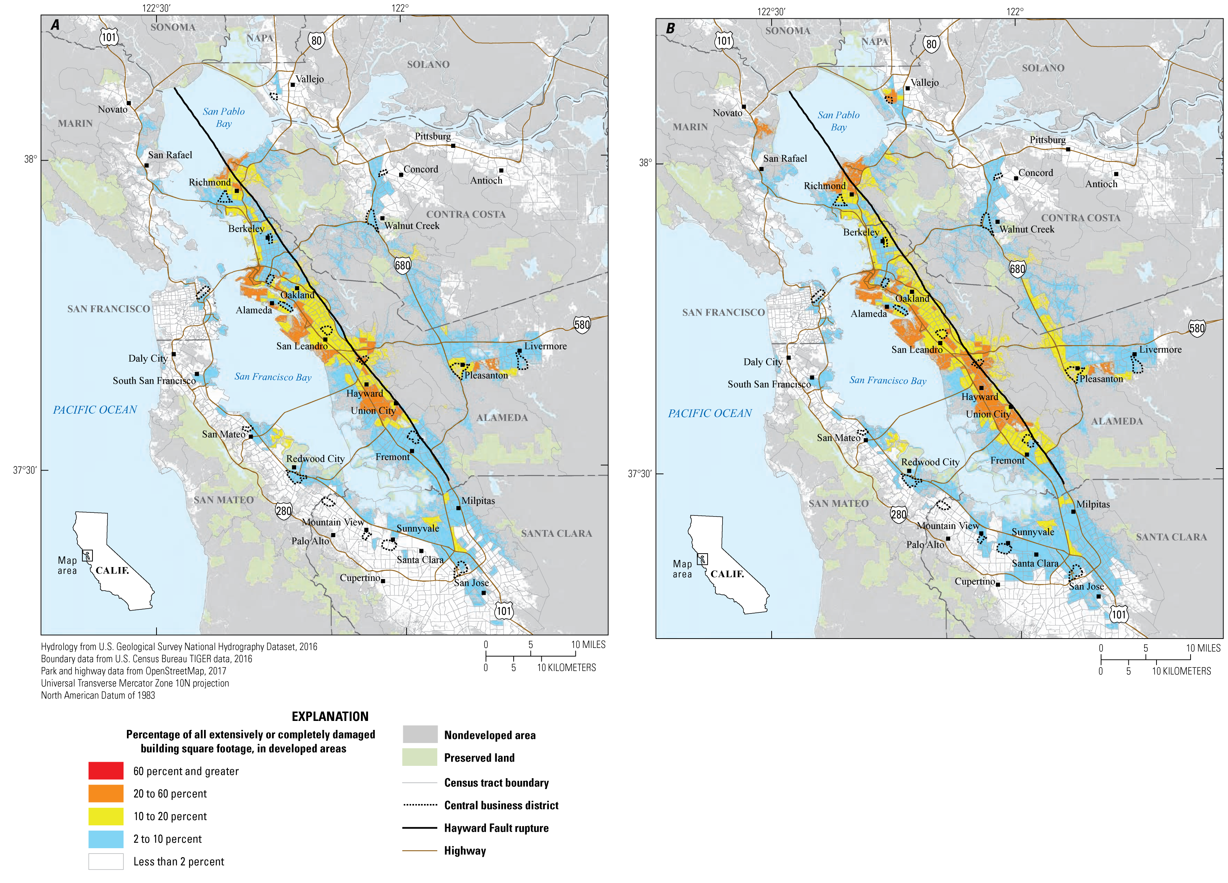
HayWired Scenario
Maps showing census tracts with concentrations of building damage for single-family and duplex dwellings in the HayWired
Earthquake Scenario mainshock. Descriptions of the 2 maps:
A, Shaking, landslide, and liquefaction hazards only (without fire). B, Shaking, landslide, liquefaction, and fire hazards.
HayWired Scenario Volume 3: Chapter U, Figure A4
9

Slide 11
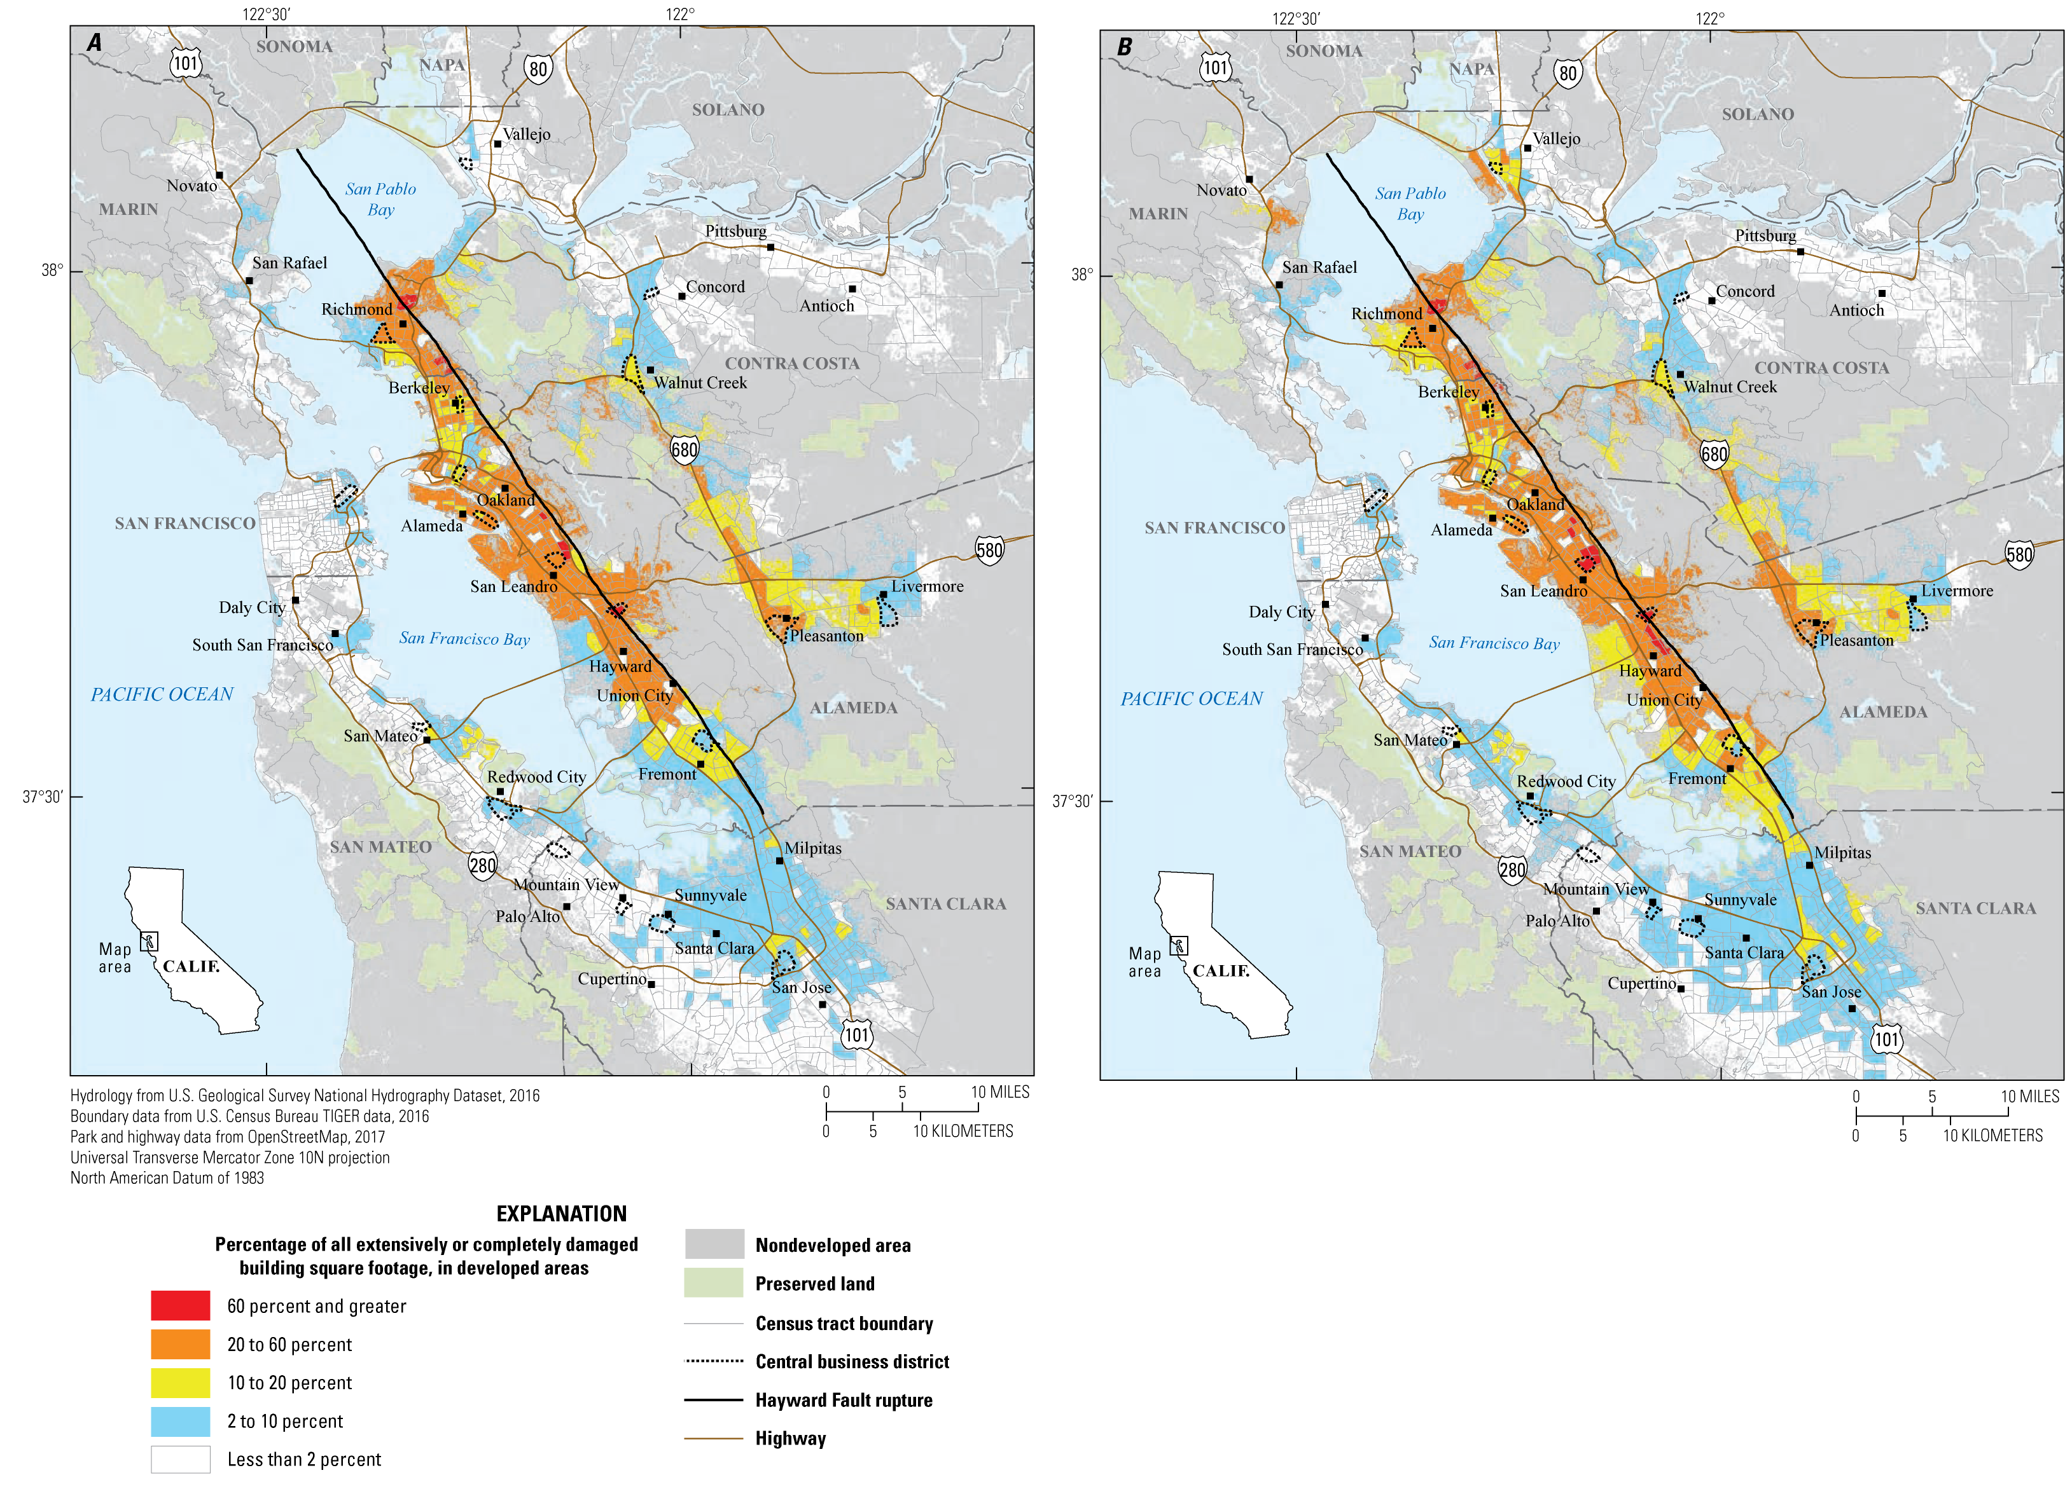
HayWired Scenario
Maps showing census tracts with concentrations of damage to household- serving uses (for example, hospitals, schools, and places of worship) in the HayWired Earthquake Scenario mainshock. Descriptions of the 2 maps: A, Shaking, landslide, and liquefaction hazards only (without fire). B, Shaking, landslide, liquefaction, and fire hazards.
HayWired Scenario Volume 3: Chapter U, Figure A6
10

Slide 12
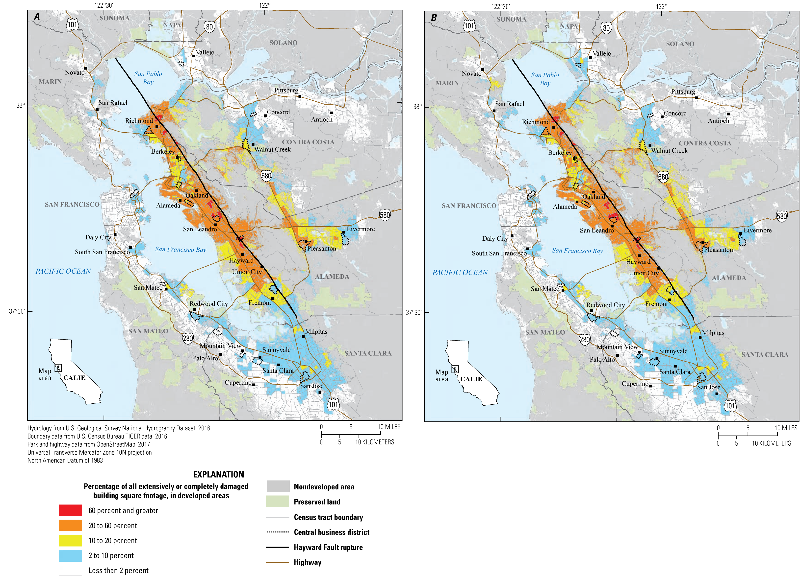
HayWired Scenario
Maps showing census tracts with concentrations of building damage to retail and commercial uses (for example, hotels, retail trade, banks, entertainment and recreation, and parking)
in the HayWired Earthquake Scenario mainshock.
Descriptions of the 2 maps: A, Shaking, landslide, and liquefaction hazards only (without fire). B, Shaking,
landslide, liquefaction, and fire
hazards.
HayWired Scenario Volume 3: Chapter U, Figure A7
11

Slide 13
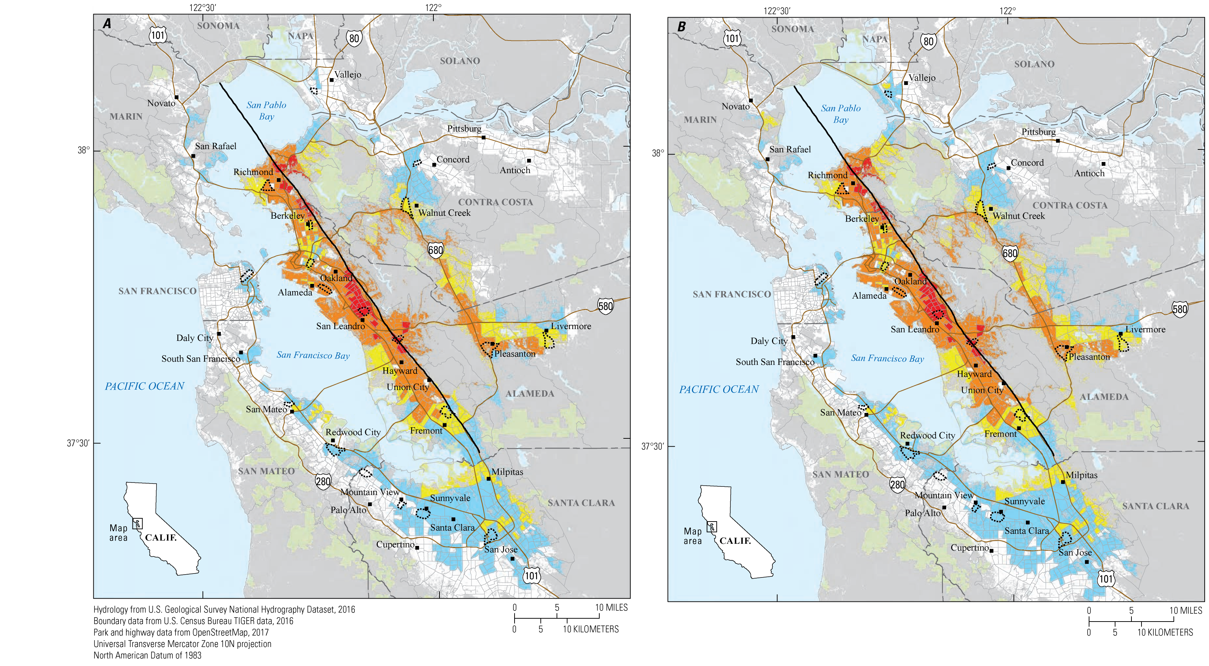
HayWired Scenario
Maps showing census tracts with concentrations of building damage to industrial and warehouse uses in the HayWired Earthquake Scenario mainshock. Buildings with industrial and warehouse uses include heavy and light industrial uses; food, drug, chemical,
or metal processing; high technology; and construction. Descriptions of the 2 maps: A, Shaking, landslide, and liquefaction hazards only (without fire). B, Shaking,
landslide, liquefaction, and fire
hazards.
HayWired Scenario Volume 3: Chapter U, Figure A9
12

Slide 14
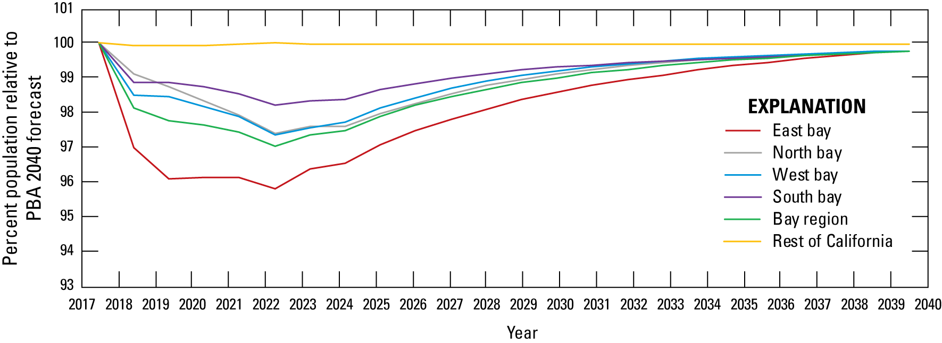
HayWired Scenario
Line graph showing population curves in the HayWired Earthquake Scenario for the Bay Area, relative to the Association of Bay Area Governments (ABAG) regional and statewide projections. PBA 2040 is the ABAG Plan Bay Area 2040 forecast.
HayWired Scenario Volume 3: Chapter V1, Figure 4
13

