Slide 2
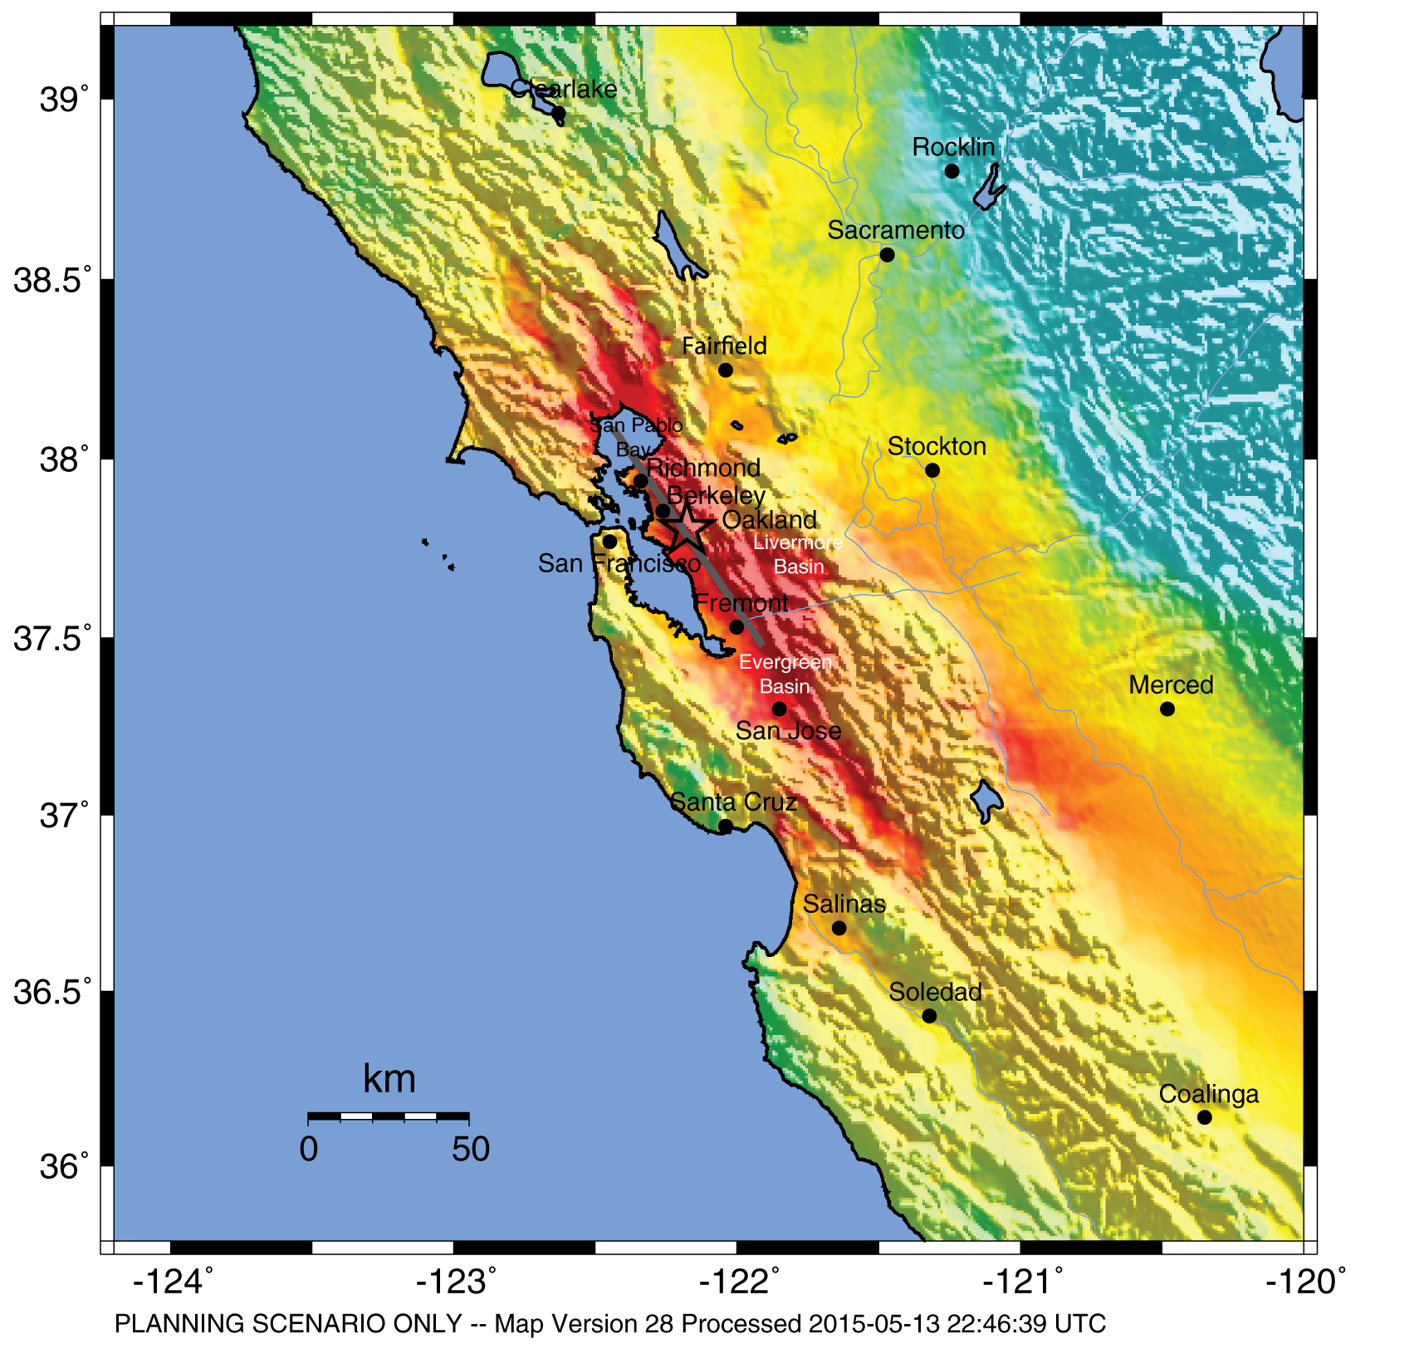
HayWired Scenario
U.S. Geological Survey ShakeMap of the HayWired Earthquake Scenario’s hypothetical magnitude 7.0 mainshock.
HayWired Scenario Volume 1: Chapter A, Figure 4
1

Slide 3
HayWired Scenario
Graph showing the 2-year time series for HayWired Earthquake Scenario aftershocks of magnitude
2.5 or greater. The colored (red, orange, yellow, and green) dots mark periods in the sequence when a larger aftershock triggers more aftershocks.
HayWired Scenario Volume 1: Chapter G, Figure 4

Slide 4
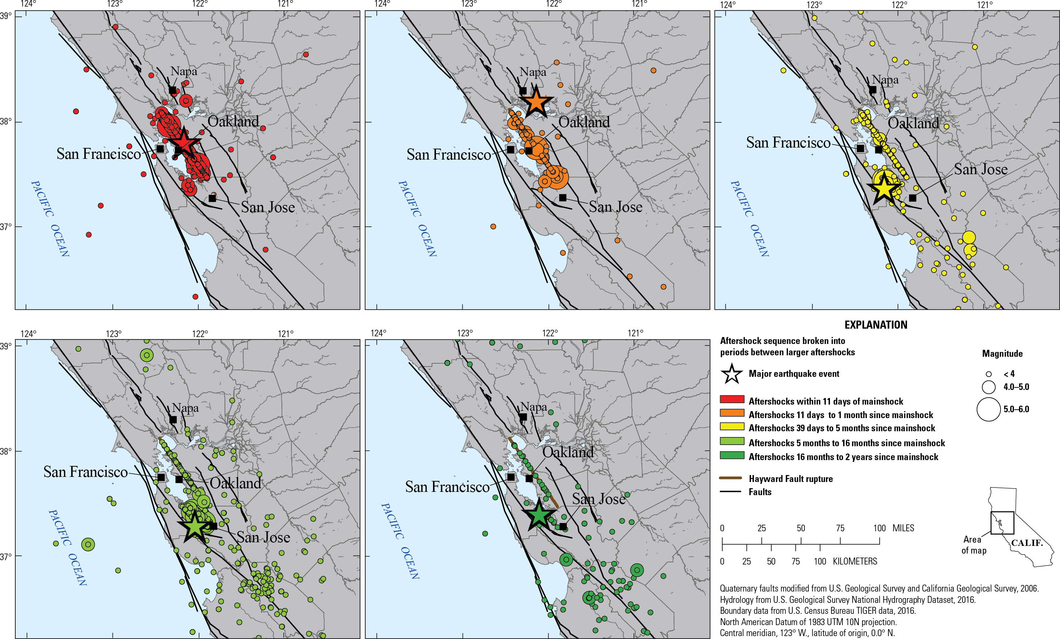
HayWired Scenario
Maps showing the HayWired Earthquake Scenario aftershock sequences within different time periods.
<, less than.
HayWired Scenario Volume 1: Chapter G, Figure 4

Slide 5
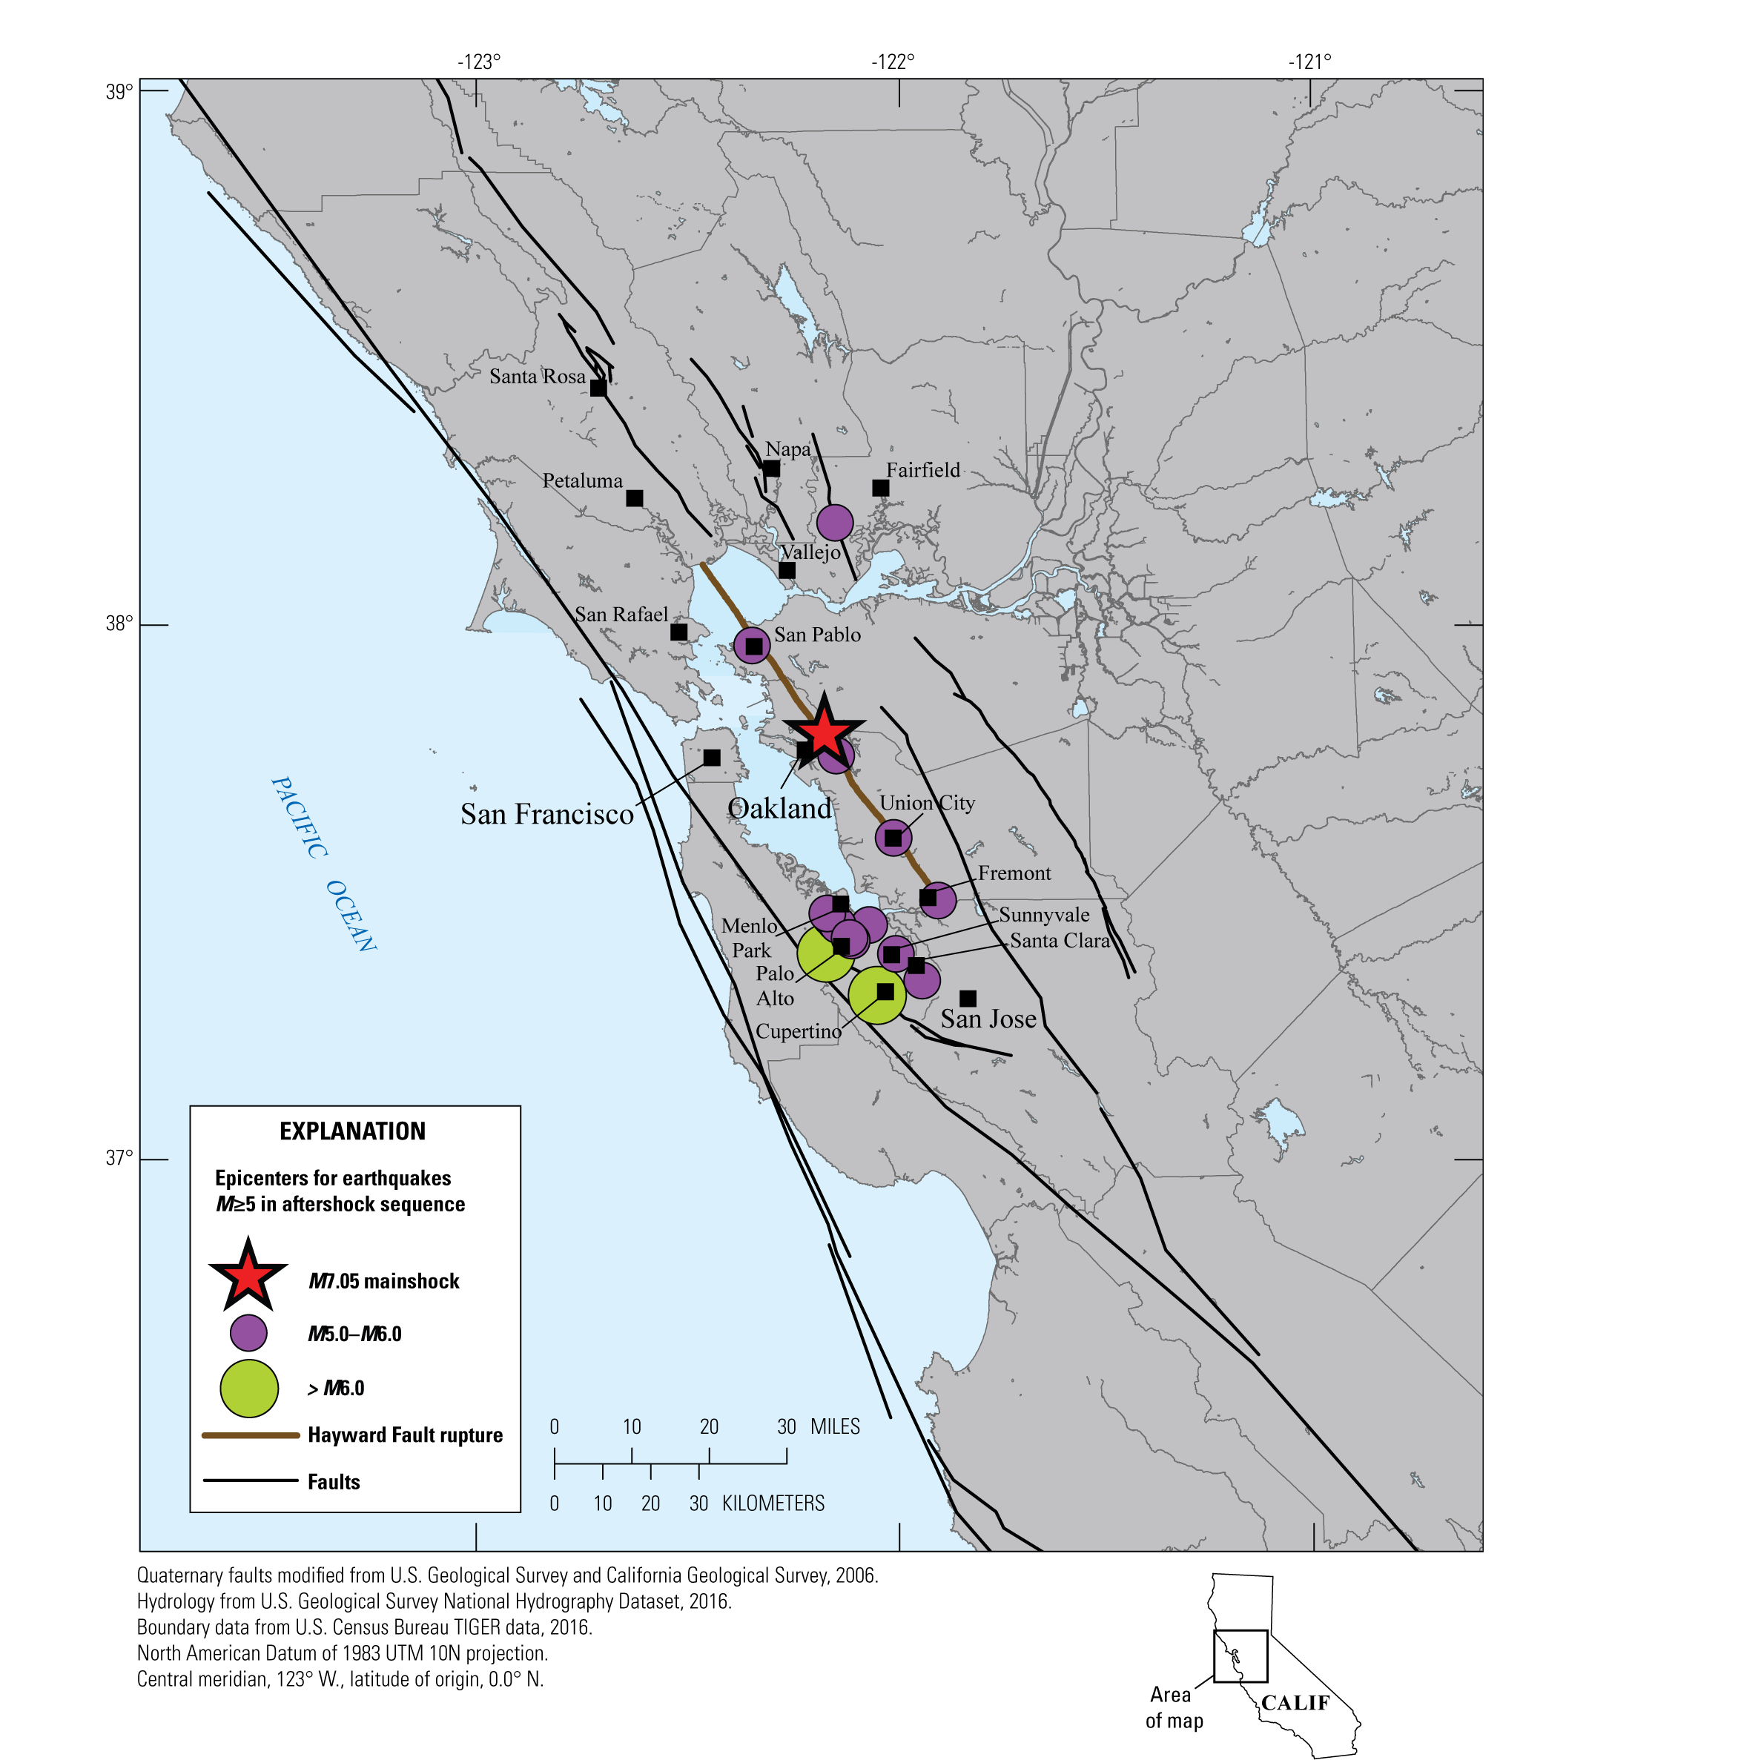
HayWired Scenario
Map showing larger aftershocks of magnitude (M) 5.0 or greater following the hypothetical magnitude 7.0 mainshock of the HayWired Earthquake Scenario on the Hayward Fault.
Note that many aftershocks are not shown, including those smaller than magnitude 5.0.
HayWired Scenario Volume 1: Chapter G, Figure 7
4

Slide 6
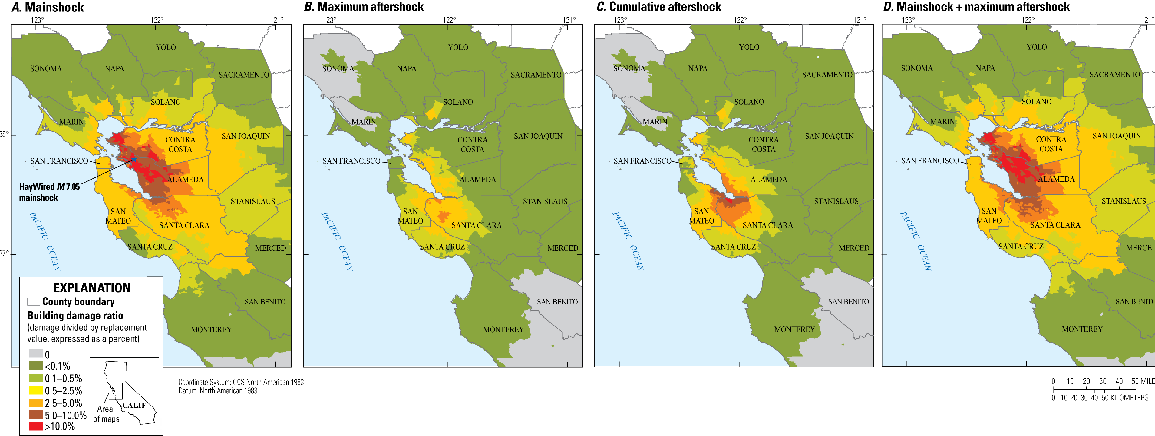
HayWired Scenario
Maps showing building damage ratio from ground shaking caused by the HayWired Earthquake Scenario mainshock and aftershocks. Descriptions of the 4 maps: A, Mainshock building damage ratio; B, Maximum aftershock building damage ratio; C, Cumulative aftershock building damage ratio; and D, Mainshock plus maximum aftershock building damage ratio.
HayWired Scenario Volume 2: Chapter J, Figure 16
5

Slide 7
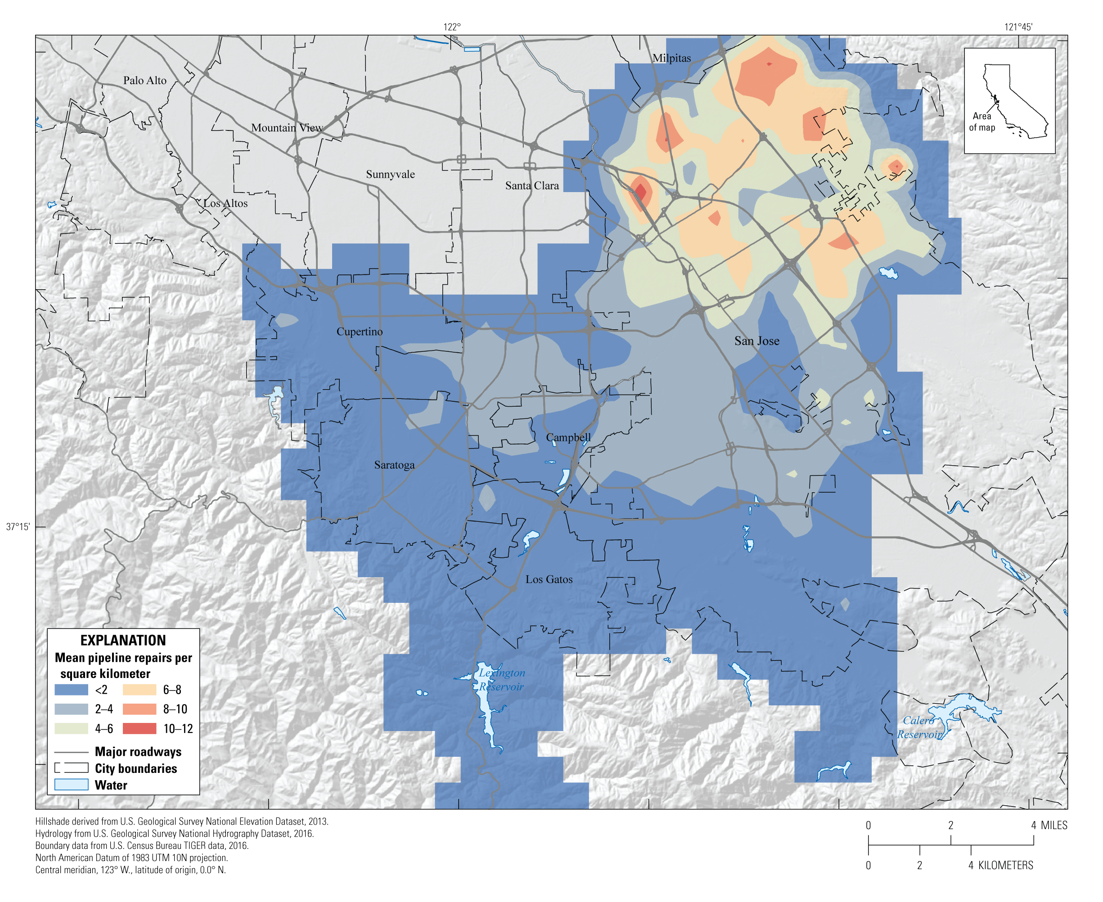
HayWired Scenario
Map of buried water-pipeline damage in San Jose Water Company’s service area for the hypothetical magnitude 7.0 mainshock of the HayWired Earthquake Scenario. Colors indicate mean (average) repairs (breaks and leaks) per square kilometer. A warmer color indicates greater concentration of damage.
HayWired Scenario Volume 2: Chapter N, Figure 19

Slide 8
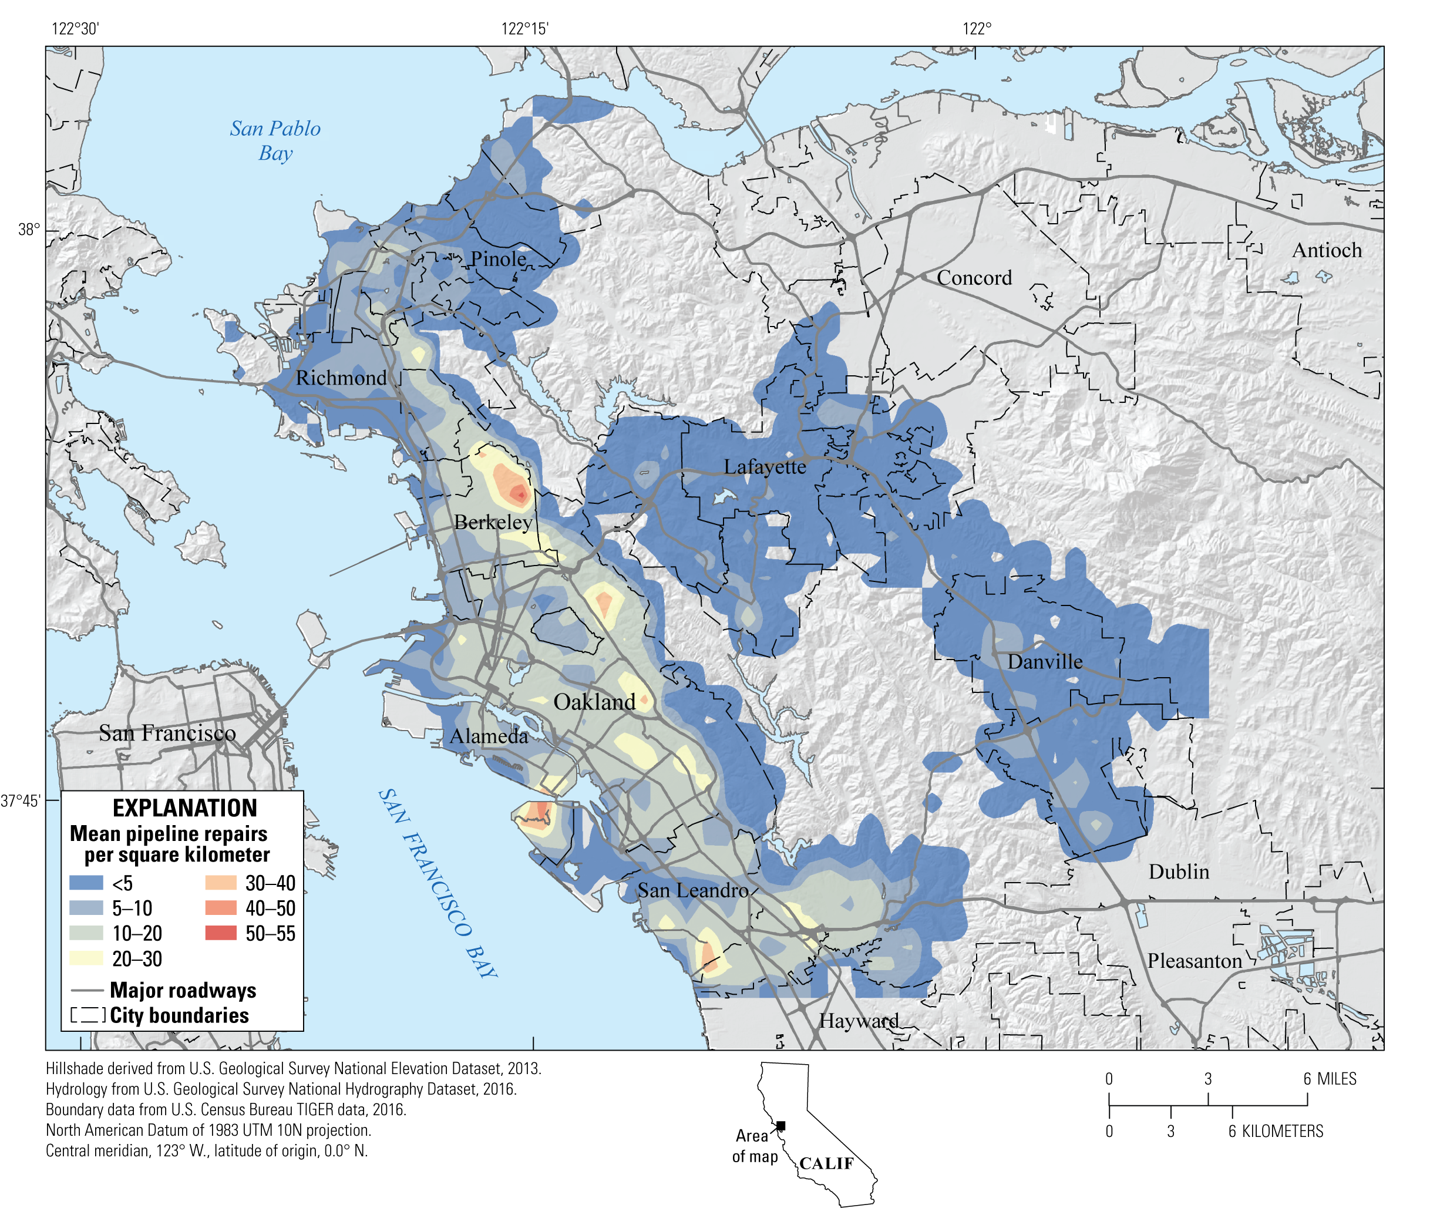
HayWired Scenario
Map of buried water-pipeline damage in East Bay Municipal Utility District’s service area for the entire HayWired Earthquake Scenario sequence including the magnitude 5.0 and above aftershocks. Colors indicate mean (average) repairs per square kilometer. A warmer color indicates greater concentration of damage.
HayWired Scenario Volume 2: Chapter N, Figure 19

Slide 9
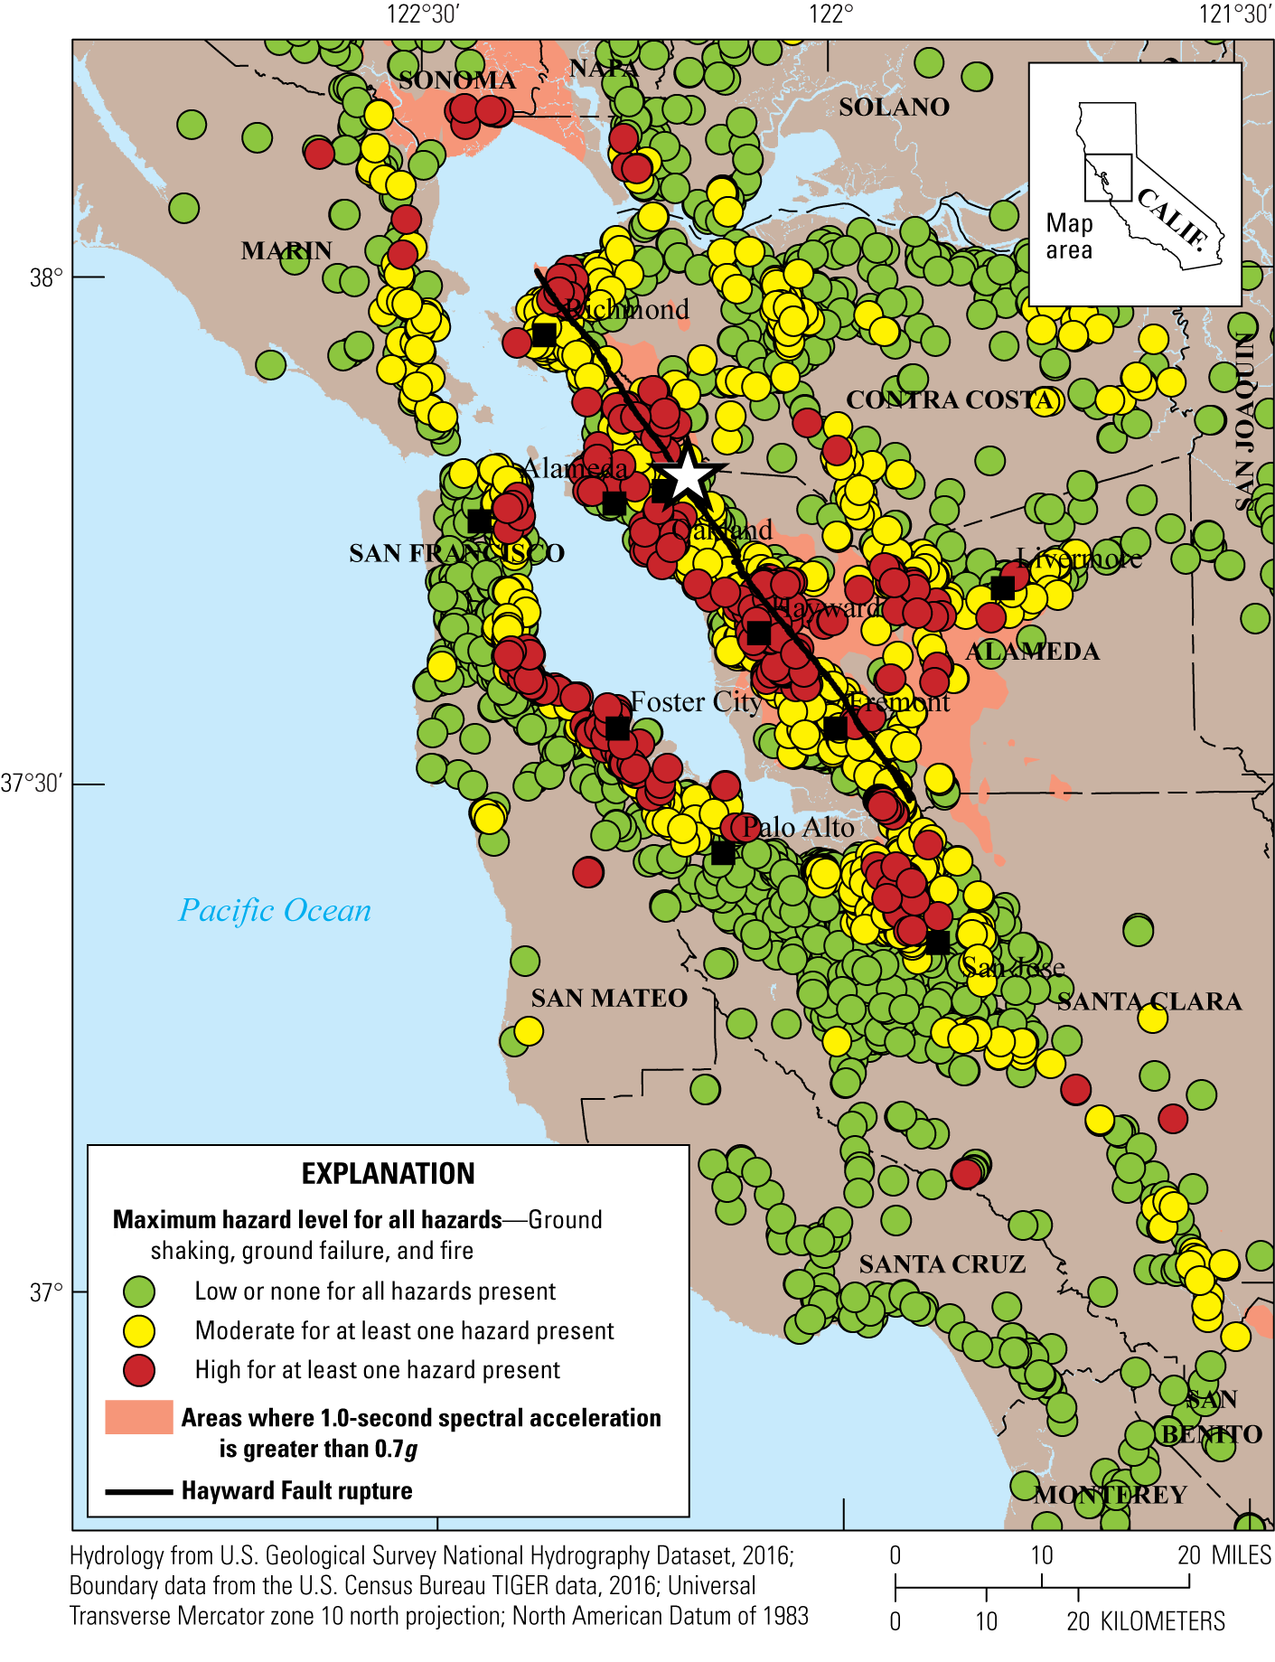
HayWired Scenario
Map showing combined hazards for all types of cellular sites for the HayWired Earthquake Scenario mainshock in the Bay Area. Each cellular site is identified based on the highest level of hazard mapped for shaking, liquefaction and landslide probability, and fire density (burned-building square footage relative to the developed area containing the fires).
White star shows the mainshock epicenter. g, acceleration due to gravity.
HayWired Scenario Volume 3: Chapter S, Figure 14

Slide 10
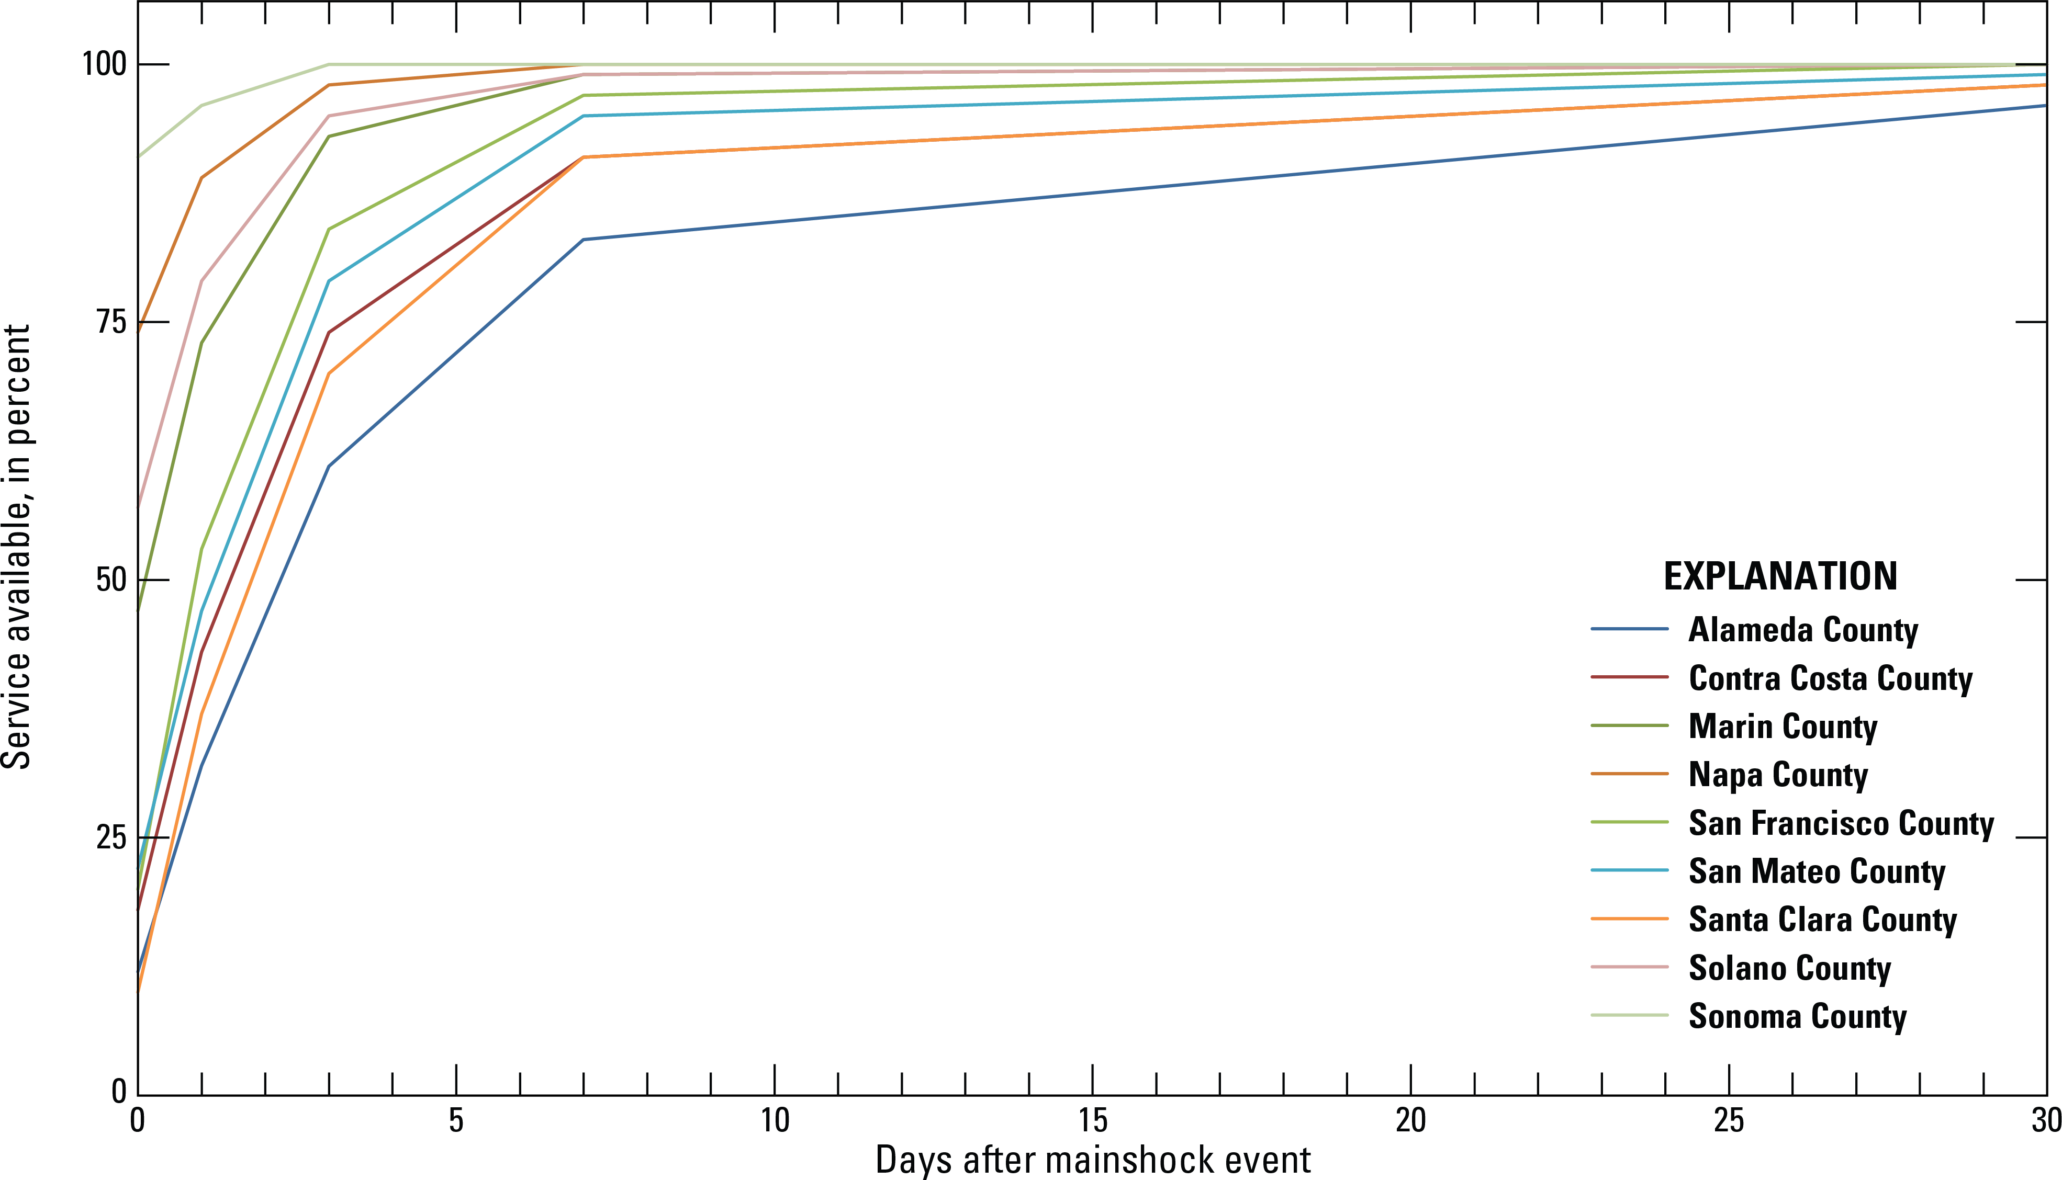
HayWired Scenario
Line graph showing the electric power restoration curve by county for the HayWired Earthquake Scenario mainshock in the nine counties adjacent to San Francisco Bay, California. From Jones and others (this volume).
HayWired Scenario Volume 3: Chapter S, Figure 14

Slide 11
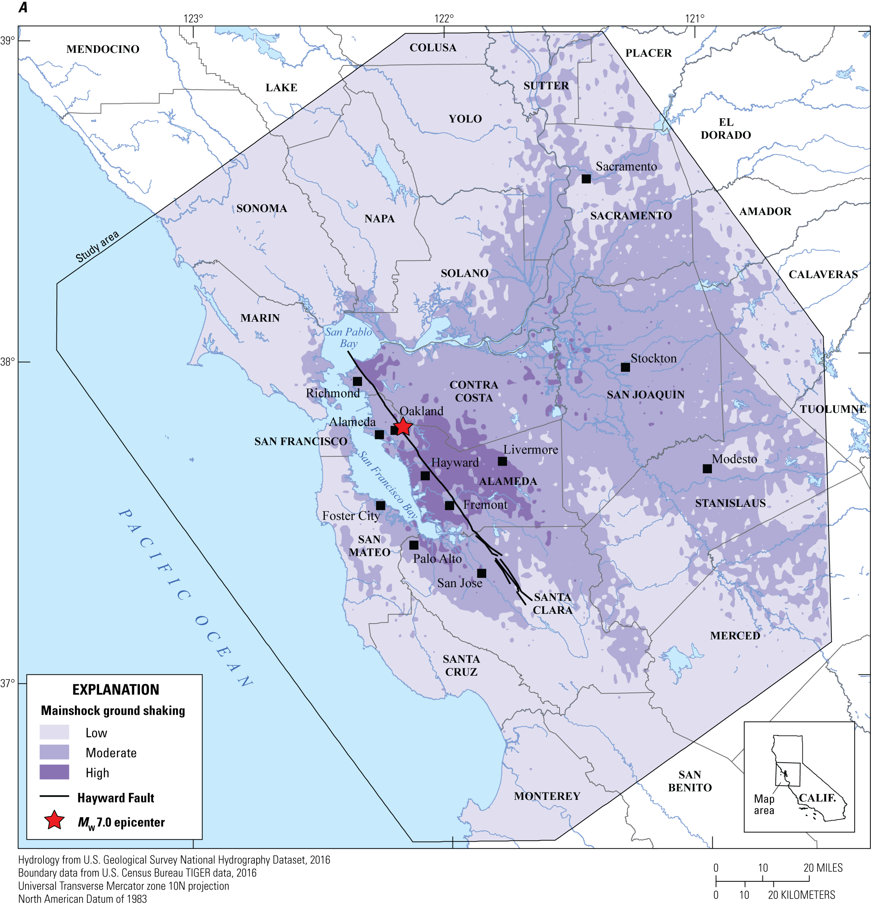
HayWired Scenario
Maps of the Bay Area, showing ground shaking as a result of the HayWired Earthquake Scenario mainshock on the Hayward Fault. Ground-shaking classifications used in this chapter. M_{w}, moment magnitude.
HayWired Scenario Volume 3: Chapter T, Figure 3A
10

Slide 12
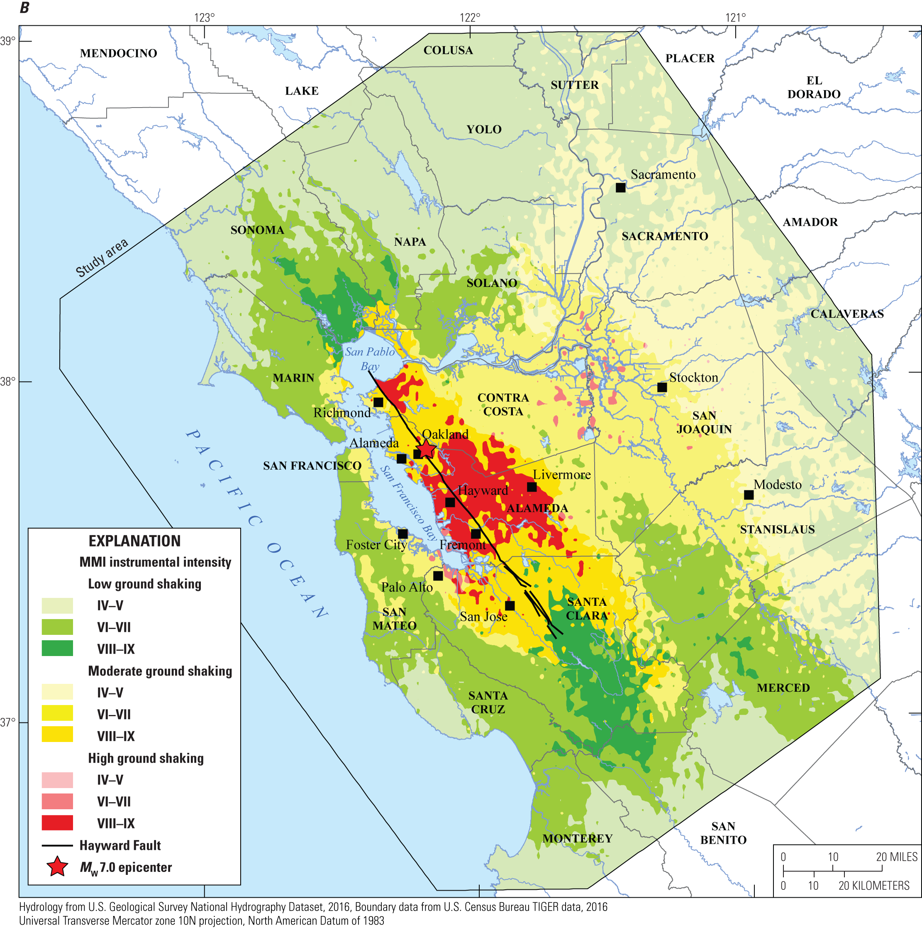
HayWired Scenario
Maps of the Bay Area, showing ground shaking as a result of the HayWired Earthquake Scenario mainshock on the Hayward Fault. Ground-shaking classifications used in this chapter. M_{w}, moment magnitude.
HayWired Scenario Volume 3: Chapter T, Figure 3B
11

Slide 13
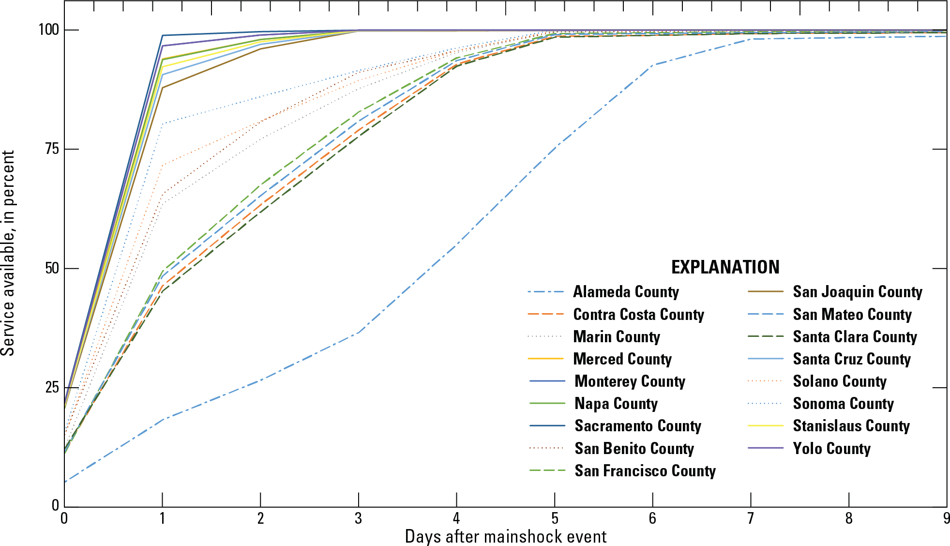
HayWired Scenario
Line graph showing the Bay Area Rapid Transit (BART) facility restoration curve
by county for the HayWired Earthquake Scenario. Damage estimates only apply to stations in the original BART system (built between 1972 and 1976). It does not include the Warm Springs/ South Fremont,
Milpitas, and Berryessa stations which opened after the assessment was completed.
Only stations built between 1996 and 2016 are included in the base number of stations used to estimate station service fraction.
HayWired Scenario Volume 3: Chapter T, Figure 18
12

Slide 14
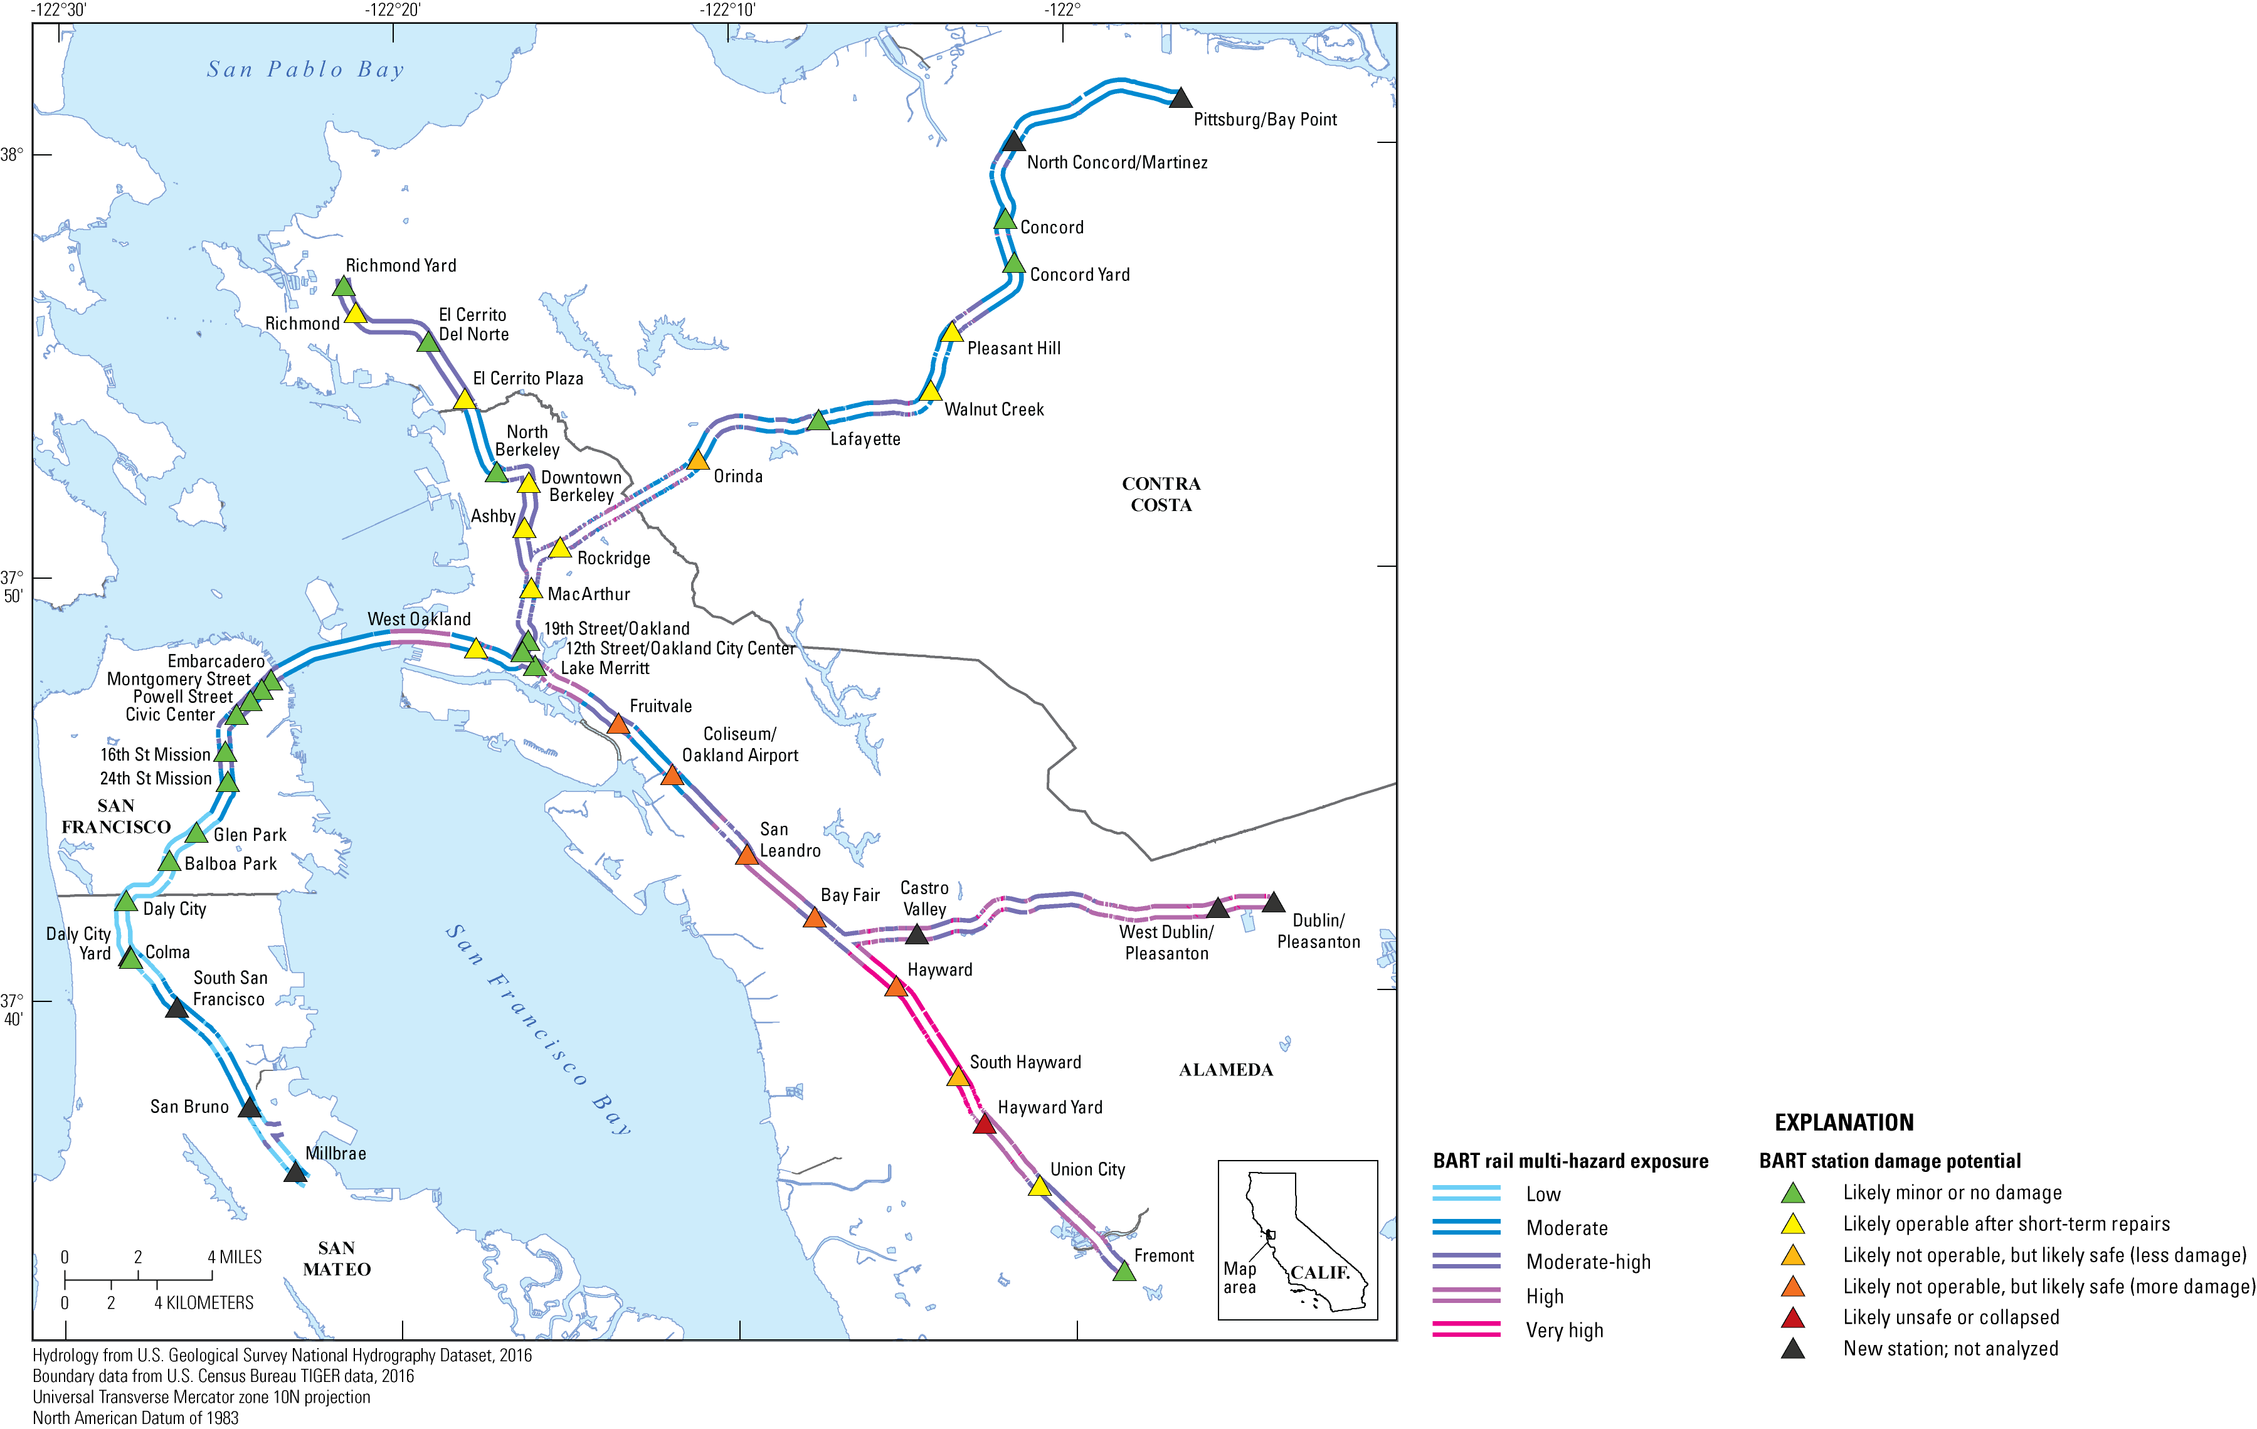
HayWired Scenario
Map showing the multi-hazard exposure of the Bay Area Rapid Transit (BART) system relative to the BART-estimated shaking damage potential for the HayWired Earthquake Scenario. The map does not include the Warm Springs/ South Fremont, Milpitas, and Berryessa stations which opened after the assessment was completed.
HayWired Scenario Volume 3: Chapter T, Appendix 4, Figure 2
13

Slide 15
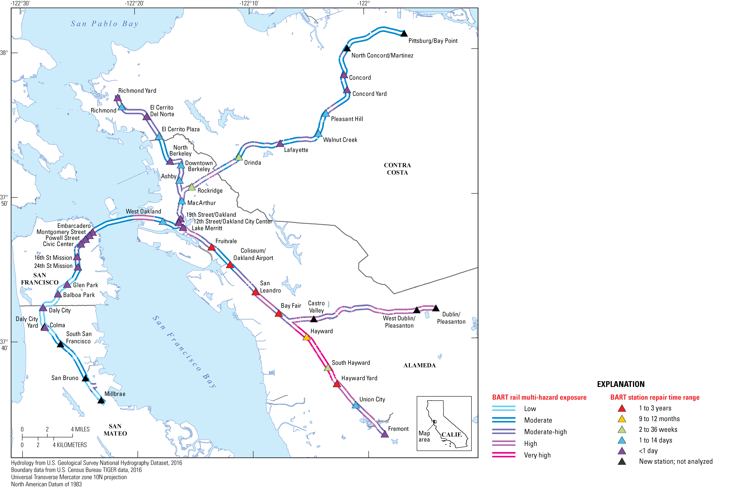
HayWired Scenario
Map showing the multi-hazard exposure of the Bay Area Rapid Transit (BART) system relative to BART- estimated facility repair duration for the HayWired Earthquake Scenario. The map does not include the Warm Springs/ South Fremont, Milpitas, and Berryessa stations which opened after the assessment was completed.
HayWired Scenario Volume 3: Chapter T, Appendix 4, Figure 3
14

Slide 16
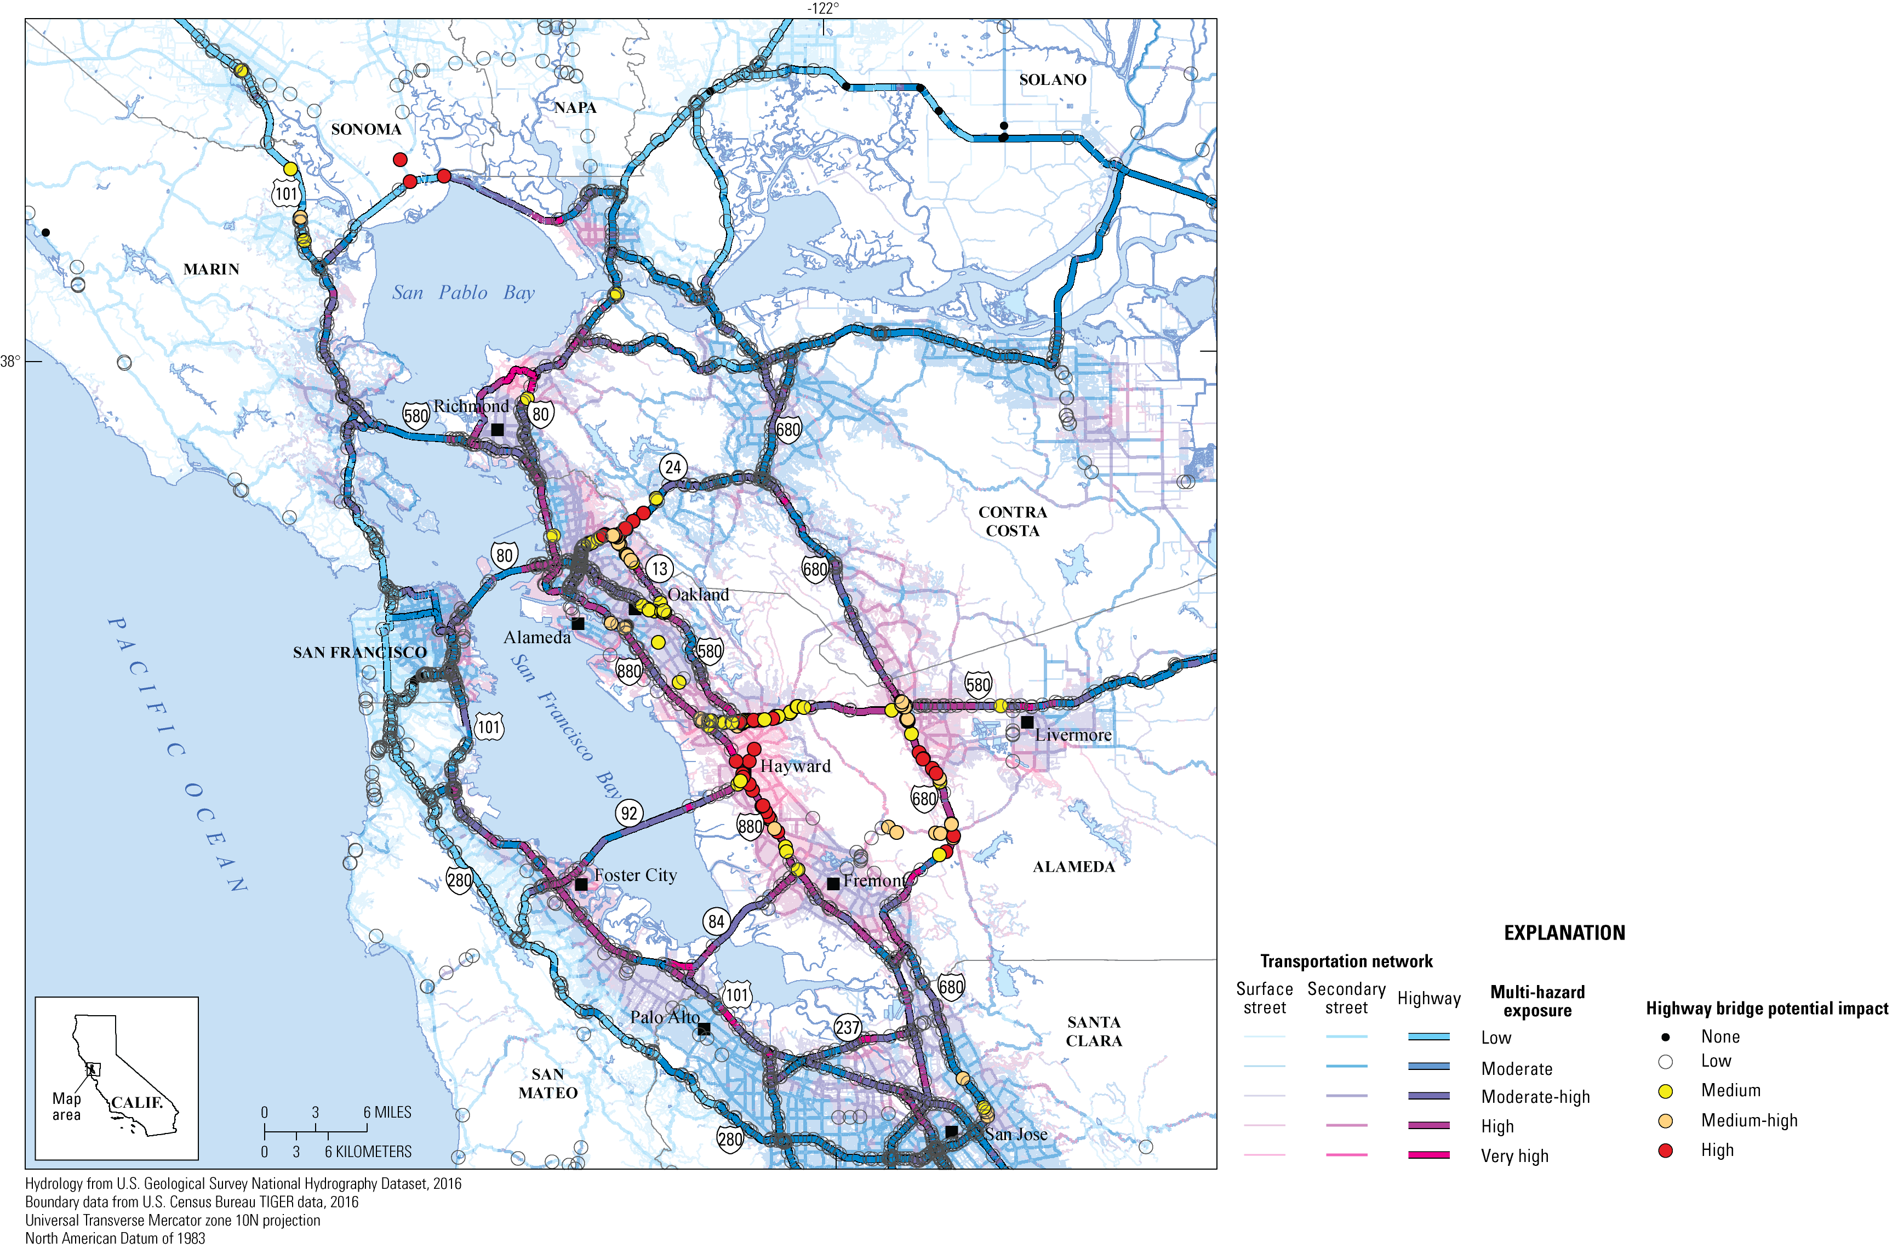
HayWired Scenario
Map showing the multi-hazard exposure of roadways and potential impacts to California Department
of Transportation highway bridges in the HayWired Earthquake Scenario.
HayWired Scenario Volume 3: Chapter T, Appendix 5, Figure 3

Slide 17
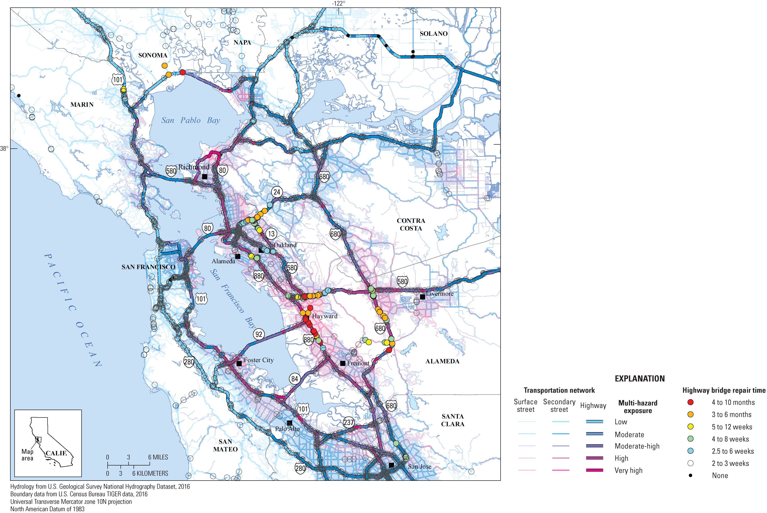
HayWired Scenario
Map showing repair times for highway bridges as determined by the California Department of Transportation relative to multi-hazard exposure in the HayWired Earthquake Scenario.
HayWired Scenario Volume 3: Chapter T, Appendix 5, Figure 3

Slide 18
Estimated building-restoration delays following the magnitude 7.0 mainshock of the HayWired Earthquake Scenario.
HayWired Scenario
Residential dwelling type | Hazus damage state
 | Slight | Moderate | Extensive | Complete
Structural and nonstructural repair cost ratios (percentage of building replacement cost)
Single family (RES1) | 2 | 10 | 44.7 | 100
Duplex (RES3A) | 2 | 10 | 41.3 | 100
Multifamily (RES3B–F) | 2 | 10 | 41.3 | 100
Median time for building repair and return to function (number of days)
Single family (RES1) | 2–5 | 30–120 | 90–360 | 180–720
Duplex (RES3A) | 5–10 | 30–120 | 120–480 | 240–960
Multifamily (RES3B–F) | 5–10 | 30–120 | 120–480 | 240–960
[Codes in parentheses are Hazus occupancy classes. Single-family and duplex dwellings are listed separately since Hazus assigns the same repair cost ratios and recovery times to duplexes as it does to other multifamily dwellings. Data from Federal Emergency Management Agency (2012)]
HayWired Scenario Volume 3: Chapter U, Table A1
17

Slide 19
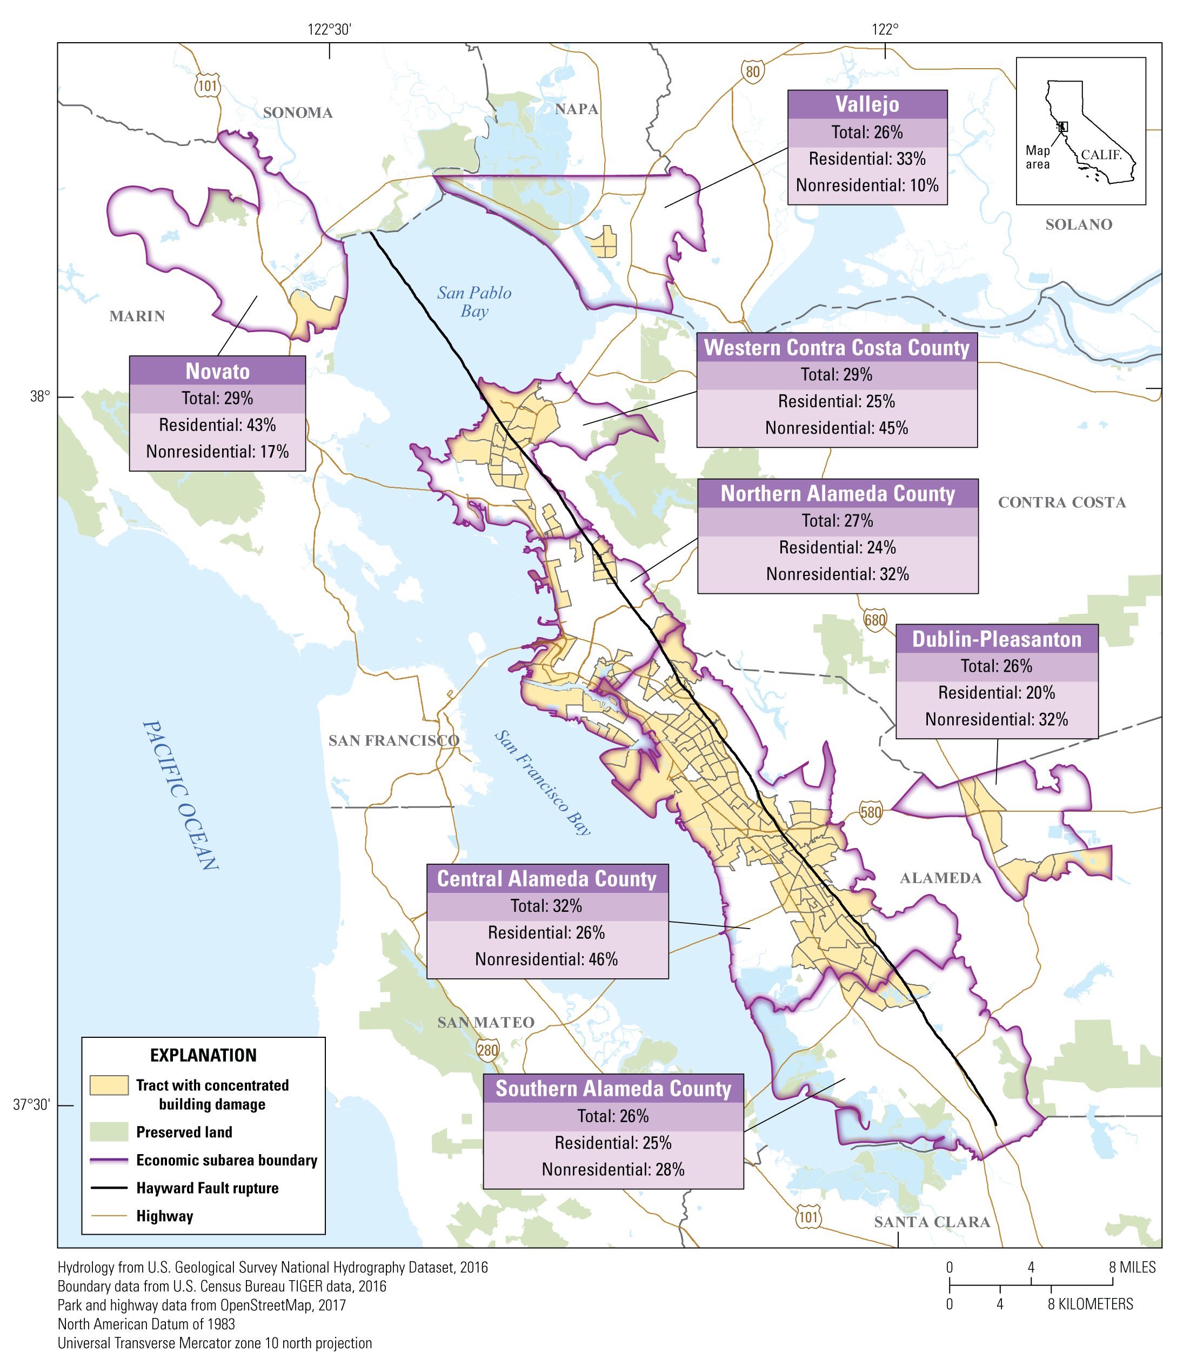
HayWired Scenario
Map showing areas of concentrated damage in economic subareas as a result of hazards caused by the HayWired Earthquake Scenario mainshock. Areas of concentrated damage are defined as census tracts with 20% or more of the total building square footage in extensive or complete damage from ground shaking, liquefaction, landslide, and fire damages. For each economic subarea, the percentage of residential, nonresidential, and total building square footage in an extensive or complete damage state from the integrated damages are also provided.
HayWired Scenario Volume 3: Chapter U, Figure 4
18

Slide 20
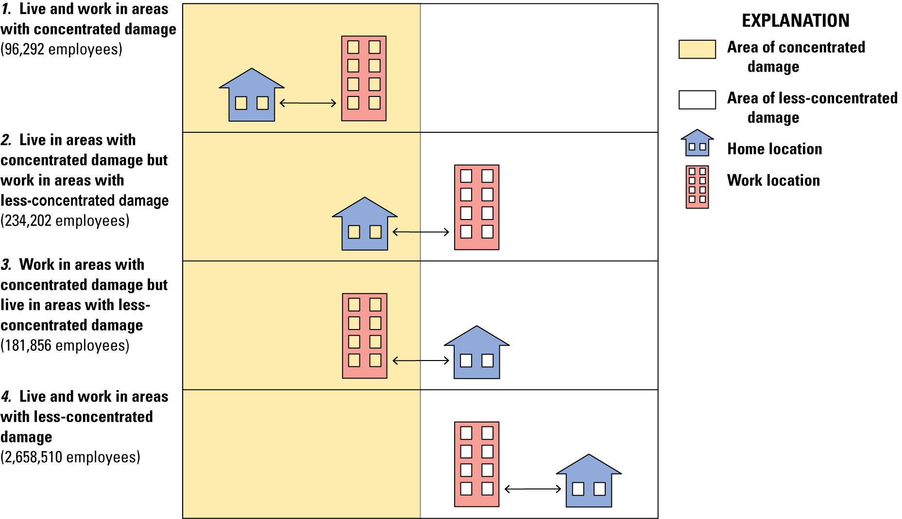
HayWired Scenario
Cartoon showing possible home- workplace relations associated with areas of concentrated and less-concentrated damage resulting from the HayWired Earthquake Scenario mainshock in the Bay Area. Employee numbers are calculated for the nine counties for all hazards (ground shaking, landslide, liquefaction, and fire following earthquake).
HayWired Scenario Volume 3: Chapter V5, Figure 12

Slide 21
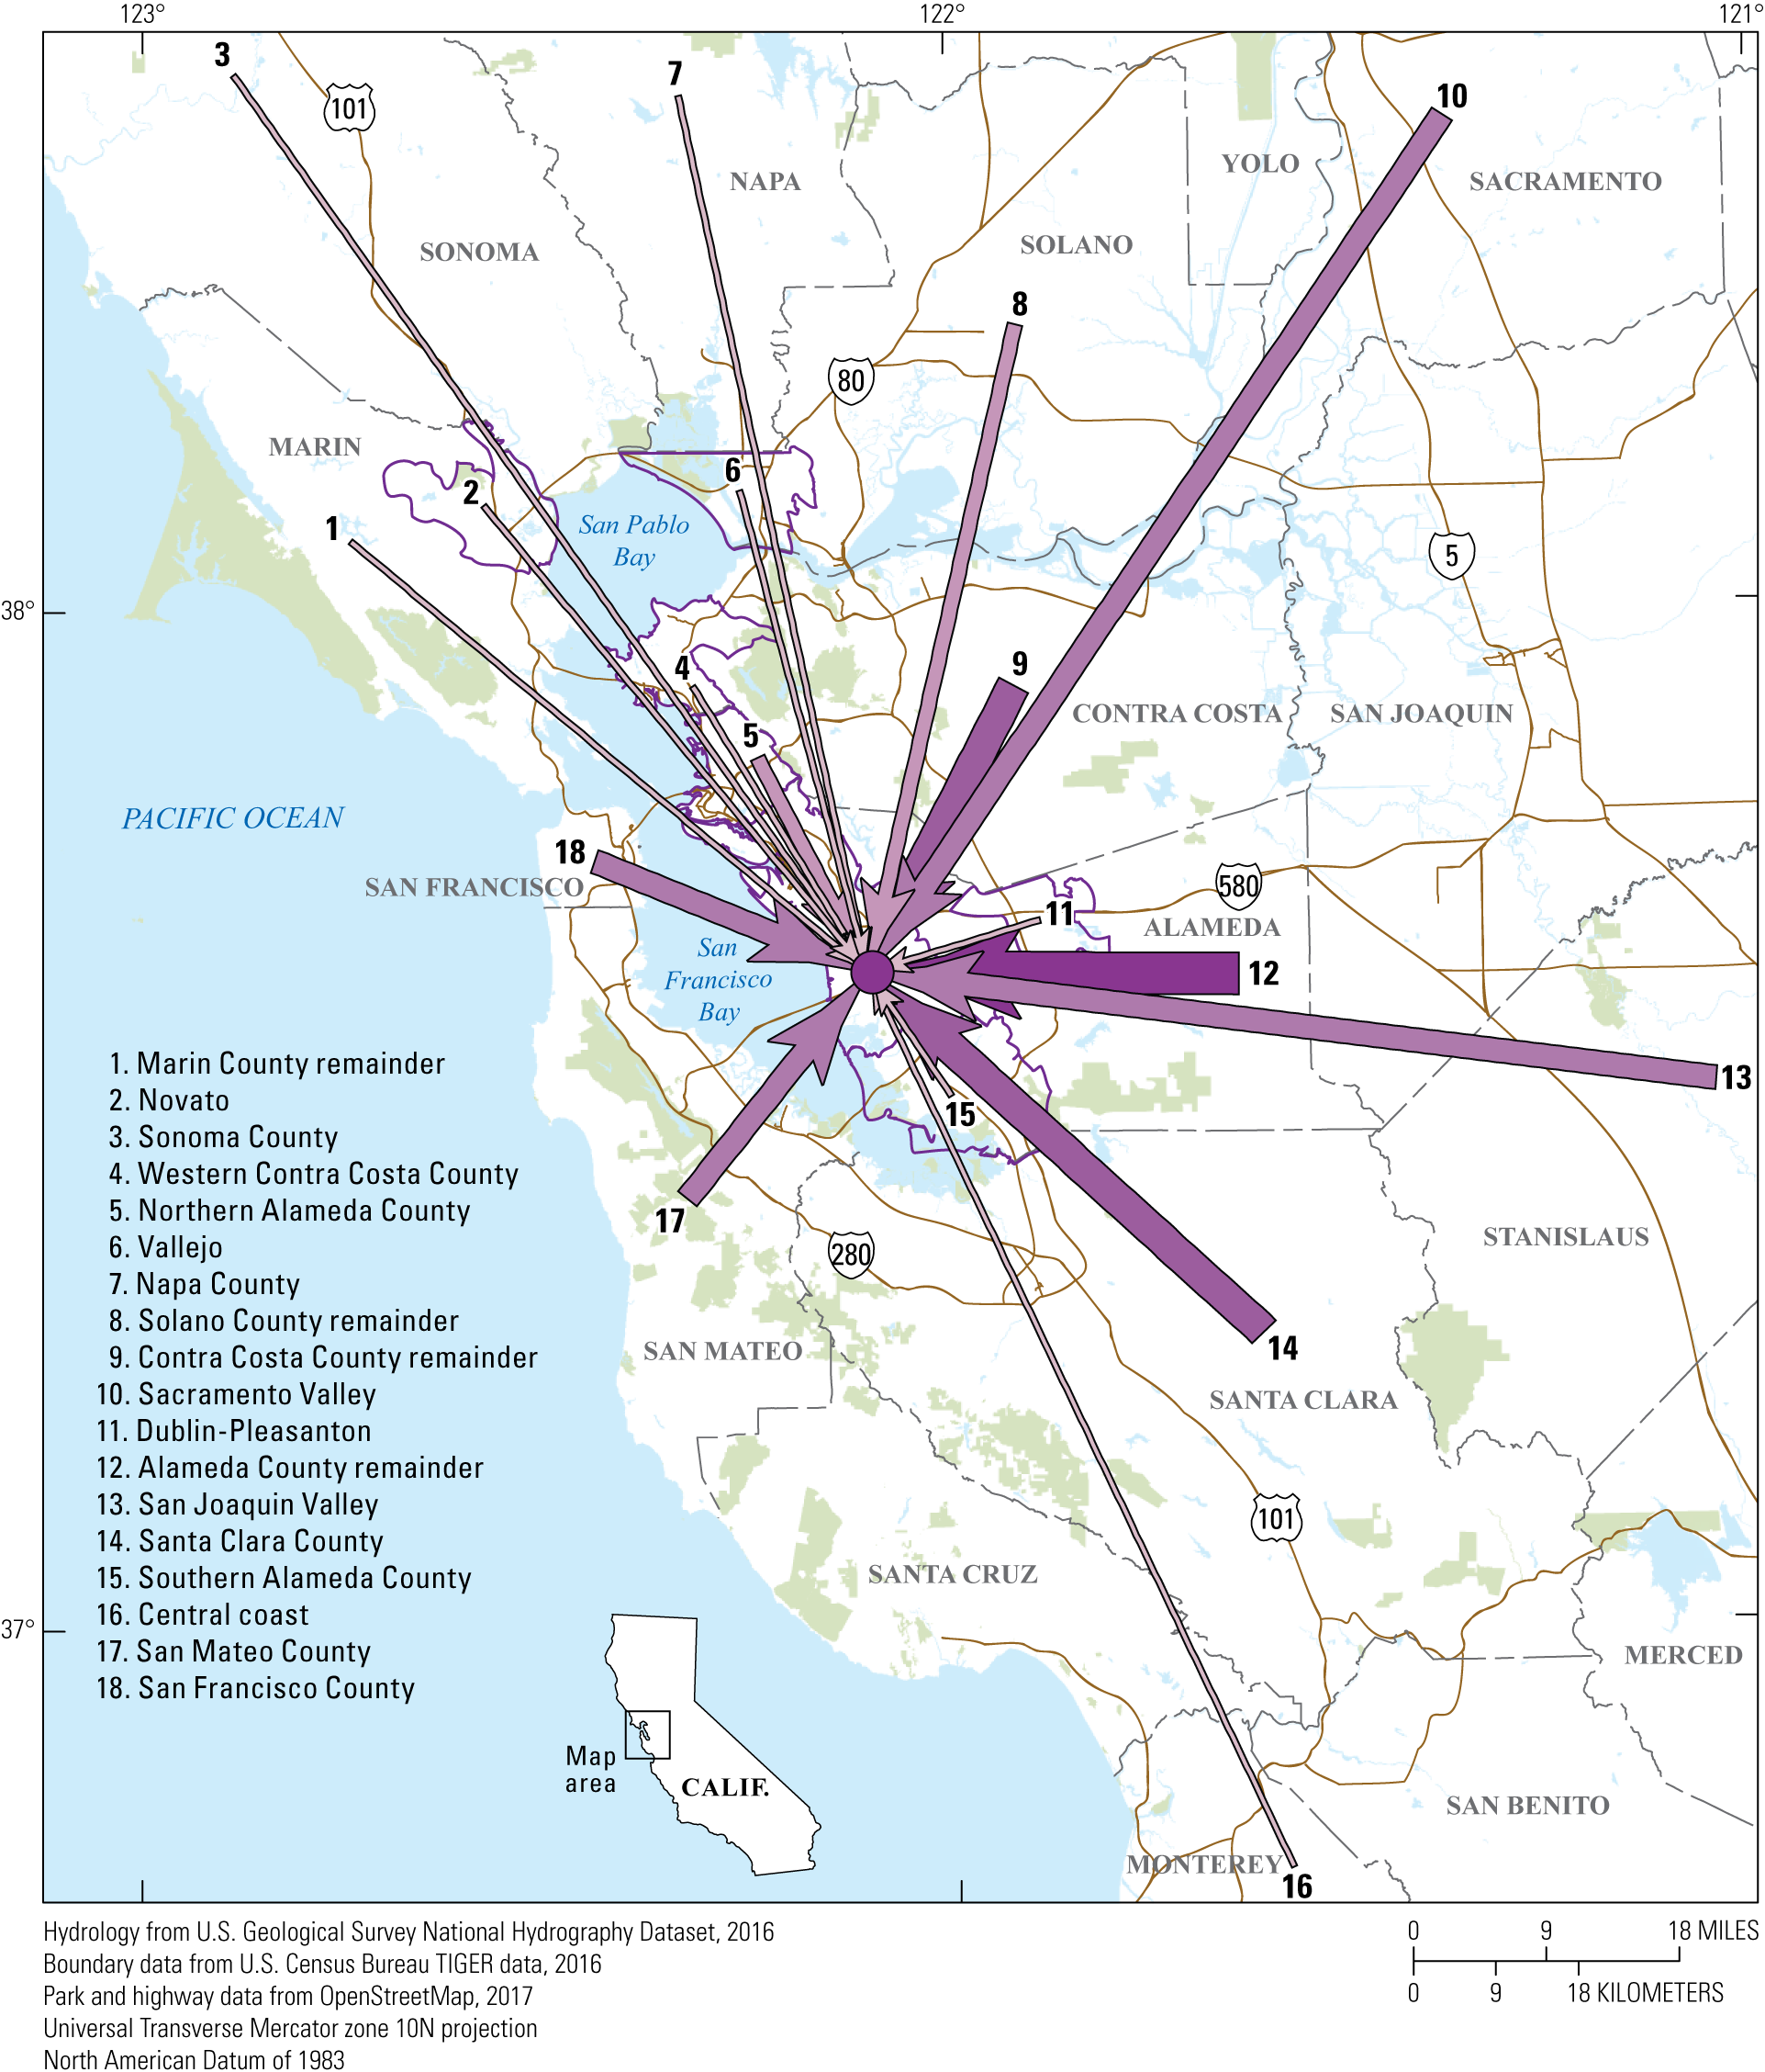
HayWired Scenario
Map showing worker commute flow into areas of concentrated damage (all hazards) in central Alameda County. All hazards refers to damages from all hazards considered for the HayWired Earthquake Scenario: ground shaking, landslide, liquefaction, and fire following earthquake. Areas with “remainder” in the name are parts of counties outside the defined subareas, and other counties that do not have concentrated-damage areas are also included. More distant counties are aggregated into larger
subregions: Sacramento Valley (Sacramento and Yolo Counties), San Joaquin Valley (Merced, San Joaquin, and Stanislaus Counties), and the central coast (Monterey, San Benito, and Santa Cruz Counties).
HayWired Scenario Volume 3: Chapter V5, Figure 12

Slide 22
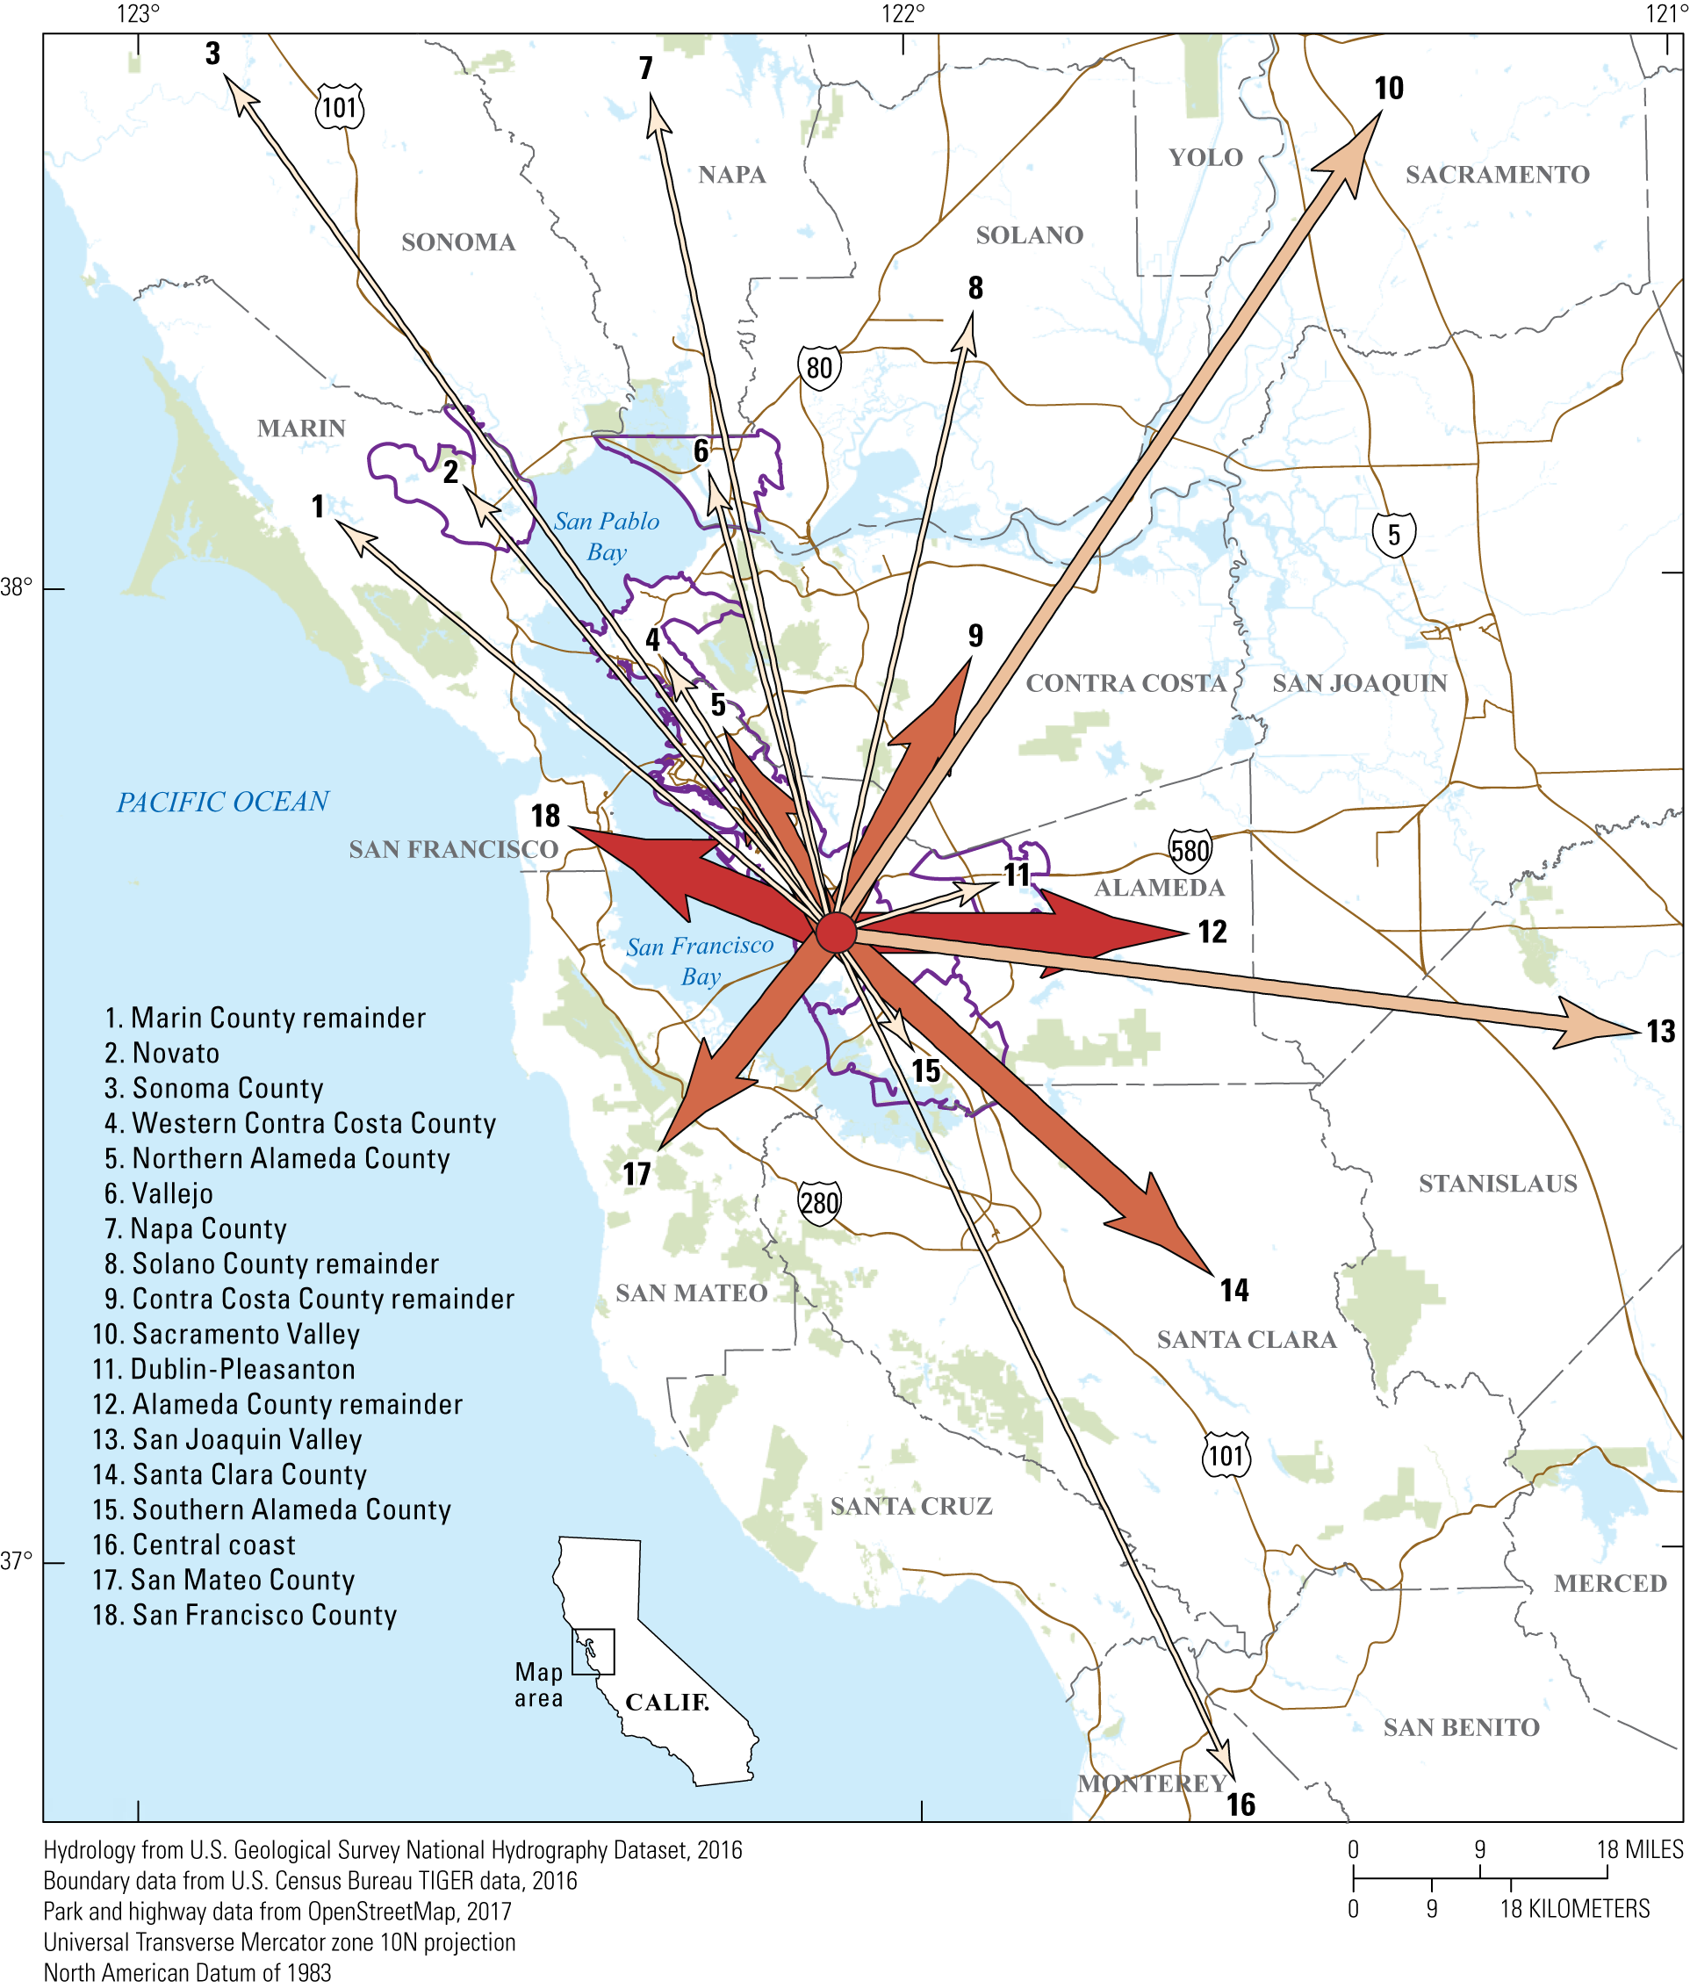
HayWired Scenario
Map showing employed resident flow out of areas of concentrated damage (all hazards) in central Alameda County. All hazards refers to damages from all hazards considered for the HayWired Earthquake Scenario: ground shaking, landslide, liquefaction, and fire following earthquake. Areas with “remainder” in the name are parts of counties outside the defined subareas, and other counties that do not have concentrated-damage areas are also included. More distant counties are aggregated into larger
subregions: Sacramento Valley (Sacramento and Yolo Counties), San Joaquin Valley (Merced, San Joaquin, and Stanislaus Counties), and the central coast (Monterey, San Benito, and Santa Cruz Counties).
HayWired Scenario Volume 3: Chapter V5, Figure 20
21

