Slide 1


Slide 2
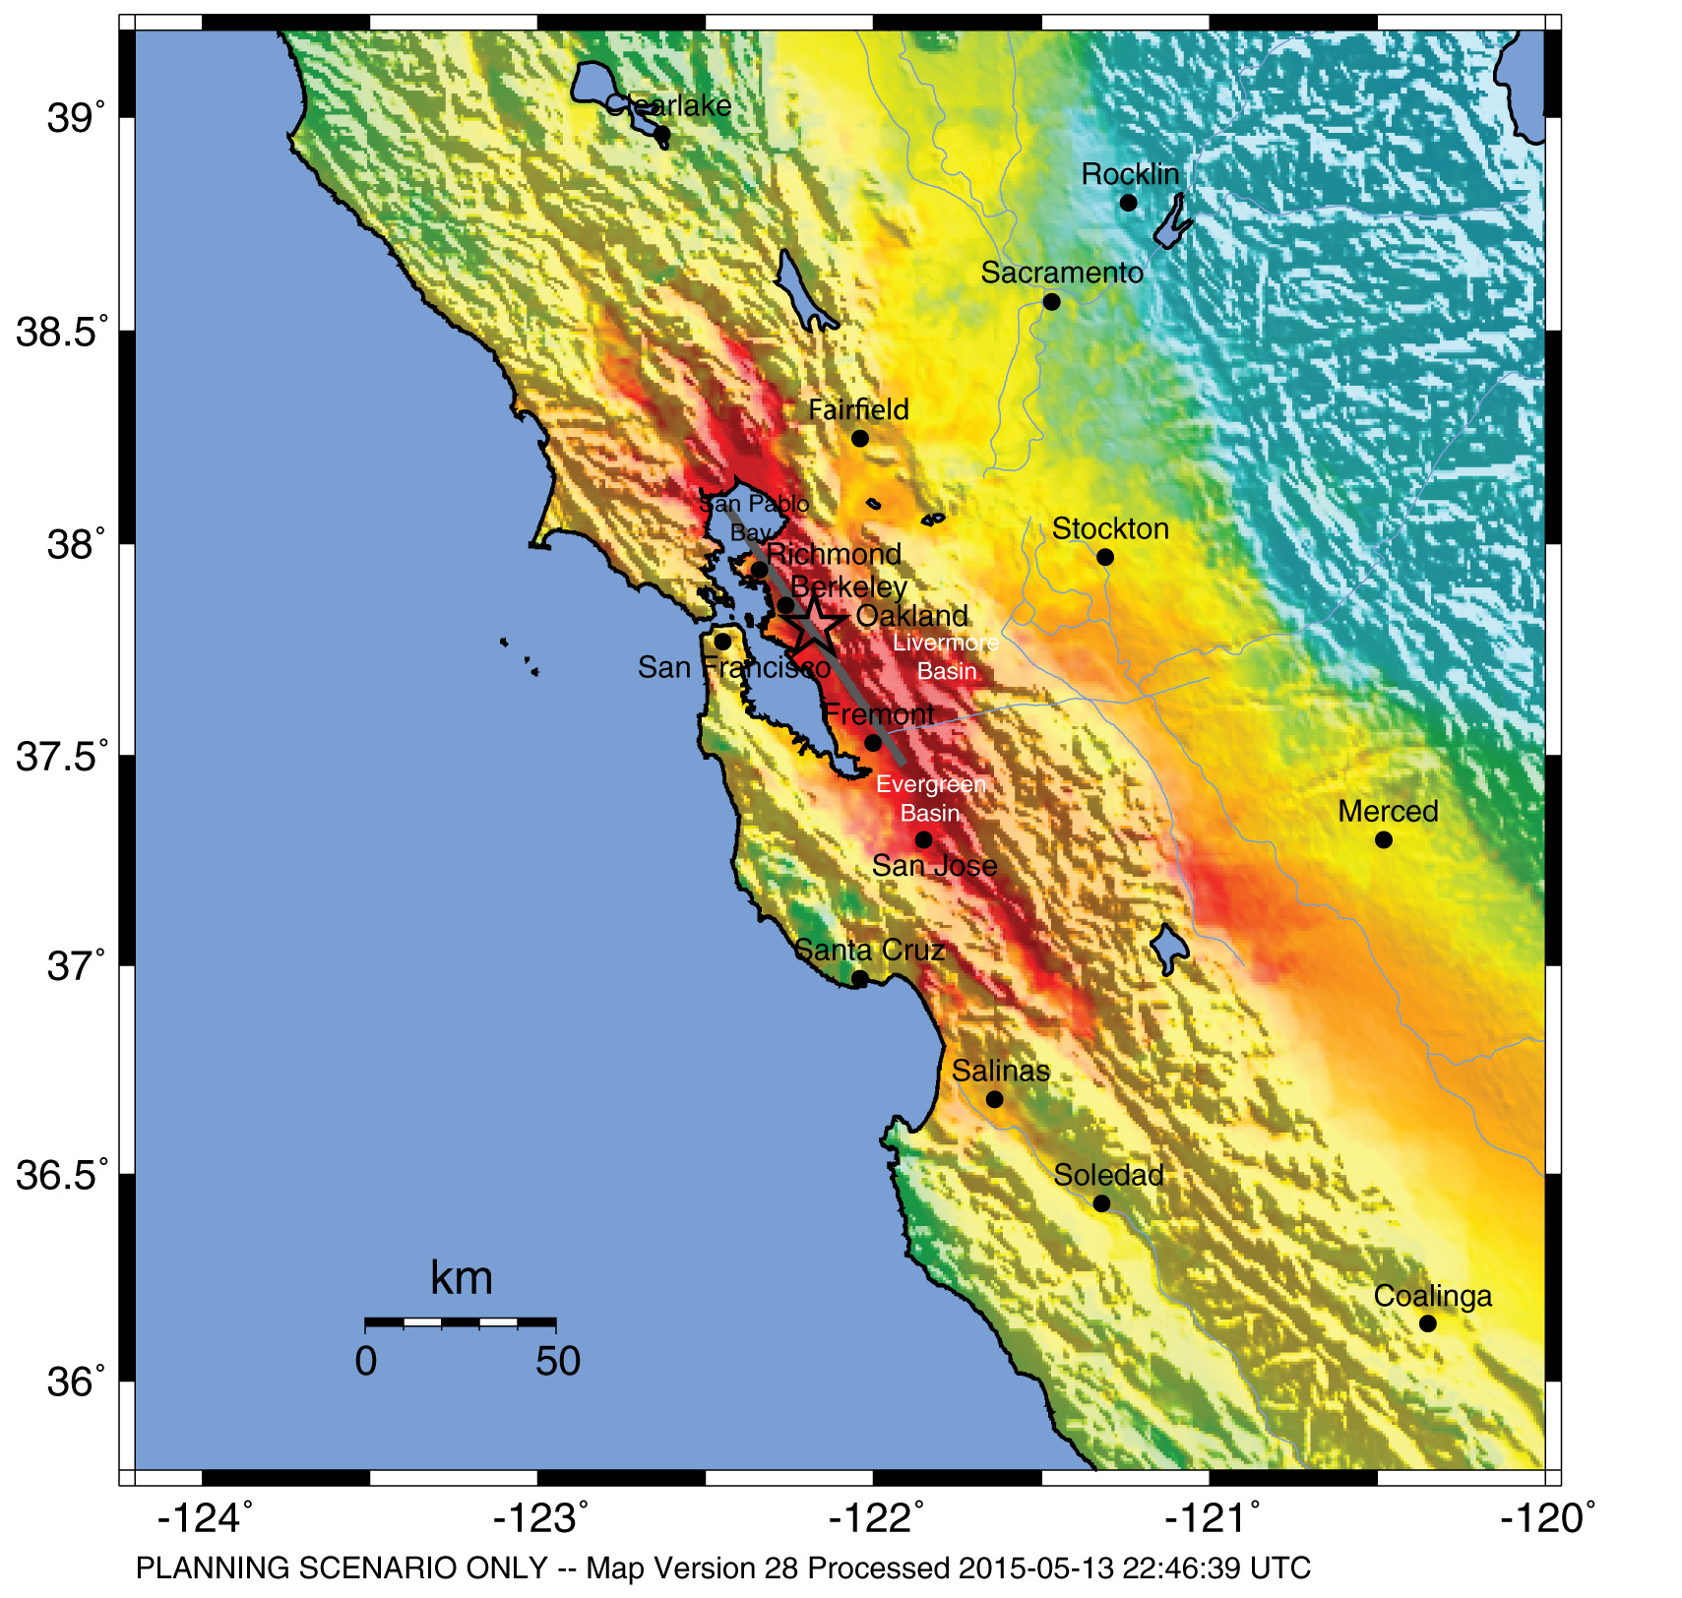
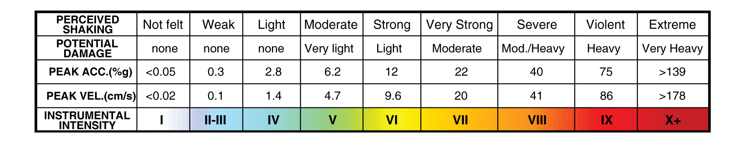
HayWired Scenario
U.S. Geological Survey ShakeMap of the HayWired Earthquake Scenario’s hypothetical magnitude 7.0 mainshock.
HayWired Scenario Volume 1: Chapter A, Figure 4

Slide 3
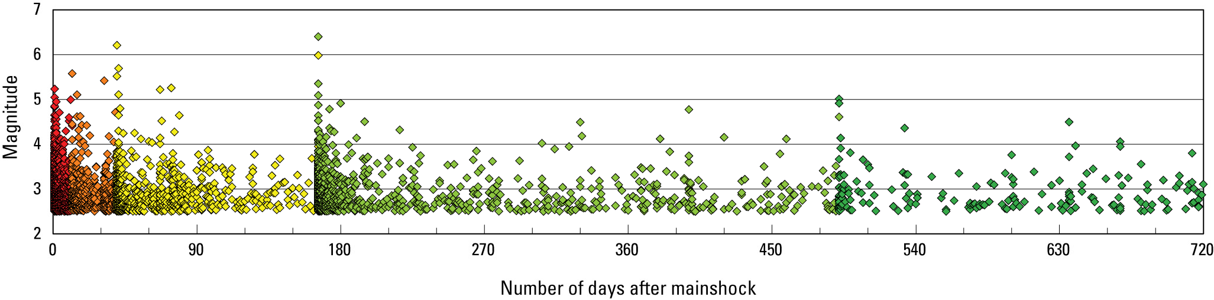
HayWired Scenario
Graph showing the 2-year time series for HayWired Earthquake Scenario aftershocks of magnitude
2.5 or greater. The colored (red, orange, yellow, and green) dots mark periods in the sequence when a larger aftershock triggers more aftershocks.
HayWired Scenario Volume 1: Chapter G, Figure 4

Slide 4
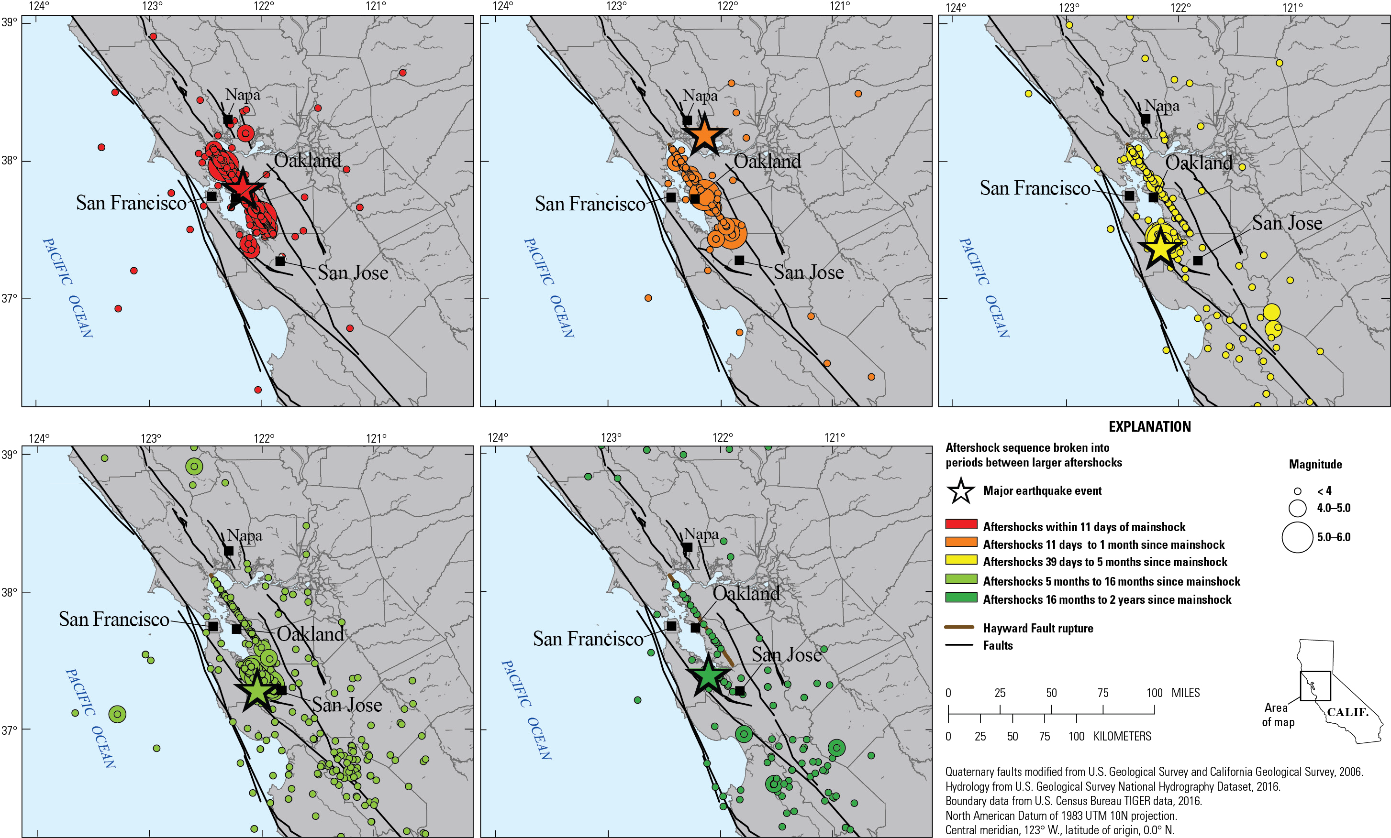
HayWired Scenario
Maps showing the HayWired Earthquake Scenario aftershock sequences within different time periods.
<, less than.
HayWired Scenario Volume 1: Chapter G, Figure 6
3

Slide 5
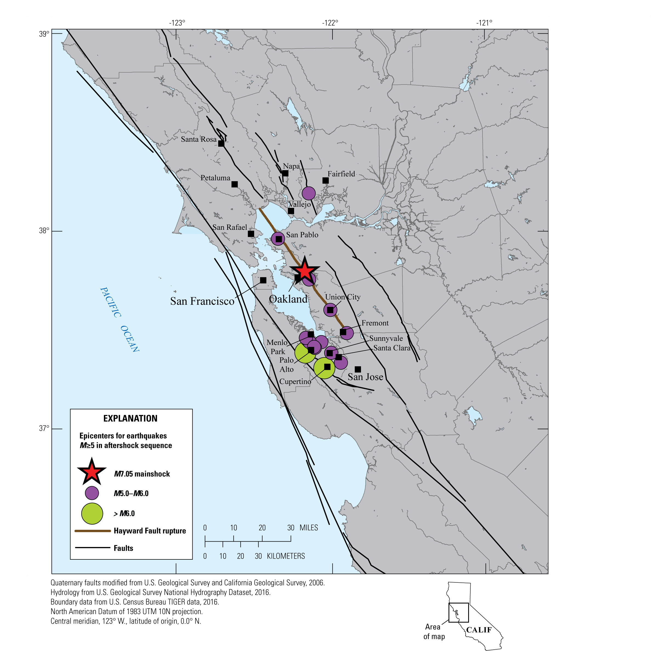
HayWired Scenario
Map showing larger aftershocks of magnitude (M) 5.0 or greater following the hypothetical magnitude 7.0 mainshock of the HayWired Earthquake Scenario on the Hayward Fault.
Note that many aftershocks are not shown, including those smaller than magnitude 5.0.
HayWired Scenario Volume 1: Chapter G, Figure 7
4

Slide 6
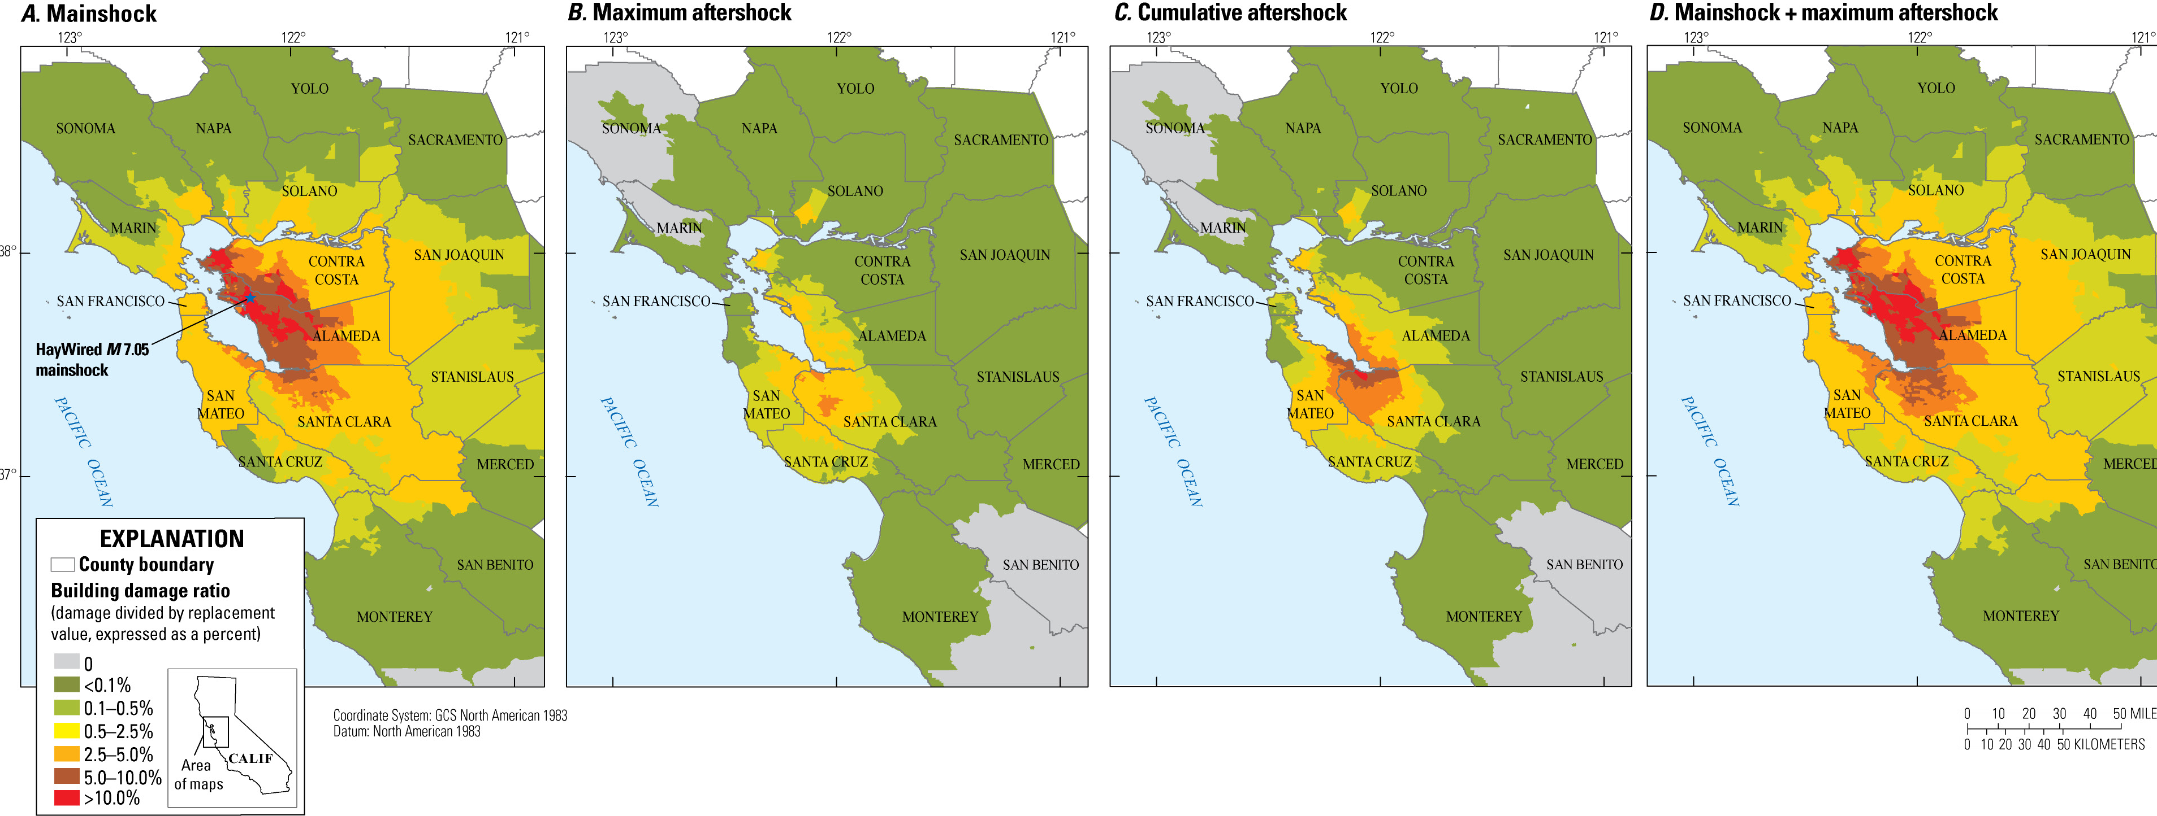
HayWired Scenario
Maps showing building damage ratio from ground shaking caused by the HayWired Earthquake Scenario mainshock and aftershocks. Descriptions of the 4 maps: A, Mainshock building damage ratio; B, Maximum aftershock building damage ratio; C, Cumulative aftershock building damage ratio; and D, Mainshock plus maximum aftershock building damage ratio.
HayWired Scenario Volume 2: Chapter J, Figure 16
5

Slide 7
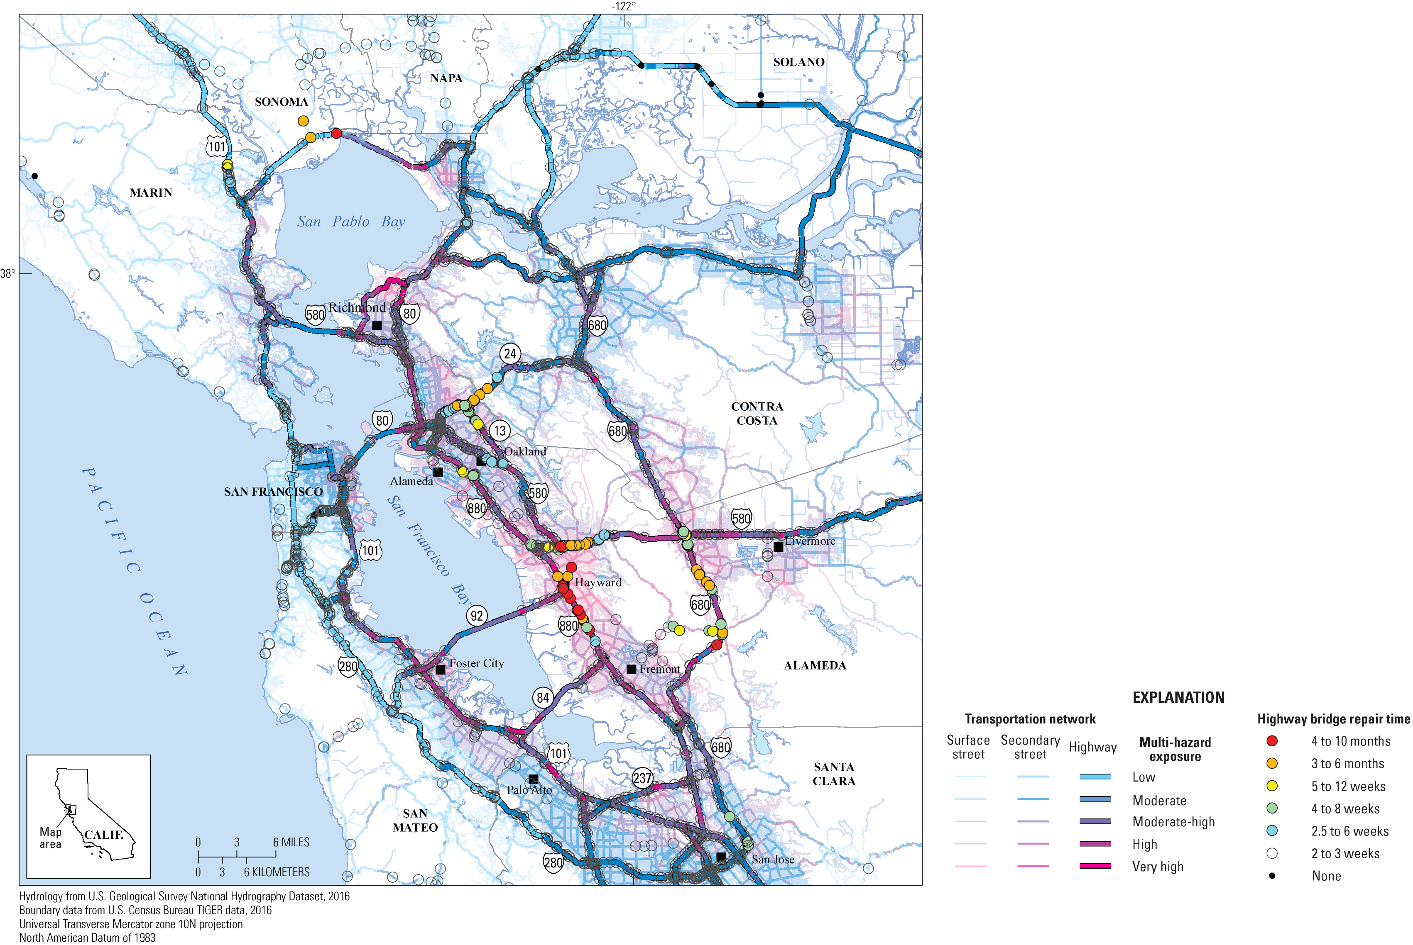
HayWired Scenario
Map showing repair times for highway bridges as determined by the California Department of Transportation relative to multi-hazard exposure in the HayWired Earthquake Scenario.
HayWired Scenario Volume 3: Chapter T, Appendix 5, Figure 4

Slide 8
HayWired Scenario
Estimates of potential populations at risk of displacement after the magnitude 7.0 mainshock in the HayWired Earthquake Scenario.
Economic subarea | Key locations in areas of concentrated damage¹ | Housing Characteristics² |  | Hazard Impacts |  |  |  |  | Notes
 |  | Age | Height (stories) | Shaking | Liquefaction | Landslide³ | Fire⁴ | Surface fault rupture⁵
Northern Alameda County | Parts of the cities of Albany and Berkeley south to Oakland and Alameda | Early 1900s to present | 1–3 | X | X | X | X | X | Older masonry and concrete residential structures are located in and around the university and downtown business district. Many “soft- story” structures in the area lack adequate seismic bracing on the bottom floors.
Central Alameda County | Parts of the city of Oakland south to Union City, as well as San Leandro, Castro Valley, and Hayward | Late 1800s to present | 1–4 | X | X | X | X | X | Older masonry and concrete residential structures are located in and around several business districts. Many “soft- story” structures in the area lack adequate seismic bracing on the bottom floors.
Southern Alameda County | Parts of the cities of Newark and Fremont | 1960s to present | 1–4 | X | X |  | X |  | Many “soft-story” structures in the area lack adequate seismic bracing on the bottom floors
Dublin–Pleasanton | Parts of the cities of Dublin and Pleasanton | 1960s to present | 1–5 | X | X |  | X |  | Many “soft-story” structures in the area lack adequate seismic bracing on the bottom floors.
HayWired Scenario Volume 3: Chapter U, Table 3, Part 1

Slide 9
Estimates of potential populations at risk of displacement after the magnitude 7.0 mainshock in the HayWired Earthquake Scenario.
HayWired Scenario
Economic subarea | Key locations in areas of concentrated damage¹ | Housing Characteristics² |  | Hazard Impacts |  |  |  |  | Notes
 |  | Age | Height (stories) | Shaking | Liquefaction | Landslide³ | Fire⁴ | Surface fault rupture⁵
Western Contra Costa County | Parts of the cities of Pinole and El Sobrante south to Richmond and El Cerrito, as well as the Kensington and North Richmond neighborhoods | 1940s to present | 1–2 | X | X | X | X | X | Many “soft-story” structures in the area lack adequate seismic bracing on the bottom floors. In addition, a few older masonry and concrete structures are located in and around the downtown business districts
Novato | Parts of the city of Novato, as well as the Bel Marin Keys and Hamilton neighborhoods | 1950s to present | 1–3 | X | X | X | X |  | Many “soft-story” structures in the area lack adequate seismic bracing on the bottom floors. In addition, a few older masonry and concrete structures are located in and around the downtown business districts
Vallejo | Parts of the city of Vallejo, particularly in and around the downtown business district | 1950s to present | 1–3 | X | X | X | X |  | Parts of the city of Vallejo, particularly in and around the downtown business district
¹Areas of concentrated damage have 20 percent or more of the building square footage in an extensive or complete damage state.
²Housing characteristics common across all economic subareas include predominantly wood-frame structures serving as single-family or multifamily housing.
³Landslides occur most commonly in areas with moderate or steep slopes.
⁴Post-earthquake fires pose high risk in areas of densely spaced wood-frame structures. Areas with high fire risk may include newly constructed buildings. ⁵Surface fault rupture may present as either coseismic slip (which occurs during an earthquake) or afterslip (which occurs in the days, weeks, months, and perhaps years after an earthquake). Surface fault rupture is not explicitly included in the Hazus damage estimates developed by Seligson and others (2018)
HayWired Scenario Volume 3: Chapter U, Table 3, Part 2

Slide 10
Estimated building-restoration delays following the magnitude 7.0 mainshock of the HayWired Earthquake Scenario.
HayWired Scenario
Residential dwelling type | Hazus damage state
 | Slight | Moderate | Extensive | Complete
Structural and nonstructural repair cost ratios (percentage of building replacement cost)
Single family (RES1) | 2 | 10 | 44.7 | 100
Duplex (RES3A) | 2 | 10 | 41.3 | 100
Multifamily (RES3B–F) | 2 | 10 | 41.3 | 100
Median time for building repair and return to function (number of days)
Single family (RES1) | 2–5 | 30–120 | 90–360 | 180–720
Duplex (RES3A) | 5–10 | 30–120 | 120–480 | 240–960
Multifamily (RES3B–F) | 5–10 | 30–120 | 120–480 | 240–960
[Codes in parentheses are Hazus occupancy classes. Single-family and duplex dwellings are listed separately since Hazus assigns the same repair cost ratios and recovery times to duplexes as it does to other multifamily dwellings. Data from Federal Emergency Management Agency (2012)]
HayWired Scenario Volume 3: Chapter U, Table A1

Slide 11
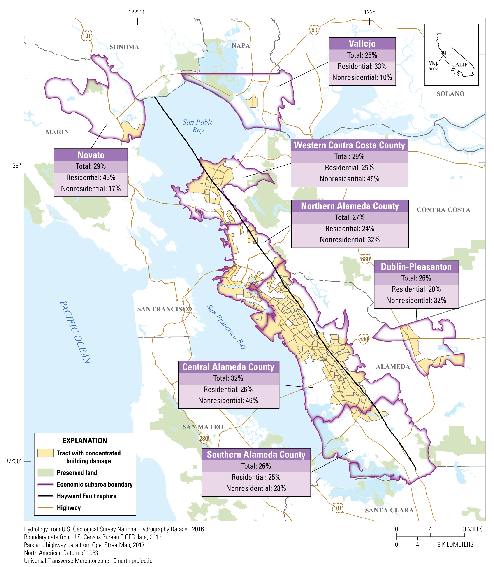
HayWired Scenario
Map showing areas of concentrated damage in economic subareas as a result of hazards caused by the HayWired Earthquake Scenario mainshock. Areas of concentrated damage are defined as census tracts with 20% or more of the total building square footage in extensive or complete damage from ground shaking, liquefaction, landslide, and fire damages. For each economic subarea, the percentage of residential, nonresidential, and total building square footage in an extensive or complete damage state from the integrated damages are also provided.
HayWired Scenario Volume 3: Chapter U, Figure 4

Slide 12
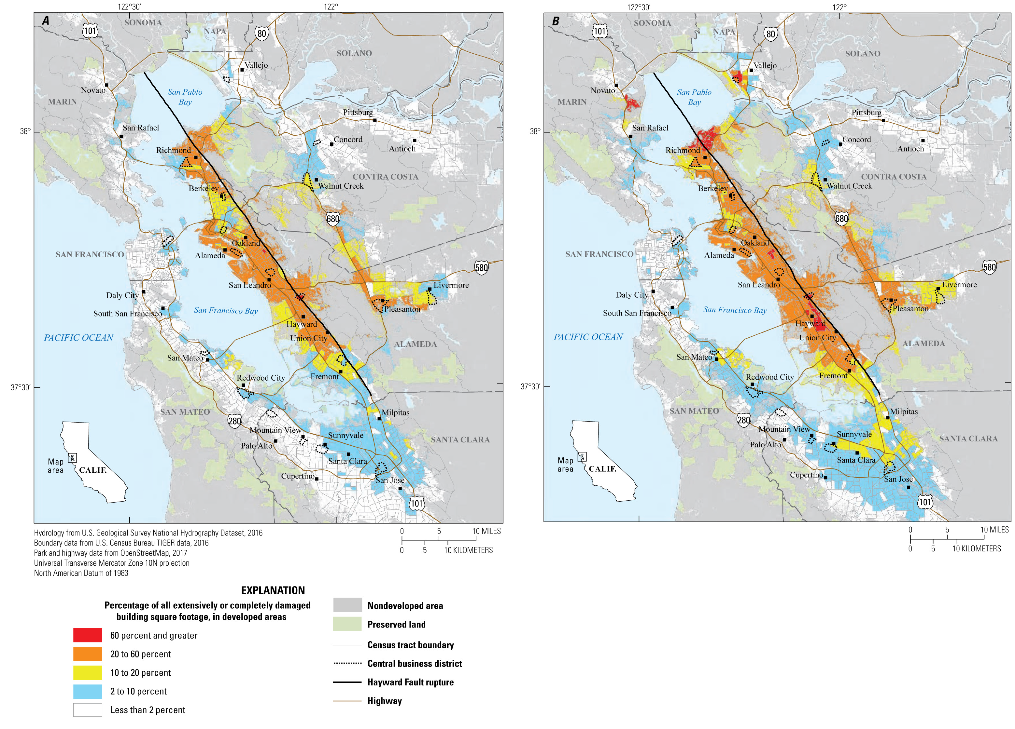
HayWired Scenario
Maps showing census tracts with concentrations of building damage for multifamily dwellings in the HayWired Earthquake Scenario
mainshock. Multifamily dwellings that have three or more housing units per structure. Descriptions of the 2 maps: A, Shaking, landslide, and liquefaction hazards only (without fire). B, Shaking, landslide, liquefaction, and fire hazards.
HayWired Scenario Volume 3: Chapter U, Figure A3

Slide 13
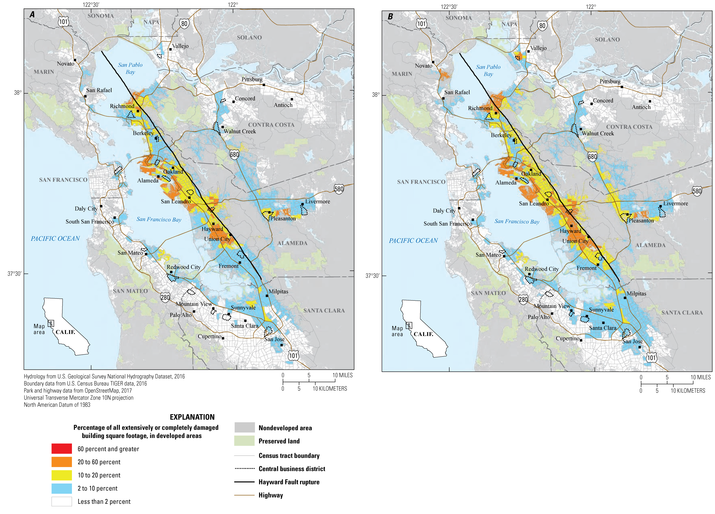
HayWired Scenario
Maps showing census tracts with concentrations of building damage for single-family and duplex dwellings in the HayWired
Earthquake Scenario mainshock. Descriptions of the 2 maps:
A, Shaking, landslide, and liquefaction hazards only (without fire). B, Shaking, landslide, liquefaction, and fire hazards.
HayWired Scenario Volume 3: Chapter U, Figure A4

Slide 14
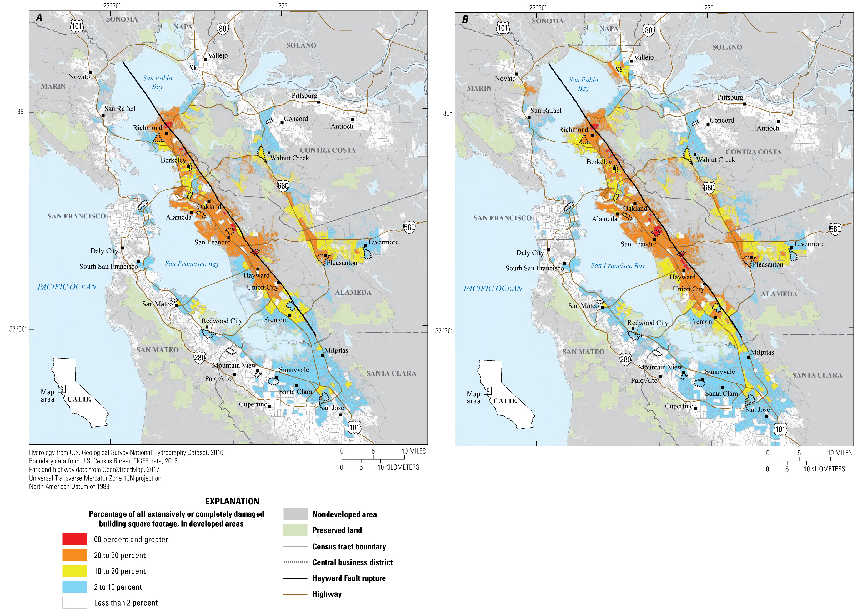
HayWired Scenario
Maps showing census tracts with concentrations of damage to household- serving uses (for example, hospitals, schools, and places of worship) in the HayWired Earthquake Scenario mainshock. Descriptions of the 2 maps: A, Shaking, landslide, and liquefaction hazards only (without fire). B, Shaking, landslide, liquefaction, and fire hazards.
HayWired Scenario Volume 3: Chapter U, Figure A4

Slide 15
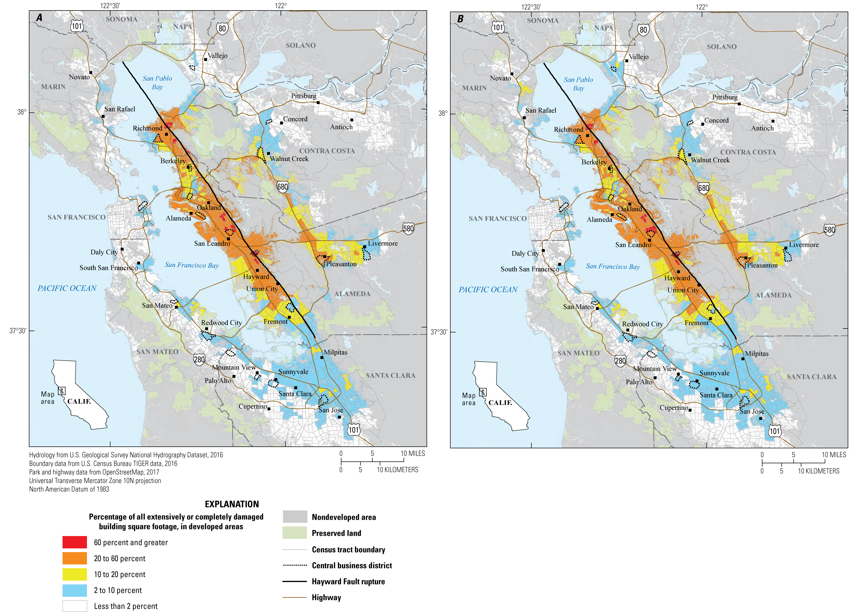
HayWired Scenario
Maps showing census tracts with concentrations of building damage to retail and commercial uses (for example, hotels, retail trade, banks, entertainment and recreation, and parking)
in the HayWired Earthquake Scenario mainshock.
Descriptions of the 2 maps: A, Shaking, landslide, and liquefaction hazards only (without fire). B, Shaking,
landslide, liquefaction, and fire hazards.
HayWired Scenario Volume 3: Chapter U, Figure A7
14

