Slide 2
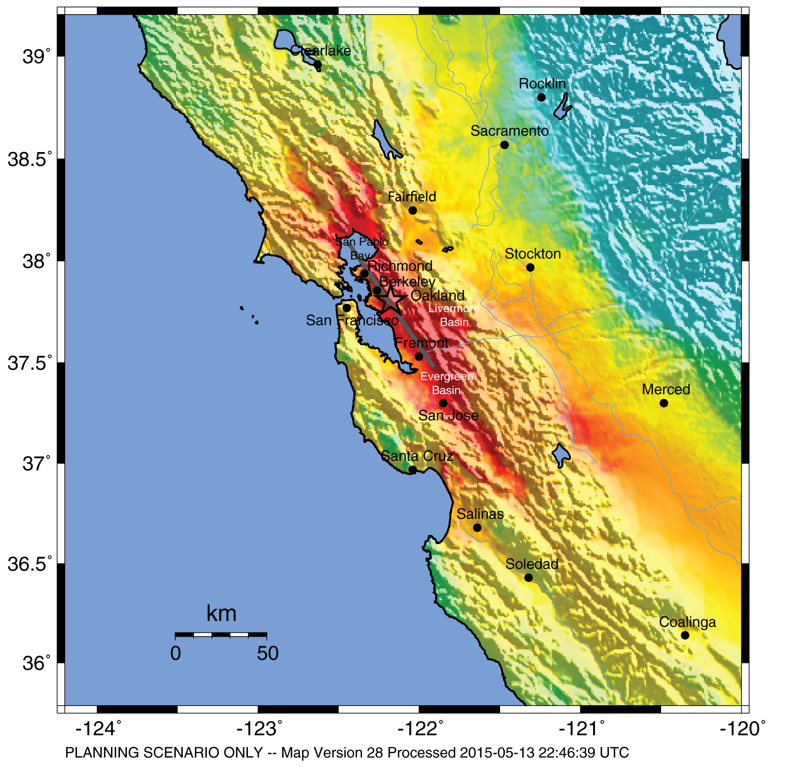
HayWired Scenario
U.S. Geological Survey ShakeMap of the HayWired Earthquake Scenario’s hypothetical magnitude 7.0 mainshock.
HayWired Scenario Volume 1: Chapter A, Figure 4
1

Slide 3
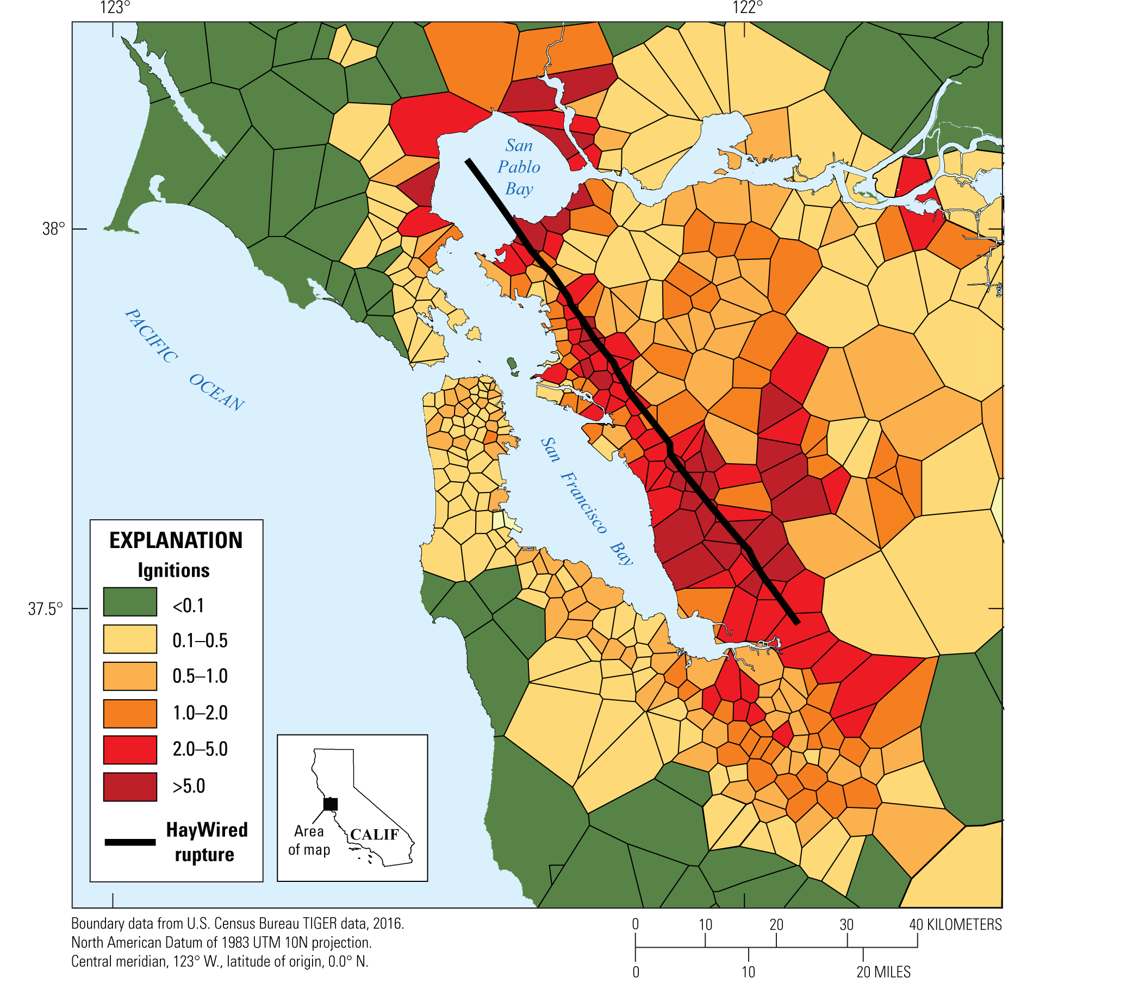
HayWired Scenario
Map showing estimated number of ignitions within fire
station primary response areas following the magnitude
7.0 mainshock of the HayWired Earthquake Scenario. Green indicates a small likelihood of ignition and dark red indicates five or more ignitions per area. The length of the Hayward Fault ruptured in the Scenario is shown on the map.
HayWired Scenario Volume 2: Chapter P, Figure 19
2

Slide 4
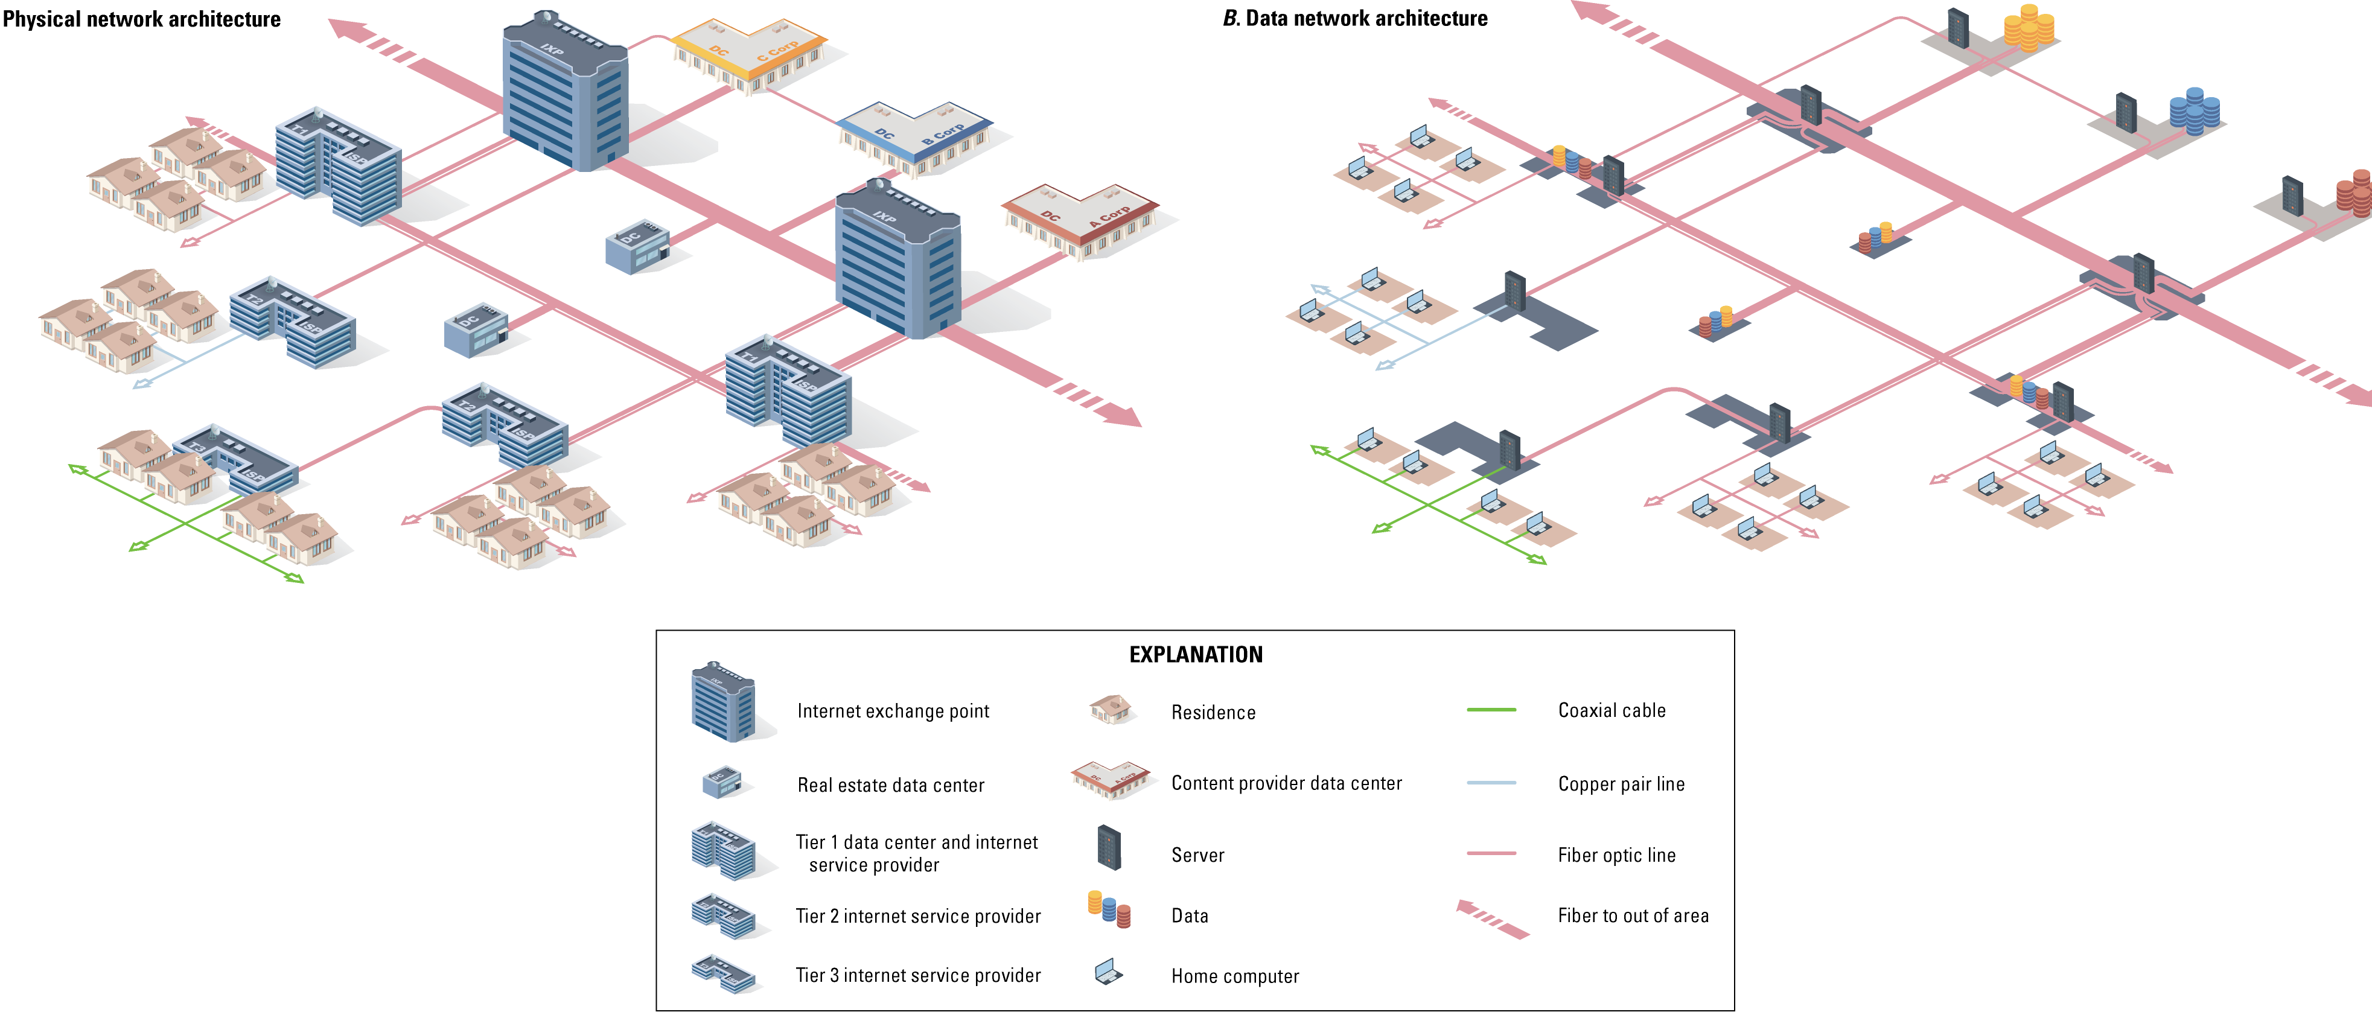
HayWired Scenario
Diagram illustrating an example of an internet-based system. The internet is a network of networks, connected together by common protocols that enable sharing of data in an office or anywhere around the world. Note that this representation of the internet is to show its parts, but not imply that it is isolated from other telecommunications systems, such as voice over internet protocol (VoIP) applications and cellular networks, that access the internet.
HayWired Scenario Volume 3: Chapter S, Figure 4
3

Slide 5
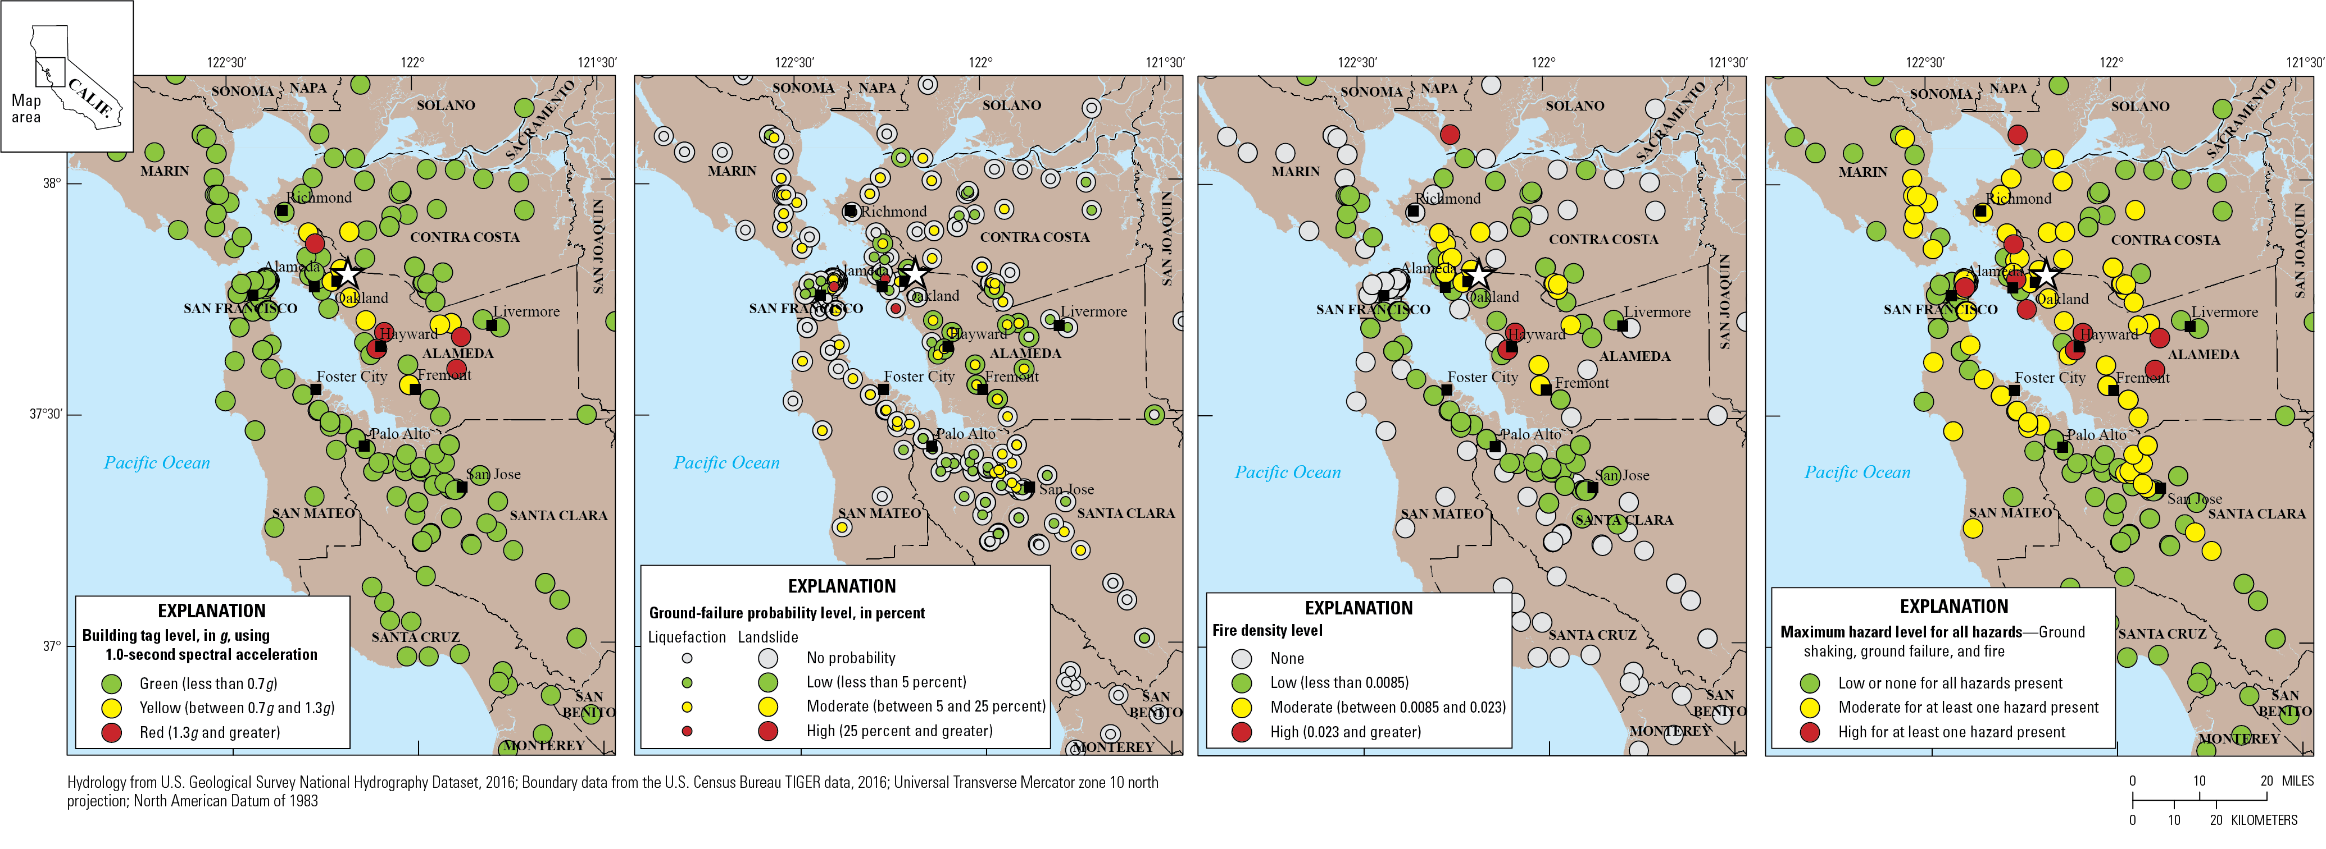
HayWired Scenario
A
B
C
D
Maps showing damage and exposure to HayWired Earthquake Scenario mainshock hazards for central offices (telecommunications). White star shows the mainshock epicenter. Descriptions of the 4 maps: A, Map of potential building tagging from shaking for central offices assuming moderate code (overturning of unanchored equipment also possible in yellow-tagged and red-tagged buildings). g is acceleration due to gravity. B, Map of central office exposure to ground-failure hazards (liquefaction and landslide). C, Map of central office exposure to fire following earthquake hazards (represented
by fire density level—burned-building square footage relative to the developed area containing the fires). D, Map of central
offices affected by maximum level of hazard from shaking, ground failure, and fire.
HayWired Scenario Volume 3: Chapter S, Figure 8
4

Slide 6
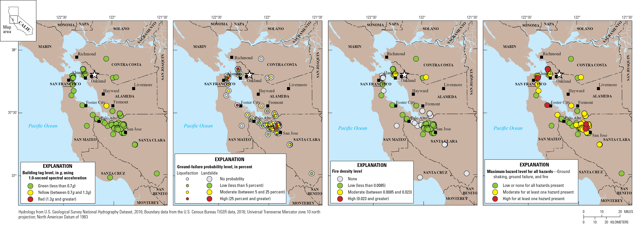
HayWired Scenario
A
B
C
D
Maps showing damage and exposure to HayWired Earthquake Scenario mainshock hazards for data centers. White star shows the mainshock epicenter. Descriptions of the 4 maps: A, Map of potential building tagging from shaking for data centers assuming moderate code (overturning of unanchored equipment also possible in yellow-tagged and red-
tagged buildings). g is acceleration due to gravity. B, Map of data center exposure to ground-failure hazards (liquefaction and landslide). C, Map of data center exposure to fire following earthquake hazards (represented by fire density level—burned- building square footage relative to the developed area containing the fires). D, Map of data centers affected by maximum level of hazard from shaking, ground failure, and fire.
HayWired Scenario Volume 3: Chapter S, Figure 10
5

Slide 7
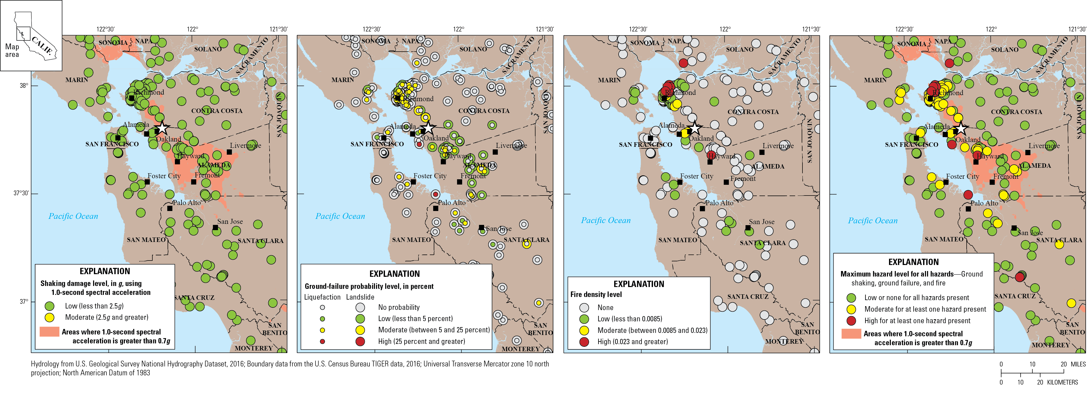
HayWired Scenario
A
B
C
D
Maps showing damage and exposure to HayWired Earthquake Scenario mainshock hazards for self-supporting towers (SST) and guyed towers (GT). White star shows the mainshock epicenter. Descriptions of the 4 maps: A, Map of potential damage to SSTs and GTs from shaking (overturning of unanchored equipment also possible in shaded areas). B, Map of SST and GT exposure to ground-failure hazards (liquefaction and landslide). C, Map of SST and GT exposure to fire following earthquake hazards (represented by fire density level—the burned-building square footage relative to the developed area containing the fires). D, Map of SST and GT affected by maximum level of hazard from shaking, ground failure, and fire. g is acceleration due to gravity.
HayWired Scenario Volume 3: Chapter S, Figure 11
6

Slide 8
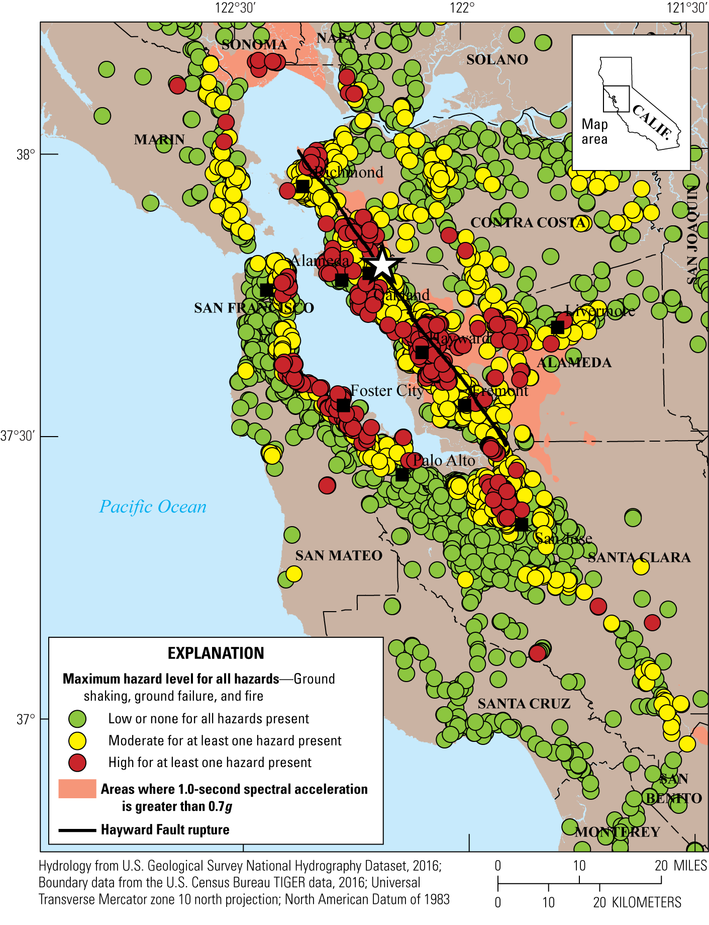
HayWired Scenario
Map showing combined hazards for all types of cellular sites for the HayWired Earthquake Scenario mainshock in the Bay Area. Each cellular site is identified based on the highest level of hazard mapped for shaking, liquefaction and landslide probability, and fire density (burned-building square footage relative to the developed area containing the fires).
White star shows the mainshock epicenter. g, acceleration
due to gravity.
HayWired Scenario Volume 3: Chapter S, Figure 11
7

Slide 9
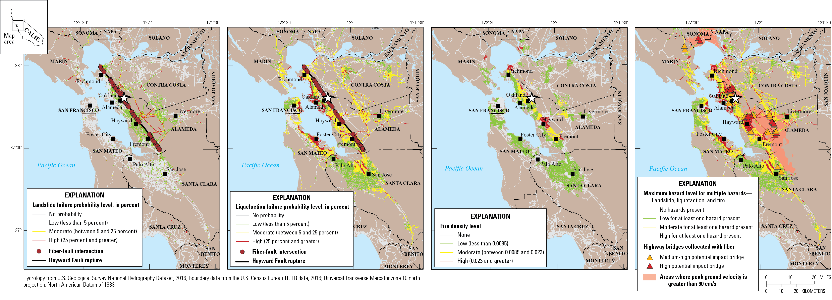
HayWired Scenario
A
B
C
D
Maps showing the exposure of fiber optic lines to various hazards from the HayWired Earthquake Scenario mainshock. White star shows the mainshock epicenter. Descriptions of the 4 maps: A, Map of fiber optic line exposure to landslide hazards. B, Map of fiber optic line exposure to liquefaction hazards. C, Map of fiber optic line exposure to fire density hazards (defined as the burned-building square footage relative to the developed area containing the fires). D,
Map of bridges classified as medium-high or high potential impact that carry fiber optic lines relative to multiple HayWired Earthquake Scenario mainshock hazards (landslide, liquefaction, and fire density). cm/s, centimeters per second.
HayWired Scenario Volume 3: Chapter S, Figure 15
8

Slide 10
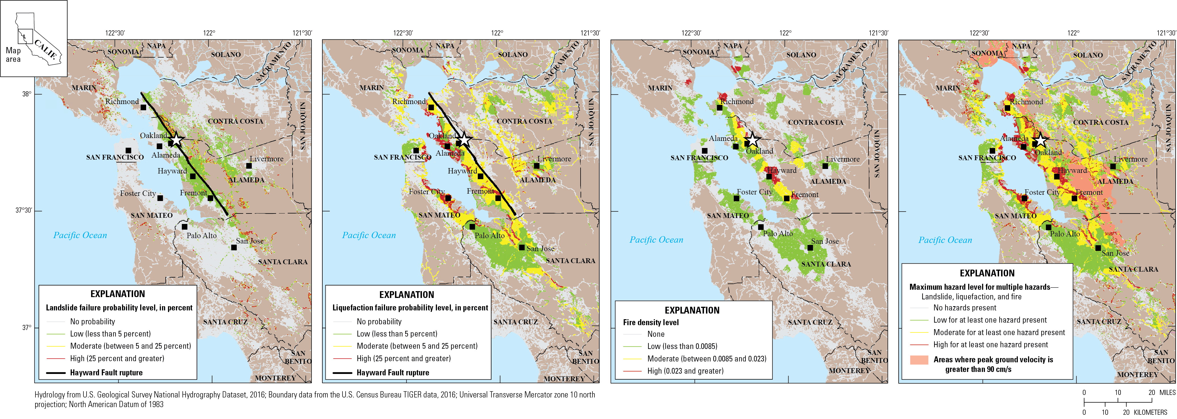
HayWired Scenario
A
B
C
D
Maps showing the exposure of surface streets (a proxy for copper and coaxial lines) to various hazards for the HayWired Earthquake Scenario mainshock. White star shows the mainshock epicenter. Descriptions of the 4 maps: A, Map of surface street exposure to landslide hazards. B, Map of surface street exposure to liquefaction hazards. C, Map of surface street exposure to fire density hazards (defined as the burned-building square footage relative to the developed area containing the fires). D, Map of surface street exposure relative to multiple HayWired Earthquake Scenario mainshock hazards (landslide, liquefaction, and fire density). cm/s, centimeters per second.
HayWired Scenario Volume 3: Chapter S, Figure 17
9

Slide 11
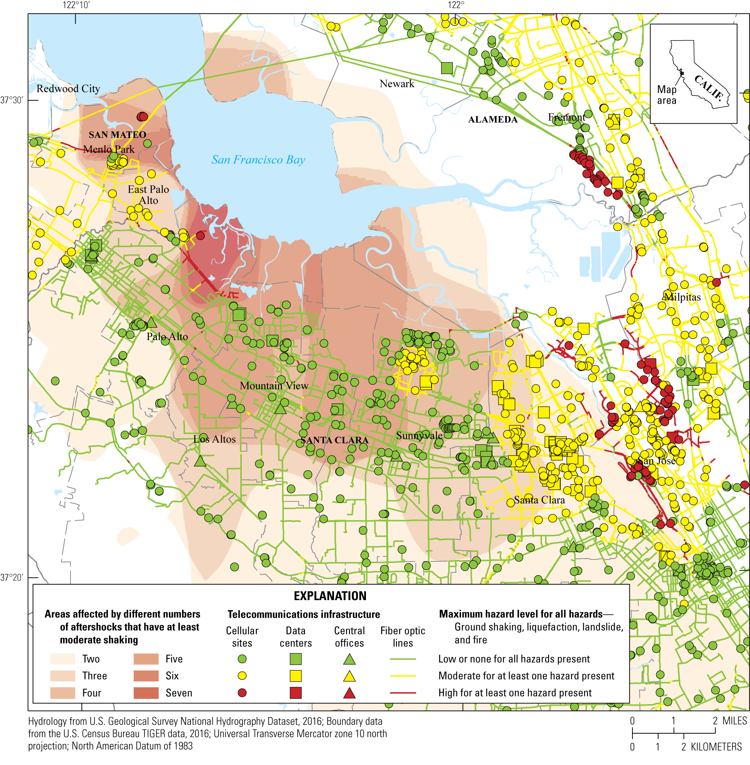
HayWired Scenario
Map showing HayWired Earthquake Scenario mainshock impacts from all hazards to telecommunications infrastructure (ground shaking, liquefaction, landslide, and fire following earthquake) compared to exposure to aftershock shaking in San Mateo and Santa Clara Counties.
HayWired Scenario Volume 3: Chapter S, Figure 18
10

Slide 12
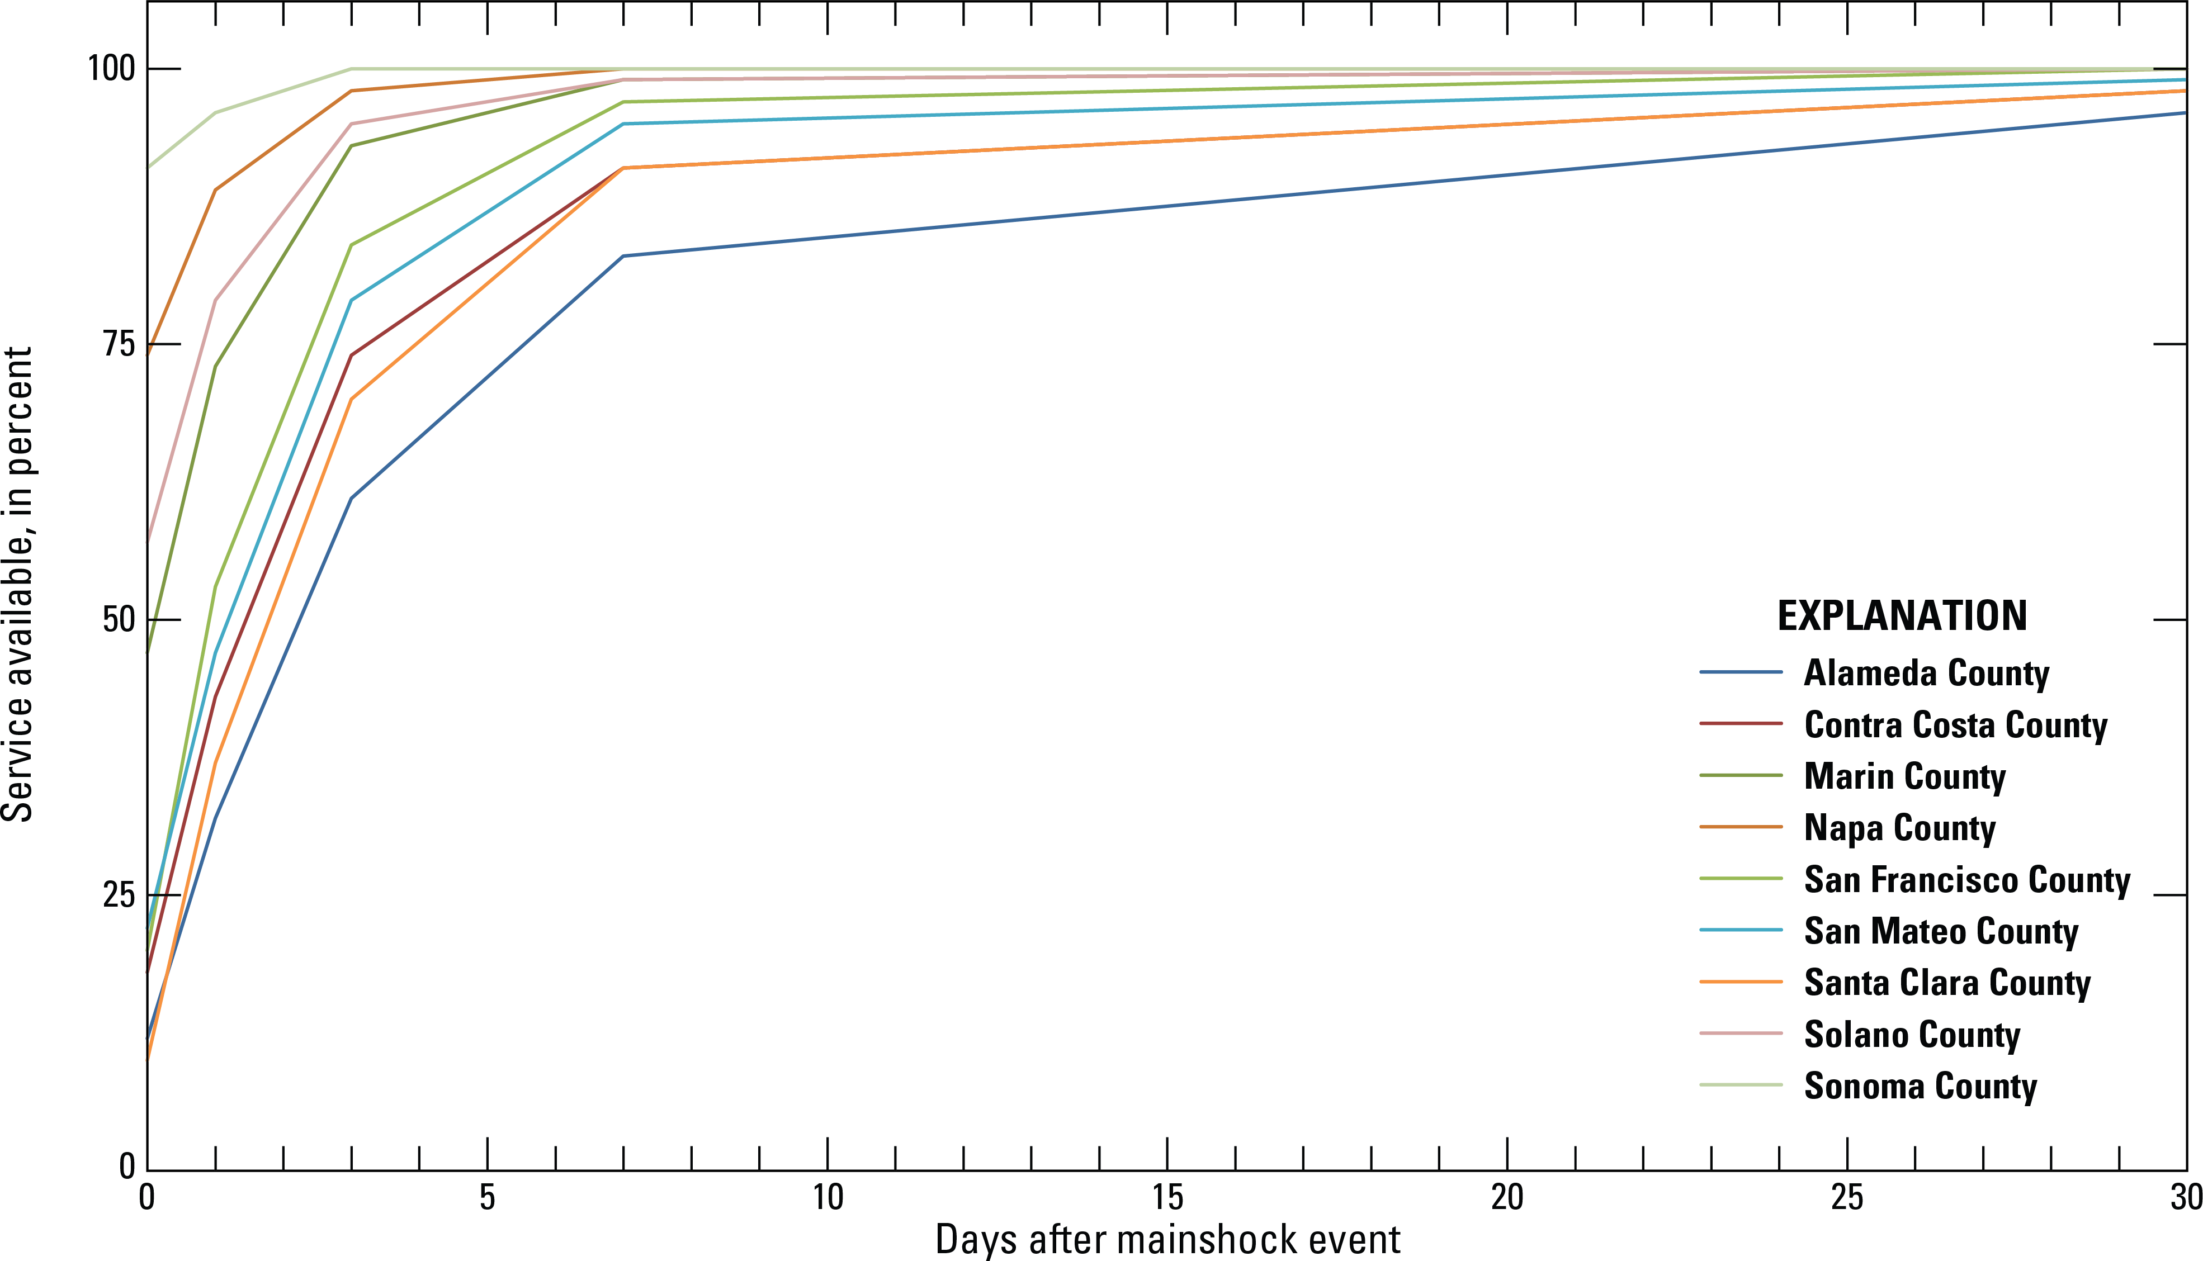
HayWired Scenario
Line graph showing the electric power restoration curves by county for the HayWired Earthquake Scenario mainshock.
HayWired Scenario Volume 3: Chapter S, Figure 20
11

Slide 13
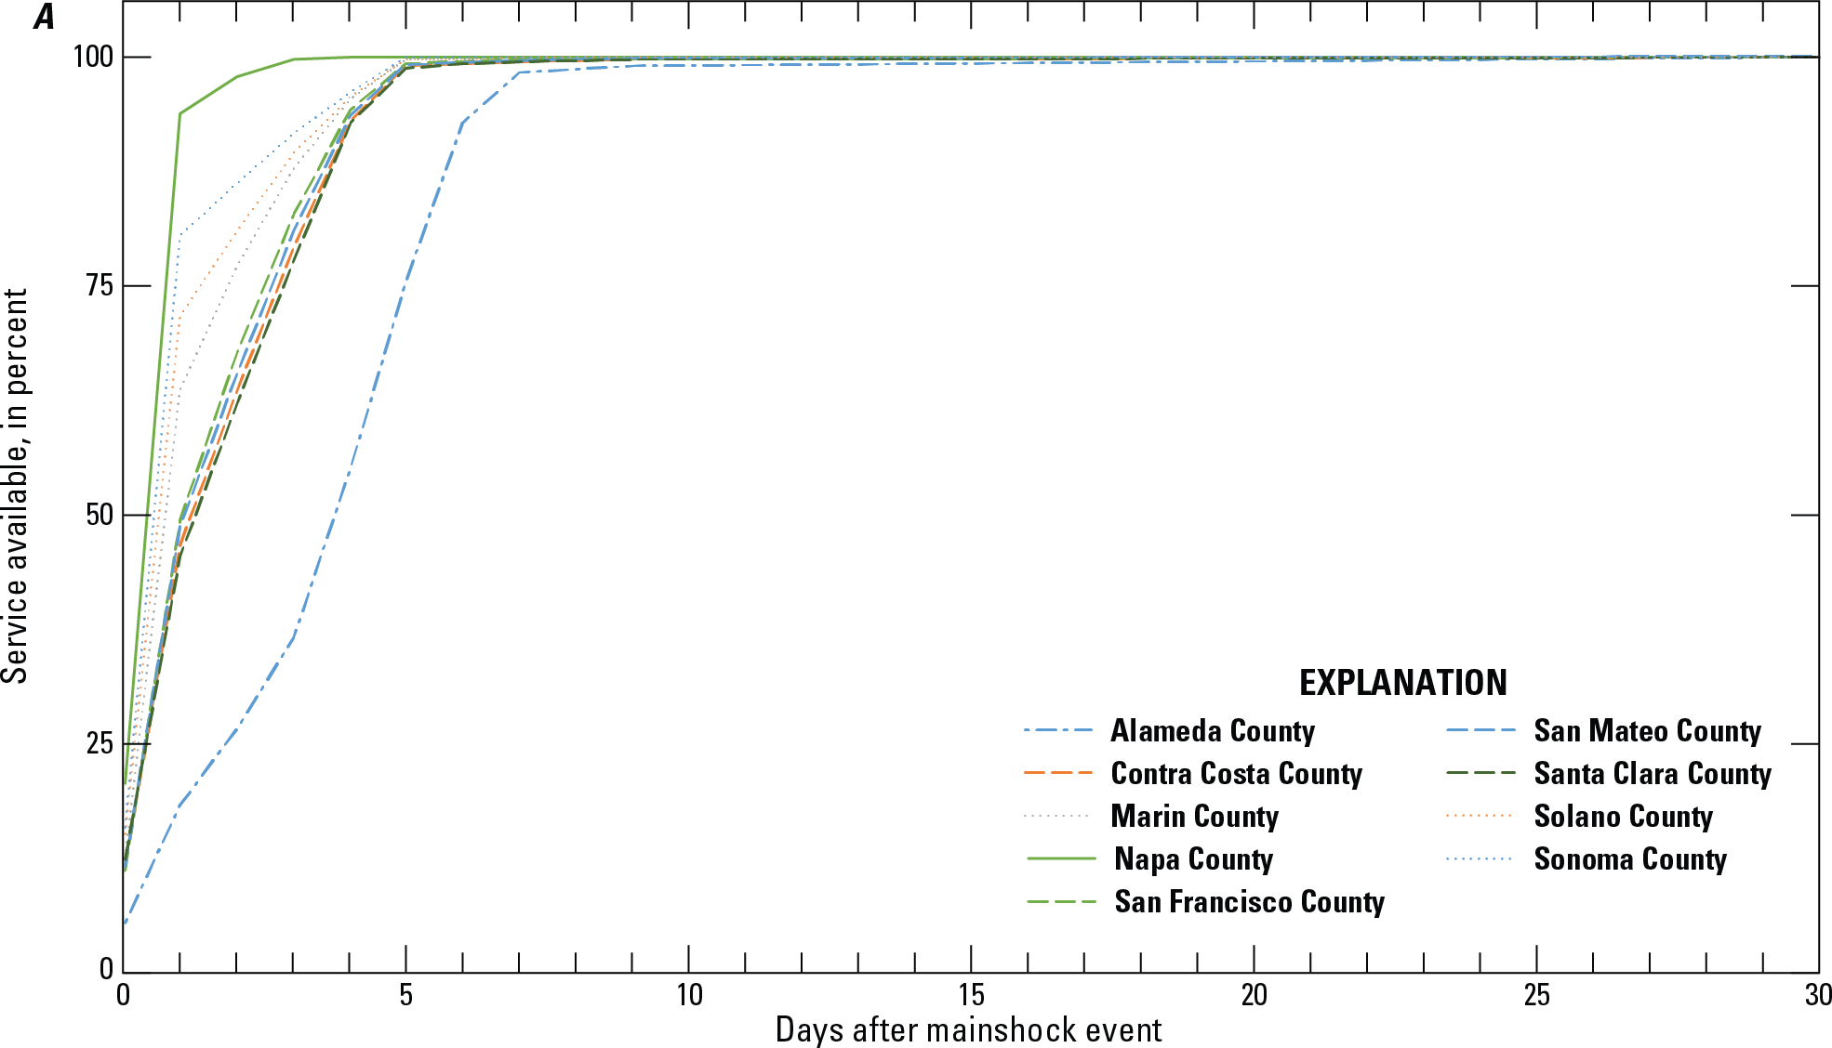
HayWired Scenario
Line graphs showing voice and data restoration curves by county for the HayWired Earthquake Scenario mainshock.
These curves include the following assumptions: use of batteries and/or generators, deployment of portable equipment (including cells on wheels [COWs] and cells on
light truck [COLTs]), and management of user behavior. Demand surge impacts are included in the estimation.
HayWired Scenario Volume 3: Chapter S, Figure 24A
12

Slide 14
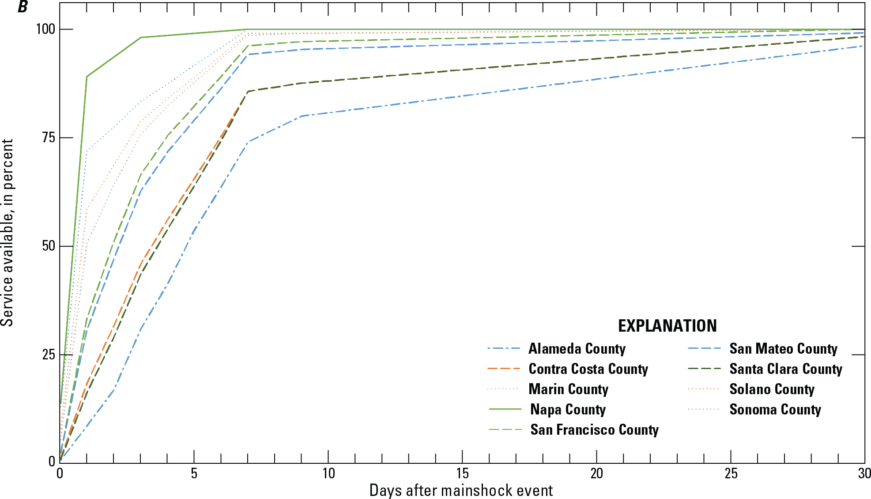
HayWired Scenario
Line graphs showing voice and data restoration curves by county for the HayWired Earthquake Scenario mainshock. The curves are based on system restoration dependent
on electric power restoration without the use of batteries and/or generators, deployment of portable equipment (including cells on wheels [COWs] and cells on
light truck [COLTs]), and management of user behavior.
HayWired Scenario Volume 3: Chapter S, Figure 24B
13

Slide 15
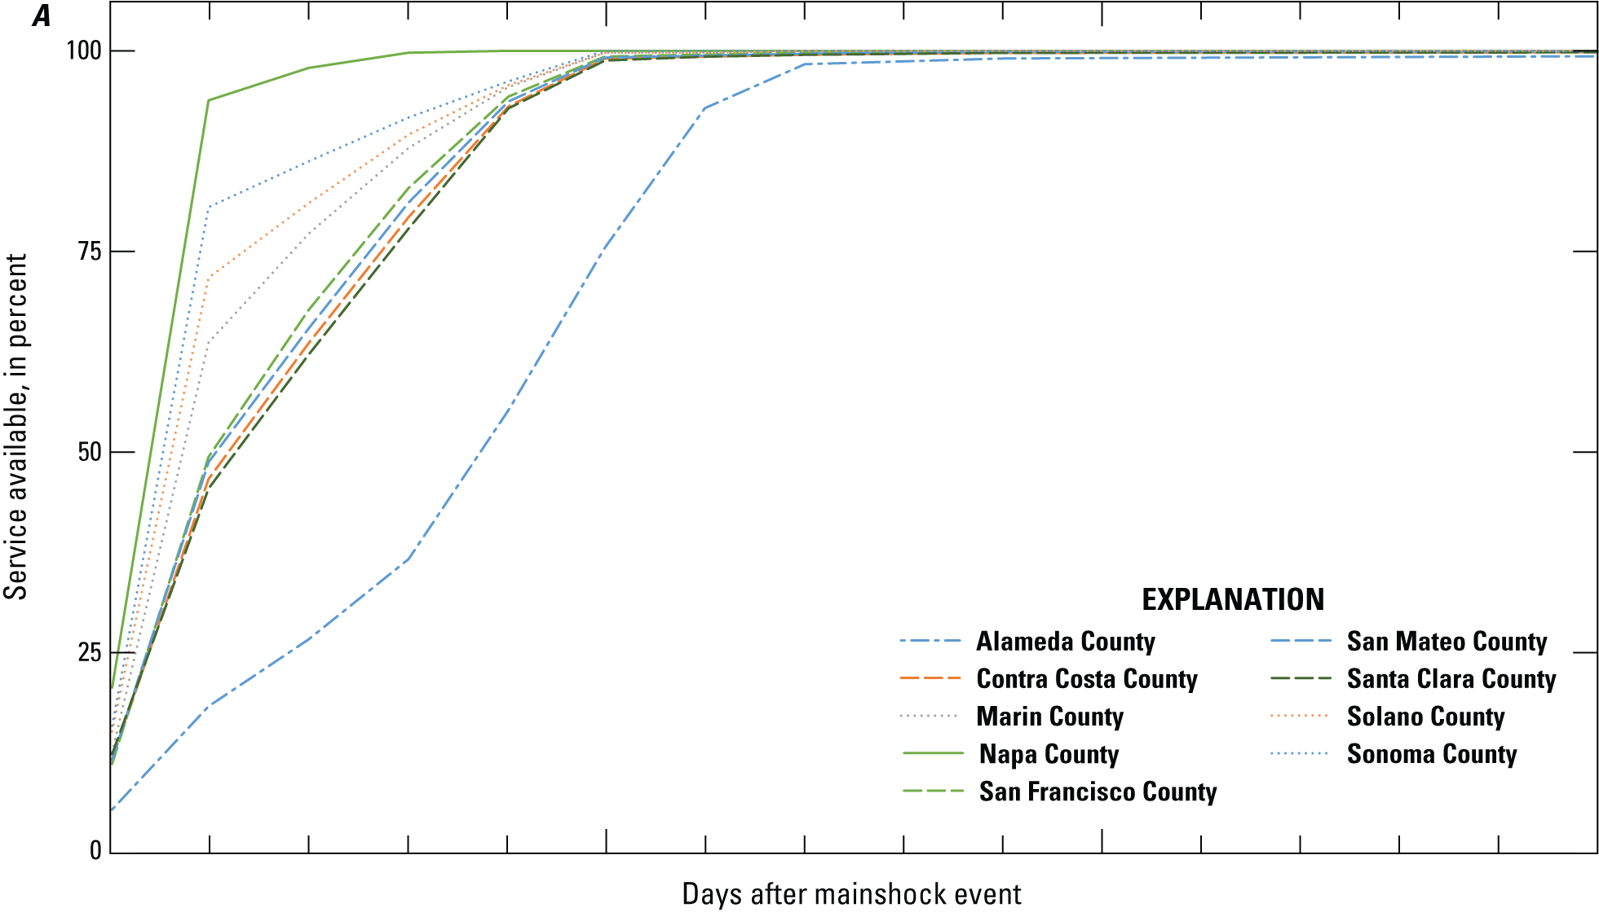
HayWired Scenario
Line graphs showing voice and data restoration curves by county for the HayWired Earthquake Scenario mainshock.
These curves include the following assumptions: use of batteries and/or generators, deployment of portable equipment (including cells on wheels [COWs] and cells on
light truck [COLTs]), and management of user behavior. Demand surge impacts are included in the estimation.
HayWired Scenario Exercise Toolkit: Telecommunications Restoration Curves, A
14

Slide 16
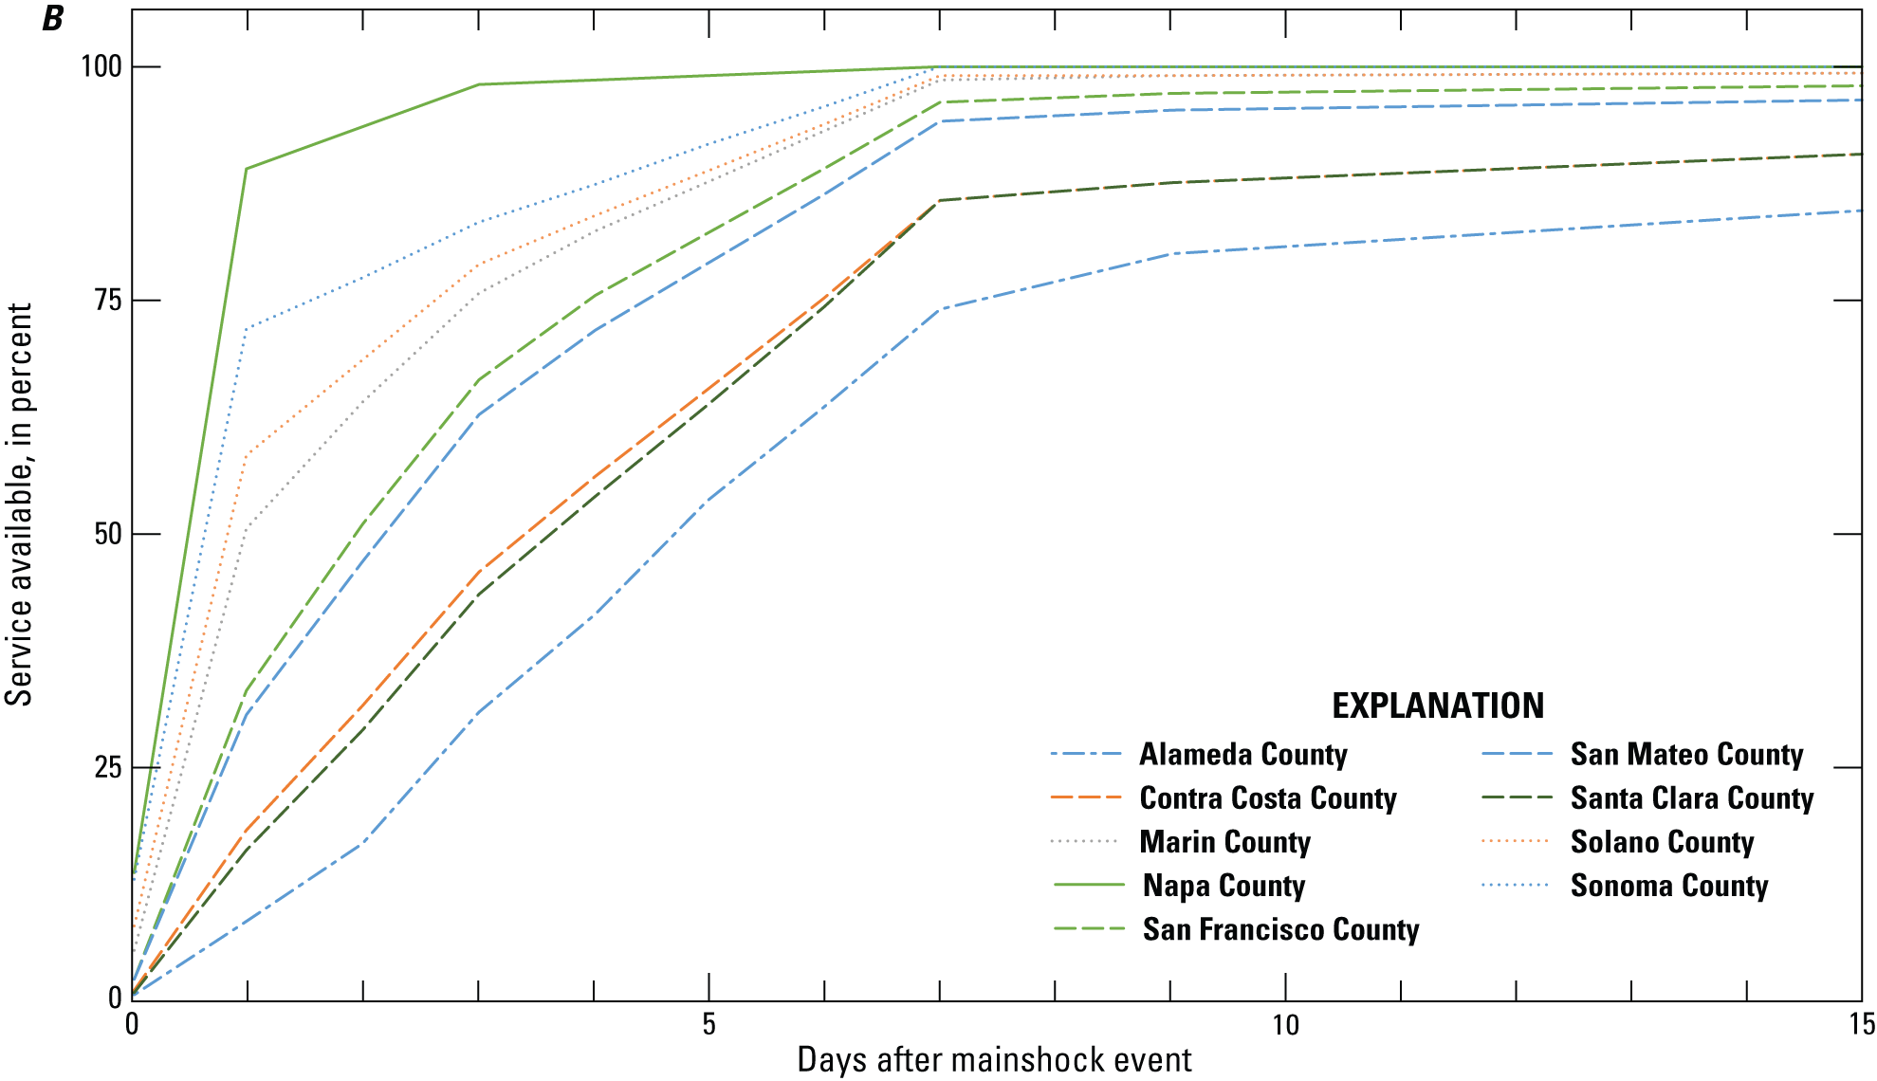
HayWired Scenario
Line graphs showing voice and data restoration curves by county for the HayWired Earthquake Scenario mainshock. The curves are based on system restoration dependent
on electric power restoration without the use of batteries and/or generators, deployment of portable equipment (including cells on wheels [COWs] and cells on
light truck [COLTs]), and management of user behavior.
HayWired Scenario Exercise Toolkit: Telecommunications Restoration Curves, B
15

Slide 17
HayWired Scenario
Exposure of telecommunications infrastructure to ground shaking from the HayWired Earthquake Scenario mainshock.
Total in study area | Fiber routes, long-haul (km) | Fiber routes, interoffice (km) | Cellular sites | Fiber-lit buildings, data centers | Fiber-lit buildings, central offices | Fiber-lit buildings, point of presence | Wireless switch offices | Internet exchange points | Microwave towers | AM radio antennas | FM radio antennas | NTSC television transmitters | Digital television transmitters
Mainshock ground shaking
Low exposure | 2,270 | 12,649 | 2,744 | 17 | 204 | 8,902 | 11 | 0 | 1,297 | 27 | 218 | 31 | 20
Percentage exposed | 38% | 27% | 33% | 4% | 30% | 22% | 21% | 0% | 34% | 35% | 67% | 84% | 39%
Moderate exposure | 3,025 | 27,943 | 4,471 | 345 | 436 | 26,677 | 39 | 8 | 2,192 | 45 | 96 | 6 | 31
Percentage exposed | 50% | 60% | 54% | 81% | 65% | 66% | 74% | 73% | 58% | 58% | 29% | 16% | 61%
High exposure | 754 | 6,200 | 1,096 | 66 | 33 | 5,149 | 3 | 3 | 318 | 6 | 12 | 0 | 0
Percentage exposed | 12% | 13% | 13% | 15% | 5% | 13% | 6% | 27% | 8% | 8% | 4% | 0% | 0%
Total exposure | 6,049 | 46,793 | 8,311 | 428 | 673 | 40,728 | 53 | 11 | 3,807 | 78 | 326 | 37 | 51
Percentage exposed | 100% | 100% | 100% | 100% | 100% | 100% | 100% | 100% | 100% | 100% | 100% | 100% | 100%
[Exposure is detailed by amount (kilometers or number of facilities) and percentage (relative to the entire study region) of affected infrastructure. Owing to rounding, amounts and percentages within exposure classes for an individual hazard may not add up to the total exposed. km, kilometers; AM, amplitude modulation; FM, frequency modulation; NTSC, National Television System Committee]
HayWired Scenario Volume 3: Chapter T, Appendix 2, Table 2.6, Part 1
16

Slide 18
HayWired Scenario
Exposure of telecommunications infrastructure to liquefaction hazards from the HayWired Earthquake Scenario.
Total in study area | Fiber routes, long-haul (km) | Fiber routes, interoffice (km) | Cellular sites | Fiber-lit buildings, data centers | Fiber-lit buildings, central offices | Fiber-lit buildings, point of presence | Wireless switch offices | Internet exchange points | Microwave towers | AM radio antennas | FM radio antennas | NTSC television transmitters | Digital television transmitters
Liquefaction
Low exposure | 680 | 5,934 | 1,392 | 205 | 135 | 10,144 | 9 | 9 | 612 | 11 | 2 | 0 | 0
Percentage exposed | 11% | 13% | 17% | 48% | 20% | 25% | 17% | 82% | 16% | 14% | 1% | 0% | 0%
Moderate exposure | 1,495 | 7,134 | 1,581 | 173 | 151 | 12,064 | 11 | 2 | 609 | 5 | 6 | 0 | 0
Percentage exposed | 25% | 15% | 19% | 40% | 22% | 30% | 21% | 18% | 16% | 6% | 2% | 0% | 0%
High exposure | 260 | 1,064 | 389 | 11 | 5 | 2,516 | 0 | 0 | 220 | 11 | 0 | 0 | 0
Percentage exposed | 4% | 2% | 5% | 3% | 1% | 6% | 0% | 0% | 6% | 14% | 0% | 0% | 0%
Total exposure | 2,435 | 14,132 | 3,362 | 389 | 291 | 24,724 | 20 | 11 | 1,441 | 27 | 8 | 0 | 0
Percentage exposed | 40% | 30% | 40% | 91% | 43% | 61% | 38% | 100% | 38% | 35% | 2% | 0% | 0%
[Exposure is detailed by amount (kilometers or number of facilities) and percentage (relative to the entire study region) of affected infrastructure. Owing to rounding, amounts and percentages within exposure classes for an individual hazard may not add up to the total exposed. km, kilometers; AM, amplitude modulation; FM, frequency modulation; NTSC, National Television System Committee]
17

Slide 19
HayWired Scenario
Exposure of telecommunications infrastructure to landslide hazards from the HayWired Earthquake Scenario.
Total in study area | Fiber routes, long-haul (km) | Fiber routes, interoffice (km) | Cellular sites | Fiber-lit buildings, data centers | Fiber-lit buildings, central offices | Fiber-lit buildings, point of presence | Wireless switch offices | Internet exchange points | Microwave towers | AM radio antennas | FM radio antennas | NTSC television transmitters | Digital television transmitters
Landslide
Low exposure | 889 | 5,356 | 690 | 1 | 41 | 3,078 | 1 | 0 | 261 | 2 | 17 | 2 | 3
Percentage exposed | 15% | 11% | 8% | <1% | 6% | 8% | 2% | 0% | 7% | 3% | 5% | 5% | 6%
Moderate exposure | 22 | 549 | 33 | 0 | 0 | 37 | 0 | 0 | 21 | 0 | 2 | 0 | 0
Percentage exposed | <1% | 1% | <1% | 0% | 0% | <1% | 0% | 0% | 1% | 0% | 1% | 0% | 0%
High exposure | 14 | 816 | 13 | 0 | 0 | 32 | 0 | 0 | 18 | 0 | 0 | 0 | 0
Percentage exposed | <1% | 2% | <1% | 0% | 0% | <1% | 0% | 0% | <1% | 0% | 0% | 0% | 0%
Total exposure | 925 | 6,721 | 736 | 1 | 41 | 3,147 | 1 | 0 | 300 | 2 | 19 | 2 | 3
Percentage exposed | 15% | 14% | 9% | <1% | 6% | 8% | 2% | 0% | 8% | 3% | 6% | 5% | 6%
[Exposure is detailed by amount (kilometers or number of facilities) and percentage (relative to the entire study region) of affected infrastructure. Owing to rounding, amounts and percentages within exposure classes for an individual hazard may not add up to the total exposed. km, kilometers; AM, amplitude modulation; FM, frequency modulation; NTSC, National Television System Committee]
17

Slide 20
HayWired Scenario
Exposure of telecommunications infrastructure to fires following earthquake hazards from the HayWired Earthquake Scenario.
Total in study area | Fiber routes, long-haul (km) | Fiber routes, interoffice (km) | Cellular sites | Fiber-lit buildings, data centers | Fiber-lit buildings, central offices | Fiber-lit buildings, point of presence | Wireless switch offices | Internet exchange points | Microwave towers | AM radio antennas | FM radio antennas | NTSC television transmitters | Digital television transmitters
Fire following earthquake
Percentage developed¹ | 63% | 60% | 73% | 98% | 95% | 95% | 96% | 100% | 66% | 22% | 18% | 11% | 27%
Low exposure | 1,029 | 7,882 | 2,054 | 287 | 158 | 14,650 | 11 | 8 | 905 | 9 | 7 | 0 | 0
Percentage exposed | 17% | 17% | 25% | 67% | 23% | 36% | 21% | 73% | 24% | 12% | 2% | 0% | 0%
Moderate exposure | 287 | 1,284 | 251 | 3 | 38 | 2,264 | 1 | 0 | 111 | 0 | 2 | 0 | 0
Percentage exposed | 5% | 2% | 3% | 1% | 6% | 6% | 2% | 0% | 3% | 0% | 1% | 0% | 0%
High exposure | 254 | 409 | 119 | 0 | 9 | 540 | 0 | 0 | 40 | 0 | 2 | 0 | 0
Percentage exposed | 4% | 1% | 1% | 0% | 1% | 1% | 0% | 0% | 1% | 0% | 1% | 0% | 0%
Total exposure | 1,570 | 9,575 | 2,424 | 290 | 205 | 17,454 | 12 | 8 | 1,056 | 9 | 11 | 0 | 0
Percentage exposed | 26% | 20% | 29% | 68% | 30% | 43% | 23% | 73% | 28% | 12% | 3% | 0% | 0%
[Exposure is detailed by amount (kilometers or number of facilities) and percentage (relative to the entire study region) of affected infrastructure. Owing to rounding, amounts and percentages within exposure classes for an individual hazard may not add up to the total exposed. km, kilometers; AM, amplitude modulation; FM, frequency modulation; NTSC, National Television System Committee]
17

Slide 21
Exposure of telecommunications infrastructure to aftershocks from the HayWired Earthquake Scenario.
HayWired Scenario
Total in study area | Fiber routes, long-haul (km) | Fiber routes, interoffice (km) | Cellular sites | Fiber-lit buildings, data centers | Fiber-lit buildings, central offices | Fiber-lit buildings, point of presence | Wireless switch offices | Internet exchange points | Microwave towers | AM radio antennas | FM radio antennas | NTSC television transmitters | Digital television transmitters
Aftershocks
3 months² | 92 | 1,866 | 461 | 108 | 27 | 3,785 | 1 | 4 | 203 | 3 | 2 | 0 | 0
1 year³ | 221 | 4,353 | 1,322 | 226 | 71 | 10,363 | 7 | 8 | 596 | 2 | 5 | 0 | 0
Total exposed⁴ | 144 | 3,108 | 917 | 236 | 59 | 7,000 | 5 | 5 | 439 | 1 | 6 | 0 | 0
Percentage exposed | 2% | 7% | 11% | 55% | 9% | 17% | 9% | 45% | 12% | 1% | 2% | 0% | 0%
[Exposure is detailed by amount (kilometers or number of facilities) and percentage (relative to the entire study region) of affected infrastructure. Owing to rounding, amounts and percentages within exposure classes for an individual hazard may not add up to the total exposed. km, kilometers; AM, amplitude modulation; FM, frequency modulation; NTSC, National Television System Committee]
¹Percentage developed refers to the percentage of an individual lifeline infrastructure system found in areas classified as low-, moderate-, or high-intensity developed land by the 2011 National Land Cover
Database.
²This count includes the lifeline infrastructure length or facility count exposed to all aftershocks of magnitude (M) 5 or greater during the first three months after the HayWired Earthquake Scenario mainshock. If a lifeline is exposed to multiple aftershocks, it is counted each time it is exposed. Aftershocks included in this category are a M6.2 event with a hypocenter in Palo Alto on May 28, 2018, at 4:47 a.m., a M5.7 event with a hypocenter in Palo Alto on May 28, 2018, at 11:53 p.m., a M5.2 event with a hypocenter in Palo Alto on June 23, 2018, at 8:27 p.m., and a M5.3 event with a hypocenter in Palo Alto on July 1, 2018, at 11:19 a.m.
³This count includes the lifeline infrastructure length or facility count exposed to all aftershocks M5 or greater between 3 and 12 months after the HayWired Earthquake Scenario mainshock. If a lifeline is exposed to multiple aftershocks, it is counted each time it is exposed. Aftershocks included in this category are a M6.0 event with a hypocenter in Mountain View on September 30, 2018, at 8:16 p.m., a M6.4 event with a hypocenter in Cupertino on October 1, 2018, at 12:33 a.m., and a M5.4 event with a hypocenter in Sunnyvale on October 1, 2018, at 2:24 a.m.
⁴Total exposed to aftershocks is the count of exposed lifeline infrastructure length or facilities affected by at least moderate shaking from one or more aftershocks (regardless of the number of aftershocks to which the lifeline infrastructure are exposed).
17

Slide 22
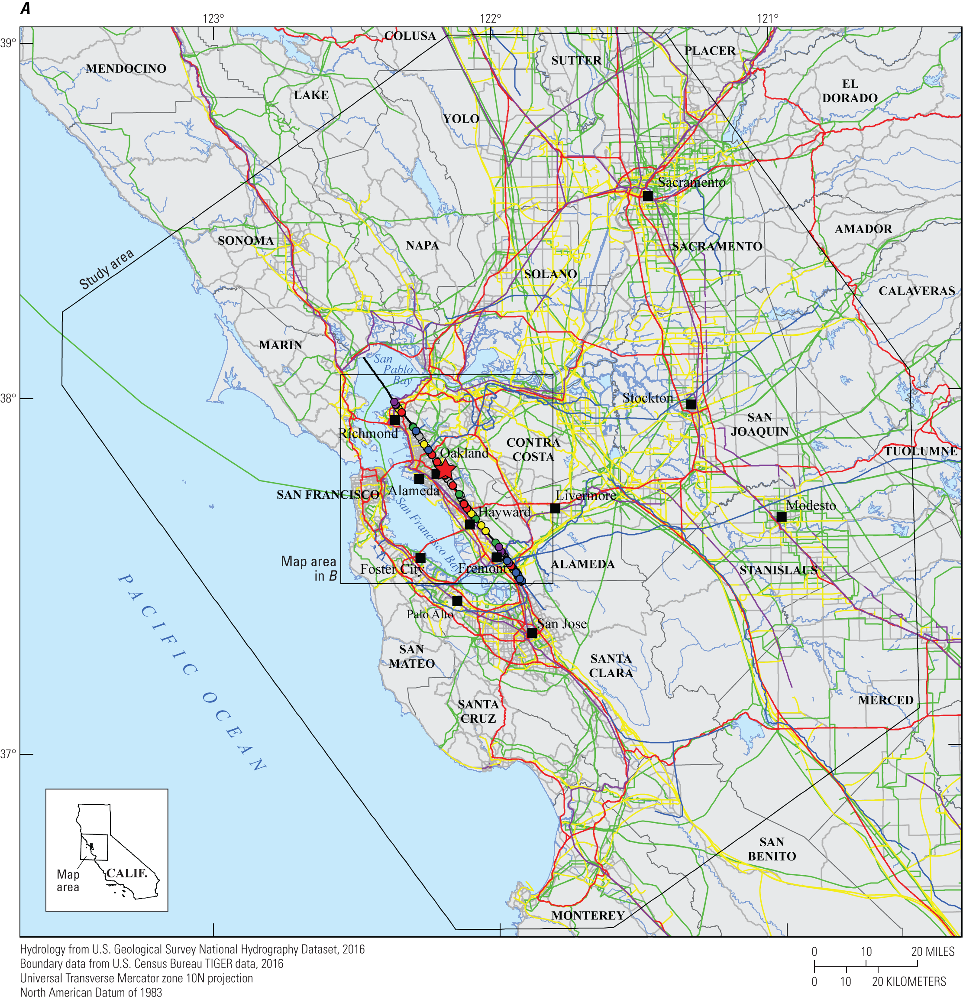
HayWired Scenario
Map showing transmission infrastructure relative to rupture of the Hayward Fault during the HayWired Earthquake Scenario mainshock. Many transmission
infrastructure lifelines cross the fault, including natural gas and petroleum pipelines, water supply transmission systems, highways and secondary roads, electric power transmission lines, and long-haul fiber optic cables. Where linear features cross the fault, the intersection points are colored to be consistent with the linear infrastructure they correspond to (for example, a yellow point denotes where a natural gas or petroleum pipeline crosses the fault).
HayWired Scenario Volume 3: Chapter T, Figure 2A
21

Slide 23
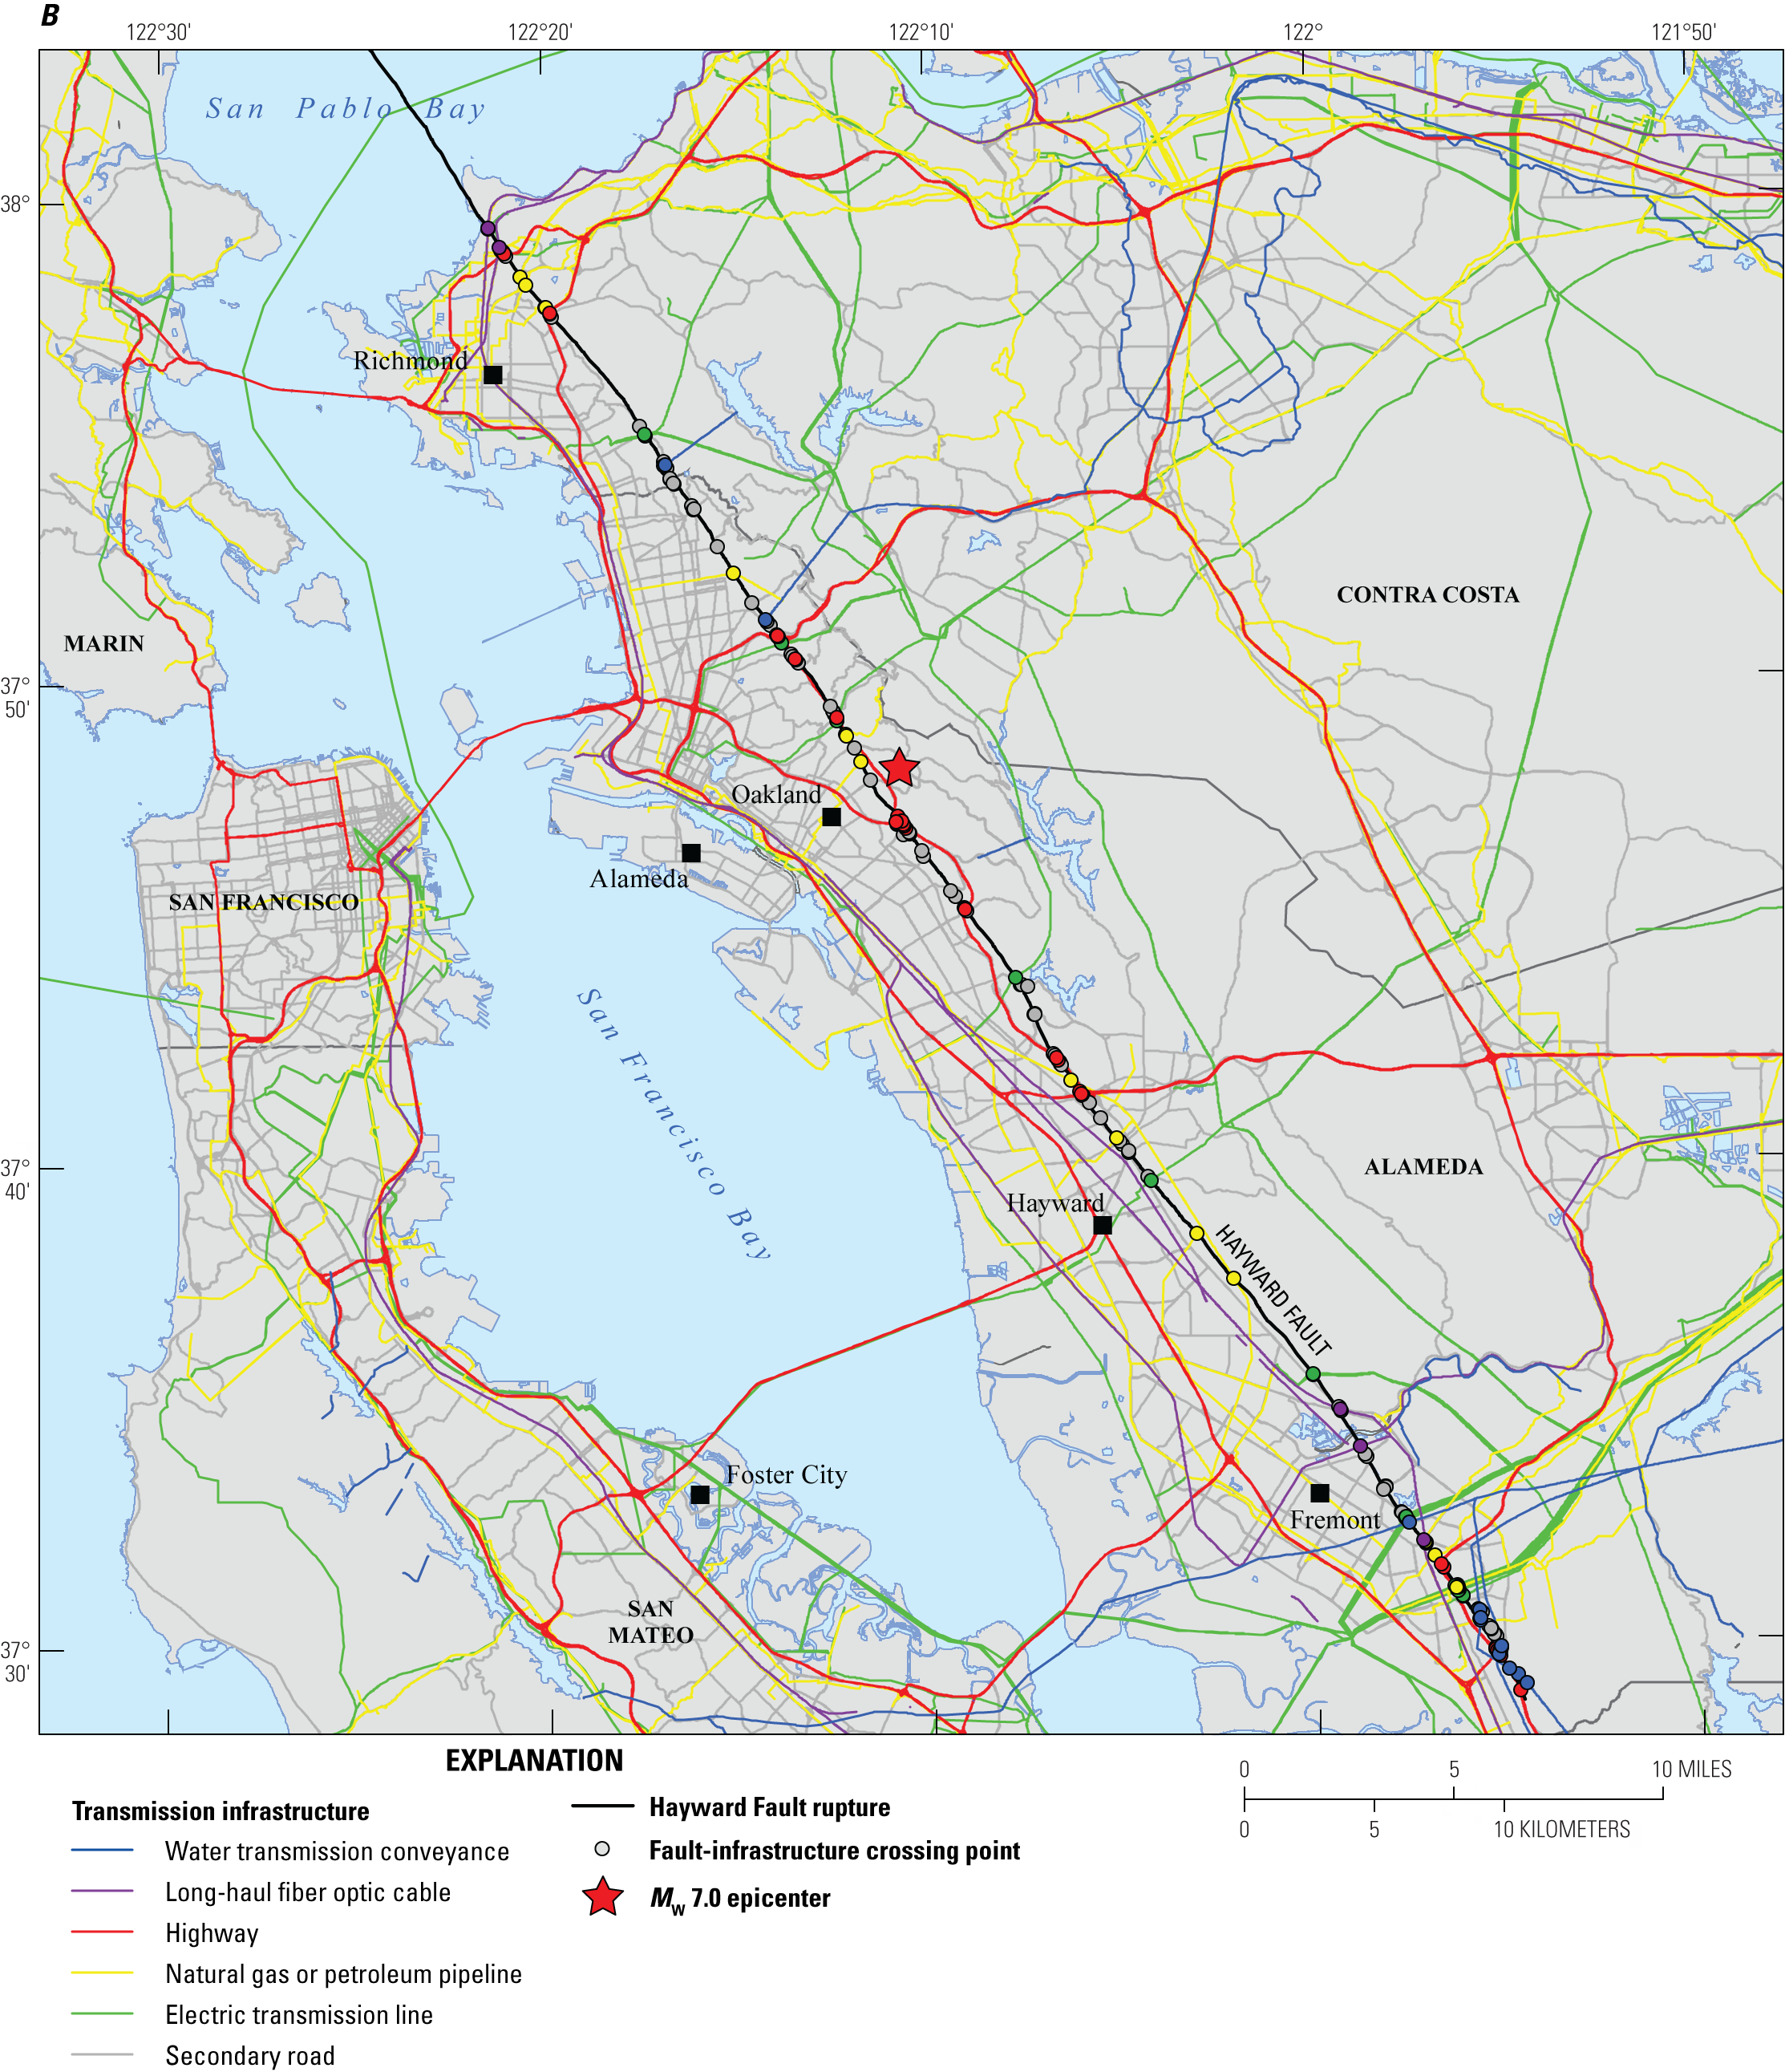
HayWired Scenario
Map showing transmission infrastructure relative to rupture of the Hayward Fault during the HayWired Earthquake Scenario mainshock. Many transmission infrastructure lifelines cross the fault, including natural gas and petroleum pipelines, water supply transmission systems, highways and secondary roads, electric power transmission lines, and long-haul fiber optic cables. Where linear features cross the fault, the intersection points are colored to be consistent with the linear infrastructure they correspond to (for example, a yellow point denotes where a natural gas or petroleum pipeline crosses the fault).
HayWired Scenario Volume 3: Chapter T, Figure 2B
22

